Slide 1
Open Data and Open Research - SRCE
Ivan Marić, Deputy Director
SRCE – University of Zagreb, University Computing Centre
ToDO - Kick-off meeting, Zagreb, 7-8 November 2019

Slide 2
Content...
About SRCE
About e-Infrastructure and relation to Research Infrastructures
SRCE (National) Initiatives / e-Infrastructures
  Project HR-ZOO
  Dabar, NI4OS/EOSC, RDA
  CroRIS

Slide 3
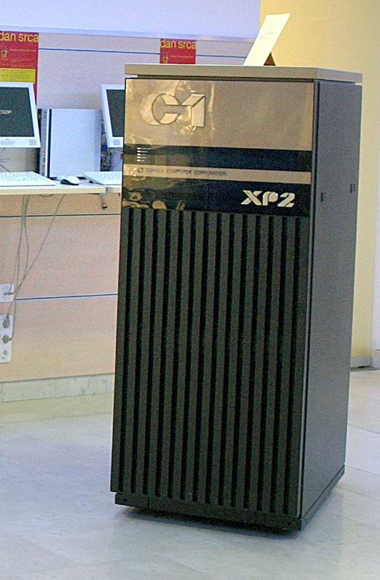
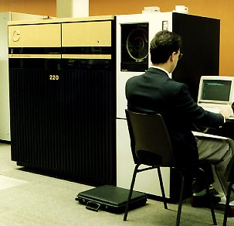
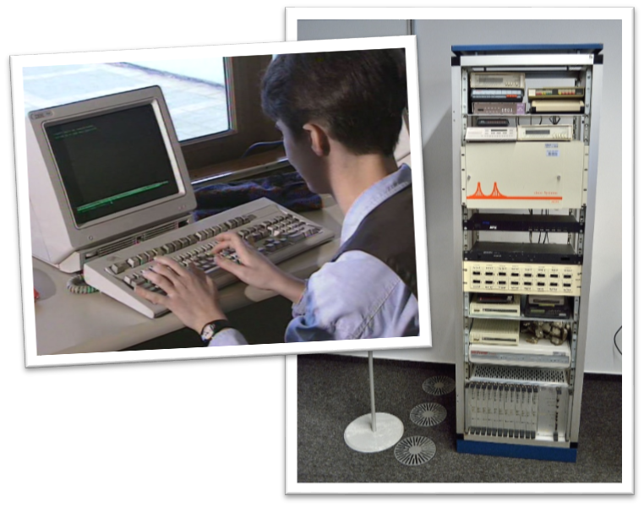
SOME FACTS FROM THE HISTORY OF SRCE…
  1972 - First training courses for end-users at temporary UNIVAC 1106 System
  1974 - UNIVAC 1100 - the biggest & fastest computer "in this part of Europe" and new building for SRCE
  1981 - SIZIF - System of Scientific Information of Croatia
  1984 - Information System for Sarajevo'84 Olympic Games
  1987 - First supercomputer in Srce (CONVEX)
  1989 - First UNIX based production servers
  1990 - BITNET connection
  1991 - Start of the CARNet (Croatian Academic and Reserach Network) project
  1992 - First Internet connection
  1993 - Croatian Internet Top Level Domain - .hr
  1995 - First ATM (155 Mbps) connection within academic network
  2000 - Croatian Internet eXchange (CIX)
  2002 - GĖANT Point of Presence (PoP)
  2002 – HPC cluster Isabella established
  2003 - National grid project - CRO-GRID started
  2004 - GigaCARNet network up & running
  2005 - National grid infrastructure CRO NGI up & running
  2006 - National authentication and authorization infrastructure AAI@EduHr up & running
  2007 - University e-learning strategy and E-learning center
  2011 - First computing and data infrastructure services ‘from the cloud”
  2015 – New DC SRCE2 - Data Center at Borongaj Campus
  2015 - Dabar – national infrastructure of Digital Academic Archives and Repositories
  2015 - edu4IT – New education program and certification of IT professionals in A&R

Slide 4

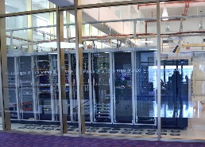
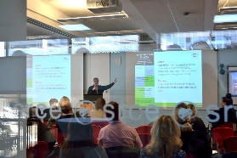
SRCE Today (1)
is heart of Croatian academic and research e-infrastructure
is one of the key subjects in planning, designing, construction and maintenance of the advanced computing, communication and information systems and services for A&R community in HR
ensures connection of Croatian A&R e-infrastructure with related European and global e-infrastructures
provides consulting, expert and educational support in the field of ICT to all subjects of the academic and research community
promotes, fosters and supports innovative usage of ICT in education and reserach
acts as the computing centre of the largest university in Croatia – the University of Zagreb

Slide 5
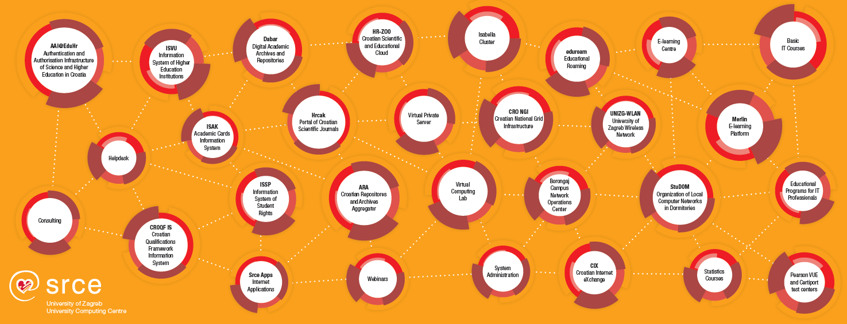
SRCE Today (2)
e-infrastructure – reliable services 24/365 + access to state-of-the-art ICT
education – enabling users to use ICT & support usage of ICT in education and research
knowledge, expertise, support, cooperation
~ 50 services
135 employees
9 org.units
2 data centers
3 locations in Zagreb

Slide 6






Notion of
e-infrastructure (cyberinfrastructure)
IT and information services to users
e - infrastructure?
Teams of professionals to develop, maintain and support usage od e-infrastructure
Information Systems and Services
(collaboration and groupware systems, information systems, Internet applications, public registries, CRIS systems, library systems, e-learning platforms, ERP, CRM, DMS, …)
E-Infrastructure is a complex, integrated environment that is based on / consists of a large number of ICT components in which researchers, teachers, students and other members of the academic and research community cooperate, share and use free / open access to distributed and / or unique elements of the research and education infrastructure, regardless of the type and geographic location of these resources.
Data Layer
(digital archives, digital repositories, dana collections, portals, …)
Middleware layer
(authentication and authorization systems, monitoring, security, accounting, …)
Computing systems and storage resources
(physical or virtual servers, clusters, IaaS, PaaS, HPC / HTC systems, supercomputers, dana storage, backup systems, …)
Data centers
(national and university data centers, computer rooms, …)
Networks and networking services
(international and national networks, MAN, LAN, WLAN…)
Organizational and governance framework of e-infrastructure
IT and information services to users

Slide 7
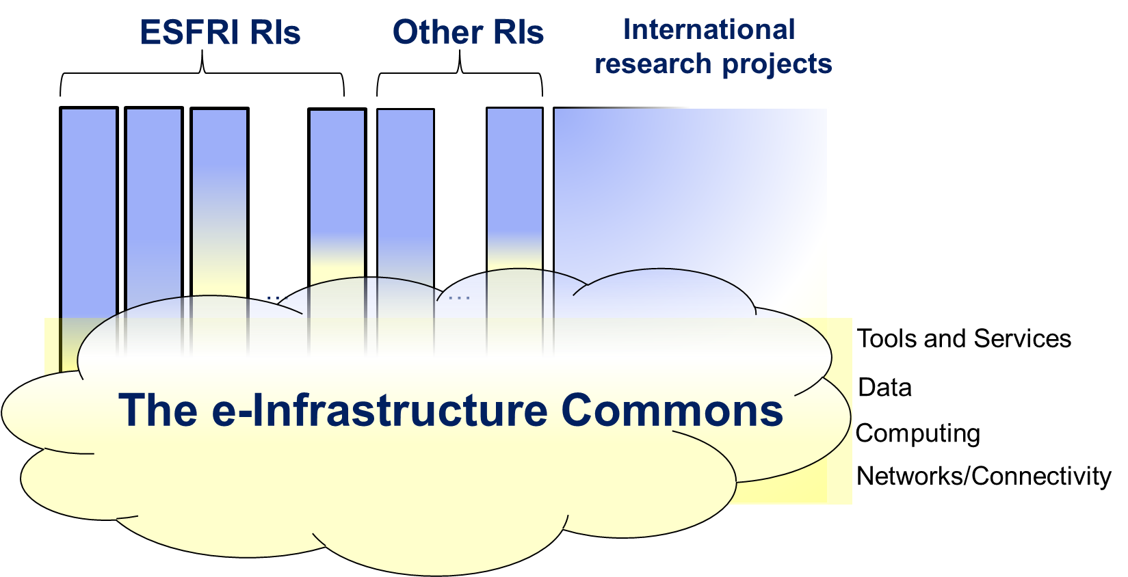
Research Infrastructures and e-Infrastructure
Source: e-IRG

Slide 8



Twinning the EOSC to the e-infrastructure
EOSC could be seen as a twin sister (or brother) of e-infra-structure organisations. One offering the compute and connectivity services and the other servicing the data and the interoperability.
e infrastructures
08

Slide 9



HR-ZOO
Croatian Scientific and Educational cloud
Flagship project for SRCE, strategic project for MSE & Croatian A&R system
26+ MEUR, 2018. - 2021. (2022.)
The main objective of the project HR-ZOO is to build a new core components of the national e-infrastructure:
  HR-ZOO sites - data centers/computer rooms at major Croatian universities
  HPC & HTC systems
  Cloud systems and services for general purpose computing
  Storage resources
  New high-speed backbone of the national academic and research network
  Team of experts / e-science engineers to support efficient usage of HR-ZOO resources
HR-ZOO is an important prerequisite for the development of the modern and competitive Croatian research and higher education area, for all stakeholders and their needs in the field of modern reserach and education, but also as an instrument of participation and integration into the European Research Area (ERA) and the European Higher Education Area (EHEA).
Europska unija
Zajedno do fondova EU
The project is co-financed by the European Union from the European Regional Development Fund

Slide 10
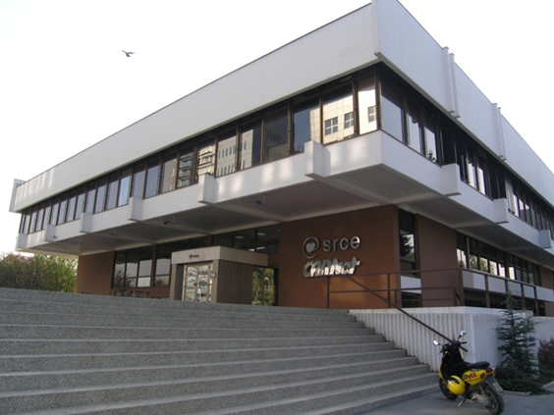


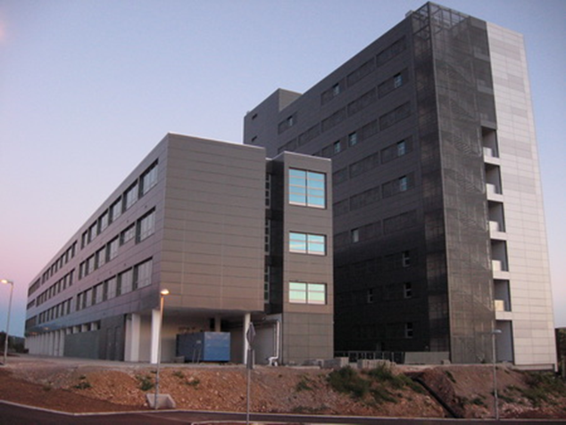
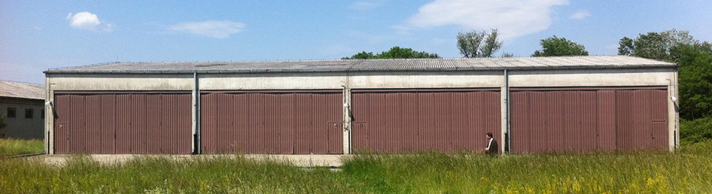


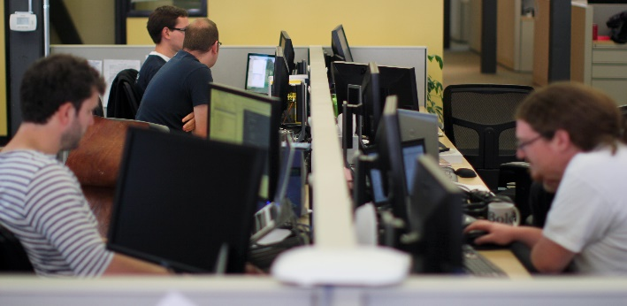
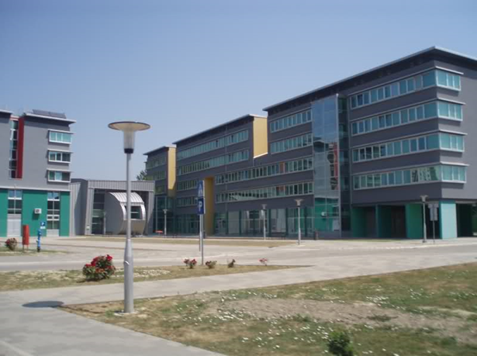


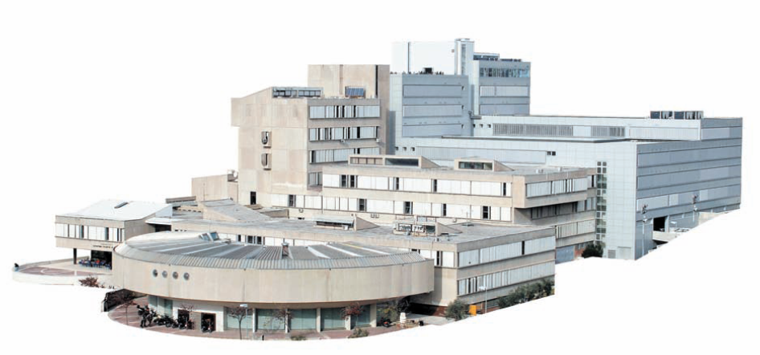
HR-ZOO
HR-ZOO computing, storage and network resources
HR-ZOO computing, storage and network resources
team of experts, e-scientists

Slide 11
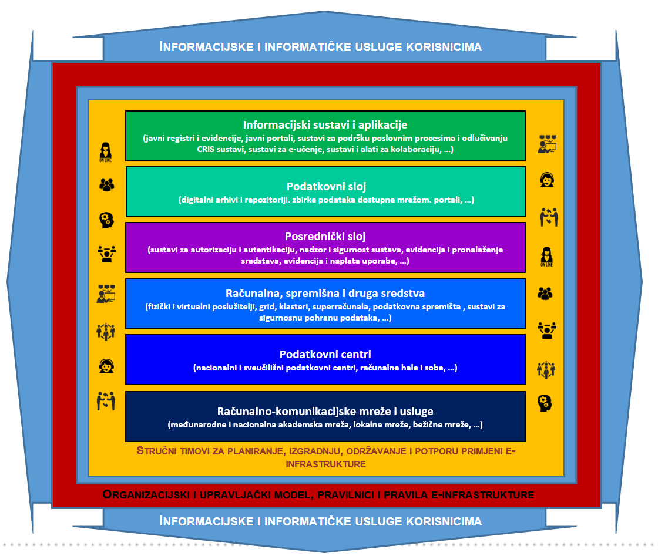
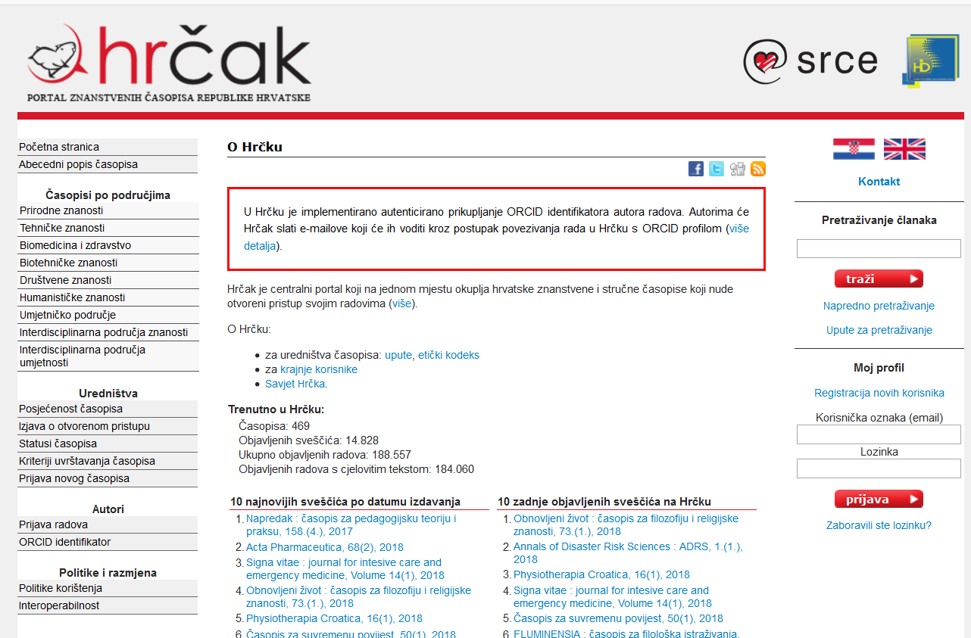
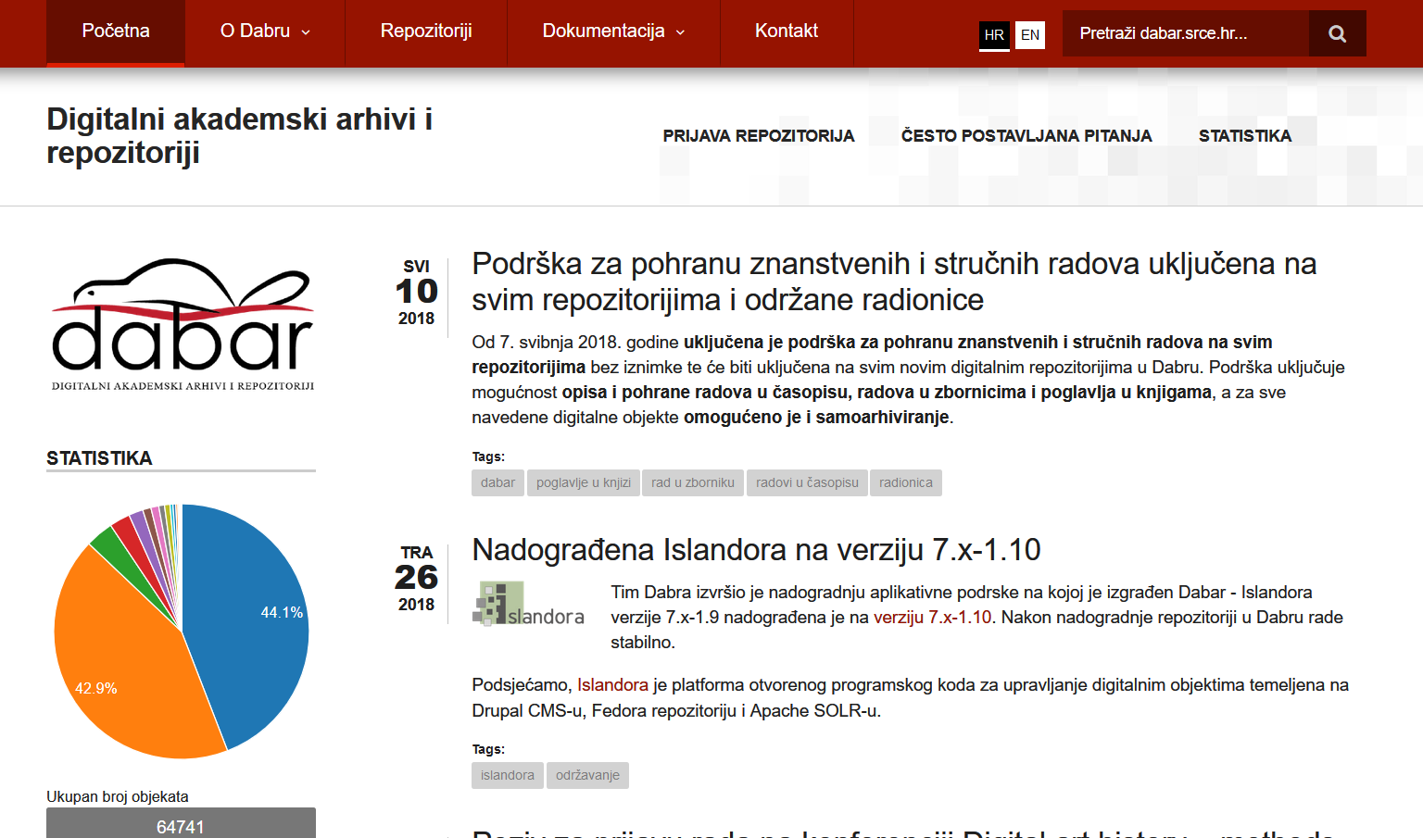

Data – curation of data, as most valuable asset in education and research environment
DABAR – national infrastructure - system of digital academic archives and repositories
HRČAK – portal (repository) of Croatian scientific and professional open access journals
  450+ journals, 175.000+ articles in OA
HAW – Croatian Web Archive
SRCE OPEN ACCESS POLICY
Open science
  Open access to research data
Open education
  Open educational resources

Slide 12



Initiatives in the (research) data layer of e-infrastructure
national platform for repositories and archives with the support for research data sharing
H2020 project – support for the inclusion of services and repositories in EOSC
global organization that promotes and supports data sharing

Slide 13
DABAR – Digital Academic Archives and Repositories
August 2015 - production
November 2019:
134 digital repositories
  10 universities
  2 national repositories
103.500+ digital objects
44.600+ OA
Notes:
43% OA
3 main goals:
National infrastructure for digital repositories: scalable, interoperable, sustainable, flexible and suited for long term preservation
Community - information needs, application profiles, controlled vocabularies, education and user support
Promotion of OA

Slide 14
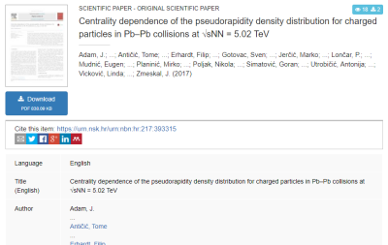

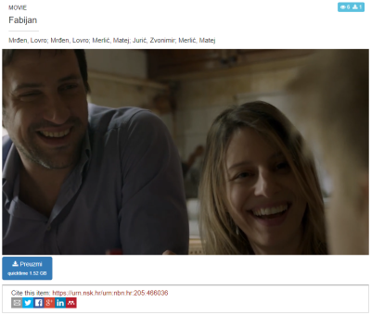
14 categories of digital objects
(nationaly agreed)
Journal articles
Papers published in proceedings
Books
Book chapters
Conference abstracts and presentations
Theses
Artistic theses
Disertations
Appendices
Photographs
Audio objects
Audiovisual objects
Research data (datasets)
Educational resurces
Notes:
Metadata agreed on a national level
https://urn.nsk.hr/urn:nbn:hr:205:258541 (photo)
https://urn.nsk.hr/urn:nbn:hr:205:466036 (video)
https://urn.nsk.hr/urn:nbn:hr:205:126638 (audio)

Slide 15
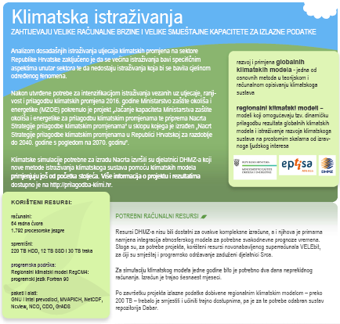
Research data in Dabar
Infrastructure for FAIR data
Findable (PID, rich metadata, search funct., services)
Accessible (HTTP)
Interoperable (open formats, MODS/DC/DataCite, links)
Re-usable (License, domain standards?)
Research data (datasets)
Croatian Meteorological and Hydrological Service
  RegCM4 Climate Change Adaptation Simulations
Ruđer Bošković Institute
The Institute of Economics Zagreb
Faculty of Humanities and Social Sciences
Notes:
Interoperable = across disciplines
First dataset: https://urn.nsk.hr/urn:nbn:hr:232:359736
RegCM4 - reducing vulnerability of society from the negative impact of climate change
https://data.fulir.irb.hr/islandora/object/irb%3A5
https://repozitorij.unizg.hr/islandora/object/ffzg%3A475
https://repozitorij.eizg.hr/islandora/object/eizg%3A263

Slide 16

National Initiatives for Open Science in Europe
(NI4OS-Europe)
Horizon H2020: 1 September 2019 – 31 August 2022
22 partners from 15 different counties
  SRCE & RBI
The objective of the project is to
  support the development and inclusion of the national Open Science Cloud initiatives in 15 member states and associated countries in the EOSC governance
  spread the EOSC and FAIR principles in the community and train it
  provide technical and policy support in on-boarding of the existing and future service providers into EOSC, including generic services (compute, data storage, data management), thematic services, repositories and data sets.
Notes:
Grant agreement ID: 857645
https://ni4os.eu/overview/
Mission and vision of the project are to be a core contributor to European Open Science Cloud service portfolio, commit to EOSC governance and ensure inclusiveness on the European level.
It will federate the existing EOSC-relevant services in the target countries by making them compatible with, and visible in core building blocks of EOSC.

Slide 17

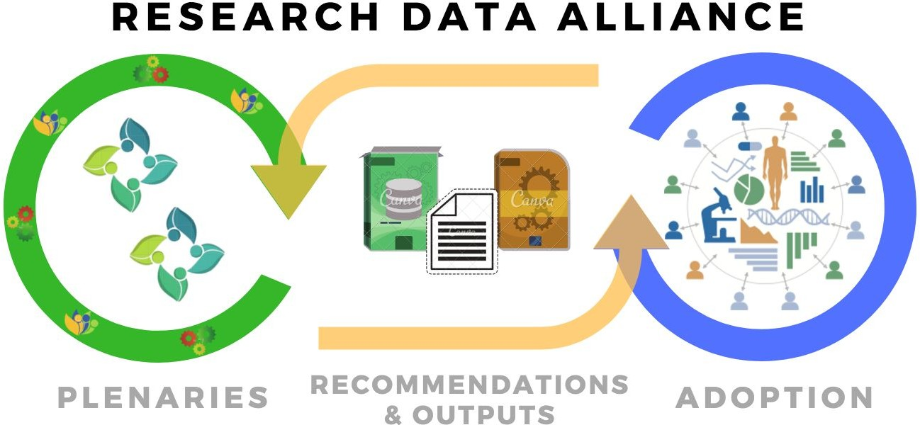
The RDA Vision: Researchers and innovators openly share data across technologies, disciplines, and countries to address the grand challenges of society.
The RDA Mission: RDA builds the social and technical bridges that enable open sharing and re-use of data.
Interest groups & Working groups
Notes:
The Research Data Alliance (RDA) was launched as a community-driven initiative in 2013 by the European Commission, the United States Government's National Science Foundation and National Institute of Standards and Technology, and the Australian Government’s Department of Innovation

Slide 18

Croatian National RDA Node: SRCE
The objective of RDA Europe 4.0 is to become the centrepiece for an EU Open Science Strategy through a consolidated European network of National Nodes...
Activities:
Communication with funding bodies: Croatian Science Foundation (HRZZ) & Ministry of Science and Education (MZO)
  Incentives for data sharing, Data Management Plans (DMPs)
Building capacitiy (skills) of HE & Research libraries to manage research data and support researchers at their institutions; starting with 4 major university libraries
4 events / trainings between February 2020 and April 2020
Promoting CoreTrustSeal (Trustworthy Data Repositories)
Notes:
Researchers, funders, digital infrastructures, policy makers, industry

Slide 19
CRORIS - Croatian Research Information System
CroRIS is the new national CRIS being implemented in Croatia
Information and processes about institutions, researches, projects, publications, equipment, patents, events and much more
Built specifically for Croatian environment, it will integrate with many national systems and international platforms, such as ORCID, OpenAire, WoS, Scopus
The base for informed decision making
Promoting open science
Gradually being put in production, aimed to finish in 2022
Funded 85% by EU
Part of the Scientific and Technological Foresight project, led by Ministry of Science and Education
Europska unija
Zajedno do fondova EU
The project is co-financed by the European Union from the European Regional Development Fund

Slide 20


UNIVERSITY OF ZAGREB
UNIVERSITY COMPUTING CENTRE
office@srce.hr

