Slide 1
European Open Science Cloud
implementation and decision making coordination and adoption
harmony and awareness
Ivan Marić, SRCE – University of Zagreb, University Computing Centre
EOSC GB Croatian delegate
EOSC Symposium, Budapest, Hungary, 26 – 28 November 2019

Slide 2
EOSC Vision and Values
EOSC as federated infrastructure that can enhance value-based open trusted, user centric digital services across borders within the Digital Single Market (Vienna Declaration)
Common values:
  Focused on research needs
  Community driven
  Inclusive and respectful of diversity
  Accessible to all
  Open by default
  Hands-on and participatory
  Transparent and trustworthy
Notes:
- In building EOSC we are designing a virtual commons where science producers and science consumers come together for more insights, new ideas and more innovation.
By federating data and services we add value.
EOSC uses IT to revolutionize the way we do research the way collective scientific knowledge is created in all disciplines in all geographies.
The diverse range of content (of data and services) will attract people thus want to come and engage and creativity will follow..there are so many creative people in Europe and World..never have a chance to meet..we are building an attractive meeting platform all wish to join.

Slide 3
From Vision to Launch
The objective of the EOSC is to give the Union a global lead in research data management and ensure that European scientists reap the full benefits of data-driven science, by offering 1.7 million European researchers and 70 million professionals in science and technology a virtual environment with free at the point of use, open and seamless services for storage, management, analysis and re-use of research data, across borders and scientific disciplines
Source: EOSC Strategic Implementation Plan
Source: EOSC Strategic Implementation Plan
Notes:
Commission presented its vision for the EOSC in its April 2016 Communication on the ECI as a part of DSM
ECI also foresee setting of EDI (HPC, widening the EOSC use base for public and industry)

Slide 4
e-IRG e-Infrastructure Commons
(e-IRG Roadmap 2012 -> e-IRG White Paper 2013 -> e-IRG Roadmap 2016)
The e-Infrastructure Commons can be defined as the integrated living ecosystem of resources and services (along with its policies and governance) that is open, user friendly and accessible to European researchers and scientists, and continuously adapts to the changing requirements of research and science.
e-IRG Roadmap 2016
Two recommendations are directed at national governments and funding agencies. They should reinforce their efforts to:
embrace e-Infrastructure coordination at the national level and build strong national e-Infrastructure building blocks, enabling coherent and efficient participation in European efforts, especially in alignment with the FAIR principles concerning data and services
together analyze and evaluate their national e-Infrastructure funding and governance mechanisms, identify best practices, and provide input to the development of the European e-Infrastructure landscape
Notes:
- Two recommendations are directed at national governments and funding agencies. They should reinforce their efforts to:
a) embrace e-Infrastructure coordination at the national level and build strong national e-Infrastructure building blocks, enabling coherent and efficient participation in European efforts, especially in alignment with the FAIR principles concerning data and services
b) together analyze and evaluate their national e-Infrastructure funding and governance mechanisms, identify best practices, and provide input to the development of the European e-Infrastructure landscape

Slide 5
EOSC (2019-2020) - Governance structure
Source: EOSC Strategic Implementation Plan

Slide 6
Governance Board
28 January 2019 - setup GB
22 May 2019 – WGs approved and endorsement of the SIP
27 March 2019 - initial ideas of WGs
11 September 2019 – initial reports from WGs, initial information about legal model for EOSC
15 November 2019 – deepened discussion about EOSC after 2020
25 March 2020
16 December 2019 – Discussion on Partnership for EOSC, new EB WG:s and GB sub-groups
10-11 Dec 2019 – Governance Team-Building in Milan
Mandate:
  Deliberate the strategic orientations for EOSC.
  Endorse the mandate of EOSC WGs.
  Ensuring coordination with relevant Member States / EC initiatives.
  Assessing the progress of the EOSC implementation.
  Recommend new activities in support of the EOSC, including long-term sustainability.
  Form opinion on post 2020 planning.
In total 75 delegates representing all 28 Member States and 11 Associate countries (November 2019)
https://www.eoscsecretariat.eu/eosc-governance/eosc-governance-board
Notes:
Adopted mandate:
The European Open Science Cloud Governance Board (EOSC GB) will deliberate on the orientations of the actions funded across Horizon 2020 in support of the implementation of the EOSC and inform the strategic configuration's exchange of views, notably in the context of possible work programme updates to support the overall governance.
Beyond recommending to the strategic configuration choices on H2020 strategic priorities for EOSC, the EOSC GB can exchange views, form opinions and provide recommendations on:
the design of the post-2020 governance structure (recommendations on strategic and financing orientations and organisational settings for the future of the EOSC);
measures to fostering synergies between the EOSC activities funded at national, regional or transnational levels;
the mobilisation of national co-funding for EOSC and related activities;
orientations for the work of the EOSC Executive Board and its technical secretariat.
The EOSC GB will review the EOSC strategic implementation and annual work plans, and related documents (e.g. rules for participation to guide service provision and an action plan for scientific data interoperability to operationalise the FAIR principles), which the European Commission will submit to the EOSC GB building on the EOSC Executive Board's work.
The Governance Board where appropriate, may decide to set up working groups for the purpose of examining particular issues related to its mandate. The decision of the EOSC GB to set up working groups should clearly define the purpose and mandate of the working group, and guidelines for its membership. The WG will be set up under the Executive Board responsibility and will be open to include Experts suggested by the GB.
The EOSC GB will function until the end of 2020.

Slide 7
Governance Board – current issues
Sustainability WG Strawman report
  Explore possible means for sustaining the European Open Science Cloud beyond 2020 (financing model: core and market places, legal vehicle, governance structure, regulatory and policy environment of the EOSC)
  Survey Feedback: important and useful inputs
Legal form of EOSC
  Post 2020 legal form
Potential European partnership under Horizon Europe Framework Programme for Research and Innovation
  Partnership options: Co-programmed-, Co-funded-, or Institutionalised Partnership
  Collective opinion within the EOSC governance
  Shared understanding of objectives, added value, type of activities, impact, types of partners and commitments
  Form opinion on a Partnership proposal by the end of February 2020 (detailed governance, quantitative figures etc)
  Discussion process and active involvement of scientific community on MS and EU level is vital for the success
Notes:
According to the proposal (27 March 2019) for a regulation for Horizon Europe FWP article 2(3) an European Partnership means an initiative where the Union, prepared with early involvement of Member States and/or Associated Countries, together with private and/or public partners commit to jointly support the development and implementation of initiatives (like EOSC).

Slide 8
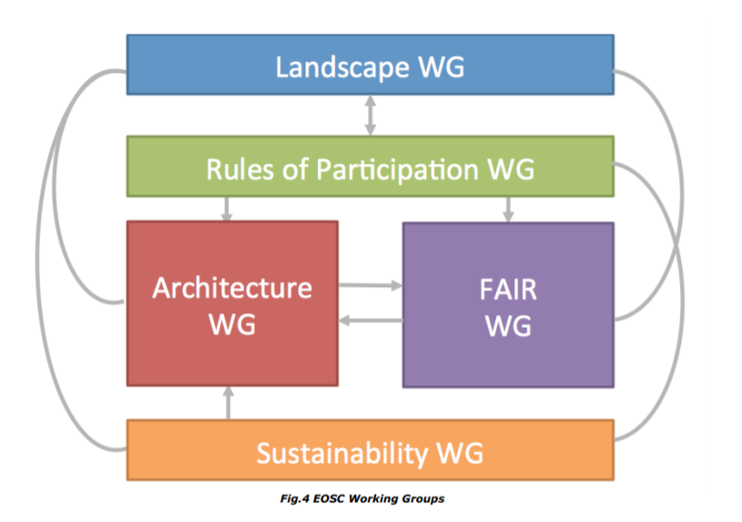
EOSC Groups
Executive Board - Working Groups
  Sustainability
  Architecture
  Rules of participation
  FAIR
  Landscape
Governance Board - Subgroups
  Compatibility of EOSC with current/planned national structures/initiatives.
  Regulatory framework for the emerging ecosystem.
  Data: Underpinning the resilience of the EOSC.
Notes:
EOSC Working Groups form an official part of the EOSC Governance structure that will ensure a community-sourced approach to the current challenges of the EOSC.
Sustainability: Providing a set of recommendations concerning the implementation of an operational, scalable and sustainable EOSC federation after 2020.
Architecture: Defining the technical framework required to enable and sustain an evolving EOSC federation of systems;
Rules of participation: Designing the Rules of Participation that shall define the rights, obligations governing EOSC transactions between EOSC users, providers and operators;
FAIR: Implementing the FAIR data principles by defining the corresponding requirements for the development of EOSC services, in order to foster cross-disciplinary interoperability;
Landscape: Mapping of the existing research infrastructures which are candidates to be part of the EOSC federation;

Slide 9
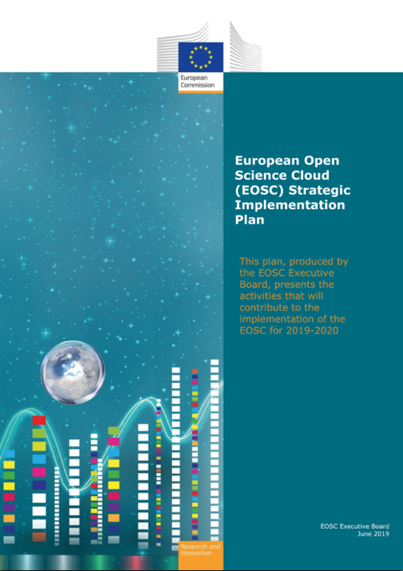
EOSC (2019-2020) - timeline
Notes:
The timeline is ambitious..

Slide 10



Harmony is the sound of things that go together well.
Source: vocabulary.com
e infrastructures
Commons
https://robertwwilliams.wordpress.com/
Karel Luyben: Next steps towards EOSC , GB Meeting 11 Sep 2019
C O O R D I N A T I O N
EOSC as federated infrastructure that can enhance value-based open trusted, user centric digital services across borders within the Digital Single Market (Vienna Declaration)
Notes:
..to decrease timeline stress, EB co-chair use illustrations from far east ☺
Full definition of harmony:
- compatibility in opinion and action
- agreement of opinions
- a harmonious state of things in general and of their properties (as of colors and sounds); congruity of parts with one another and with the whole

Slide 11
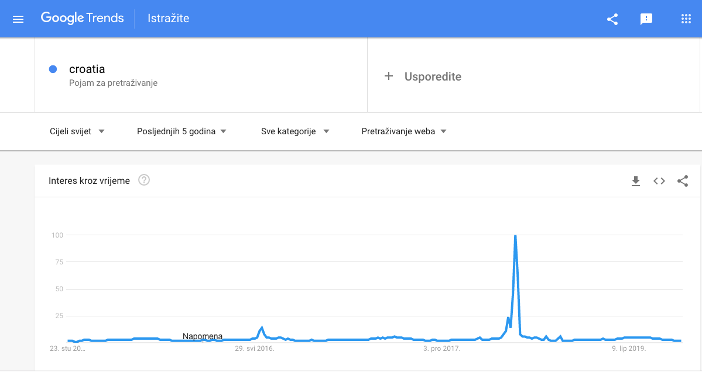
Awareness is the ability to directly know and percive, to feel, or to be cognizant of events.
Source: wikipedia.com
And the media coverage was unprecedented. More than 60 BILLION impressions on articles about Croatia in those days in mid-July, more online mentions of Croatia than the rest of the entire 27 years online, according to media monitoring company, Mediatoolkit.
HR&IE delegates proposed the creation of a GB subgroup focussing on the adoption of the EOSC by different stakeholders.
(Action from Sep 11, EOSC GB meeting)
A D O P T I O N
The objective of the EOSC is to give the Union a global lead in research data management and ensure that European scientists reap the full benefits of data-driven science, by offering 1.7 million European researchers and 70 million professionals in science and technology a virtual environment with free at the point of use, open and seamless services for storage, management, analysis and re-use of research data, across borders and scientific disciplines
Source: Reuter
Source: The Economic Times
Notes:
More broadly, it is the state of being conscious of something. Another definition describes it as a state wherein a subject is aware of some information when that information is directly available to bring to bear in the direction of a wide range of behavioral actions.

Slide 12
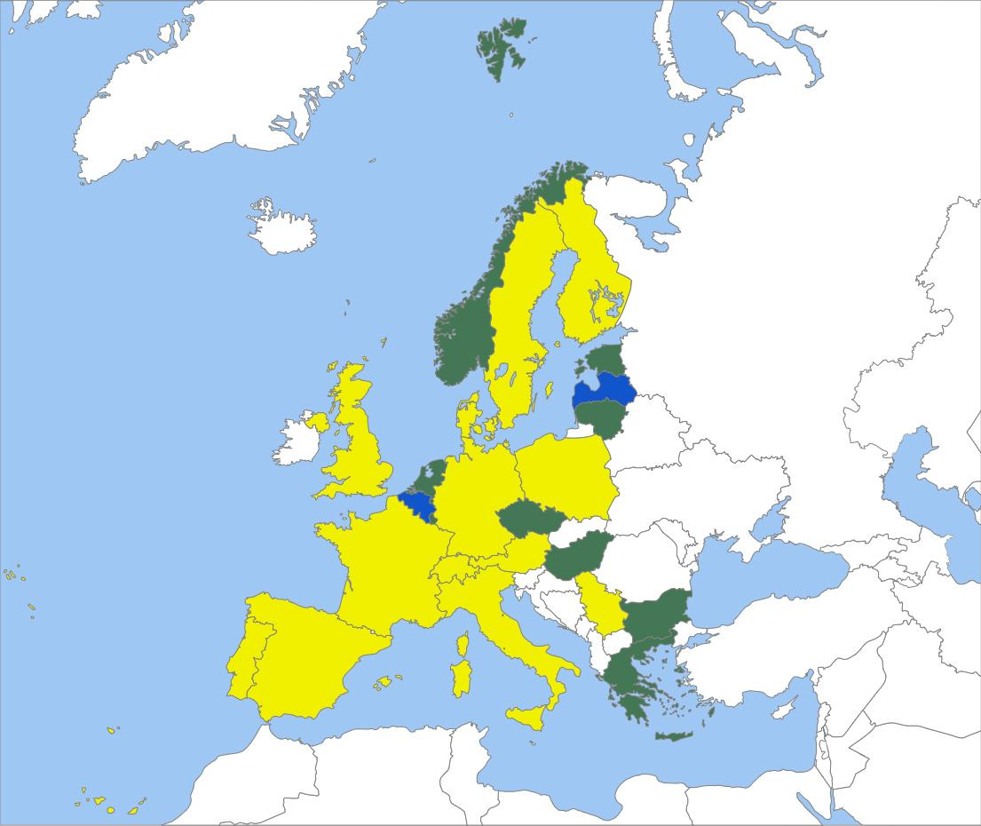
e-IRG National Nodes – Getting organised; how far are we?
Recommendation (MS/AC)
MS/AC should continue to increase the level of coordination and consolidation of the various national e-Infrastructure players – horizontal (generic) and vertical (thematic)
Recommendation (EC)
e-IRG recommends, that in future Work Programmes the EC provides strong incentives for further coordination and consolidation of e-Infrastructure service development and provisioning at the national and the European level.
Use of horizontal e-Infrastructures by domain specific RIs
Blue = mostly yes; Green = mixed cases; Yellow = mostly no; White = no classification
It is evident that in order to reach the goals of the EOSC most of the resources need to be mobilised at the national level. We have to reach strong national e-Infrastructure coordination, because the EOSC will most likely be a federation of national (and thematic) Open Science Clouds.
Notes:
It is evident that in order to reach the goals of the EOSC most of the resources need to be mobilised at the national level.
We have to reach strong national e-Infrastructure coordination, because the EOSC will most likely be a federation of national (and thematic) Open Science Clouds.

Slide 13





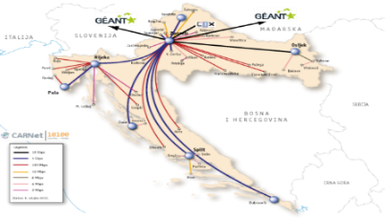


Croatian e-Infrastructure Commons...(2019)
Cloud IaaS –
VPS (323/450 VMs)
VCL (+1250 users; +200 images)
CHALLENGES:
Resource (under)capacity
Financing - Sustainability
Coordination & Integration
HPC infrastructure
135 nodes
3100 cores
12 GPUs
765 TB shared storage
90 projects
over 260 individual users
e-identities:981.853
IdPs:238
Services:776
HTC Cloud:
600 cores
150 TB shared storage
3246 Full Members
(370 from A&R)
PODATKOVNA INFRASTRUKTURA RH )
Storage infrastructure
~ 1 PB

Slide 14



HR-ZOO
Croatian Scientific and Educational Cloud
Flagship project for SRCE, strategic project for MSE & Croatian A&R system
26+ MEUR, (planned to put in production in 2022)
The main objective of the project HR-ZOO is to build a new core components of the national e-infrastructure:
  HR-ZOO sites - data centers/computer rooms at major Croatian universities
  HPC & HTC systems
  Cloud systems and services for general purpose computing
  Storage resources
  New high-speed backbone of the national academic and research network
  Team of experts / e-science engineers to support efficient usage of HR-ZOO resources
HR-ZOO is an important prerequisite for the development of the modern and competitive Croatian research and higher education area, for all stakeholders and their needs in the field of modern research and education, but also as an instrument of participation and integration into the European Research Area (ERA) and the European Higher Education Area (EHEA).
Europska unija
Zajedno do fondova EU
The project is co-financed by the European Union from the European Regional Development Fund

Slide 15
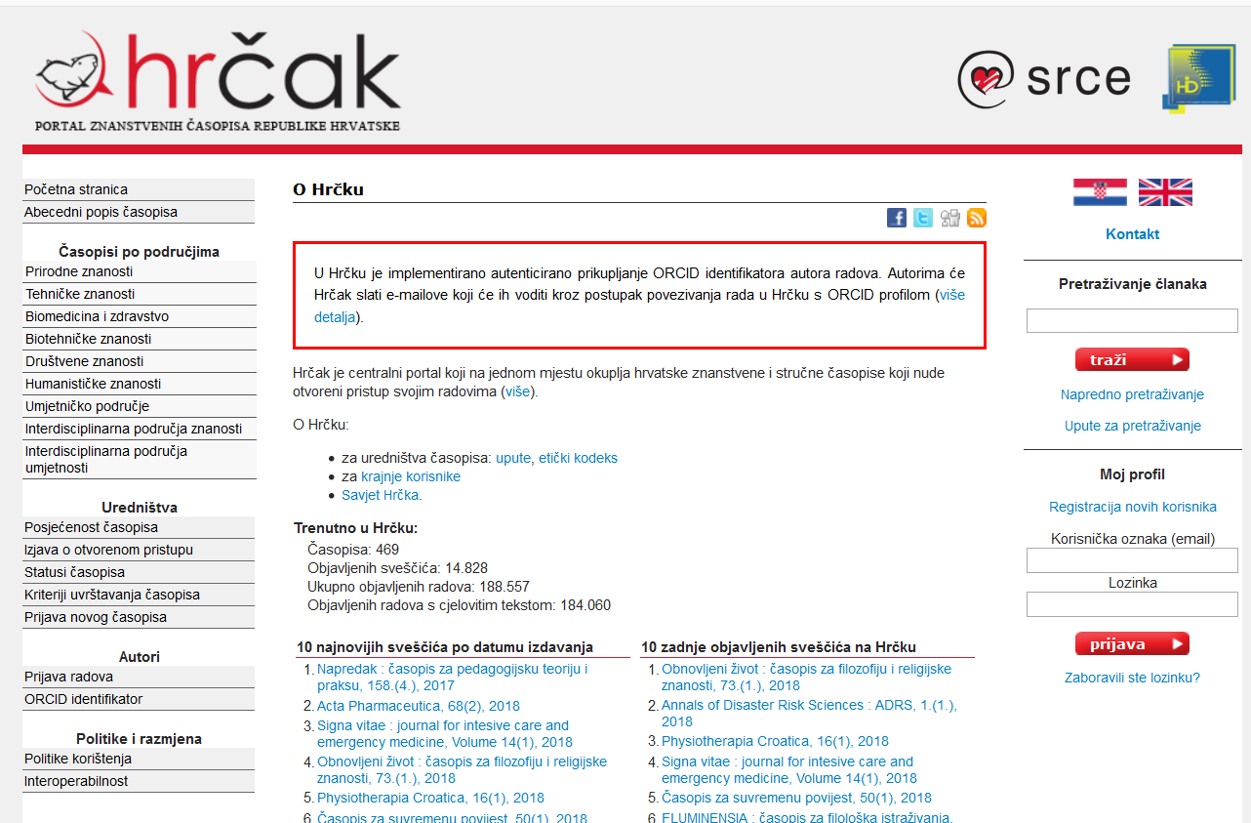
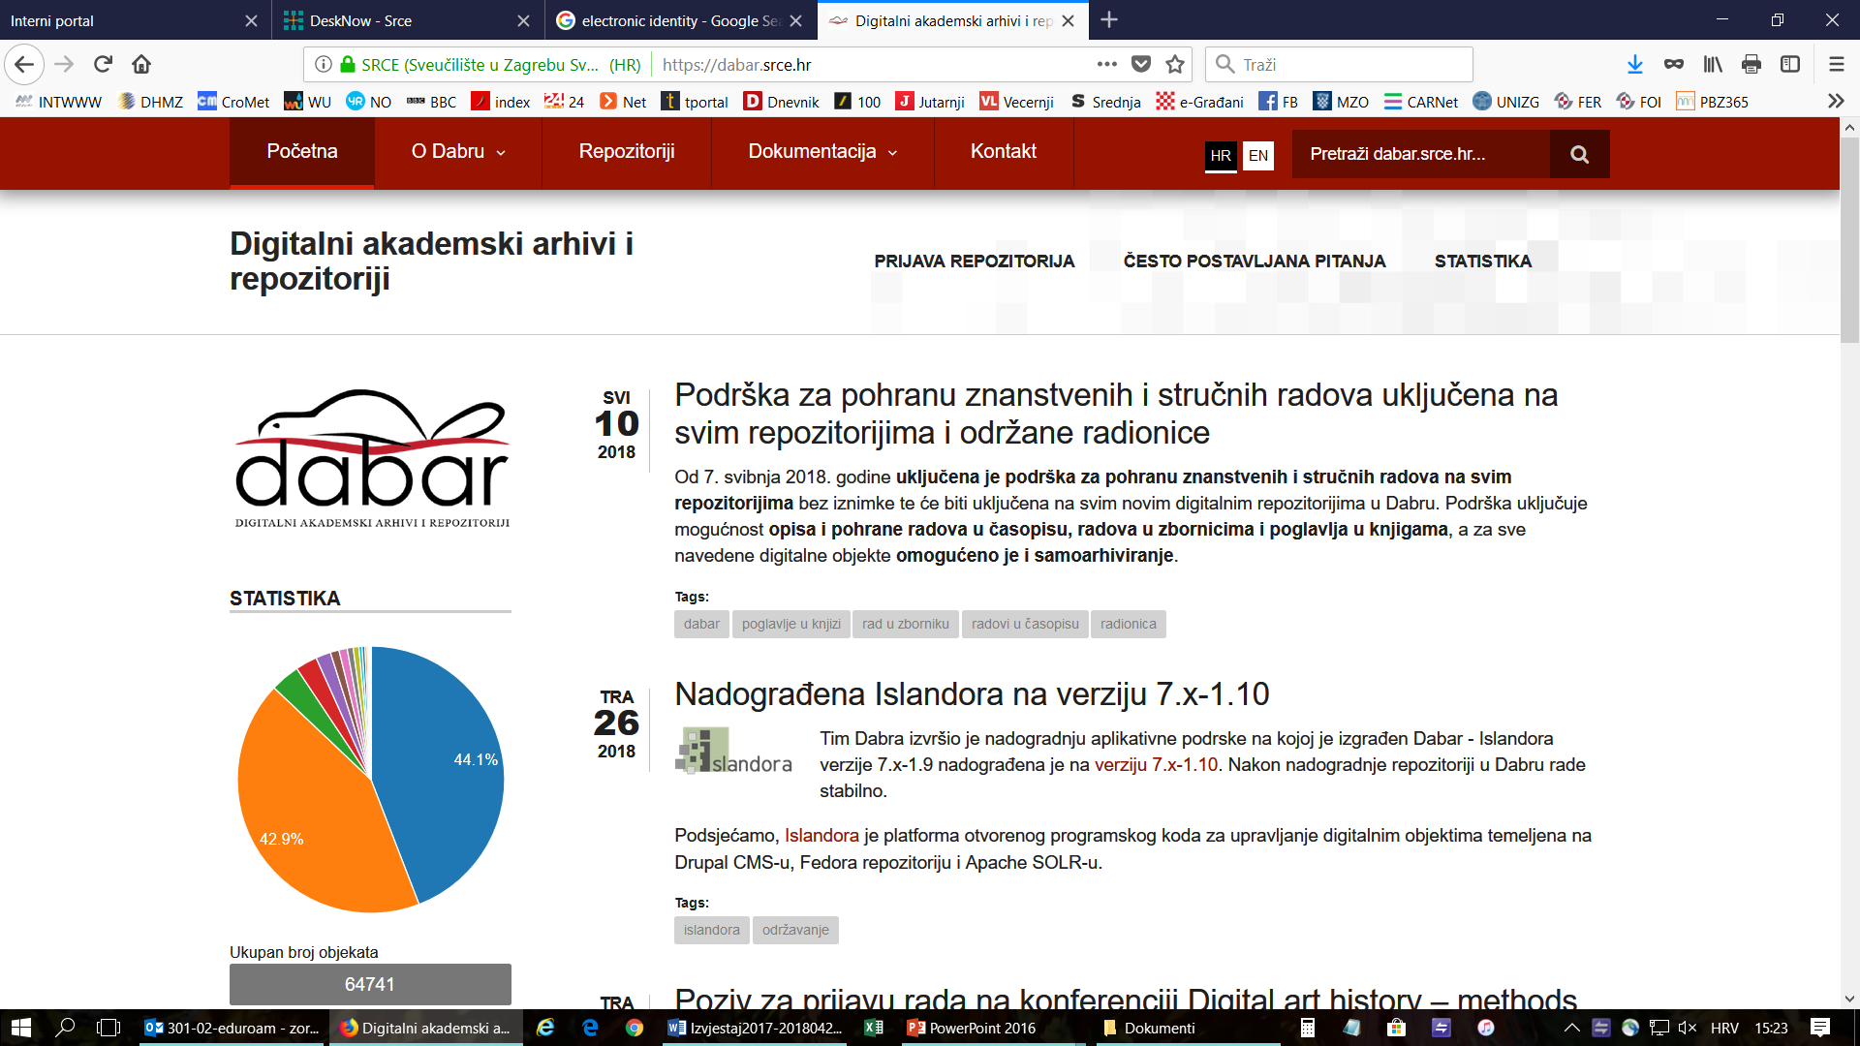


Initiatives in the (research) data layer of e-infrastructure
HRČAK – portal (repository) of Croatian scientific and professional open access journals
  450+ journals, 175.000+ articles in OA
DABAR – national infrastructure - system of digital academic archives and repositories
  134 digital repositories
  14 categories of digital objects
    103.500+ digital objects
    44.600+ OA

Slide 16
CroRIS - Croatian Research Information System
CroRIS is the new national CRIS being implemented in Croatia
Information and processes about institutions, researches, projects, publications, equipment, patents, services, events and much more
Built specifically for Croatian environment, it will integrate with many national systems and international platforms, such as ORCID, OpenAire, WoS, Scopus
The base for informed decision making
Promoting open science
Gradually being put in production, aimed to finish in 2022
Funded 85% by EU
Part of the Scientific and Technological Foresight project, led by Ministry of Science and Education
Europska unija
Zajedno do fondova EU
The project is co-financed by the European Union from the European Regional Development Fund

Slide 17
HR PRES Priorities
BRAIN CIRCULATION
DESIGNED TO HELP
FUTURE JOBS
RESEARCH
INOVAT ION
EDUCATI ON
Future jobs
High-tech for
growth and job creation
Future skills for Industry 4.0.
CroRIS
…
Main avenues of intervention
Notes:
BRAIN CIRCULATION:
Important factor that influence the economic development and competitiveness of the whole ERA
In each EU MS, as well as region, the process of mobility and brain circulation is exemplified in a different way
Empower a fair and well-balanced brain circulation and developing a sustainable system as a set of measures against the destabilizing effects of brain drain
The goal of HR PRES is to create conditions and platform for continuation of brain circulation being one of the pillars/priorities for the future period of ERA
‘One size fits all’ approach cannot be enforced”
FUTURE JOBS:
Possible policy debate during COMPET meeting 28-29 May
addressed in line with current Horizon Europe and ERA discussions
Horizon 2020 Presidency conferences
SSH (Future jobs for innovative creative industries; Societal response to disruptive technologies)
Health (Smart technologies for age friendly eco-systems)
Other Presidency events:
Future of Research infrastructures in Europe (ESFRI meeting and conference)
Forum of national ethical committees meeting (AI and CRISPR technology)

Slide 18
Köszönöm!
Thank you!

