Slide 1
Advanced Computing for Digital Art History
Digital Art History – Methods, Practices, Epistemologies III International Conference 13 October, 2021

Slide 2
Overview
Advanced Computing in Research Data Lifecycle
National Resources
International Resources
Conclusion

Slide 3
Advanced Computing In Research Data Lifecycle
Solving compute and data intensive scientific challenges
High Performance Computing (HPC)
Supercomputers
High Performance Data Analytics (HPDA)
Notebooks
Artificial Intelligence (AI)
Machine learning platforms
Plan
Reuse
Create
Publish & share
Process
Preserve
Analyze

Slide 4
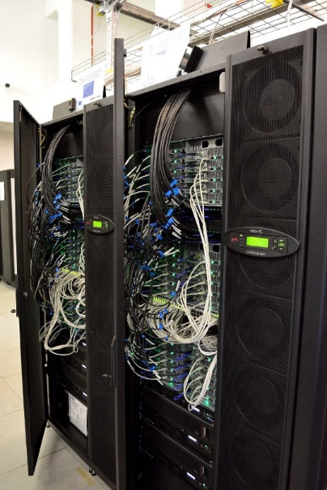
HPC – Isabella
HPC resource available to Croatian researchers
established in 2002.
currently provides ~140 TFLOPs with CPU & GPU
User applications provided
Compilers – Intel, GNU, NVIDIA, PGI
application libraries – MPI, CUDA
~60 scientific applications
chemistry, biology, physics, math
machine learning (GPUs)
Abinit, Gaussian, Gromacs, Quantum Espresso, Tensorflow, MS .NET
https://www.srce.unizg.hr/isabella/

Slide 5
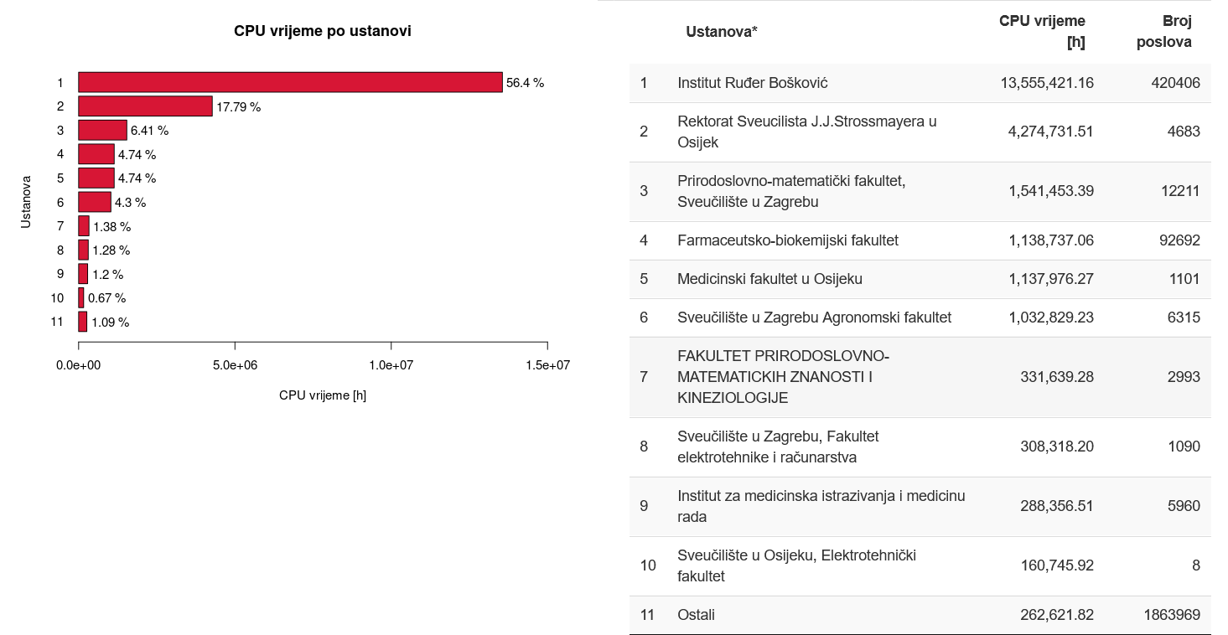
HPC – Isabella
141 projects & 352 users
Usage in 2020.
~2.4M jobs
2752 CPU-years
470 TB storage used
6.56 PB read/written to storage

Slide 6
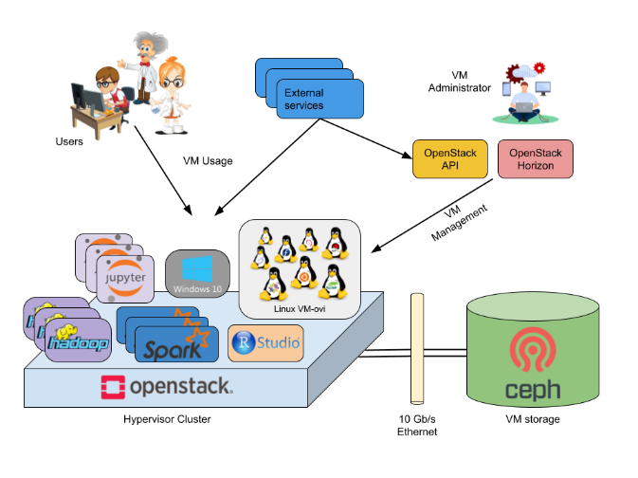
HTC Cloud
Infrastructure based on cloud computing for computationally-demanding applications
2.400 virtual CPU cores with 4.7 TB RAM
Services
JupyterLab Notebooks
EC3 – elastic compute clusters
HPDA platforms – Spark, Hadoop, Flink, Kafka
https://wiki.srce.hr/display/CRONGI/HTC+Cloud

Slide 7
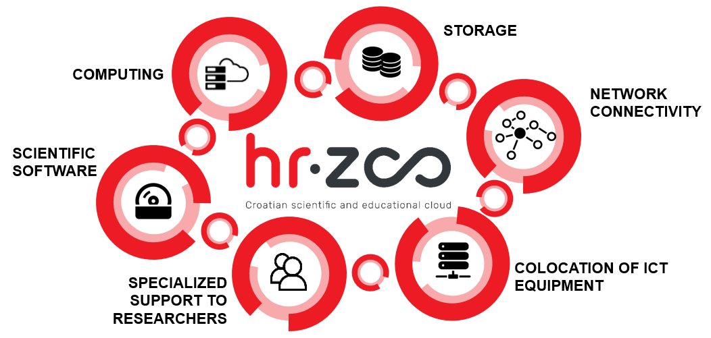
Croatian Scientific and Educational Cloud – HR-ZOO
Build advanced national e-infrastructure for Croatian A&R community
1 PFLOPS HPC resource
10 PB storage
over 10.000 CPU-cores for HTC Cloud
virtual data centres
Team of e-Scientists will be established
consulting researchers on the best way to meet their needs
implementing Specialized interfaces for accessing HR-ZOO resources (scientific portals)
Europska unija
Zajedno do fondova EU

Slide 8
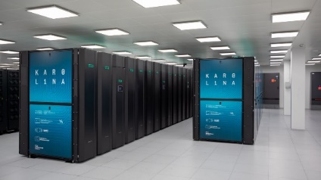
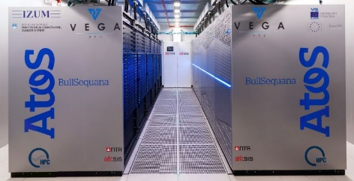
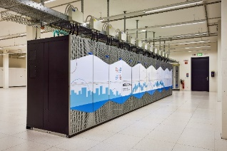
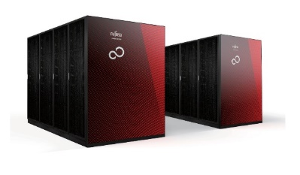
EuroHPC
World Class Supercomputing Ecosystem in Europe
joint initiative between the EU, European countries and private partners
support research and innovation activities
8 HPC centres
3 exascale + 5 petascale
total over 650 PFLOPs

Slide 9
EuroCC
National HPC Competence Centres
services for industry, academia and public
Domains
Training and Skills Development
Technology Transfer/Business Development
Industrial Collaboration
Facilitation of access to scientific and technical expertise and knowledge pools
Awareness Creation

Slide 10
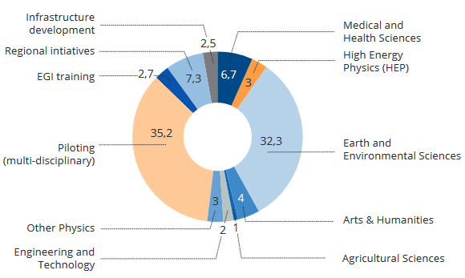
EGI
Provides compute & storage
High level services
AAI proxy, training
Usage in 2020.
75400 users
500M jobs
5.6 billion CPU-hours
User communities
DARIAH
https://www.egi.eu

Slide 11
EOSC
European Open Science Cloud
support the development of open science and innovation
create an open and reliable virtual environment for data storage, management, analysis and reuse in all scientific fields
Thematic services
hiding advanced computing complexity
providing easy to use interfaces to researchers
EOSC Association
200 European institutions – full members and observers

Slide 12
Conclusion
Advanced computing resources crucial for enabling research
Thematic services crucial for widespread adoption
e-Scientists – advanced human interface to increasingly complex infrastructure

Slide 13
Thank You!

