Slide 1
SRCE – At the Very Heart of Digital Transformation of Science and Higher Education
Ivan Marić, Director
SRCE – University of Zagreb, University Computing Centre
EGI Conference 2021: Beyond the Horizon – Shaping the Digital Future, October 19th 2021

Slide 2
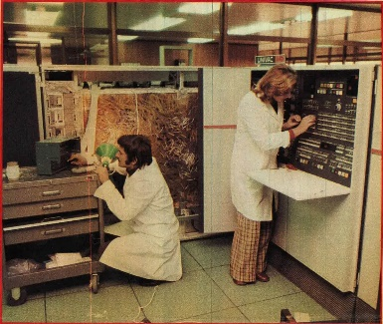
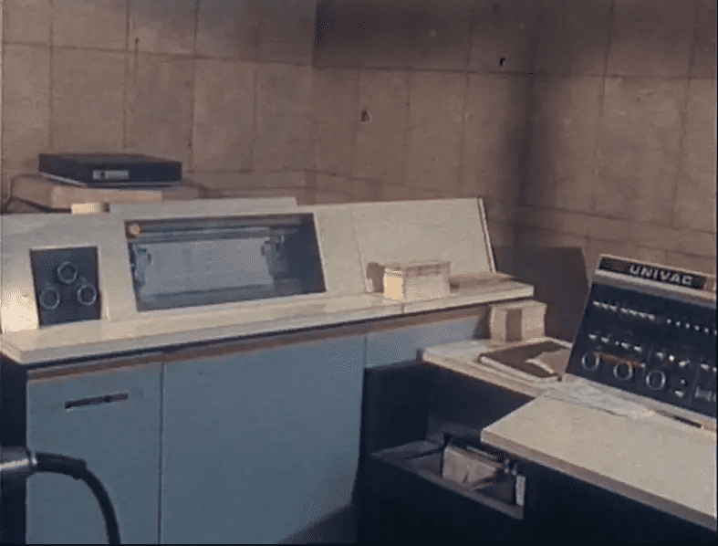
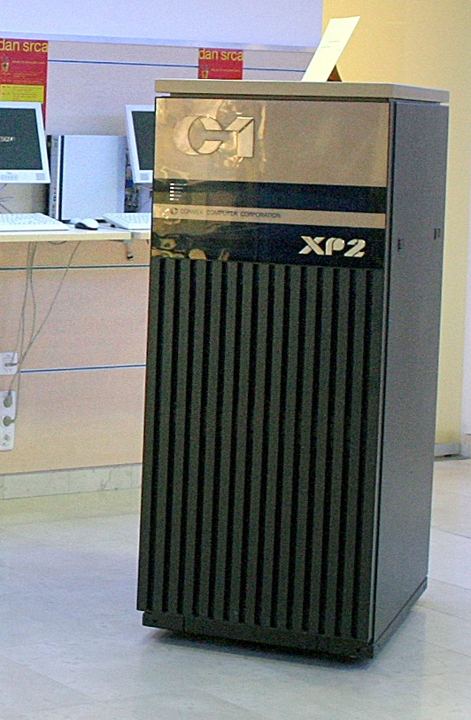
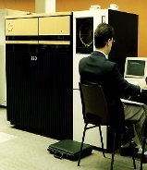
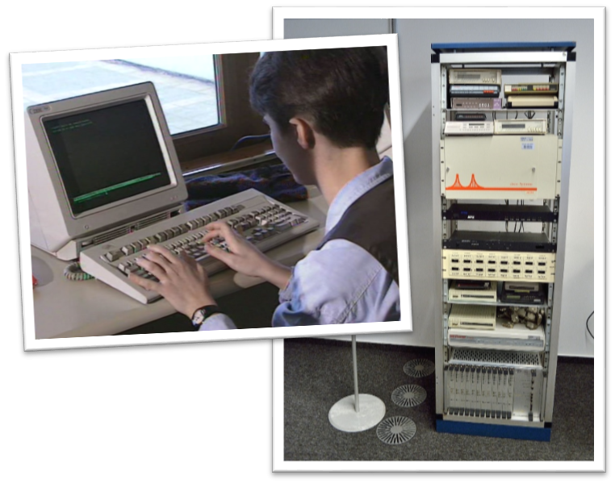
EARLY DAYS OF SRCE…20TH CENTURY
29 April 1971 SRCE Birthday
1972 - First training courses for end-users at temporary UNIVAC 1106 System
1974 - UNIVAC 1100 - the biggest & fastest computer "in this part of Europe" - new building specially designed for SRCE
1981 - SIZIF - System of Scientific Information of Croatia
1984 - Information System for Sarajevo'84 Olympic Games
1987 - First supercomputer (CONVEX)
1989 - First UNIX based production servers
1990 - BITNET connection
1991 – CARNet (Croatian Academic and Reserach Network) project started
1992 - First Internet connection
1993 - Croatian Internet Top Level Domain – “.hr”
1995 - First ATM (155 Mbps) connection within academic network

Slide 3
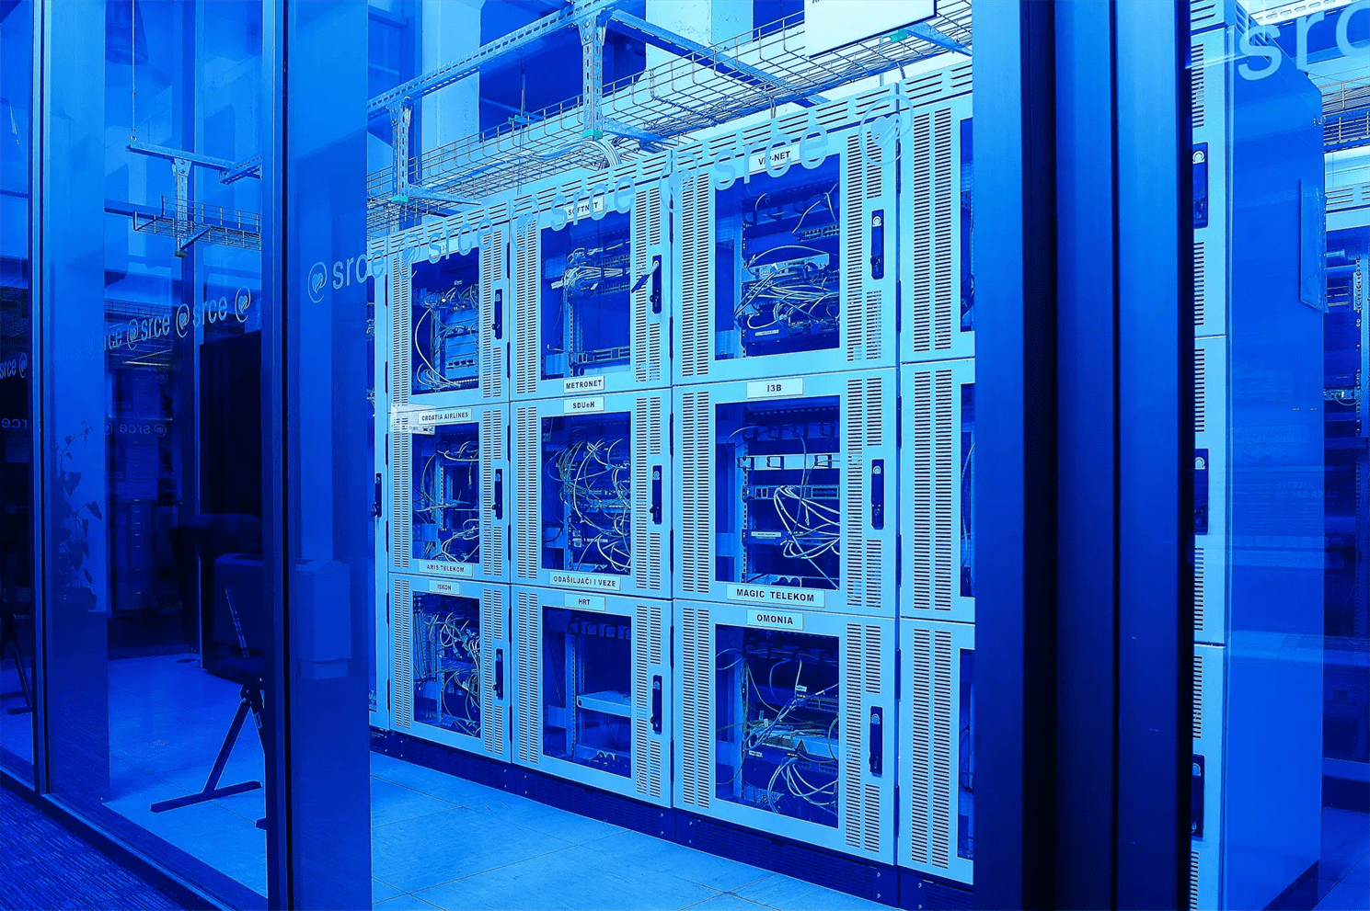
21ST CENTURY …
2000 - Croatian Internet eXchange (CIX)
2002 - GĖANT Point of Presence (PoP)
2002 - HPC cluster Isabella established (part of EDG)
2003 - National grid project CRO-GRID started
2005 - National grid infrastructure CRO NGI up & running
2006 - AAI@EduHr - national authentication and authorization infrastructure
2006 - Portal of Croatian scientific and professional journals
2007 - SRCE E-learning Centre established
2011 - SRCE Computing Cloud (VPS/VCL)
2015 - New DC SRCE2 - Data Center at Borongaj Campus
2015 - Dabar – national infrastructure of Digital Academic Archives and Repositories
2015 - edu4IT – New education program and certification of IT professionals 2017 - Croatian Research Information System (CroRIS) project started
2018 - Croatian Scientific and Educational Cloud (HR-ZOO) project started
2021 - Croatian Open Science Cloud Initiative (HR-OOZ)

Slide 4
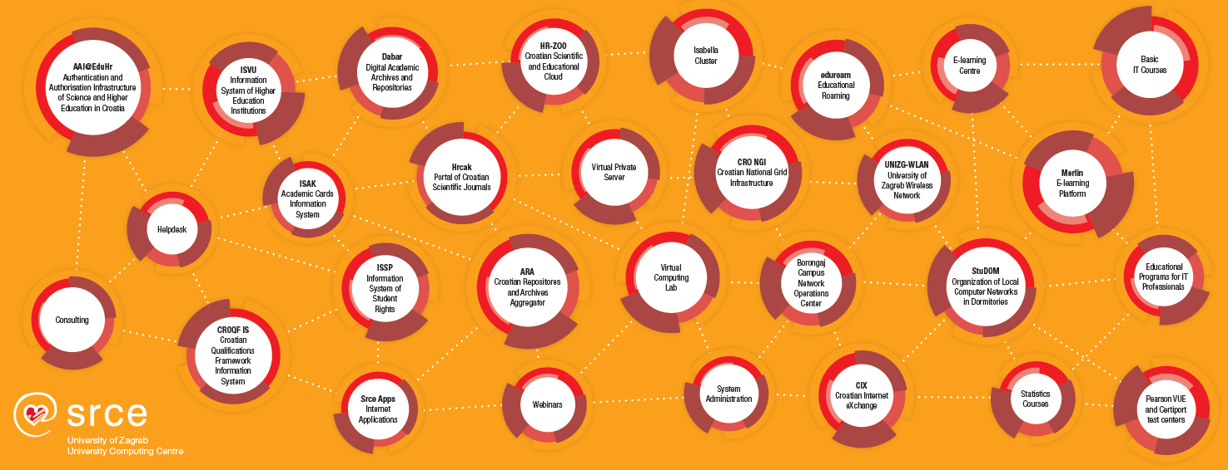
SRCE TODAY
e-infrastructure – reliable services 24/365 + access to state-of-the-art ICT
education – enabling users to use ICT & support usage of ICT in education and research
consultancy, support and partnership in research and education
~ 50 services
155 employees
2 data centres
3 locations in Zagreb

Slide 5
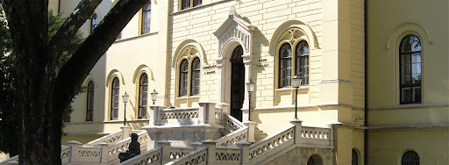
SRCE – TOWARD A VISION OF E-INFRASTRUCTURE
IT and information services to users
e - infrastructure?
Teams of professionals to develop, maintain and support usage od e-infrastructure
227 R & HE institutions
INFORMATION SYSTEMS AND SERVICES (collaboration and groupware systems, information systems, Internet applications, public registries, CRIS systems, library systems, e-learning platforms, ERP, CRM, DMS, …)
DATA LAYER (digital archives, digital repositories, dana collections, portals, …)
MIDDLEWARE LAYER (authentication and authorization systems, monitoring, security, accounting, …)
131 HE institutions
of which 106 public
(159 000 + students)
25 public scientific institutes
71 other legal entities that registered scientific activity (National and University Library, Croatian Academy of Sciences and Arts, hospitals, archives...)
COMPUTING SYSTEMS AND STORAGE RESOURCES (physical or virtual servers, clusters, IaaS, PaaS, HPC / HTC systems, supercomputers, dana storage, backup systems, …)
DATA CENTERS (national and university data centers, computer rooms, …)
NETWORKS AND NETWORKING SERVICES (international and national networks, MAN, LAN, WLAN…)
(20.000 + scientists)
Organizational and governance framework of e-infrastructure
IT and information services to users

Slide 6
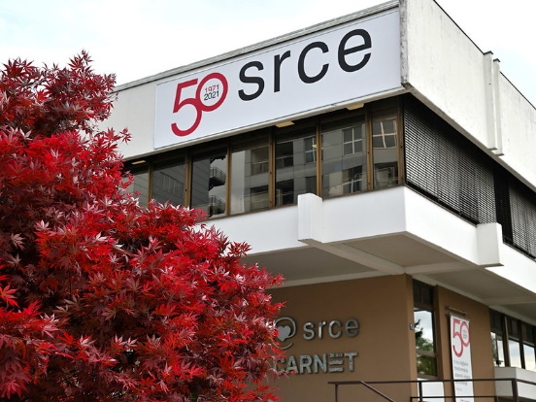
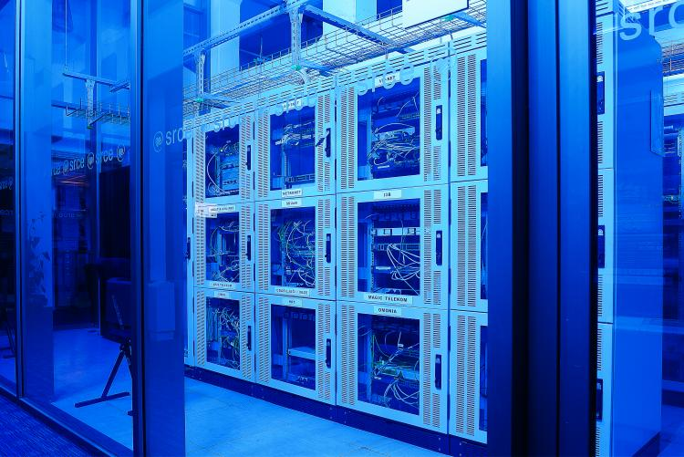
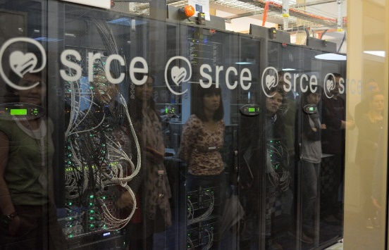
SRCE AND NETWORKING - CONNECTING PEOPLE AND LOCATIONS
CIX – Croatian Internet Exchange
2 locations in Zagreb
37 members (ISPs)
Data Centres
reliable housing for equipment and services
2 DC in Zagreb
NOC – Network Operation Center
SRCE NOC
Campus Borongaj NOC
VoIP infrastructure
UNIZG - WLAN

Slide 7
SRCE - COMPUTING & STORAGE
SRCE Central Computing & Storage Infrastructure
Cloud IaaS VMware
350 / 750 VMs
1+ PB used storage
800+ TB backup
1200 TB archives (tapes)
HTC Cloud
600 CPUs
2.400 virtual CPUs
150 TB HDD
70 users
22 projects
HPC
140 TFLOPs
3.100 CPUs
12 GPUs
350 users
140 projects
266 scientific works
Cloud IaaS
340 / 400 VPS
400 VCL

Slide 8
SRCE – T&I … ENABELING MOBILITY
AAI@EduHr
234 IdP
946 880 el. identities
946 services
91 066 880 successful authentications over last 30 days
80 406 668 successful SSO authentication in 2020
eduroam
safe, easy to use and,
for the end user, completely free Internet access service in Croatia …
1 149 locations
407 cities/places
and worldwide
32 000+ locations
106 countries

Slide 9
SRCE – DATA INFRASTRUCTURE AND SERVICES
CROATIAN OA JOURNALS
Since February 2006
508 scientific & professional journals (395 active)
244 700+ OA articles
65.000+ visits daily
PRESERVATION & DISEMINATION
16 types of digital objects
150 digital repsitories of research & HE institutions
166.400 digital objects
(TEMPORARY)
STORAGE & SHARING SERVICE
430+ researchers & lecturers
200 GB (default)
Notes:
HRČAK – includes support for entire editorial process: 54 journals using Open Journal System (OJS3)
DABAR: research data, publications like journal arricles, book chapters, educational content, artistic content, students theses and disertations; interoperable with Croatian e-infrastructure eg CroRIS, European eg OpenAIRE, & global eg Google Scholar
PUH various types of interfaces: web interface, native desktop & mobile clients, remote disc on pc or server

Slide 10
INFORMATION AND COLLABORATION SYSTEMS AND APPLICATIONS
ISVU
Information System of Higher Education Institutions
110+ HE institutions, 140.000+ students, 1.700.000+ exams/ac.year
ISSP
Information System of Student Rights
115+ HE institutions 159.000+ students
ISAK
Information System of Academic (student) Cards
MOZVAG
Information System for Accreditation of HE institutions and Study Programs
110+ HE institutions 1.900+ study programs
ISRHKO
Information System of Croatian Qualifications Framework
CroRIS
Croatian Research Information System
(in development)

Slide 11
SRCE AND EDUCATION
National
E-learning platform
virtual learning environment
about 25.000 e-courses per year
connected with ISVU, e-portfolio and videoconferencing system
E- learning Centre
support in use of e-learning tools and technologies
expert support in instructional and learning design of e-courses
education of teachers in digital competences
Croatian Catalogue of HE e-courses
101.700 + e-courses
in catalogue
Educational and training activities
related to use of the ICT on basic and advanced level, specialized topics
for teachers, students, researchers and others
f2f, online, instructor led or self-paced
IT programs for IT professionals
Linux academy
edu4IT – educational program & certification for IT professionals
Test centre
(Pearson VUE)
Notes:
LMS – Moodle + e-portfolio (Mahara) + webinars (AdobeConnect + eduMEET)+ ISVU+Dabar

Slide 12
SUPPORTING RESEARCH
COMPUTING
Cloud services and advanced computing
Isabella – high performance computing (HPC) resource
HTC-Cloud – cloud based platform for elastic & interactive computing
Cloud services
Virtual servers (VPS)
Virtual classrooms and labs (VCL)
PLAN
COLLECT
ANALYSE
PRESERVE
SHARE
PROCESS
RE-USE
DATA
Curation of data, as most valuable asset
in education and research environment
Puh – storage & data sharing during research
Dabar – national infrastructure system of digital academic archives and repositories
Hrčak – portal (repository) of Croatian scientific and professional journals in open access

Slide 13
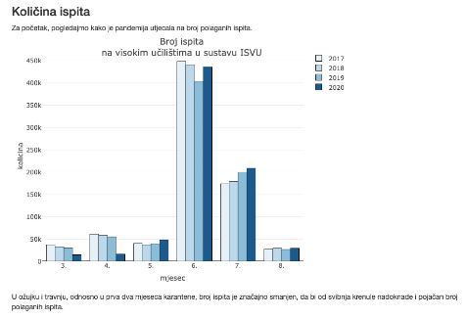
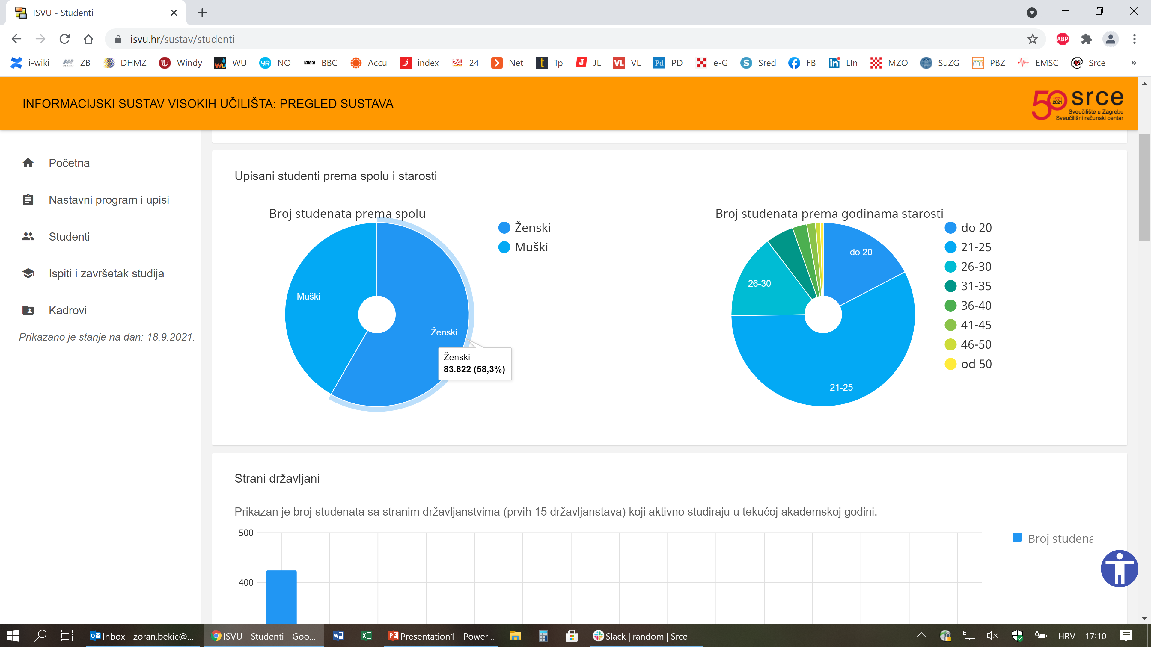
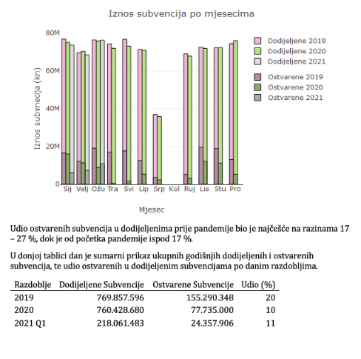
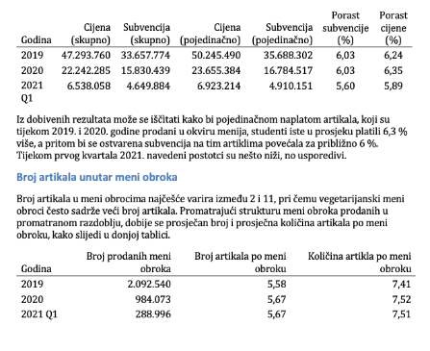
IMPORTANCE OF DATA – SRCE AND THE KNOWLEDGE PYRAMID
Policy and decision-making (ministry, university, other institutions)
WISDOM
..by applying we acquire …
KNOWLEDGE
Data analysis at SRCE
..analaysing we obtain…
INFORMATIONS
…we organize it in...
Information and data infrastructure at SRCE
DATA
We collect…

Slide 14
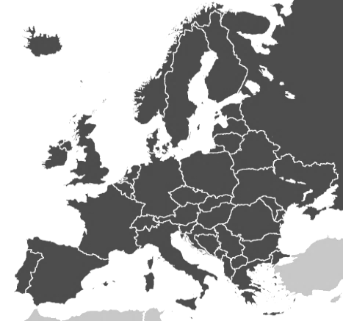
SRCE AND INTERNATIONAL COOPERATION – BUILDING BRIDGES
… Connects and supports:
national components with the similar European
Croatian scientists and research area with ERA
Interoperability of Croatian information systems towards the EU
mobility of scientists, teachers, students…
EU PROJECTS & MEMBERSHIP
… builds, improves and maintains national:
e-infrastructure
information systems
referral centres
competence centres
catalogue of services
… contributes to the development of:
European Research Area (ERA)
European Higher Education Area (EHEA)
EU guidelines and policies, representing the interests of Croatia

Slide 15
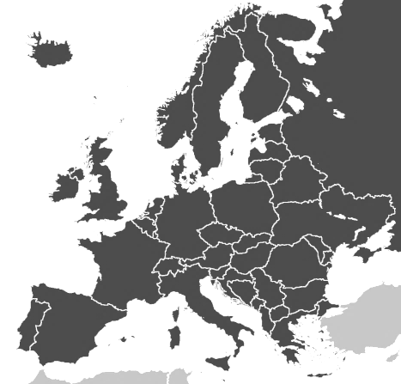
SRCE AND INTERNATIONAL COOPERATION – BUILDING BRIDGES
EU PROJECTS
contributes to the development of the European Research Area, the European Higher Education Area and the digitalisation of processes related to student mobility
MEMBERSHIP
as a national representative SRCE represents Croatian interests and commitments in international bodies and organizations

Slide 16
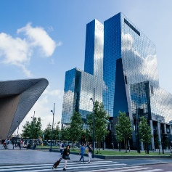
SRCE AND EGI - SUPPORTING RESEARCH
The Croatian participation in the EGI Federation is coordinated by SRCE
through CRO NGI (Croatian National Grid Infrastructure)
in 2020
Croatia participates in
8 out of 30 research infrastructures in EGI federation
76 researchers from Croatia
used
the services of the
EGI federation
210 peer reviewed scientific publications
were produced by research communities from Croatia and supported by the EGI Federation
Croatian partners participate in several H2020 projects with EGI Foundation:
EGI-ACE,
EOSC-Hub, OPERAS-P, totalling to 212,926 EUR

Slide 17
CROATIAN SCIENTIFIC AND EDUCATIONAL CLOUD (HR-ZOO)
Strategic project by Ministry of Science and Education of Republic of Croatia
Coordinator: SRCE
Reference No: KK.01.1.1.08.0001
Project value: 196.802.438,11 HRK
EU contribution: 167.282.072,40 HRK
National share: 29.520.365,71‬ HRK
Implementation: 1.7.2017. - 30.4.2023.
Distributed national e-infrastructure of computing, storage and network resources for different purposes, designed for strengthening the capacity of the Croatian academic and research community
for research, technological development and innovation.
Project is co-funded by European Union from European Regional Development Fund
https://www.srce.hr/hr-zoo/en/

Slide 18
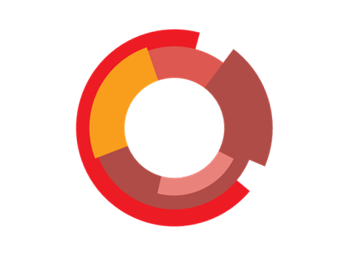
SERVICE CATALOGUE
5 Data Centres
HR-ZOO ZG2
HR-ZOO ZG1
STORAGE
HR-ZOO OS
COMPUTING
HR-ZOO RI
SCIENTIFIC SOFTWARE
NETWORK CONNECTIVITY
HR-ZOO ST
SPECIALIZED SUPPORT TO RESEARCHERS
COLLOCATION OF ICT EQUIPMENT
100 Gbps interconnection

Slide 19
COMPUTING (HPC)
High Performance Computing (HPC)
1,1 PFLOPS
(double precision)
100 Gbps network
connection between nodes
0,5 PB of high performance
storage
Applications with high performance and capacity requirements:
Computationally demanding research
Modelling and simulation
Data processing
High performance data analytics (HPDA)
Artificial Intelligence (AI)

Slide 20
COMPUTING (Cloud)
Elastic Cloud Computing
Virtual Data Centres
11.000 core processors
16 GPUs
3 PB of high performance storage
1.800 redundant virtual servers in high availability mode

Slide 21
STORAGE
Data Storage
... resources for reliable storage of large volumes of data and other digital assets ...
Unified file and object storage
10 PB of disk storage
3 PB of tape storage
Backup and archive system

Slide 22
SUPPORT
Scientific Software
Specialized support to researchers
Collocation of ICT equipment
... a team of experts who will provide advanced support to researchers and teachers in the use of ICT.

Slide 23
NATIONAL CENTER OF COMPETENCES FOR HPC
Centre of Competences for HPC
Technology transfer and business development
Access to EuroHPC / national resources
Cooperation with industry
Education and skills development in HPC / HPDA / AI
Advisory support in funding applications
Established as part of the EuroCC project
ONE-STOP-SHOP FOR HPC
support users in the use of HPC resources
development of new competencies in the HPC field
cooperation between the academic community and industry
building a European HPC ecosystem
Notes:
Rješenje → Centar kao jedinstvena kontaktna točka za sve identificirane potrebe
Kratkoročni cilj → samostalan i održiv centar kompetencija za HPC
Razvoj snažne upravljačke strukture i dugoročnog poslovnog plana → osiguranje održivosti
Osnaživanje postojećih i razvoj novih kompetencija iz HPC područja
Koordinacija nacionalnih inicijativa
Uspostava suradnje između akademske zajednice i gospodarstva
Dugoročni cilj → središnje mjesto za HPC u Hrvatskoj
Doprinos izgradnji HPC ekosustava u Europi
Korištenje bespovratnih sredstava EU programa (razvoj istraživanja i inovacija)
Integracija Hrvatske u Europski istraživački prostor
Sudjelovanje u digitalnoj i zelenoj tranziciji

Slide 24
CROATIAN RESEARCH INFORMATION SYSTEM – CRORIS
(AS PART OF PROJECT SCIENTIFIC AND TECHNOLOGICAL FORECASTING LEAD BY MSE)
Strategic project for Ministry of Science and Education of Republic of Croatia
Promote open science
Provide information reliability
Ensures openness and interoperability
Support decision making
New national Research Information System of the Republic of Croatia, gradually being put in production
Information and processes about institutions, researches, projects, publications, equipment, patents, services, events and much more
Integration with many national systems and international platforms, such as ORCID, OpenAire, WoS, Scopus
Project is co-funded by European Union from European Regional Development Fund

Slide 25
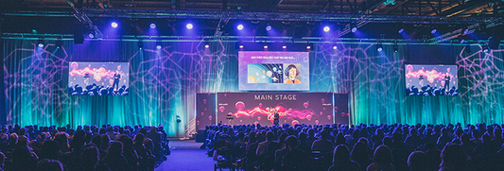
CRORIS CONTENT
Projects
Journals
Financing
Register of Scientists
Publications
Register of Sc. Inst.
Register of HE Inst.
Citations
Equipment and Services
Science Fields and Areas
Patents and Products
Events

Slide 26
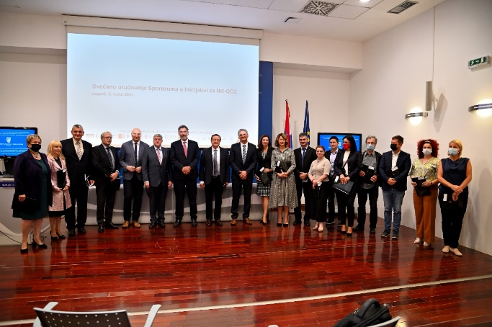
CROATIAN OPEN SCIENCE CLOUD INITIATIVE – HR-OOZ
INSTALLATION GUIDE
Use and connect the existing national elements of open science for the development of HR-OOZ and connect with European / international network
Ensure that there is a national plan for the development of research infrastructure (including e-infrastructure)
Develop and maintain national cooperation and bring together all relevant stakeholders :
horizontal: joint projects for the development of new infrastructures, services and resources
vertical: joint projects for building data standards, catalogue of services, joint application for large (scientific) and challenging projects
Ensure funding and sustainability of research infrastructures (including e-infrastructure)

Slide 27
SRCE – READY FOR NEXT 50 YEARS!
Big data & IoT in science
Open Science &
Open Education
Interinstitutional & international
cooperation & collaboratiotion
National and
university e-learning centre
National Competence Center for HPC
EDIH
…
Advanced computing
Models & services
Centre of competence for trust and identity
systems
National eduroam operator
National Open Science Cloud
HR-ZOO
National RDA node
HR-OOZ
…
…
Digital skills and
competences
Stronger application of e-infrastructure in science and education (expanding to public sector and SMEs)
Flexibility in work of students, teachers and researchers &
Institutional flexibility in doing business
Notes:
Projekti u okviru NPOO-a (HPC4AI, HPC4SME…)
Srce i donošenje politika ZiVO - HR-OOZ i radna skupina za nacionalni plan otvorene znanosti
Nacionalni centar kompetencija za HPC – EuroCC i mogući nastavak projekta
EDIH i projekt CROBOHUB++
Plan za razvoj istraživačke infrastrukture (??-da ili ne?)
Strategija pametne specijalizacije (?’ – da ili ne?)
Ivan: treba dodati u pozadini sliku koja ocrtava okruženje u kojem se realizira naša vizija (sustav ZiVO ali i šire)..

Slide 28
SRCE - PEOPLE ARE THE KEY TO OUR SUCCESS
TECHNOLOGY
TALENTS
TOLERANCE
https://50.srce.hr/en.html

Slide 29
THANKS!
ivan.maric@srce.hr
https://www.srce.hr/
SRCE – At the Very Heart of Digital Transformation of Science and Higher Education
EGI Conference 2021: Beyond the Horizon – Shaping the Digital Future, October 19th 2021

