Slide 1
In-database Auditing Subsystem for Security
Enhancement
B. Bašić*, P. Udovičić* and O. Orel* * University of Zagreb, University Computing Center, Zagreb, Croatia
{bjanka.basic, petra.udovicic, ognjen.orel}@srce.hr

Slide 2
Introduction: In-database auditing subsystem
Auditing - control mechanism designed to track the use of database resources and authority
Each audited operation creates audit trail - What? Who? When?
Different ways to audit database:
DBMS – Oracle, MS SQL Server, IBM Informix, PostgreSQL
External software/hardware – ApexSQL Audit, Oracle Audit Vault and Database Firewall
In-database

Slide 3
Introduction
Goal – to present auditing solution that is:
Simple
Secure
Configurable
Capable of keeping the entire data history and all executed SQL statements
Roleseparated
Why?
for access control, intrusion detection, fraud detection and other security-related analyses and procedures
Currently implemented in several information systems

Slide 4
ARCHITECTURE

Slide 5
Architecture

Slide 6
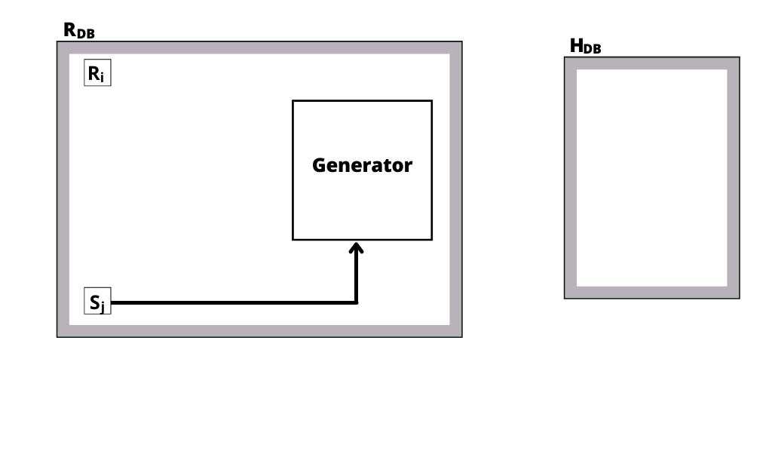
Code generator

Slide 7
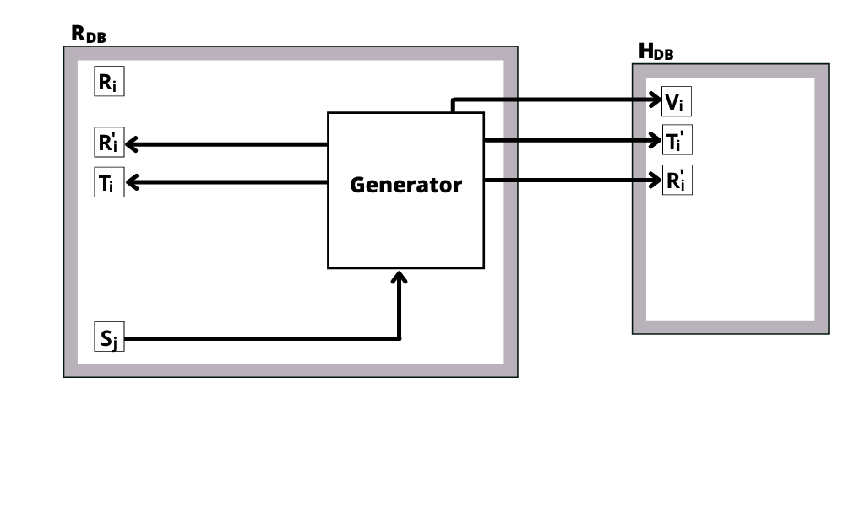
DML auditing

Slide 8
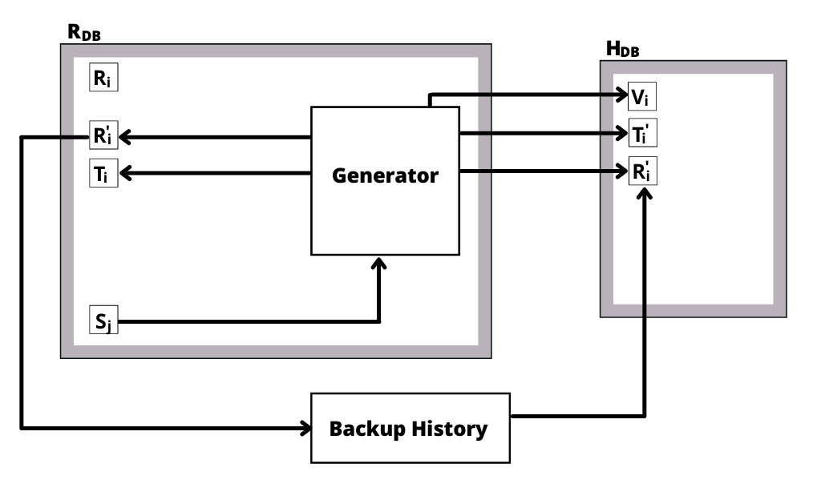
Backup History process

Slide 9
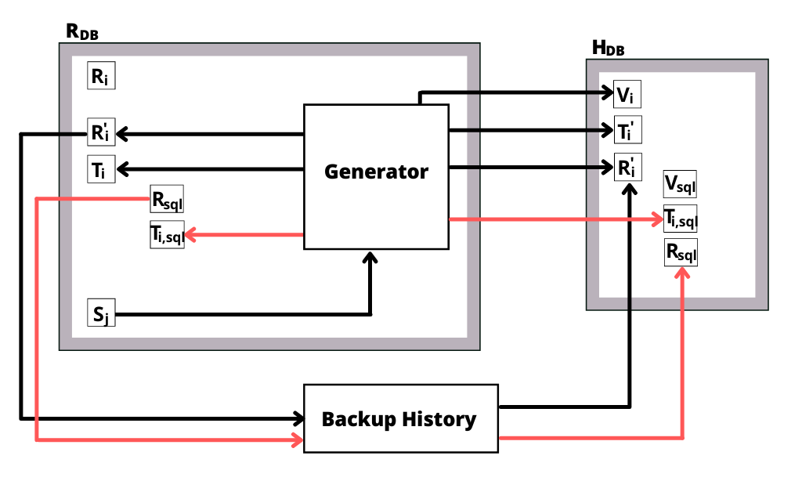
SQL auditing

Slide 10
PERFORMANCE

Slide 11
Performance overhead
Testing - using Apache JMeter
Comparing duration of JDBC requests with audit on and off
1 thread, executing 1000 operations

Slide 12
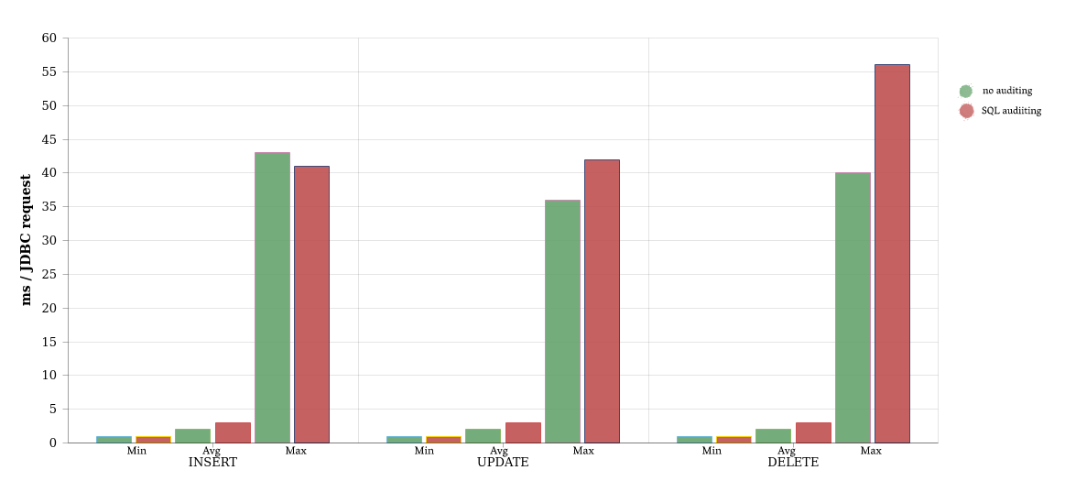
DML auditing

Slide 13
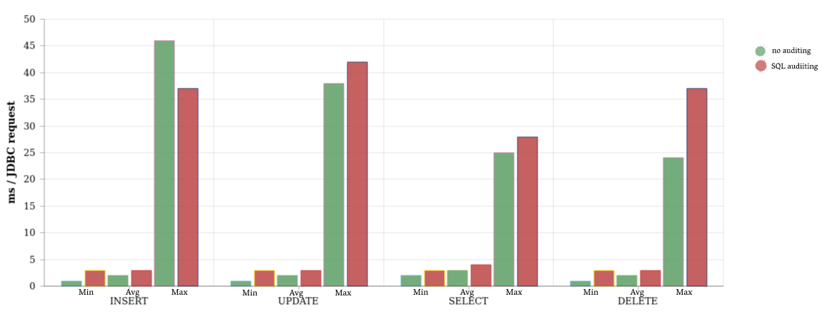
SQL auditing
Testing statments affect only a single row in relation

Slide 14
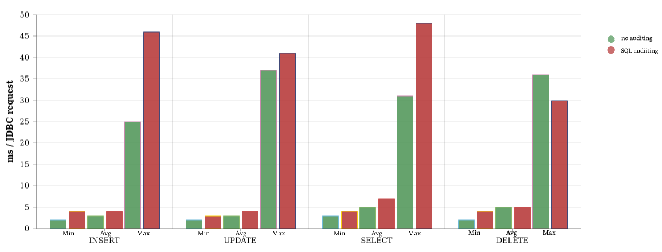
SQL auditing
Testing statments affect 100 rows in relation

Slide 15
Future work
Using audit trail collected with this method we can focus on:
implementation of reaction mechanism to prevent overstepping of given permissions or unwanted queries
process mining methods – in order to recognize processes in the system and define security measures
mechanisms and methods for investigation of complex, multi-user frauds

Slide 16
Questions?

