Slide 1
Developing Bloom Filters for
Web Archives’ Holdings
Martin Klein, Lyudmila Balakireva
Los Alamos National Laboratory (LANL)
{@mart1nkle1n, @milbala}
Karolina Holub, Inge Rudomino
National and University Library in Zagreb, Croatian Web Archive (HAW)
{@KarolHolu, @ingeRudomino}
Drazenko Celjak
SRCE - University of Zagreb University Computing Centre
@dceljak
Thanks to the IIPC for generously funding this project!

Slide 2
Recall, the Problem
Archival holdings largely unknown
To the public
To web archives
Searching through a CDX file
Not available to the public
Requires insight knowledge and time
CDX file sharing w/ 3rd parties
Not practical
Potential legal implications unclear
https://twitter.com/anjacks0n/status/466690812269846528

Slide 3
Investigating a Potential Solution
Bloom Filters (see: https://llimllib.github.io/bloomfilter-tutorial/)
Data structure to reveal whether an element is present in a set
Database of hashed URIs that are part of a WA’s holdings
Pros:
Fast lookup (hash URI, check for match)
No active publication of plain URIs in archive
Benefit for dark/hybrid archives
Unknowns:
Cost to create a BF
Performance
Scale

Slide 4
At the previous IIPC webinar…
Sample CDX file from HAW
Contained 180 million URIs
BF library:
Max of 200mio URLs
Desired FPR: 1%
Number of hash functions: 5
https://github.com/Baqend/Orestes-Bloomfilter

Slide 5
At the previous IIPC webinar…
Mode | Redis DB
Partner | LANL
Ingested entries | 180,379,433
Time to ingest | 7,273.6s (121.2min)
Size of the BF | 246MB
Query response time | 0.033ms
FPR | 0.66%

Slide 6
Since then…
BF implementation in two possible modes:
Redis-based
Persistent store
Possibly distributed across systems
Memory-based
Not persistent
“local”

Slide 7
Redis vs. Memory Mode
Mode | Redis DB |  | Memory
Partner | LANL | HAW | LANL | HAW
Ingested entries | 180,379,433 | 180,379,433 | 180,379,433 | 180,379,433
Time to ingest | 7,273.6s (121.2min) | 10,759.2s (179.3min) | 1,382.7s (23m) | 1505.5s (25.1min)
Size of the BF | 246MB | 246MB | 246MB | 246MB
Query response time | 0.033ms | 0.051ms | 0.0008ms | 0.0008ms
FPR | 0.66% | 0.66% | 0.66% | 0.66%
Time to serialize to CSV | 16.8s | 17.8s | 2.6s | 3.4s

Slide 8
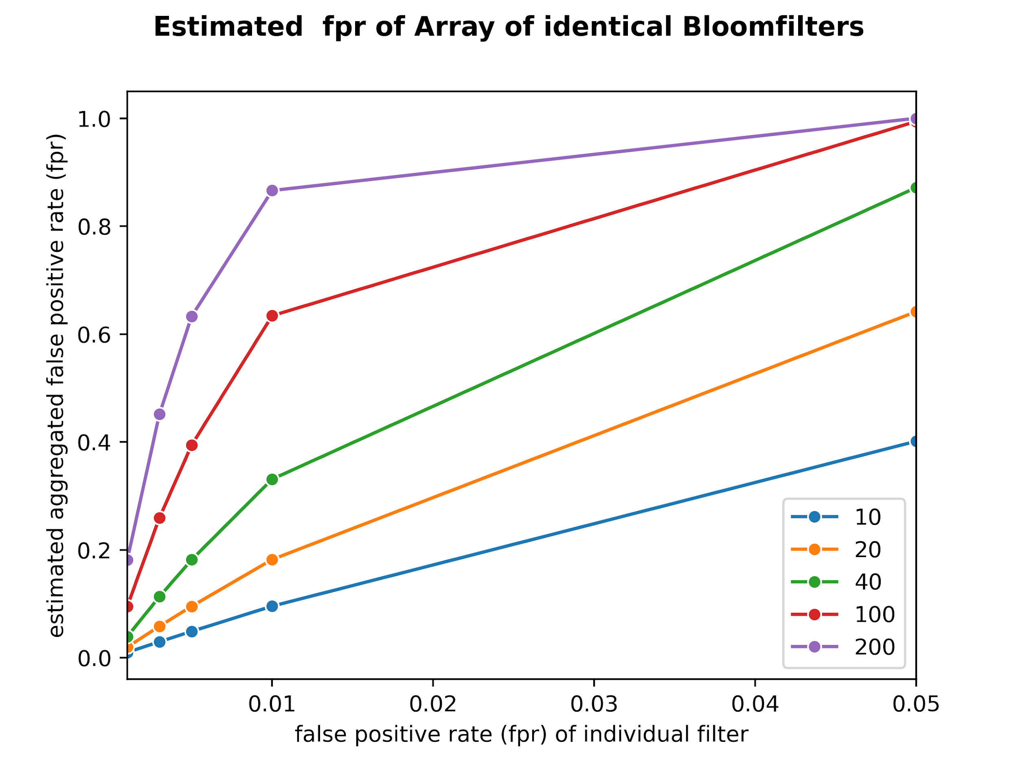
How does this scale?
Redis mode:
Key limit of 512MB, so BF can not exceed 512MB in size
HAW, for example, would currently require ~ 1GB
Dynamic BFs previously introduced
FPR increases significantly with each added BF
Memory mode:
Got unlimited memory?
BF library:
uses integer values
BF can not grow beyond 268.44MB

Slide 9
Our Proposal
Modified DBFs:
HAW: 800mio URLs & 200mio added per year
Creation of 16 BFs, 200mio URLs each
Name each BF after a hex character (‘0’, ’1’, ’2’, ’3’, ’4’, ’5’, ’6’, ’7’, ’8’, ’9’, ’a’, ’b’, ’c’, ’d’, ’e’, and ’f’)
special routing rule for insertion, based on first hex character of the URL’s MD5 hash value
each URL will be inserted in its corresponding filter, matched by name
Distribution done by hash values → filters have equal population of URLs (same probability for insertion)

Slide 10
Our Proposal
Modified DBFs:
Lookup done by routing for appropriate BF based on URL’s first hex character
Avoids parallel querying, main bottleneck in DBFs
For HAW, 16 BFs:
Desired FPR: 1% at 3.8 GB
Desired FPR: 5% at 1.6 GB
Good for next 10+ years
Can be extended to first 2 hex characters, or 32 BFs, or ….

Slide 11
Our Proposal - Ingest/Lookup
0
1
2
3
4
5
6
7
8
9
a
b
c
d
e
f

Slide 12
Our Proposal - Ingest/Lookup
https://haw.nsk.hr/en
0
1
2
3
4
5
6
7
8
9
a
b
c
d
e
f

Slide 13
Our Proposal - Ingest/Lookup
https://haw.nsk.hr/en
MD5 ("https://haw.nsk.hr/en")
=
3f4ad1140570916db71f6681735bdb0c
0
1
2
3
4
5
6
7
8
9
a
b
c
d
e
f

Slide 14
Our Proposal - Ingest/Lookup
https://haw.nsk.hr/en
MD5 ("https://haw.nsk.hr/en")
=
3f4ad1140570916db71f6681735bdb0c
0
1
2
3
4
5
6
7
8
9
a
b
c
d
e
f

Slide 15
Our Proposal - Ingest/Lookup
https://netpreserve.org/
MD5 ("https://netpreserve.org/")
=
e217006c26da28c2e7ef7df892506907
0
1
2
3
4
5
6
7
8
9
a
b
c
d
e
f

Slide 16
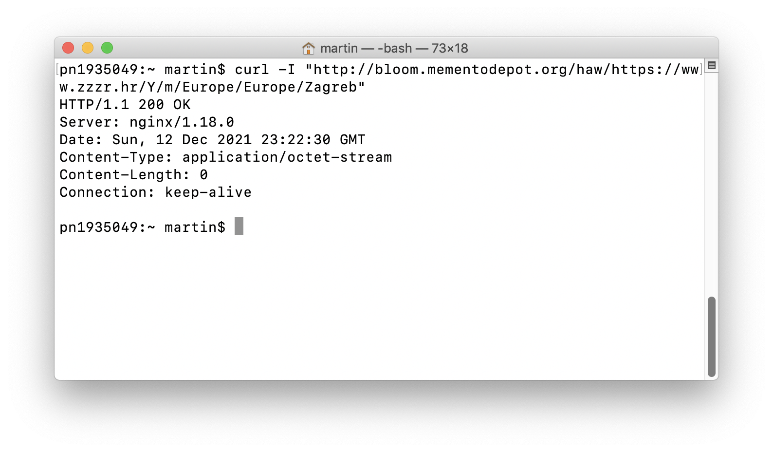
Our Proposal - Implemented
http://bloom.mementodepot.org/haw/https://www.zzzr.hr/Y/m/Europe/Europe/Zagreb

Slide 17
Pilot of Federated Search via BFs
Implemented a simple lookup service, based on CDX files from:
HAW
Internet Archive
British Library
http://bloom.mementodepot.org/bloom/agg/{uri}
Takes URI as parameter

Slide 18
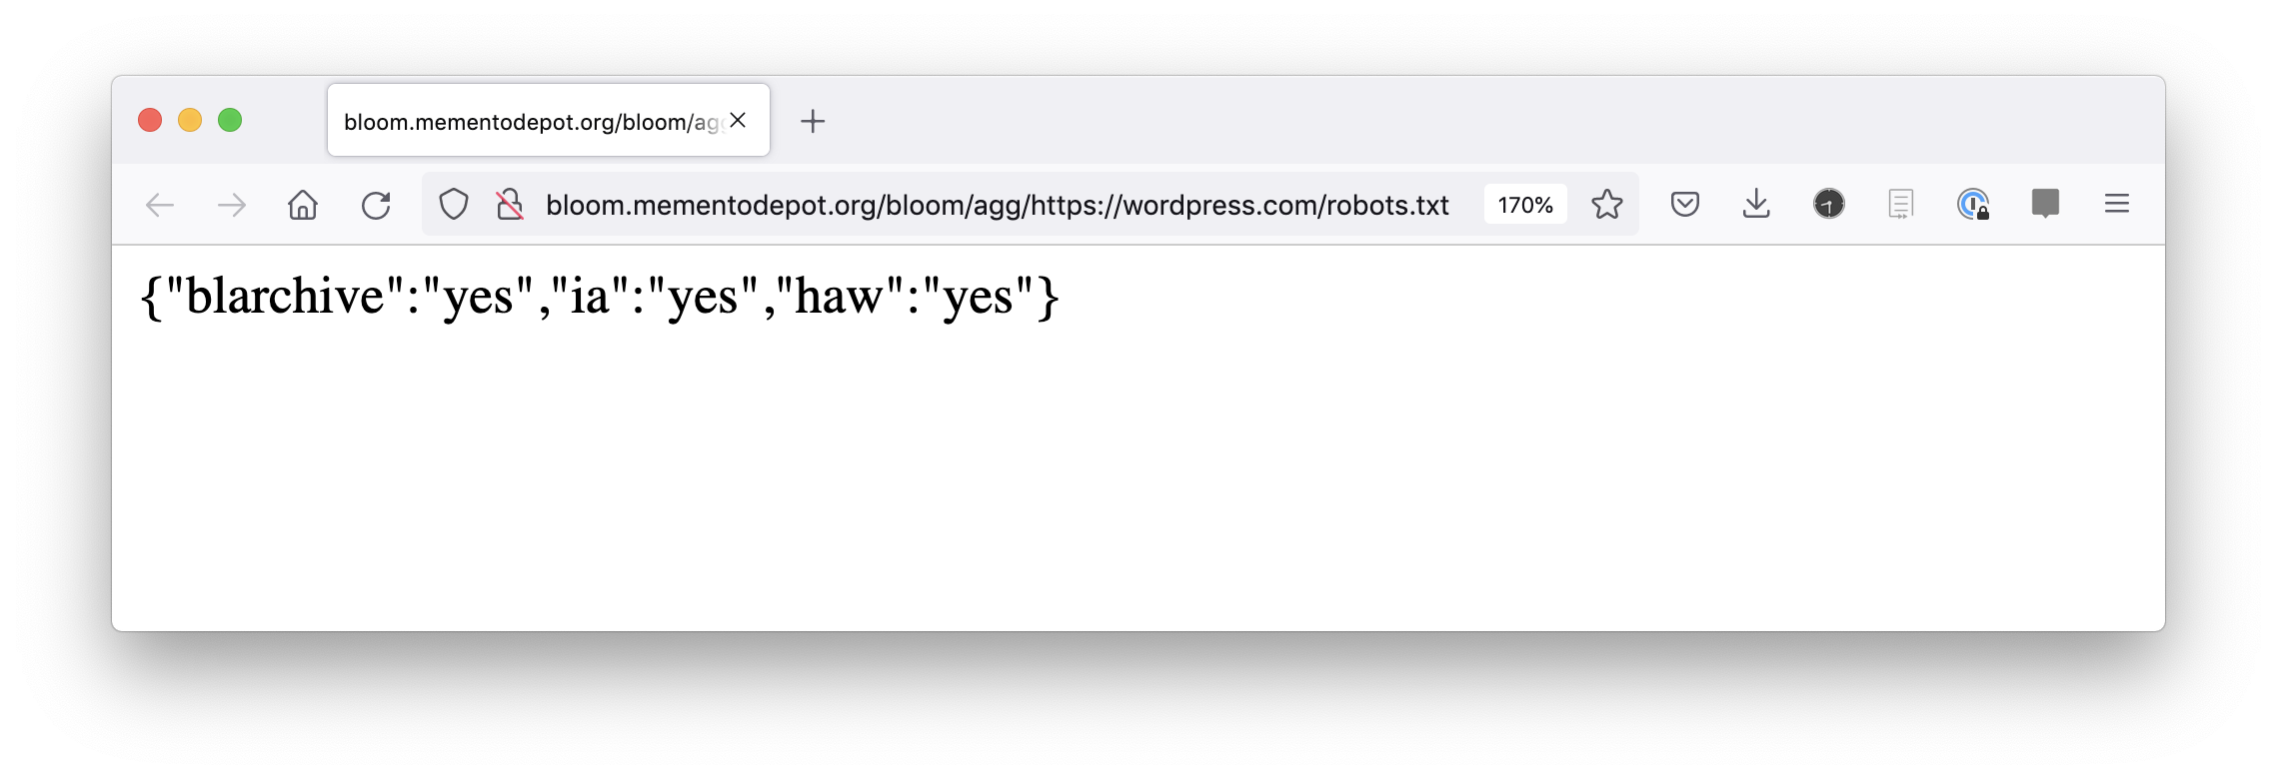
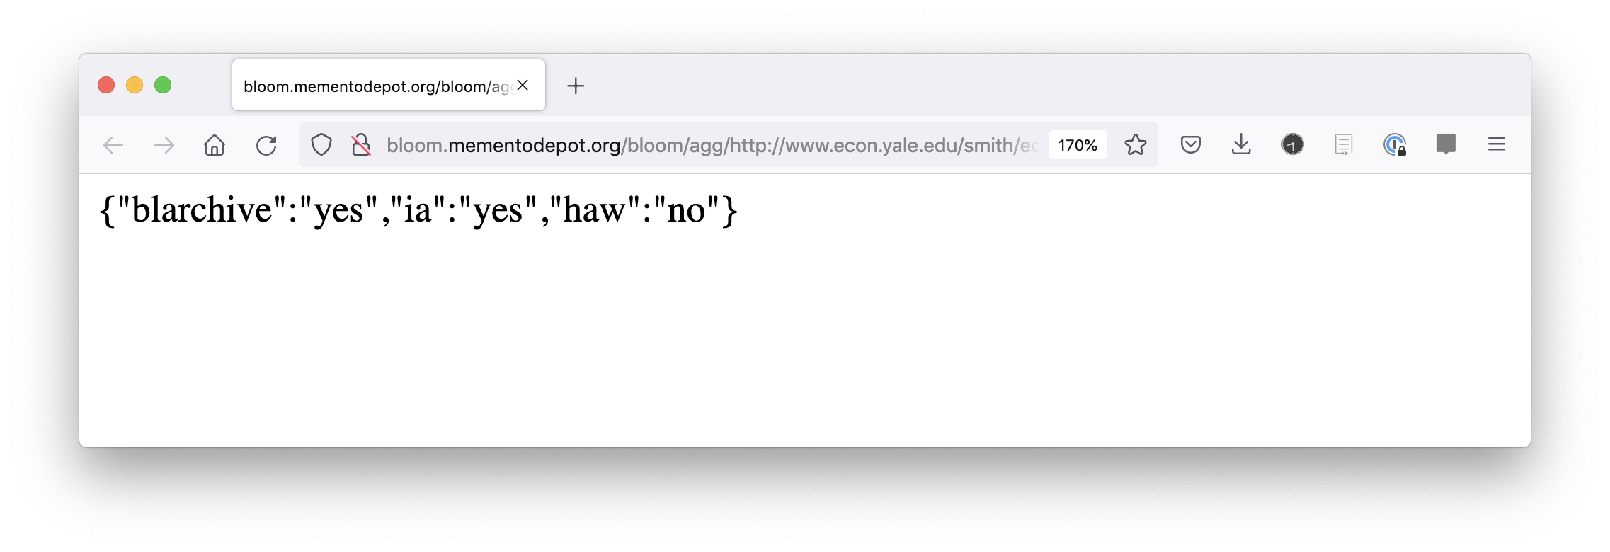
http://bloom.mementodepot.org/bloom/agg/https://wordpress.com/robots.txt
http://bloom.mementodepot.org/bloom/agg/http://www.econ.yale.edu/smith/econ116a/keynes1.pdf

Slide 19
Concept to Share BFs
Croatian Web Archive (HAW)
Testing environment vs. production environment
Goal? To share archive’s holdings
The process of sharing an archive’s BF has the following steps:
BF creation in memory
Serialization of BF into plain text file
Creation/update of sitemap, possibly with added metadata.

Slide 20
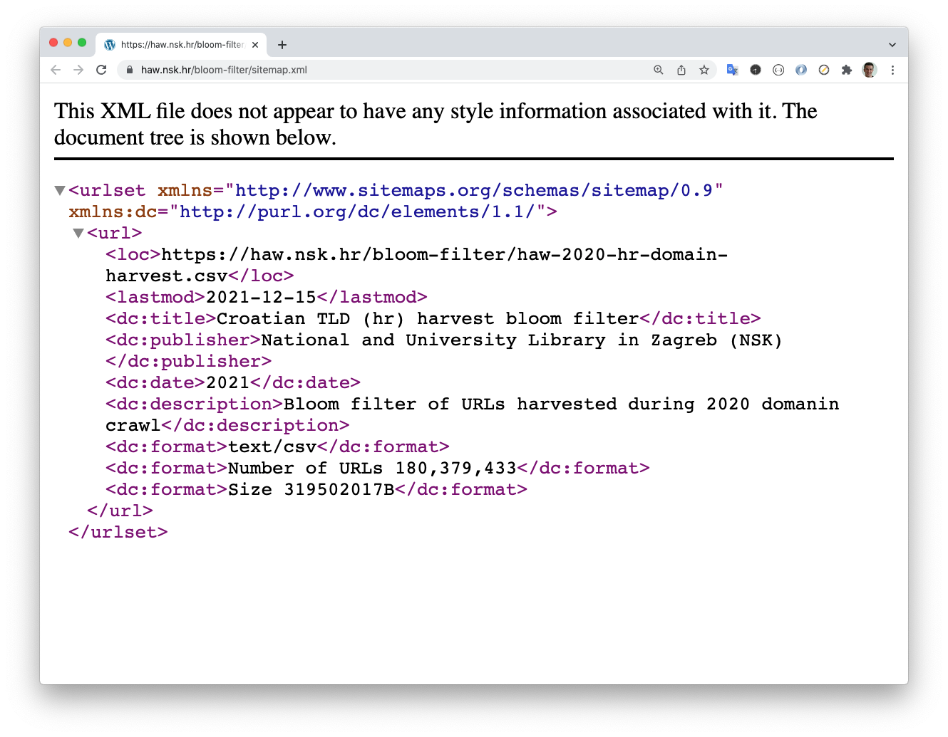
HAW’s Sitemap
https://haw.nsk.hr/bloom-filter/sitemap.xml

Slide 21
Concept to Share (Use) BFs
The process of using BF exposed by archives:
sitemap discovery
parse the sitemap XML file
extract the URL of new or updated BF files
get the serialized plain text file
ingest the file into the local BF implementation.

Slide 22
Final Thoughts
Code currently undergoing LANL-internal review
Open Source release as soon as approved
This really works!!! (with pros and cons)
Likely most suitable for:
Smaller archives
Individual collections
Live lookup of URLs during distributed crawl of (topic) collection

Slide 23
Developing Bloom Filters for
Web Archives’ Holdings
Martin Klein, Lyudmila Balakireva
Los Alamos National Laboratory (LANL)
{@mart1nkle1n, @milbala}
Karolina Holub, Inge Rudomino
National and University Library in Zagreb, Croatian Web Archive (HAW)
{@KarolHolu, @ingeRudomino}
Drazenko Celjak
SRCE - University of Zagreb
@dceljak
Thanks to the IIPC for generously funding this project!

Slide 24
HAW’s CDXs
File name | recordcount | loadTimeInSec | loadTimeInMin
index-2011.cdx | 65,525,756 | 2731.744635 | 42.5
index-2012.cdx | 69,197,158 | 2884.026416 | 48.1
index-2013.cdx | 80,006,504 | 3339.867583 | 55.7
index-2014.cdx | 94,445,269 | 3946.300632 | 65.8
index-2015.cdx | 88,303,363 | 3683.1083 | 61.4
index-2016.cdx | 93,152,112 | 3891.03869 | 64.9
index-2017.cdx | 85,003,467 | 3801.229491 | 63.4
index-2018.cdx | 156,308,196 | 6476.537223 | 107.9
index-2019.cdx | 164,433,243 | 6831.800261 | 113.9
index-2020.cdx | 180,379,433 | 7469.478346 | 124.5

