Slide 1
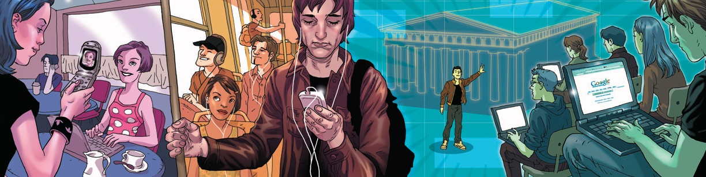
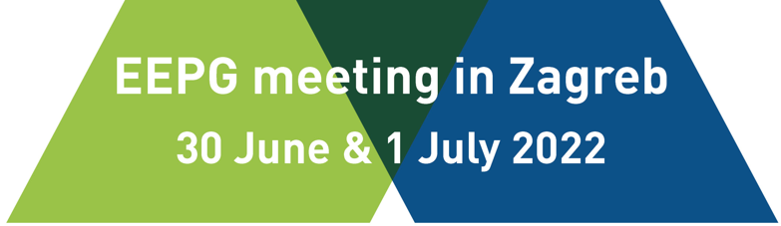


Digital transformation of education- advantages/benefits and challenges
Assistant professor Sandra Kučina Softić, M. Sc. In Digital Education
Assistant Director University Computing Centre SRCE
Director European Distance and E-learning Network EDEN UK

Slide 2
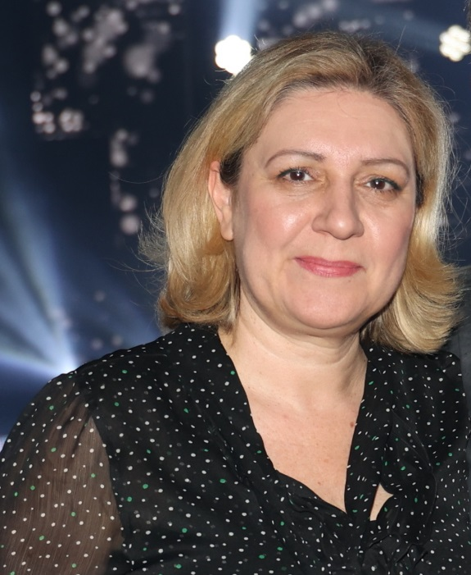
ABOUT ME
Working for more than 25 years in HE on implementation of digital technologies into educational process and support to institutions, teachers and students in this process
Manager, trainer, teachers, learner…
M.Sc. In Digital Education, University of Edinburgh
PhD. In Information and Communication Technologies, University of Zagreb
Assistant Director at the University Computing Centre SRCE University of Zagreb
President of the European Distance and E-learning Network EDEN UK
Author of the Book on digital transformation in education, published in 2021
I love my job!

Slide 3

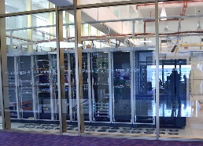
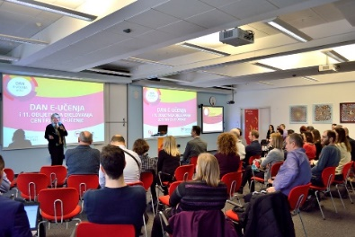
University Computing Centre SRCE
is computing centre and the architect of the e-infrastructure of the entire system of science and higher education of the Republic of Croatia
competence centre for information and communication technologies as well as the centre for education and support in the area of ICT application
in 2021 – 50th anniversary

Slide 4

SRCE – National Centre for E-learning in Higher Education
www.srce.hr/enc
E-learning Centre@SRCE
established in 2007
to support institutions, teachers and students in the use of e-learning technologies and tools
provides infrastructure, usage support and user education
a key stakeholder in the process of digital transformation of the higher education system
Basic objectives:
  to support higher education teachers, students, e-learning teams and institutions
  to provide and maintain reliable and generally accessible university platform for e-learning
  to support the university network of people involved or interested in e-learning
  to promote and foster implementation of e-learning

Slide 5







E-learning Centre@SRCE
E-learning platform for HE
state-of-the-art
e-learning system tailored to user needs
Academic
e-portfolio
for personal use, for presentation or as a learning activity
Webinars
For online lectures, presentations, seminars, consultations
Adobe Connect
Edumeet
E-course Catalogue
of HEI in Croatia
a central place to find basic information about all e-courses
Promoting Open Access and OER
all educational materials develed in SRCE in Open Access
SRCE Open education portal
Antiplagiarism software
for checking students work, theses and doctoral dissertations
by students and teachers

Slide 6

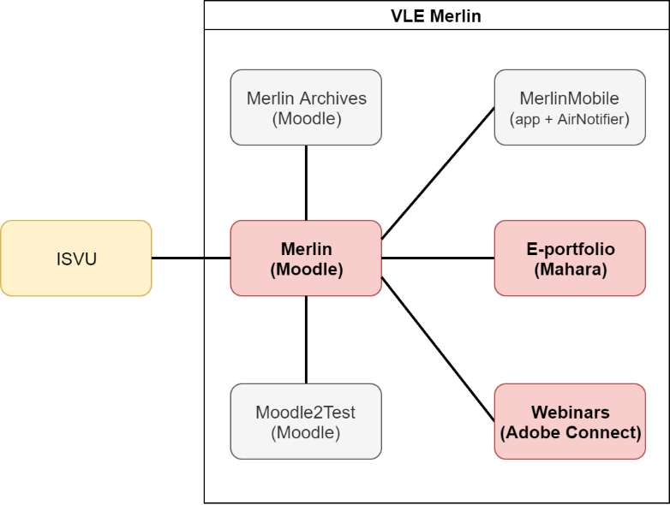
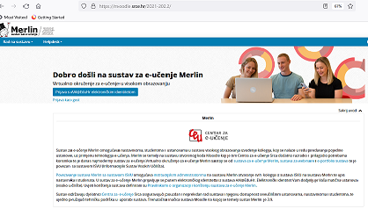
Virtual Learning Environment – Merlin
http://merlin.srce.hr
Dabar
1 Moodle installation
96 institutions on Merlin

Slide 7
Merlin – numbers…
73.752
archived
e-courses

Slide 8
High quality, easily accessible and sustainable support
to HEI
in the systematic
Implementation of e-learning and the process of digital transformation
to teachers
in the use of digital technologies;
in implementation of digital techoologies in teaching and learning
to students
in navigating the online environment and using digital technologies
Courses (classroom and online)
Manuals
FAQ
Quick help
Animations
Guidelines, additional materials
Helpdesk
Consultations
Tailor made support to teachers in implementation of e-learning into educational process
Template for an e-course creation
E-course self-assessment application
Digital badges for completed courses
Interactive guide for grading in Moodle….

Slide 9

EDEN Digital Learning Europe
https://eden-europe.eu/
EDEN exist to share knowledge and improve understanding amongst professionals in distance and e-learning and to promote policy and practice across the whole of Europe and beyond
EDEN is smart network for the professional community and a professional community for smart learning
EDEN is UK based legal entity, the continuation of EDEN’s Europe-wide mission became a problem after Brexit
EDEN DLE established in 2019 and registered in Estonia
EDEN DLE has taken over EDEN’s activities in 2022 and is fully functional and operating

Slide 10
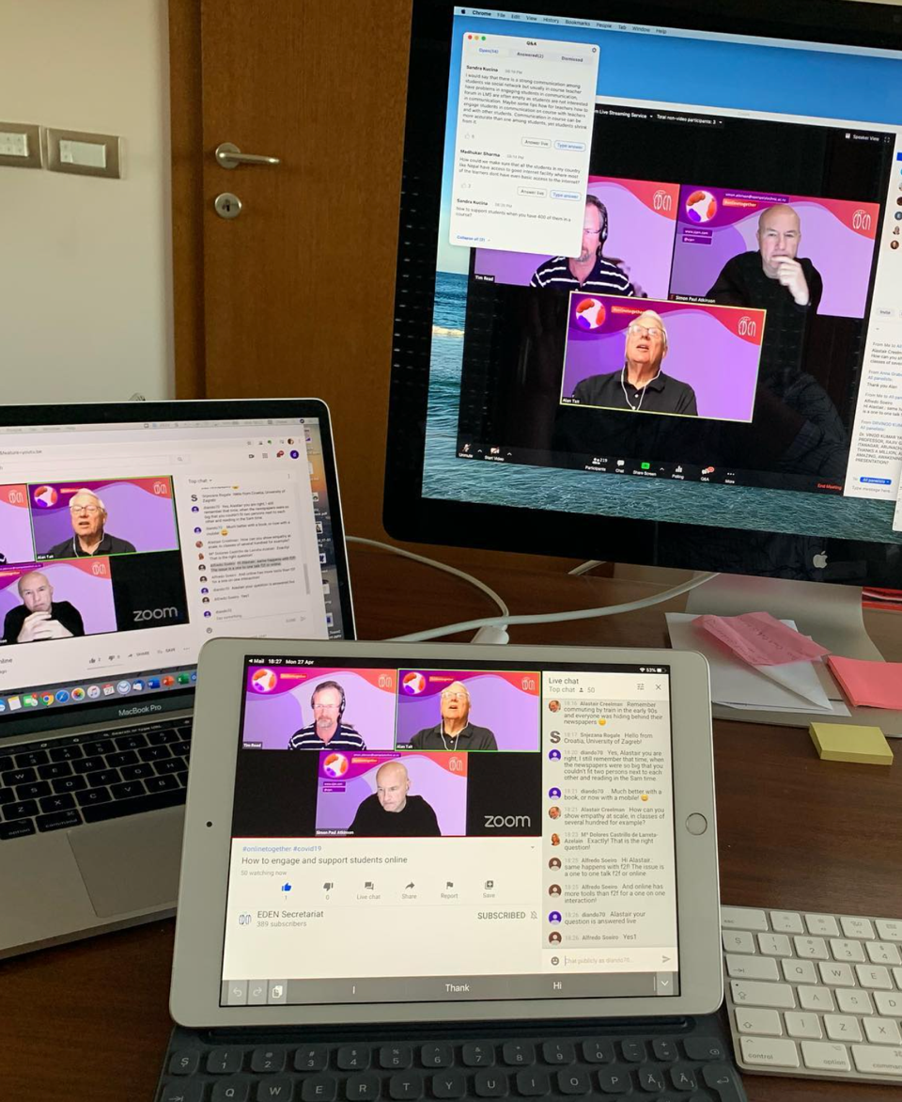
EDEN initiative - webinars #onlinetogether
Started on March 30, 2020
Prompt response of the EDEN to the pandemic and situation in education
to support the education community worldwide and provide practice-oriented advice combining methodology and technology, examples and resources, to those faced with the challenges of taking present educational practice on a higher level.
Practical webinars on how to take face-to-face education online
Focus on the day-to-day challenges teachers and educators face
Recording available in open access
Spring Series 2020: Education in Time of Pandemic: 11 webinars
Autumn Series 2020: Education in Time of New Normal: 6 webinars
Spring and Autumn Series 2021: Time for Action in Shaping the HE 4.0: 7 webinars
98 speakers and moderators

Slide 11
EDEN initiative - webinars #onlinetogether
Series | Total participants
#1 | 3552
#2 | 923
#3 | 868
Total | 5343
Geographical Area | Number of responses | %
Europe | 374 | 84,4
North America | 7 | 1,6
South America | 10 | 2,3
Asia | 37 | 8,4
Antarctica | 6 | 1,4
Oceania | 9 | 2

Slide 12


Slide 13


Write a word that comes first to your mind when talking about digital transformation of education
ⓘ Start presenting to display the poll results on this slide.

Slide 14
Digital transformation in Education
The digital transformation in education requires teachers to adapt and adopt digital technologies, methodologies and thinking. The digital transformation in educational institutions is not about innovation or technology, but about culture. Through the digitalization of learning experiences, both teachers and students can improve their skills with a common goal: to create a more active and effective educational process.
Digital transformation of education is the process of the transformation of the content, methods, and organizational forms of educational activities improving educational quality in a rapid developing digital environment to meet the requirements of the digital economy (A. Y. Uvarov, 2019)
Not a new process... existing for several decades
Education is undergoing massive changes as emerging technology reshapes and redefines the ways students are learning, additionally fostered by pandemic
One fundamental element to keep in mind is that education is not only for the young people. It does not begin and end with school life. Education and learning is a continuous process and continues well into adult life.

Slide 15
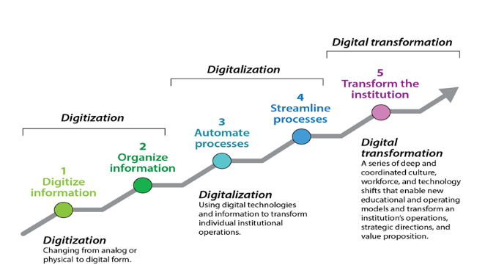
Digital transformation in context
Educause Digital Transformation Study 2020, (Brooks & McCormack, 2020.)

Slide 16
Aspects to be considered in the Digital Transformation of education
Adjust governance and leadership to an educational innovation framework (holistic vision, strategic planning, educational innovation management model)
Open up the educational ecosystem (integrated digital learning environment, digitalization of libraries, administrative services and others, use, reuse and remix of open educational resources, MOOCs, learning analytics, AI, universal accessibility)
Develop an online pedagogy (reference model for teaching and learning, digital inclusion, eAssessment, teacher training and support, tutor training and support, student/learner training and support, continuous exchange of experiences)
Promote curricular development innovation (openness, flexibility, personalization, formal(non-formal integration, participation of students in co-deigning their learning experiences)
Change to a participatory learning culture (learning and assessment based on trust and collaboration fragmentary and transdisciplinary knowledge, disaggregation of learning, importance of ethical aspects, educating to survive in the era of information overload)

Slide 17
Technology alone does not change anything,
but in the hands of trained teachers, it can transform the learning process.
Mariya Gabriel, EU Commissioner for Innovation, Research, Culture, Education and Youth
17/7/2020

Slide 18

Digital technologies can enhance the quality of education enabling
ⓘ Start presenting to display the poll results on this slide.

Slide 19
But, do we want formal education to be online?
mostly education is prepared to be campus based
lectures in classroom dominant model of teaching
importance of the social contact
issue of quality of teaching and learning
issue of quality of online learning materials
lack of digital skills of teachers and students
education in pandemic - emergency remote teaching is not online education!
online education – planned and prepared for delivery in online environment
distance education and online education
our students have succeeded in the online space

Slide 20
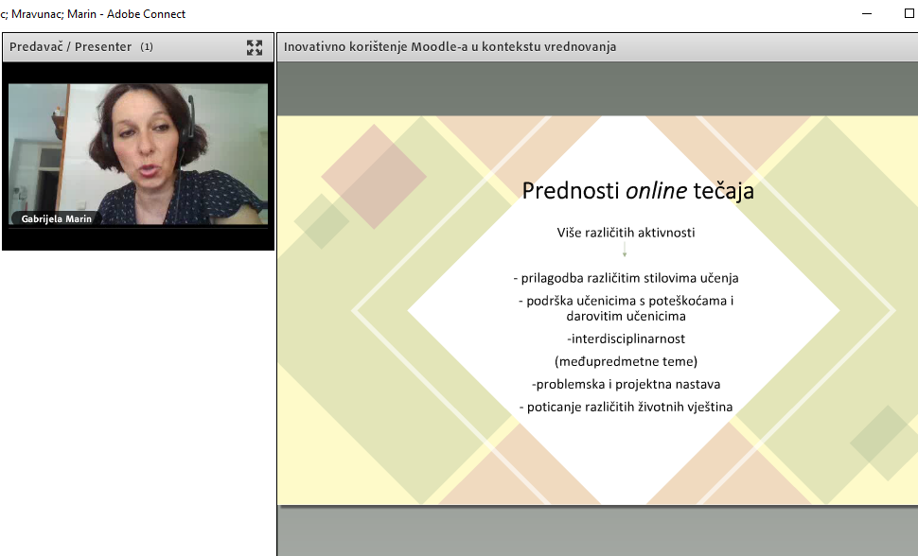
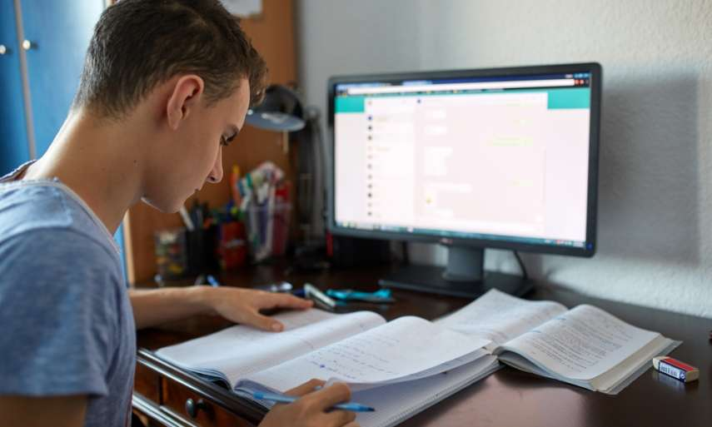
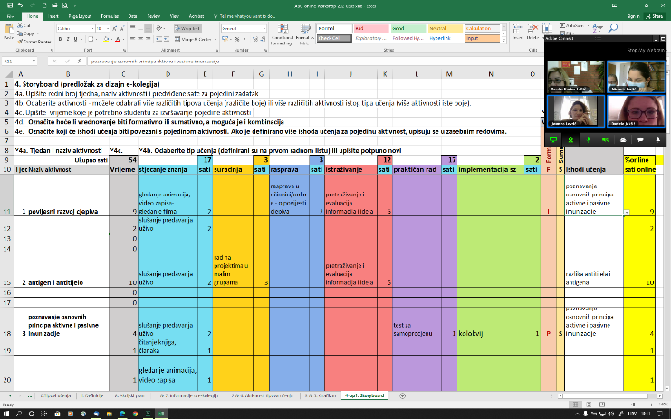

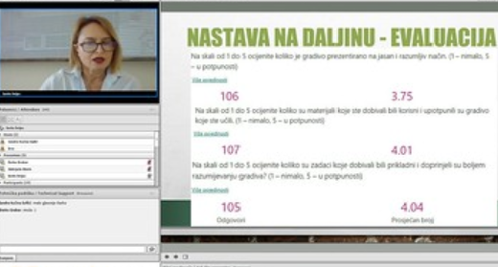
Education in pandemic –when distance learning saved education

Slide 21
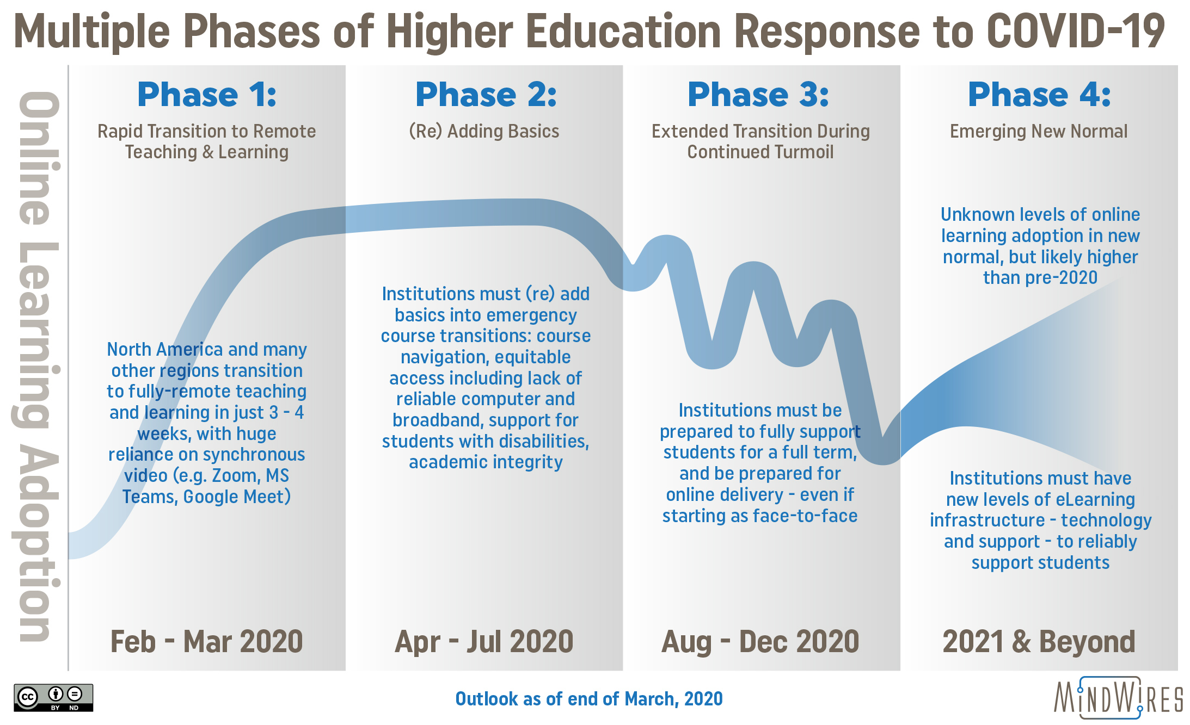
Higher Education and COVID-19
biggest disruption in the education in history
stressful for teachers and students
emergency remote teaching as first solutions but no as permanent solution
it is important to look at what we have done so far and to plan further based on experience
revision of existing strategies and adoption of new ones
revision of existing curricula
emphasis on quality
Graphic https://mindwires.com/multiple-phases-of-he-response-to-covid-19/

Slide 22

Possible scenarios…after pandemic
Restore. We will be focused on figuring out what to do to get back to where we were before the pandemic.
Evolve. We will be focused on adapting to the new normal.
Transform. We will be focused on redefining our institution and taking an active role in creating the innovative future of higher education.
Which scenario will you choose?

Slide 23
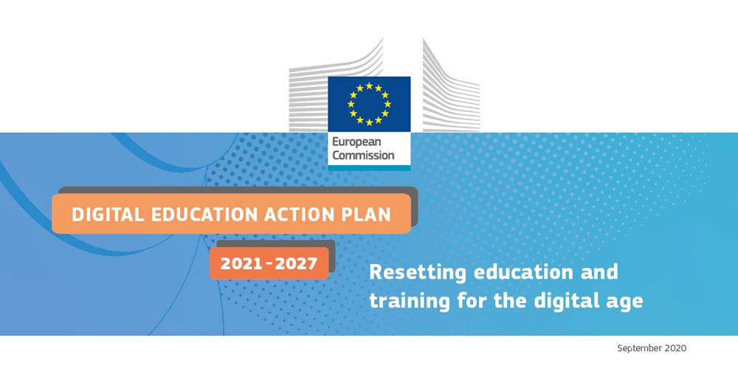
New Digital Education Action Plan 2021 – 2027
Resetting education and training for the digital age
Two strategic priorities:
  Helping develop a high-performing digital education ecosystem
  This needs:
  infrastructure, connectivity and digital equipment
  effective digital capacity planning and development, including up-to-date organisational capabilities
  digitally competent and confident teachers and education and training staff
  high-quality learning content, user-friendly tools and secure platforms which respect privacy and ethical standards
  Enhancing digital skills and digital transformation competences
  This needs:
  basic digital skills and competences from an early age
  advanced digital skills which produce more digital specialists and also ensure
  that girls and young women are equally represented in digital studies and careers

Slide 24
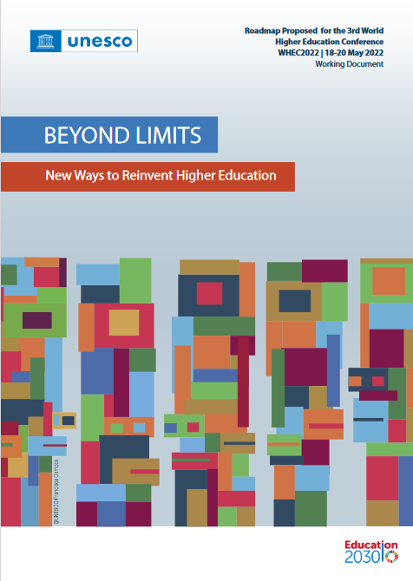
UNESCO roadmap for higher education for the next decade
Equitable and sustainable access to Higher education
Prioritising a holistic student learning experience
Inter- and intra- disciplinarity: Open dialogue between diverse perspective
Lifelong learning approach to serve youth and adult
Integrated system with programme diversity and flexible learning pathways
Technology in support of effective teaching, learning
and research

Slide 25
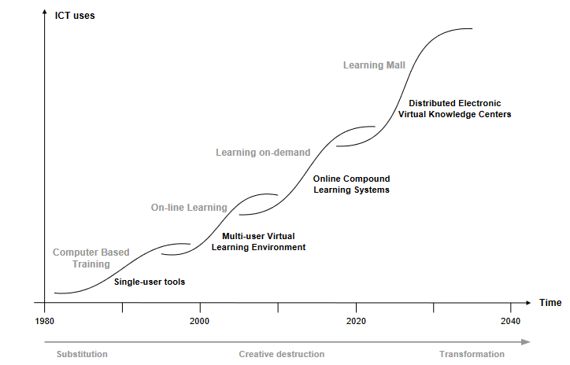
Successive Stages of Educational Technologies and Practices by Piet van der Zanden and Wim Veen, 2004

Slide 26
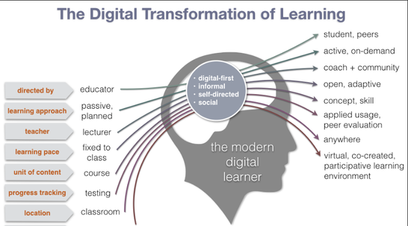
Image Reference Source: https://app-scoop.com/blog/digital-transformation-next-phase-for-education

Slide 27
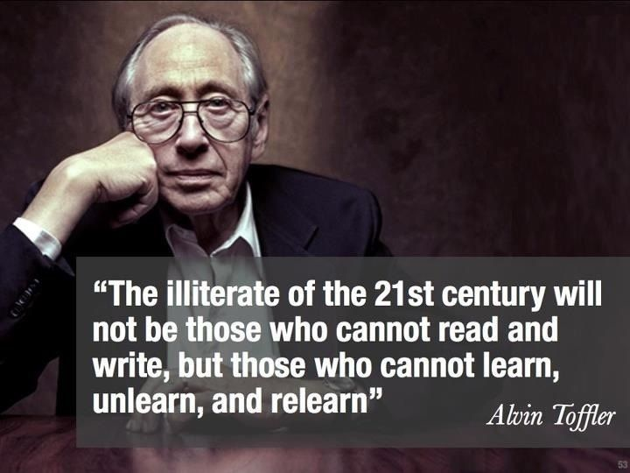
lifelong learner
https://smiletutor.sg/facilitating-21st-century-learners/

Slide 28
What does digital education bring...
flexibility of time and space
easiness of communication
accessibility to educational resources.. new ones and actual... multimedia and interactive
access to repositories, museums and digital libraries on global level
accessibility to larger population...
openness to wider learning possibilities
personalisation of learning process
digital gap... in access to internet and ICT... in digital skills
modularity of learning ...modules
MOOCs
microcredentials
social networking.... communication without borders
digital skills to be able to fully participate in a society today
...but also feeling of isolation in online world... poorer oral communication skills... less reading of books...

Slide 29
What is your idea of education in 21st century?
ⓘ Start presenting to display the poll results on this slide.

Slide 30

New developments
Developments of private provision
  Growing private sector higher educational institutions and adult education institutions
  But as well civil society organizations that carry non-formal programs
Implementation of digital technologies in education and online learning programmes
  Growing use of ICT and e-learning
  Access to the international pool of online programmes and MOOC
Need to up-skilling and re-skilling during work life
  Big enterprises have developed training programmes for workers
  Erasmus+ programs for young people and members of the academic community
Micro-credentials
  indicators of achievements or skills
  visibility and presentation of acquired knowledge and skills
  open
  stackable
Resilience of education
  lessons learned

Slide 31
Technologies used in the Educational Sector
Internet of Things
  School activities
  Homework reminders
  Group study locations
  After-school activities
  Use of digital whiteboard to pass information to student devices
  Automatic tracking of assignments
  Tests being graded and results shared in real time
Security
  Facial recognition, weather updates for storms and criminal activity on campus, potential threats
Artificial Intelligence (AI) and Big Data
  E-Learning courses
  IT tools
  Chatbots
  Online tutoring
  Online enrolment and admissions
Augmented Reality and Virtual Reality
  3D rendering of a historic relic
  Walkthrough a museum
  Studying human DNA
  Personalised learning modules
  Adaptive gamification to make learning fun

Slide 32
Future related to jobs
More often change of jobs
  15-20 jobs during working life
Content of jobs is changing more often
  Until 2022 more than 54% of workers will need additional training Higher automation of tasks - cobotization
  2018: machines/algorithams 29% - humans 71%
  2022: machines/algoritham 42% – humans 58%
Izvor: M. Horgan, Ec DG Employment, Soc. Affairss and Inclusion, e-IRG Workshop, December 2019

Slide 33
It is no more a question if it is classroom or online teaching but how to combine both of these to ensure the best students learning experience
We need to prepare our students to be lifelong learners, skilled to be able to live, work and contribute to the world they are living in - we need skilled teachers who will be able to design such teaching and learning
We need higher education that will be able to fulfil the needs of society and citizens today and tomorrow!

Slide 34
Dr. Sandra Kučina Softić, M.Sc in Digital Education
sskucina@srce.hr
fcb: sskucina
Progress is not possible without change,
those who cannot change their minds, cannot change anything.
George Bernard Shaw

