Slide 1
National infrastructure for digital repositories DABAR
Draženko Celjak <drazenko.celjak@srce.hr>
SRCE – University of Zagreb, University Computing Centre
EUNIS Enterprise Architecture Special Interest Group
13 January 2023

Slide 2
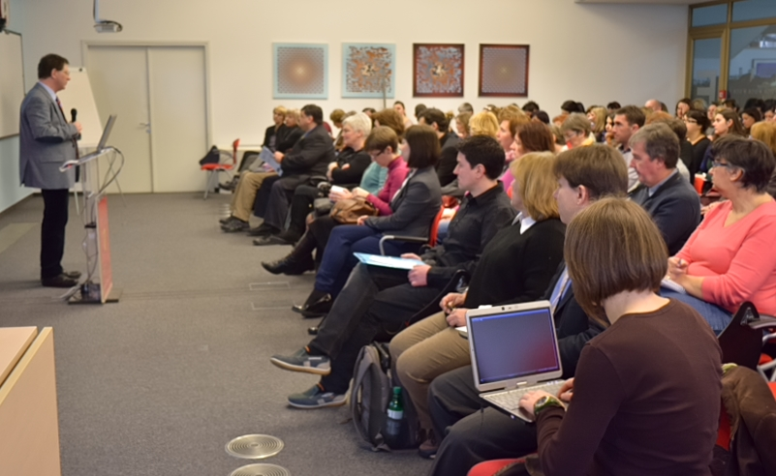
Context
2006
HRČAK (https://hrcak.srce.hr)
530 OA journals & 270.000 OA papers
2012
Croatian OA Declaration
2013
The Scientific Activity and Higher Education Act - requires universities and higher education institutions to permanently publish theses and dissertations in public databases (institutional repositories?)
2014
Digital repositories day
6-7 institutional repositories in Croatia
Notes:
DDR 2014/03
OpenDOAR/2014: 6 repositories from Croatia: Hrčak, FOI, FFZG, MEF, FULIR, DIZBI

Slide 3
The DABAR project
June 2014 - 3 main goals:
National infrastructure for digital repositories
scalable, interoperable, sustainable, flexible and suited for long term preservation
SaaS
Community
information needs, application profiles, controlled vocabularies, education and user support
Promotion of OA
August 2015 – production
Support for the object graduation thesis

Slide 4
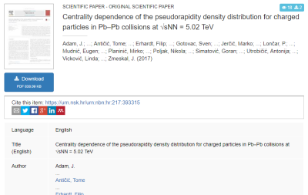
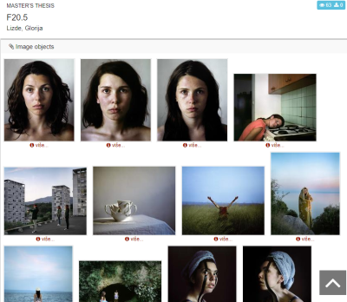
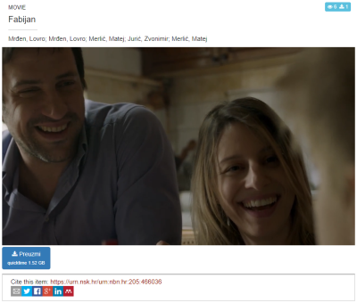
16 (nationaly agreed) digital objects
Journal articles
Papers published in proceedings
Books
Book chapters
Conference abstracts and presentations
Theses
Artistic theses
Dissertations
Appendices
Photographs
Audio objects
Audio-visual objects
Educational resources
Research data (datasets)
Other documents (plans, deliverables,…)
Virtual collections
Notes:
Metadata agreed on a national level
https://urn.nsk.hr/urn:nbn:hr:205:258541 (photo)
https://urn.nsk.hr/urn:nbn:hr:205:466036 (video)
https://urn.nsk.hr/urn:nbn:hr:205:126638 (audio)

Slide 5
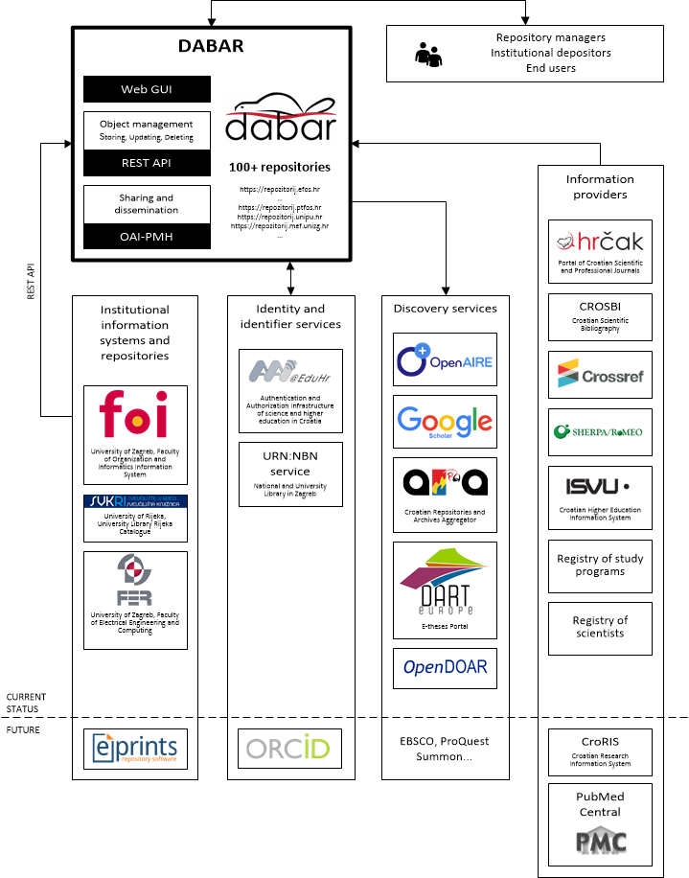
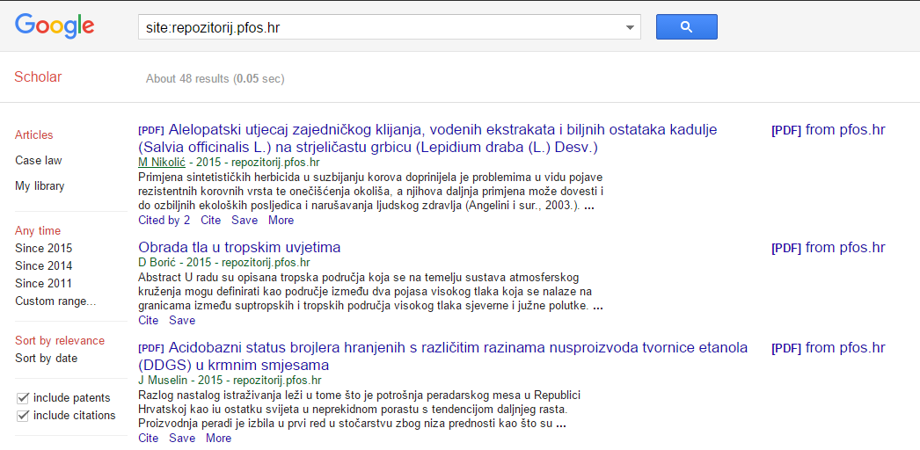
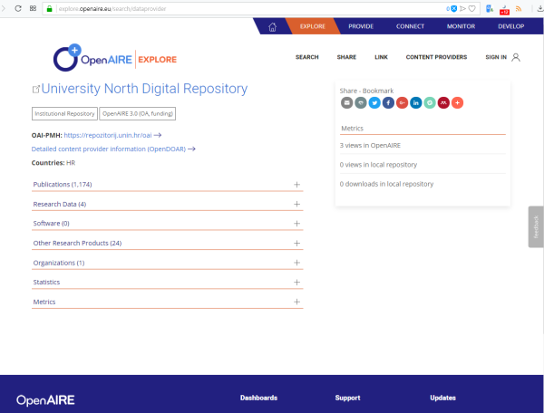
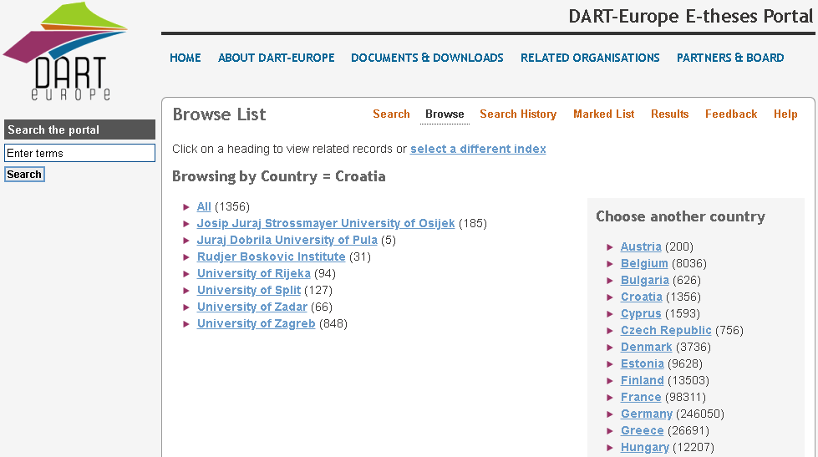
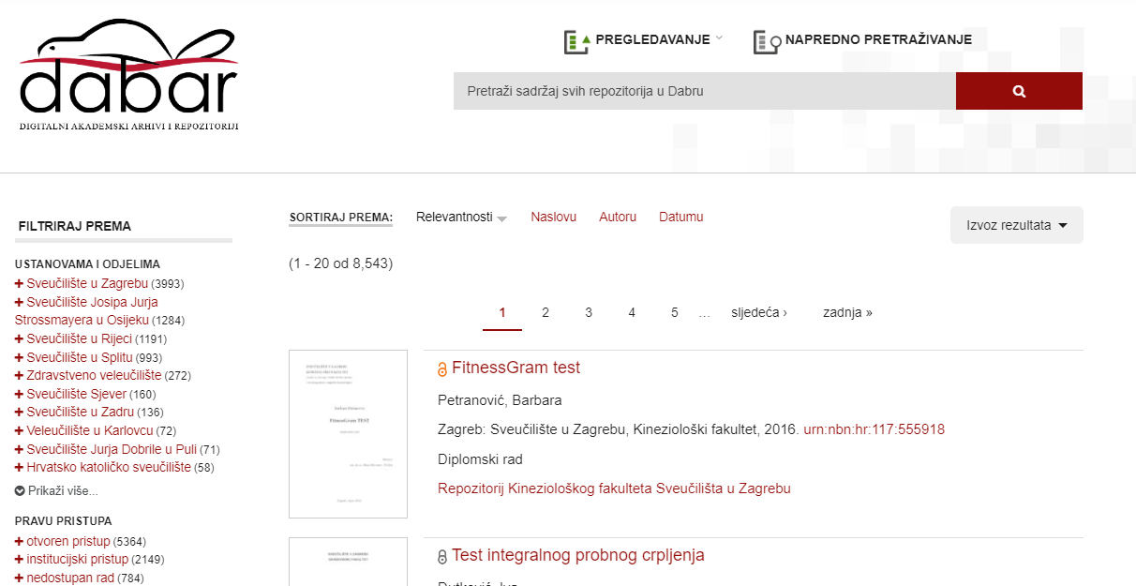
Interoperability
DABAR’s integration with national and global e-infrastructure (2019)

Slide 6
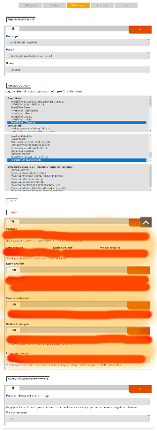
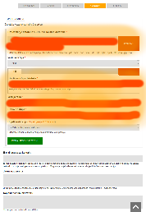
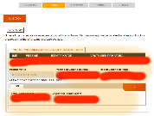
Rich metadata & efficiency
HRČAK (OAI-PMH, KBART)
CROSBI (Web/MODS)
DOI/CrossRef (API)
Sherpa / ROMEO
AAI@EduHr
URN:NBN
CroRIS (Registry of Scientists,…)
Croatian Higher Education Information System (ISVU)
Registry of Study Programs
AAI@EduHr
URN:NBN
Notes:
MeSH (Medical Subject Headings)
UDC (Universal Decimal Classification)

Slide 7
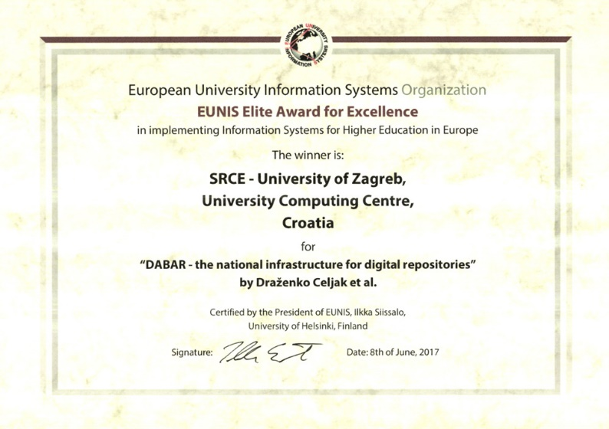
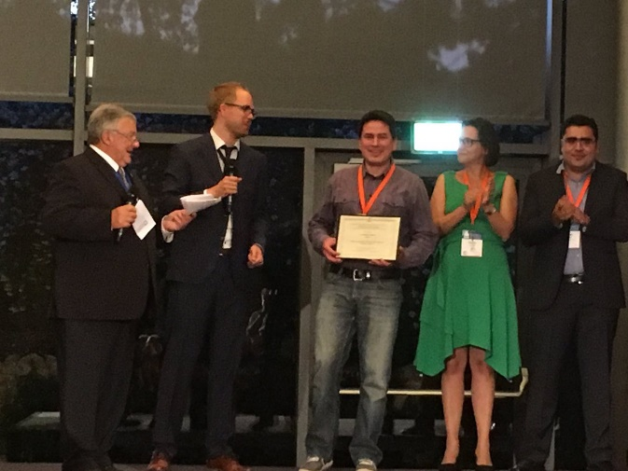
EUNIS Elite Award for Excellence in 2017 ☺☺☺

Slide 8
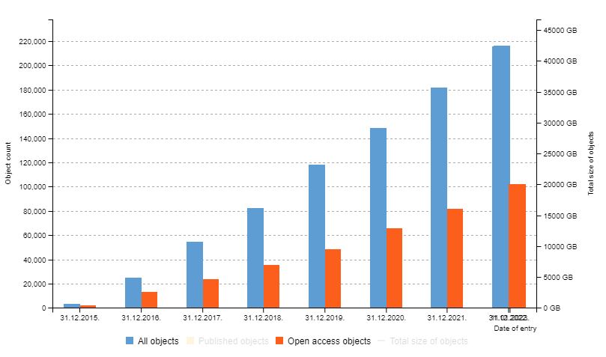
DABAR – Digital Academic Archives and Repositories
January 2023:
159 digital repositories
all 10 public universities
2 national repositories
209.900+ digital objects
48,7% OA
Notes:
7,5 years

Slide 9
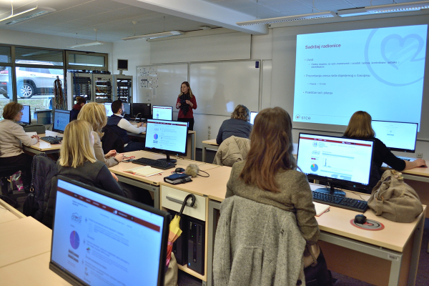
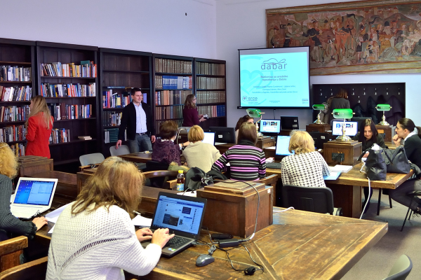
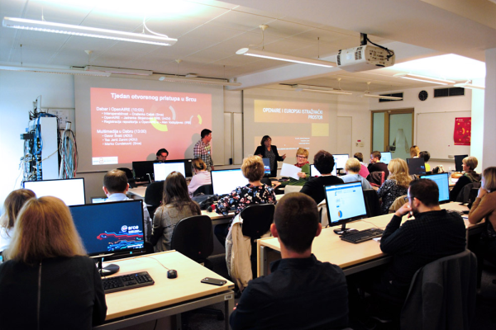
Trainings
48 workshops for repository managers in
Zagreb, Rijeka, Osijek, Split & Dubrovnik
with ~500 participants
Topics:
Introduction to repositories in DABAR
Journal articles in DABAR
DABAR & OpenAIRE
Multimedia in DABAR
Research dana sharing

Slide 10
DABAR – Organisational aspects
March 2016. - memorandum of understanding:
SRCE
Ruđer Bošković Institute
University of Zagreb School of Medicine
University of Zagreb Faculty of Humanities and Social Sciences
National and University Library in Zagreb
SRCE
Data management department (7-10 people)
DABAR team is a subset of DMD
Many hats: HRČAK, PUH (cloud storage), RDA national node, Open Science trainings, Croatian Web Archive,…
10 working groups:
Theses and dissertations
Scientific and related works
Image, audio and video content
Interoperability
Long-term preservation
User functionality
Copyright
Education & Support
Research Data
Educational Resources
29 institutions
Notes:
Direct the developement

Slide 11
Technical aspects - software platform?
Notes:
Requirements:
Repository on the institutions domain
One platfrom many repositories
Virtual repositories (flexibility)
No need for a dedicated technical support for the repository at the institution

Slide 12
Technical aspects - software platform
multisite
https://github.com/alen-z/open-source-stamp.git
Notes:
Open infrastructure

Slide 13
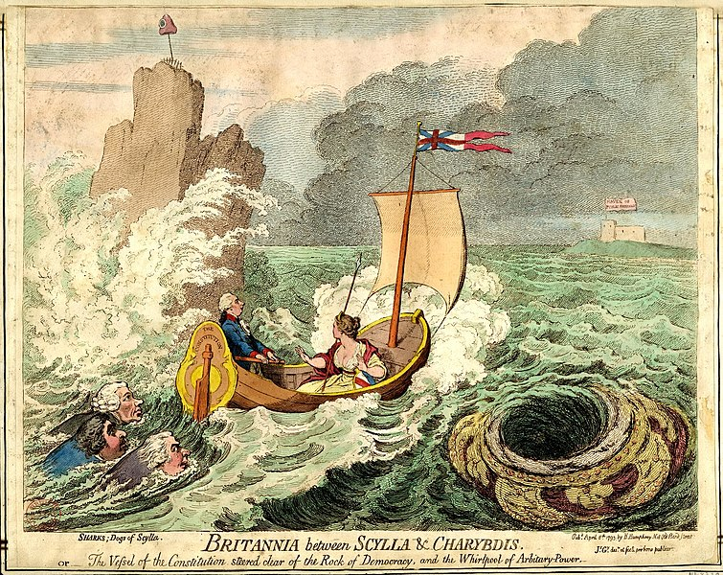
Technical aspects - challenges
2022
Drupal 7 EOL
Drupal (Islandora) 7 > 8 migration FAIL
Dilemmas
Drupal vs. development of our solution (based on PHP/Laravel) on top of Fedrora
Notes:
https://en.wikipedia.org/wiki/Between_Scylla_and_Charybdis#/media/File:GillrayBritannia.jpg

Slide 14
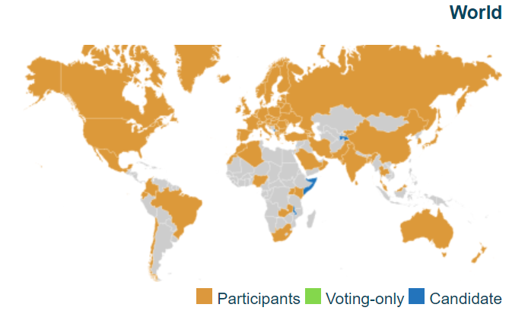
Current activities & plans
Ongoing:
Analytics for Dabar: custom analysis of repositories content
Promotion of research data sharing and FAIR principles
Findable (PID, rich metadata, search funct., services)
Accessible (HTTP)
Interoperable (open formats, MODS/DC/DataCite, links)
Re-usable (License, domain standards?)
Plans for 2023:
CoreTrustSeal certification of repositories
Support for new digital object: research software
Improve support for ERIC-s (eduGAIN authentication)
Notes:
Map source: https://technical.edugain.org/status
https://edugain.org: „eduGAIN interfederation service connects identity federations around the world, simplifying access to content, services and resources for the global research and education community”

Slide 15
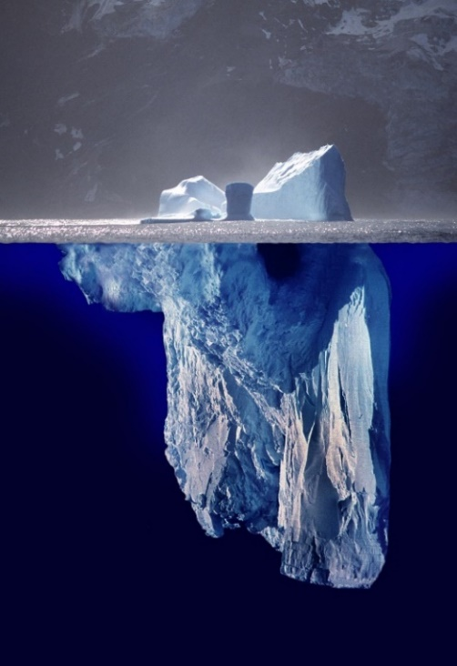
Conclusion?
200.000+ digital objects
100.000+ OA
...
-------------------------------
Academic integrity
Visibility
Cooperation
Sustainability
...
Created by Uwe Kils (iceberg) and User:Wiska Bodo (sky). [CC BY-SA 3.0 (http://creativecommons.org/licenses/by-sa/3.0/)]
Notes:
No dilemmas about the need for national/common infrastructure
https://commons.wikimedia.org/wiki/File:Iceberg.jpg
Created by Uwe Kils (iceberg) and User:Wiska Bodo (sky). [CC BY-SA 3.0 (http://creativecommons.org/licenses/by-sa/3.0/)]

Slide 16
Thank you!
dabar@srce.hr
https://dabar.srce.hr/

