Slide 1
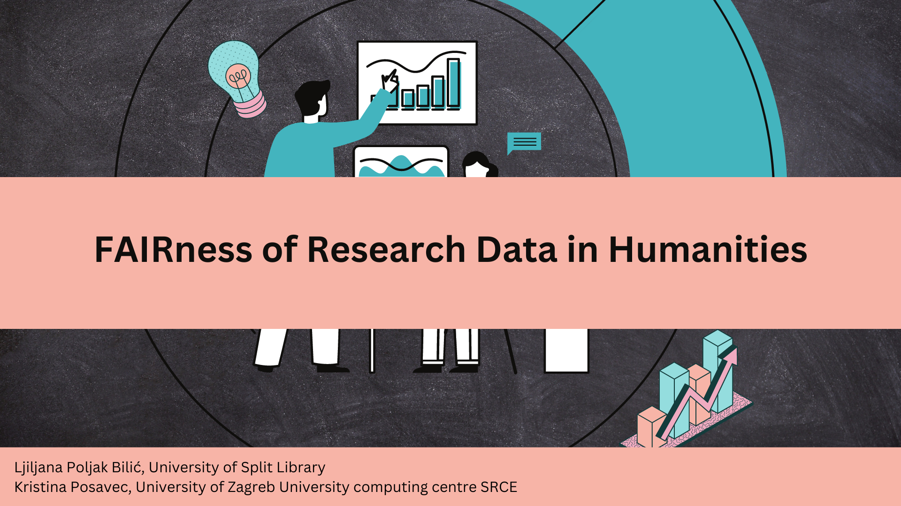


Slide 2
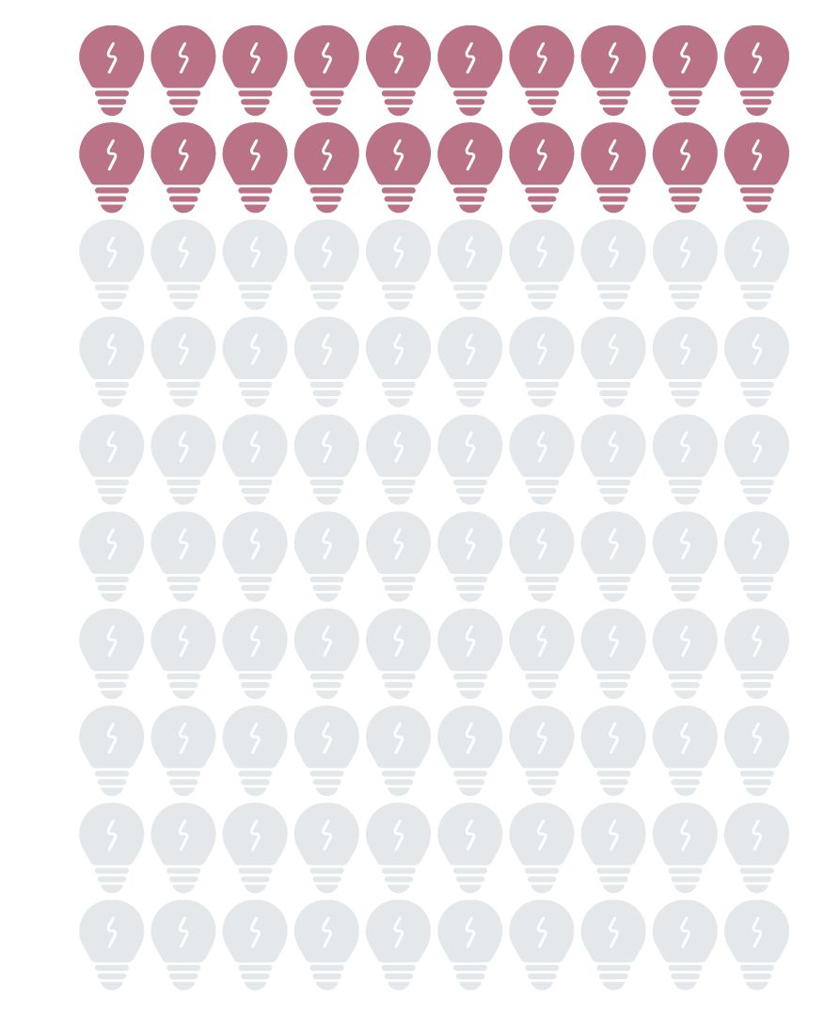
(Research) Data in humanities?
Ambiguity of term/concept (Unsworth et al. 2006, Borgman 2009, Edmond & Tóth-Czifra, 2018):
  source vs data
  the concept of research data is understood differently by the scientists from different fields and authors vs. readers
  data as blanket term
”When is data?” instead of “What is data?”
DH data types:
• print paradigm publications
• electronic paradigm publications
• single or collected/curated primary sources
• software
•[patents/licenses]
• [ephemera, such as exhibitions and performances] (Edmond, 2019)
Humanities data types:
publications
other primary sources (manuscripts, artworks)
digital representation of cultural objects
events, websites
software
documentation
standards
digital infrastructures personal data
corpora
born-digital artifacts (e.g., tags, associations, texts) (Gualandi, Pareschi, Peroni, 2022)
SSH data types:
text samples
• tables
• images
• maps
• photographs
• statistics
• graphs, figures, charts, visualisations)
• databases
• timelines
• audio-visual media (Prost et al., 2015)
Notes:
Research data in the humanities is the most diverse of all scientific disciplines because almost any data on human activity can be considered research data, such as newspapers, photographs, diaries, court files, etc. So, the source, or the research phenomena itself is often the evidence, so the boundary between research source and research data is quite blurry, and needs to be clarified. On the other hand, the term data itself is not very popular with the humanities and often is stereotyped as something that belongs to STEM fields, which is common misconception. The many things that would be seen as data in another discipline are often called something else in the humanities. One interesting point from literature regarding terminology is that there is resistance in using the blanket term ‘data’ because there is more and precise terminology available in humanities to describe and make transparent the research processes(e.g. primary sources, secondary sources, theoretical documents, bibliographies, critical editions, annotations, notes, etc.). So, C. Borgman finds that in humanities the question when something is data is more appropriate than to ask what is data, because it usually involves the process by which a scientist recognizes that an observation, object, record, or other entity can be used as evidence of phenomena and then collects, acquires, presents, analyzes and interprets these entities as data.

Slide 3
Research methodology
Sample:
Repositories: CROSSDA, DABAR, OPENAIRE
Subject category: Humanities: philosophy, theology, philology, history, art history, art science, archaeology, ethnology and anthropology, religious studies, and interdisciplinary humanities
Type of object: Research Data / Dataset
Methodology:
Searching and retrieving datasets
Data analysis
A priori coding (Connaway & Radford, 2021); Attribute / Framework Matrix Coding (Saldaña, 2013) with codes:
name of the repository, scientific field, dataset title, dataset type, openness, licence, read-me file, file format, downloads No, citations No, methodology, PID, Findable score (FS), FS FAIR level, Accessible score (AS), AS FAIR level, Interoperable score (IS), IS FAIR level, Reusable score (RS), RS FAIR level, FAIR level overall, FAIR %
Two independent researchers analyzed the data; in the second stage, a consensus was reached in case there were any different values applied
Notes:
The research was conducted for humanities fields, which includes philosophy, theology, philology, history, art history, art science, archaeology, ethnology and anthropology, religious studies, and interdisciplinary humanities science. Analyzed datasets were published in CROSSDA, DABAR, and Openaire repositories.
After searching and retrieving data sets, each data set was analyzed independently by both researchers, and they were assigned by the name of the repository, scientific field, etc.

Slide 4
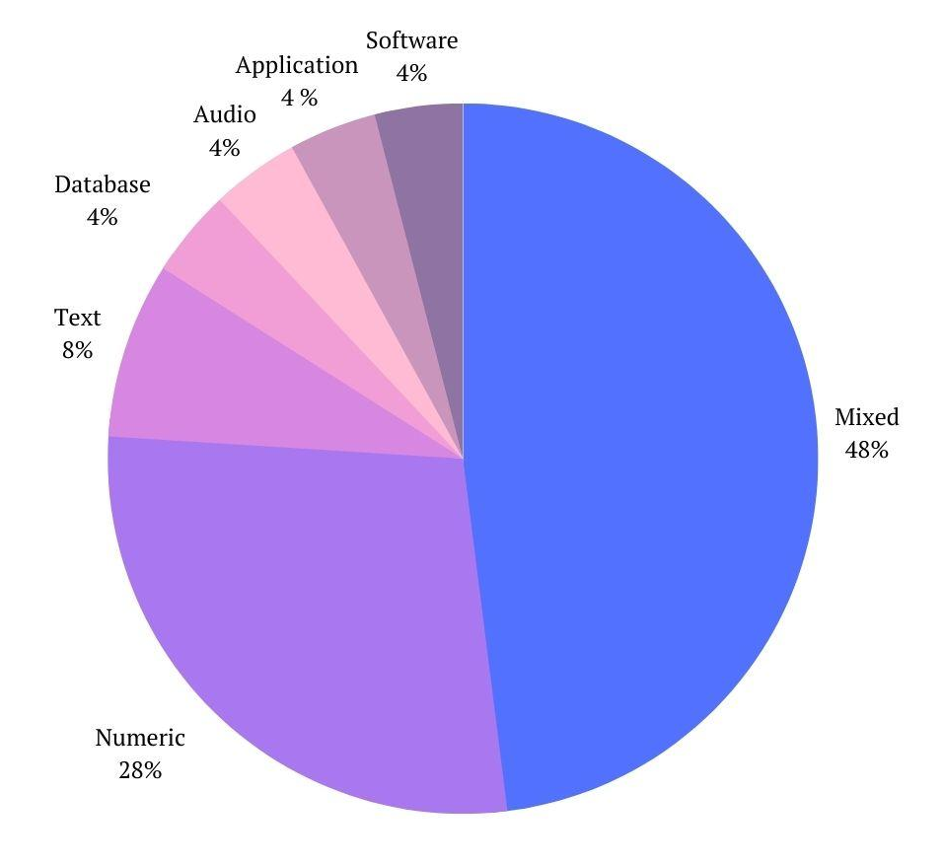
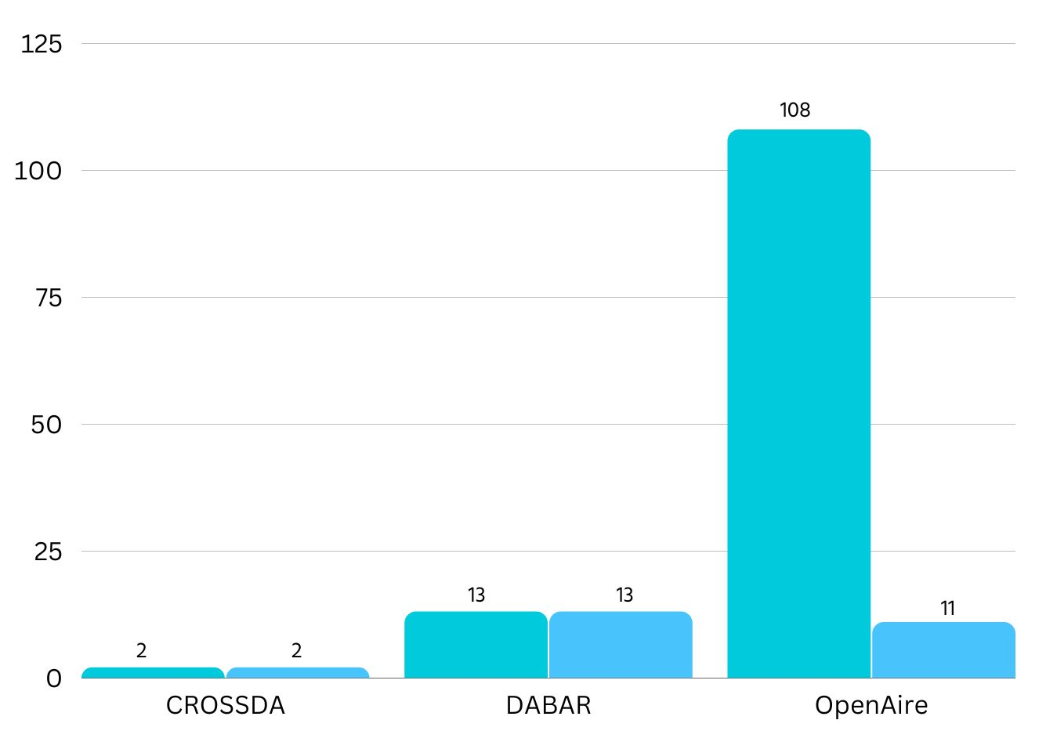
RQ1: What types of research data are represented in humanities?
DARIAH-DE: Research data in humanities as all those sources/materials and results collected, written, described, and/or evaluated in the context of a research and research question in the field of human and cultural sciences and in machine-readable form for the purpose of archiving, citation and for further processing.
Notes:
While the question of defining research data in the humanities is still under discussion, for the purpose of this research, we choose DARIAH DE definition of RD:
“DARIAH-DE defines research data in humanities as all those sources/materials and results collected, written, described, and/or evaluated in the context of a research and research question in the field of human and cultural sciences and in machine-readable form for the purpose of archiving, citation and for further processing.”
The definition is broad on purpose, which is to encompass the particularities of research in the humanities and the heterogeneity in what research data entails.
So, research data types can be various, such as text samples, tables, images, maps, databases, and so on. But, based on this definition, research data is not the publication or research article.
From our sample, we have gathered 123 objects stored as datasets, but only 20 % were actual datasets, and the rest were research papers. Among 25 of the actual datasets retrieved, the majority of them were mixed types (mostly numeric and textual data). Besides them, there are also software, databases, audio files, and applications.
numeric, text (n=9)
text, code, numeric, document (n=1)
text, audio (n=1)
numeric, graphic (n=1)

Slide 5
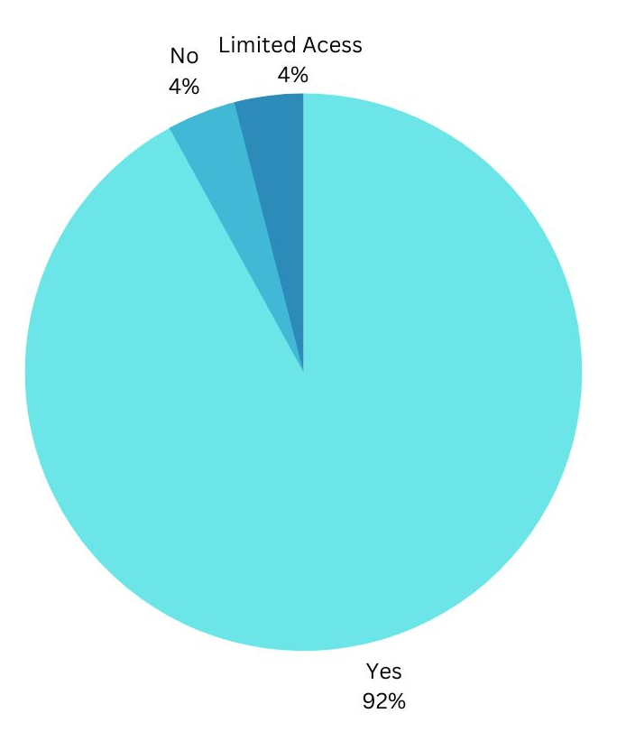
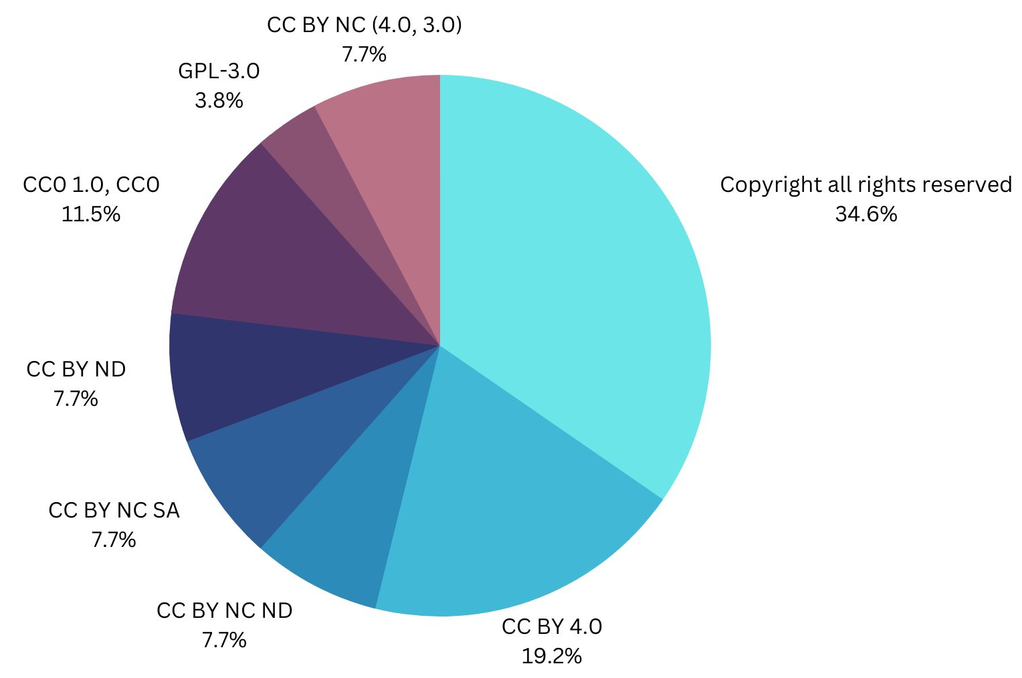
RQ2: To what extent are datasets in the field of humanities represented in repositories by level of openness and under which license?
Notes:
Although almost all of the data is openly accessible, there are still some restrictions on reuse. The majority of datasets are licensed with copyright. CC BY is one of the less restrictive licenses, represented in 20 % of the datasets as the second most popular license in this sample. 12% of datasets are marked with ccO, which serves as a public domain dedication tool and is the most suitable for research data.

Slide 6
RQ 3 To what extent does research data align with FAIR principles?
The evaluation of datasets FAIRness was conducted using the FAIR Data Maturity Model developed by RDA Working Group “FAIR Data Maturity Model”
The tool used for FAIR assessment is F-UJI a web service for assessing datasets and it is based on metrics developed by the FAIRsFAIR project which are proposed by the RDA FAIR Data Maturity Model Working Group.
Assessment is based on:
URL or persistent identifier of dataset
aggregated metadata:
  embedded in the data (landing) page
  retrieved from a PID provider.

Slide 7
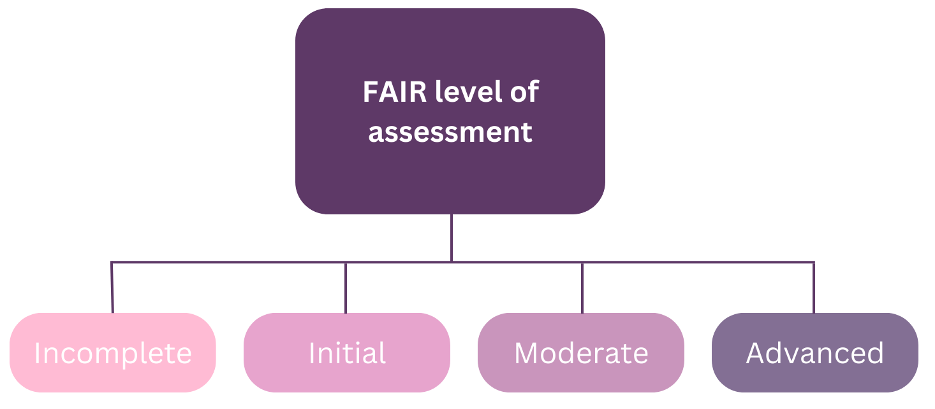
RQ 3 To what extent does research data align with FAIR principles?
Assessment metrics implemented in F-UJI tool:
Findable
Data is assigned a globally unique identifier.
Data is assigned a persistent identifier.
Metadata includes descriptive core elements.
Metadata includes the identifier of the data it describes.
Metadata is offered in such a way that it can be retrieved programmatically.
Accessible
Metadata contains access level and access conditions of the data.
Data is accessible through a standardized communication protocol.
Metadata is accessible through a standardized communication protocol.
Interoperable
Metadata is represented using a formal knowledge representation language.
Metadata uses semantic resources.
Reusable
Metadata specifies the content of the data.
Metadata includes license information under which data can be reused.
Metadata includes provenance information about data creation or generation.
Metadata follows a standard recommended by the target research community of the data.
Data is available in a file format recommended by the target research community.
Notes:
Each FAIR element is assessed based on metrics which are visible in list.
Source: Anusuriya Devaraju, & Robert Huber. (2020). F-UJI - An Automated FAIR Data Assessment Tool (v1.0.0). Zenodo. https://doi.org/10.5281/zenodo.4063720

Slide 8
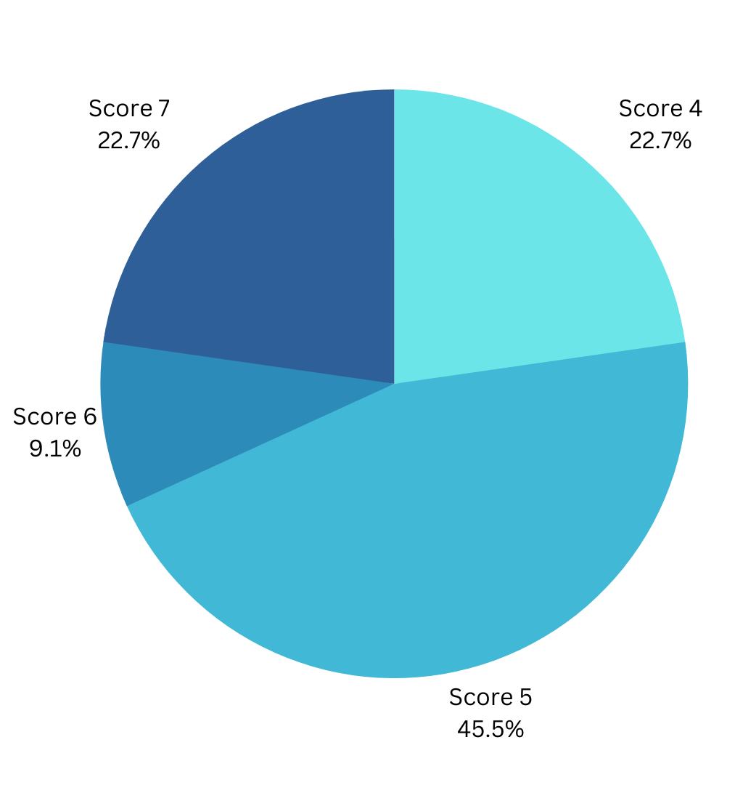
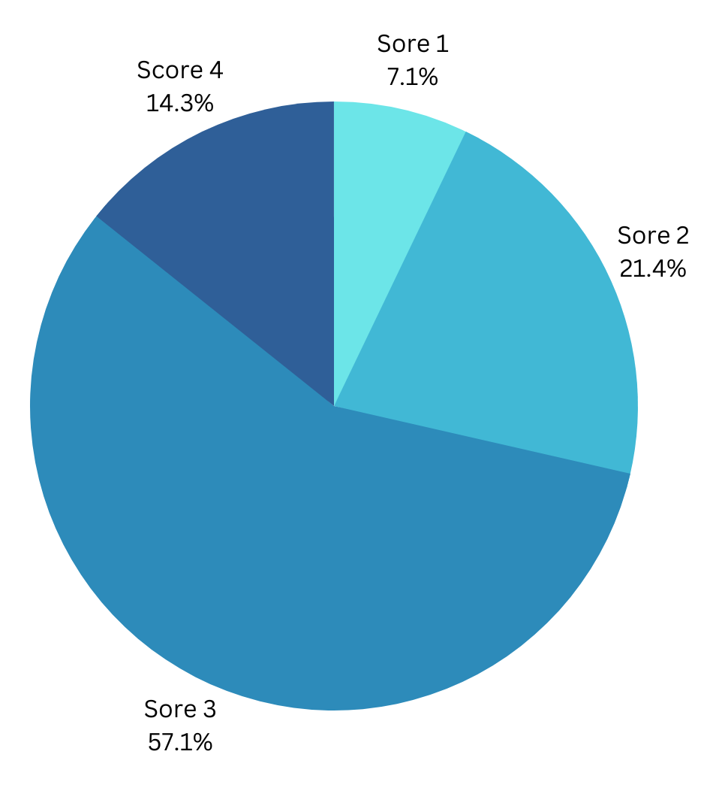
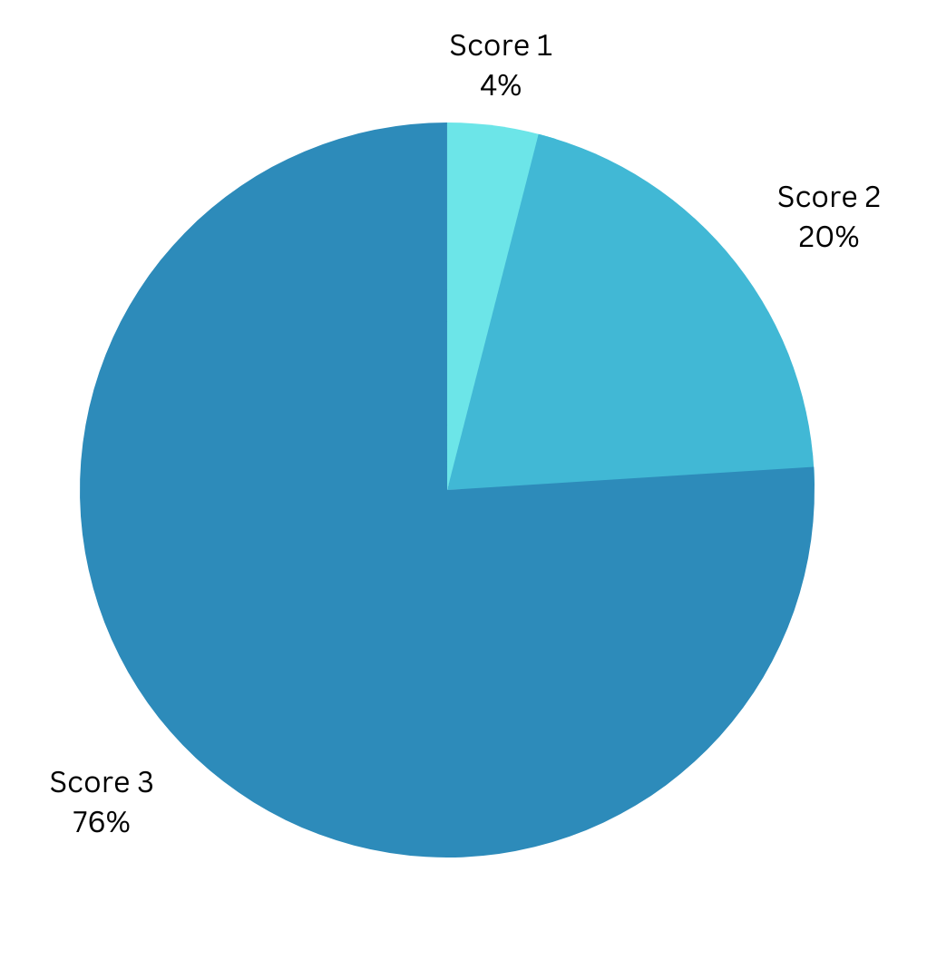
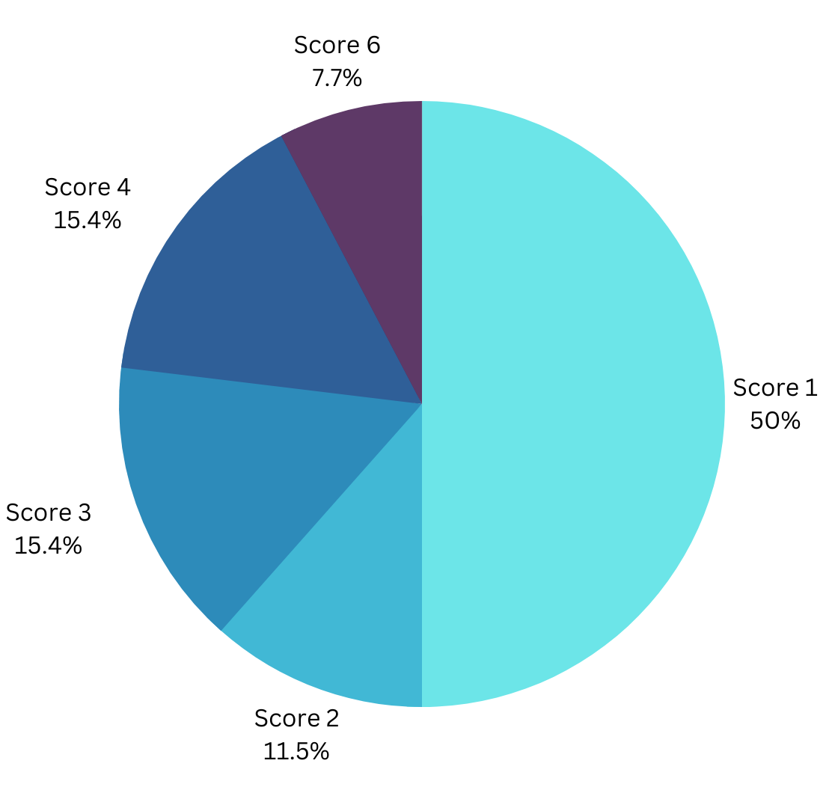
RQ 3 To what extent does research data align with FAIR principles?
A
R
F
I

Slide 9
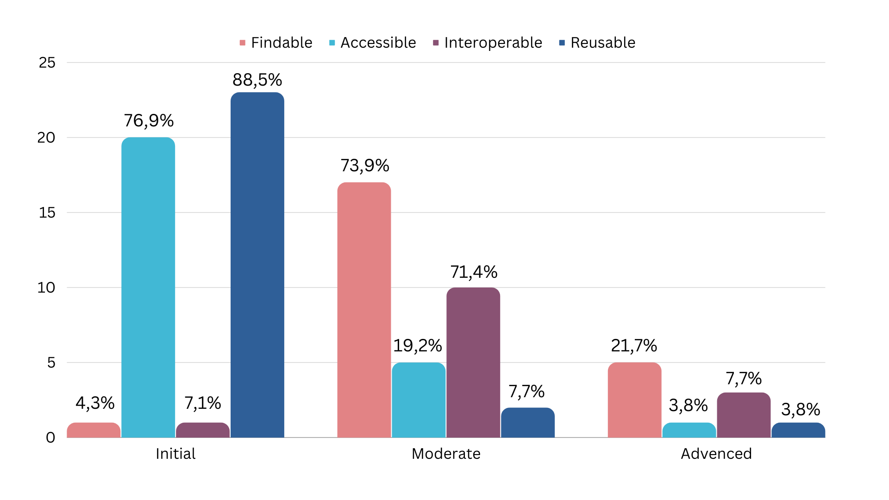
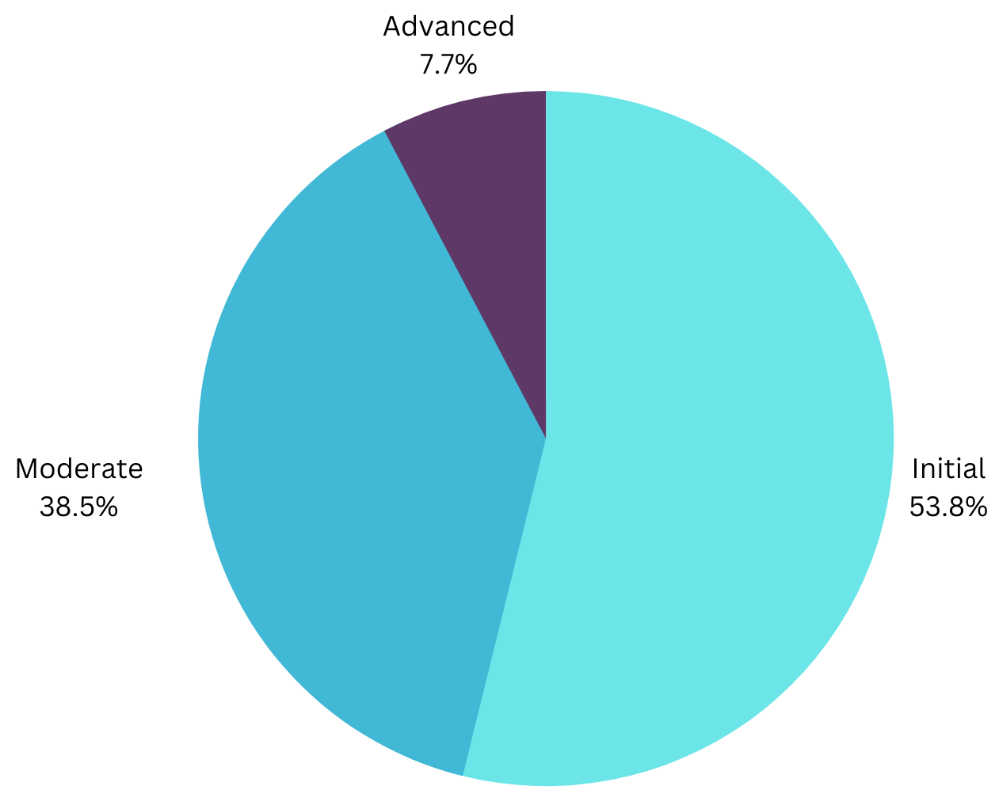
RQ 3 To what extent does research data align with FAIR principles?

Slide 10
Conclusion
RQ1: What types of research data are represented in humanities?
123 objects are stored as data sets, but only 20 % are actual datasets
Majority (48%) are mixed-type data sets which contains textual and numerical data and 28% are numerical datassets
RQ2: To what extent are data sets in the field of humanities represented in repositories by level of openness and under which license?
92% of datasets are openly available but 34,6% are licensed with copyright all right reserved
11,5% of datasets have CCO licenses which serves as a public domain and is the most suitable for research data
RQ3: To what extent does research data align with FAIR principles?
all data sets are aligned with FAIR principles
majority of datasets (53,8%) are on initial FAIR level, just one data set has highest FAIR score with 83%
the most frequent percentage of FAIR level is 29% which is equivalent to initial FAIR level
Notes:
(npr. istaknuti incijative kao što su Lexicographic Data Seal of Compliance, koji se više fokusiraju na datasetove nego metapodatke, jer prema našim rezultatima FAIRnessa tu ima mjesta za napredak;
Toth-Czifra- Humanities RD data – problem is not openess, but lack of transparency and proper documentation – naši rezultati to potvrđuju (https://figshare.com/articles/presentation/FAIR_from_the_perspective_of_the_Humanities_V2_pptx/8342585)

Slide 11
Limitations and future research
Limitations
difficulties in finding datasets from humanities
large number of objects is stored in repositories as datasets but further analysis shows that majority are not datasets but research papers
limited filter and search option in repositories
in this research authors conducted analysis of 3 databases: DABAR, CROSSDA and OpenAIRE
use of different FAIRness tool could provide different results
automated testing with F-UJI tool depends on clear machine assessable criteria and some aspects (e.g. rich, plurality, accurate, relevant) specified in FAIR principles still require human mediation and interpretation
F-UJI tests are designed in consideration of generic cross domain metadata standards such as dublin core, dcat, datacite, schema.org and conduct only cursory examination
Future research
research could be conducted on a larger scale with more databases and repositories
Notes:
Istaknuti poteškoće koje smo imale pri pretraživanju podataka (Buddenbohm et al. (2016) note that a culture of sharing and reusing research data has not yet been established; although research data are to some extent stored in repositories, they are difficult to find)
velik broj objekata kategoriziran kao skup podataka, ali je samo rad/Dokument, što je posebna kategorija objekta pri pohrani, no moguće je da potvrđuje jedan od temeljnih problema istraživačkih podataka u humanistici- razlikovanje primarnih i sekundarnih izvora, odnosno razliku između izvora za istraživanje i istraživačkog podatka (Iz sažetka: In the humanities, research data are the most diverse of all scientific disciplines because almost any data on human activity can be considered research data, such as newspapers or photographs, so the boundary between data and publication is very vague (Borgman, 2008; Thoegersen, 2018).)
Since all FAIR assessment tools and their underlying metrics look at slightly different aspects of the original FAIR principles and the digital objects it evaluates, it is recommended to use several of these tools to get the most complete impression of the FAIRness of any given unit. The following approach might be beneficial:
● First, one should get a rough overview of the accessibility and preparation of an object to be tested.
● After that, it is useful to use a self-assessment tool to highlight and understand the human aspect(s) of facilitating FAIR digital objects
● Then, use an automated tool (e.g. F-UJI) to test the machine-friendliness of the offering. (https://zenodo.org/record/8224360)

Slide 12


