Slide 1
Open online courses and MOOCs for students’ extended learning experience
University Computing Centre (SRCE)
University of Zagreb
Sandra Kučina Softić, Tona Radobolja, Tea Čičko
16th annual International Conference of Education, Research and Innovation Seville (Spain). 13th - 15th of November, 2023.

Slide 2
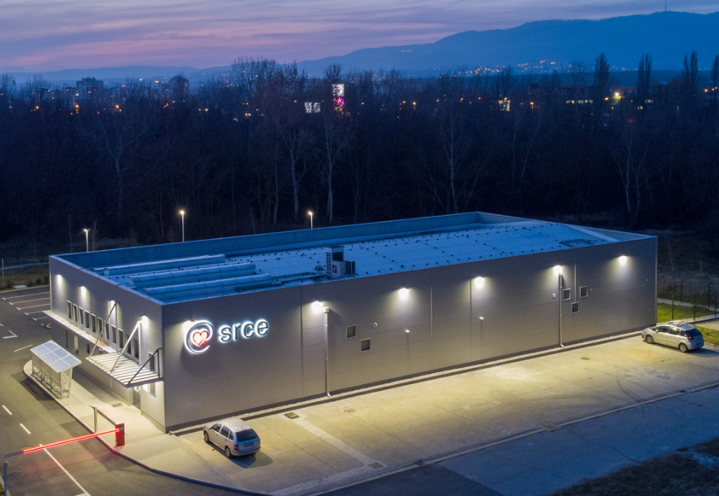
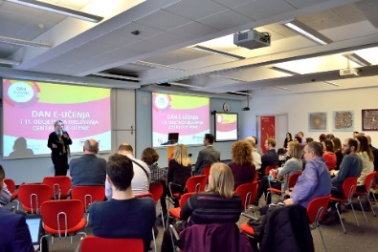
University Computing Centre SRCE
https://www.srce.unizg.hr/en
established in 1971
is computing centre and the architect of the e-infrastructure of the entire system of science and higher education of the Republic of Croatia
competence centre for Information and Communication Technologies as well as the centre for education and support in the area of ICT application

Slide 3
National Centre for E-learning in Higher Education
www.srce.hr/enc
E-learning Centre@SRCE
established in 2007
to support institutions, teachers and students in the use of e-learning technologies and tools
provides infrastructure, usage support and user education
a key stakeholder in the process of digital transformation of the higher education system
Basic objectives:
to support higher education teachers, students, e-learning teams and institutions
to provide and maintain a reliable and generally accessible university platform for e-learning
to support the university network of people involved or interested in e-learning
to promote and foster the implementation of e-learning

Slide 4
E-learning Centre@SRCE
E-learning platform for HE
state-of-the-art
e-learning system tailored to user needs
Academic e-portfolio
for personal use, for presentation or as a learning activity
Webinars
For online lectures, presentations, seminars, consultations
Adobe Connect
Edumeet
E-course Catalogue
of HEI in Croatia
a central place to find basic information about all e-courses
Promoting Open Access and OER
all educational materials develed in SRCE in Open Access
SRCE Open education portal
Antiplagiarism software
for checking students work, theses and doctoral dissertations
by students and teachers

Slide 5
The overall objective of the DIGinLaw project is to advance the utilization of digital technologies in higher education in law.
providing quality training on digital competences addressed to law professors and lecturers
providing high-quality training on digital competences to law students
development of 12 high-standard e-learning courses in law (MOOCs)
foster open access research areas addressing issues of digitalization of legal education and law
Erasmus + project 2020-1-HR01-KA226-HE-094693
Duration: April 2021 – September 2023
URL: https://www.pravos.unios.hr/diginlaw

Slide 6
Development of MOOCs – SRCE support and feedback
Strategy to support teachers
„Digital Competences of Higher Education Teachers for Innovative Teaching Practices”– July, 2021.
„Digital Competences for Lifelong Learning for Law Students” – July, 2022.
MOOCs development
Qualitative research
First MOOCs participants – first feedback to teachers
SRCE evaluation of MOOCs -improvement following feedback
know your participants
tailor made training
course development form
course template
online consultations
feedback on the experience of MOOC preparation and development
Teacher training workshops
MOOC for Teachers

Slide 7
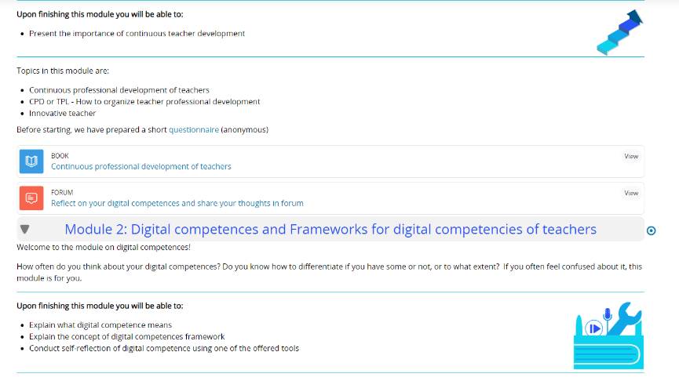
This course consists of 5 modules:
What is continuous professional development and why it is important?
Digital competencies and Frameworks for digital competencies of teachers
How to develop an e-course using Moodle?
Implementing learning outcomes in Moodle
Role of teacher in the technology-enhanced learning
The course is self paced and free.

Slide 8
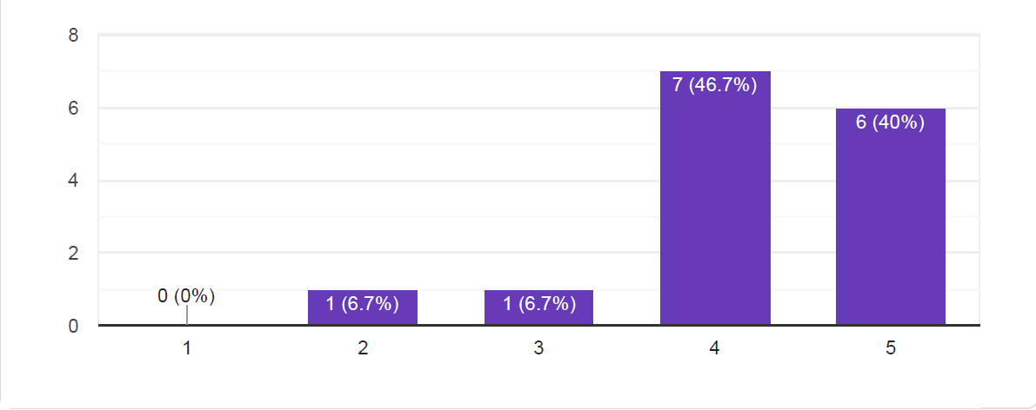
What is your overall evaluation of the training? (Scale from 1 to 5 with 5 as the highest and 1 as the lowest grade)

Slide 9
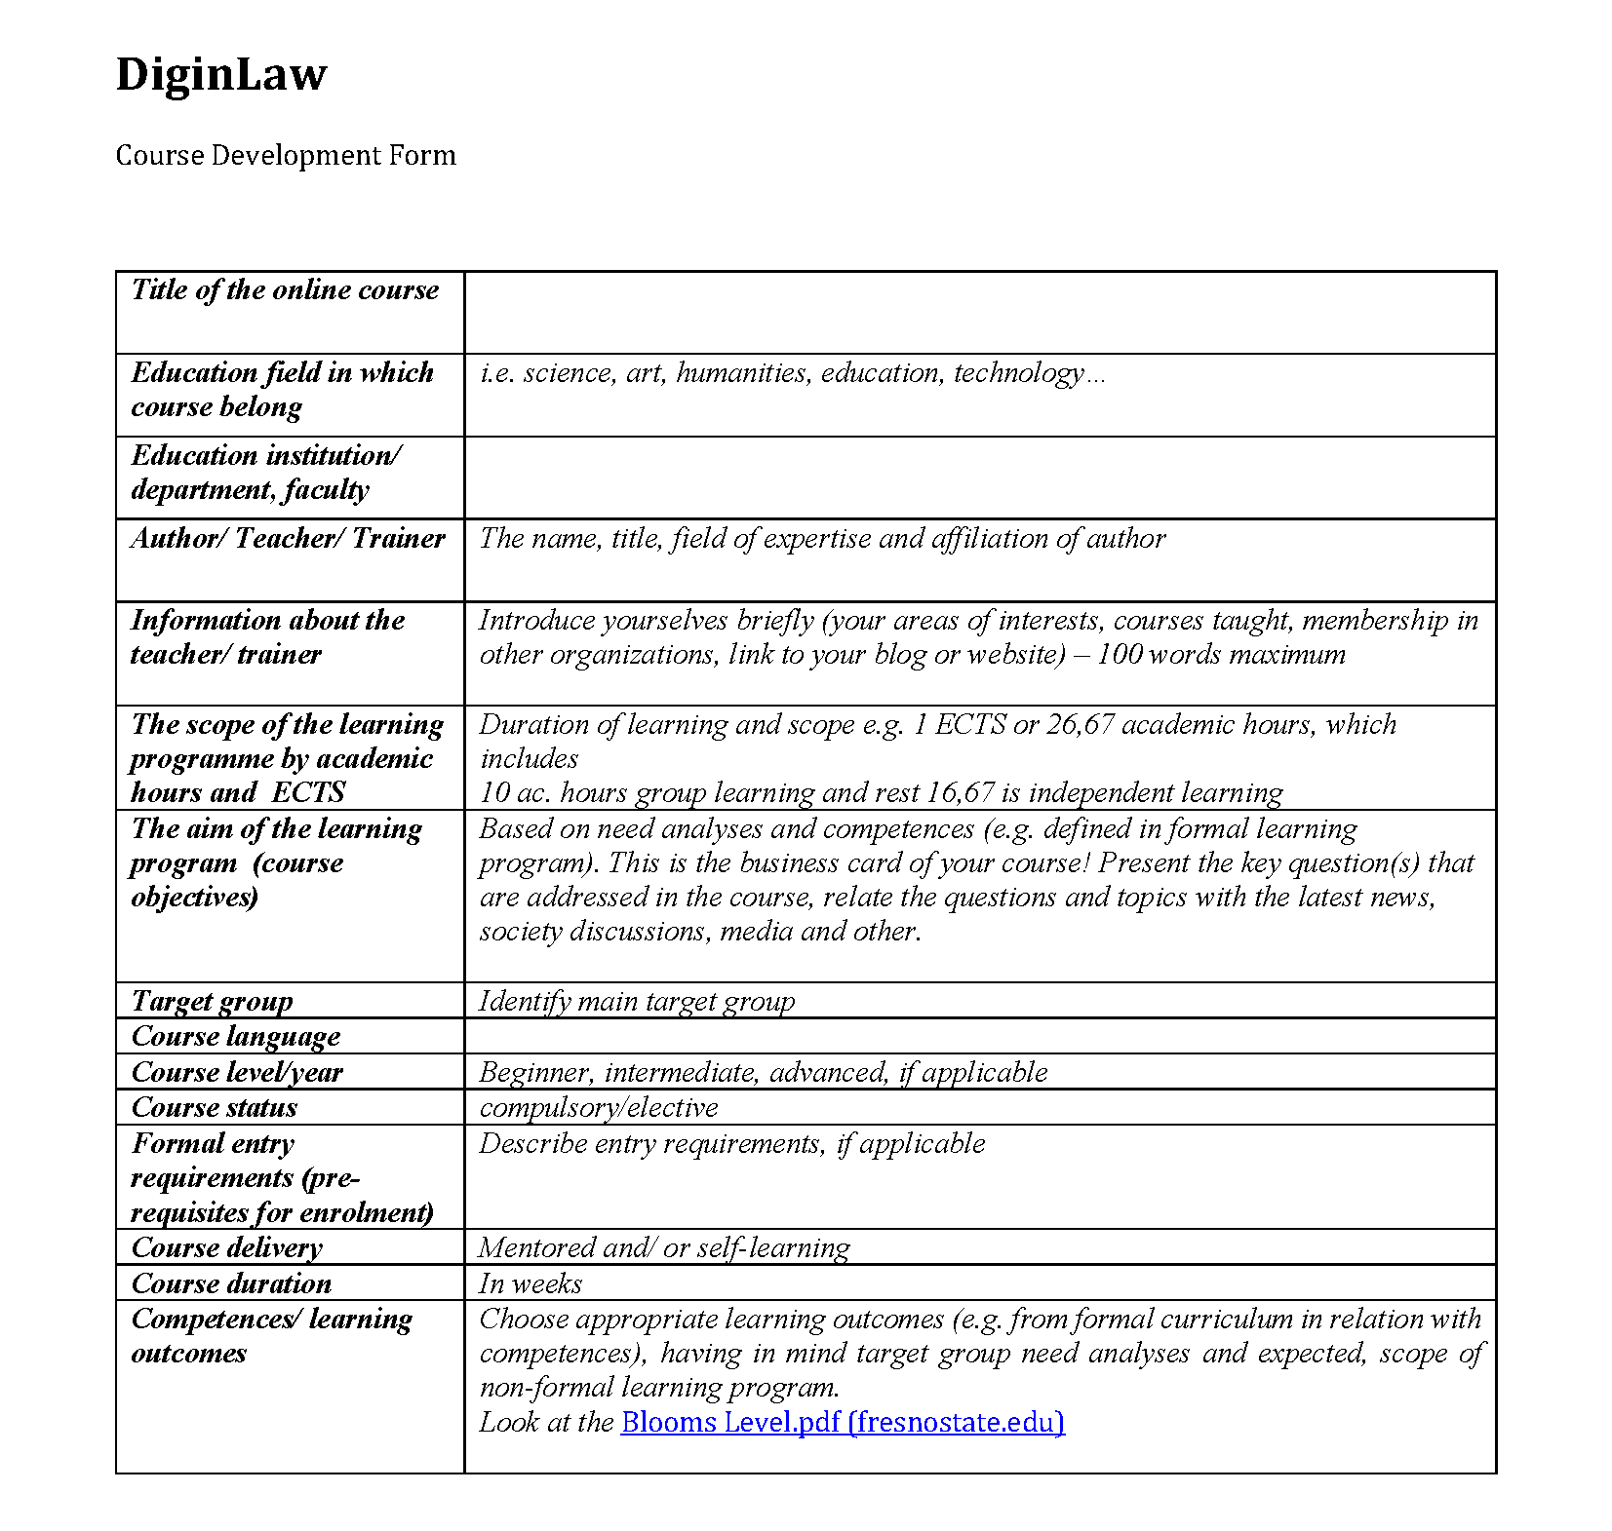
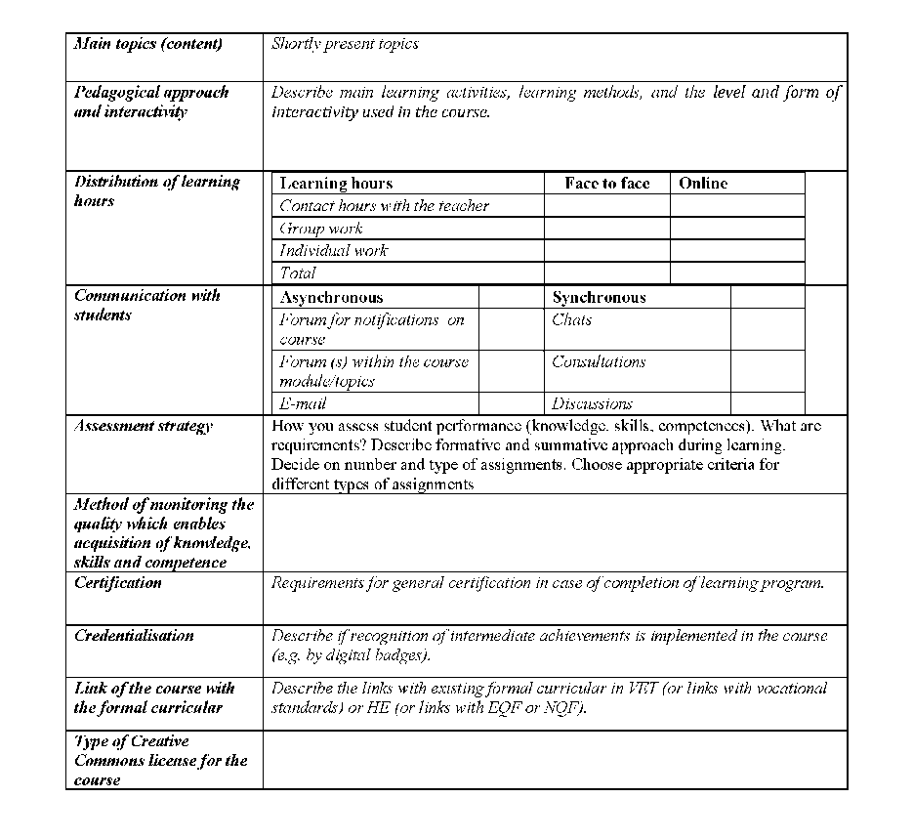

Slide 10
Course template
Guide on how to develop an online course
Recommended resources and activities
Important course/teacher information
Course design
Description of the implemented multimedia

Slide 11
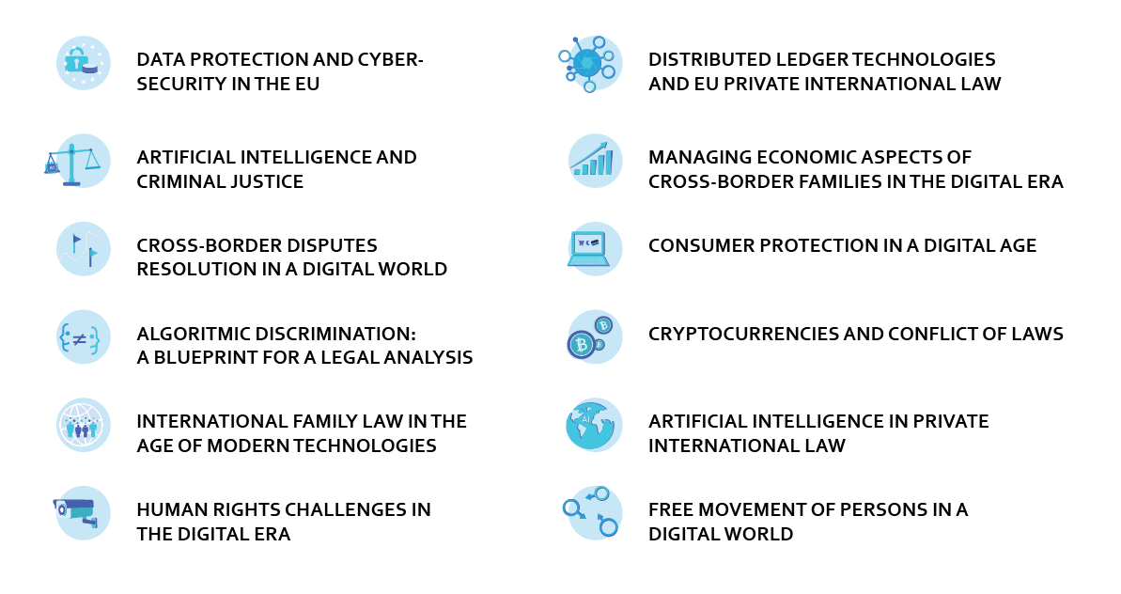
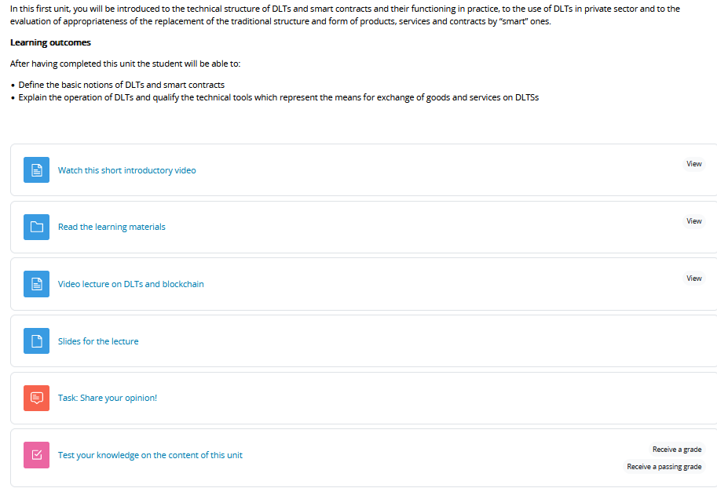
Results

Slide 12
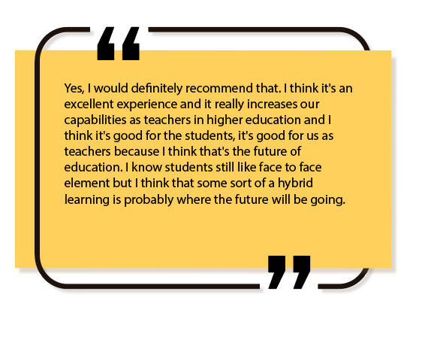

Slide 13
E-Learning Centre University Computing Centre University of Zagreb www.srce.hr/ceu diginlaw@srce.hr
Our model is applicable for others, so we would be happy to share our experience if you’re interested!

