Slide 1
In Search for Support – Why Organized Support Units in E-learning is Important to Teachers and in Digital Transformation
Sandra Kučina Softić, PhD. M.Sc. in Digital Education
Assistant Director
University of Zagreb University Computing Centre (SRCE)
sskucina@srce.hr
Berlin, November 23rd, 2023

Slide 2
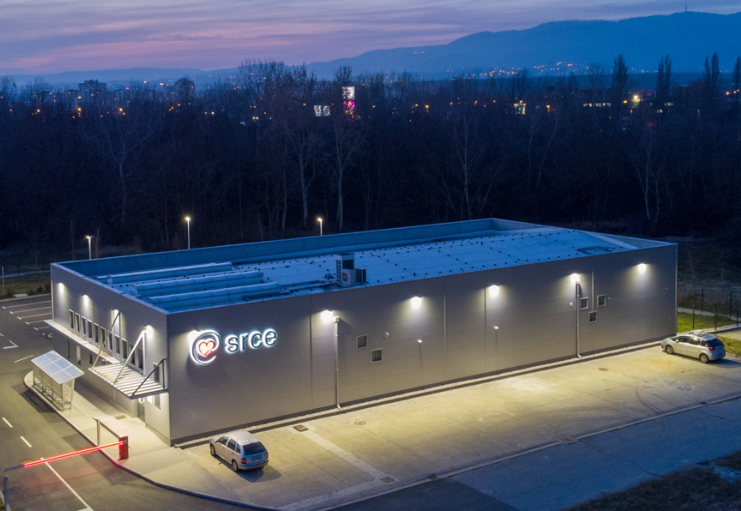
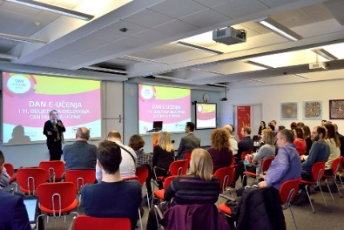
University Computing Centre SRCE
https://www.srce.unizg.hr/en
established in 1971
is computing centre and the architect of the e-infrastructure of the entire system of science and higher education of the Republic of Croatia
competence centre for Information and Communication Technologies as well as the centre for education and support in the area of ICT application

Slide 3
National Centre for E-learning in Higher Education
www.srce.hr/enc
E-learning Centre@SRCE
established in 2007
to support institutions, teachers and students in the use of e-learning technologies and tools
provides infrastructure, usage support and user education
a key stakeholder in the process of digital transformation of the higher education system
Basic objectives:
to support higher education teachers, students, e-learning teams and institutions
to provide and maintain a reliable and generally accessible university platform for e-learning
to support the university network of people involved or interested in e-learning
to promote and foster the implementation of e-learning

Slide 4
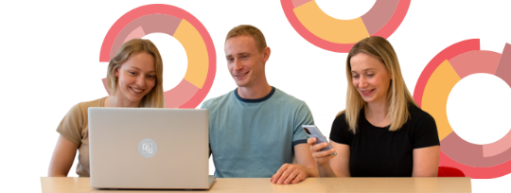
E-learning Centre@SRCE
E-learning platform for HE
state-of-the-art
e-learning system tailored to user needs
30.000+ e-courses per ac. year
Academic e-portfolio
for personal use, for presentation or as a learning activity
Webinars
For online lectures, presentations, seminars, consultations
Adobe Connect
Edumeet
E-course Catalogue
of HEI in Croatia
a central place to find basic information about all e-courses
Promoting Open Access and OER
all educational materials develed in SRCE in Open Access
SRCE Open education portal
Antiplagiarism software
for checking students work, theses and doctoral dissertations
by students and teachers

Slide 5
High quality, easily accessible and sustainable support
8.500-10.000 user queries per year
to HEI
in the systematic
Implementation of e-learning and the process of digital transformation
to teachers
in the use of digital technologies;
in implementation of digital techoologies in teaching and learning
to students
in navigating the online environment and using digital technologies
Courses and workshops (classroom and online)
Manuals
Quick help
Animations
Guides, additional materials
Helpdesk
Consultations
Tailor made support to teachers in implementation of e-learning into educational process
Template for an e-course creation
E-course self-assessment application
Digital badges for completed courses
Interactive guide for grading in Moodle….

Slide 6
Educator thinking about the use of digital technologies in his/hers classroom
Which technologies to choose?
How to use them?
Do I need to change the assessment type?
Where to find them?
Who can I contact to help me?
How to integrate them into teaching and learning?
Which teaching methods to choose with these technologies?
Colleagues
Friends
Family
Community
Support unit
No one, I have to work on my own
How to ensure interactivity when using technologies?
How to organise communication with students?
Are these technologies available to me and my students?

Slide 7
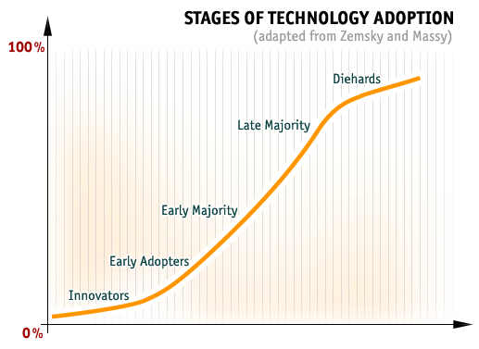
All teachers are not the same …
THEY NEED DIFFERENT KINDS OF SUPPORT

Slide 8
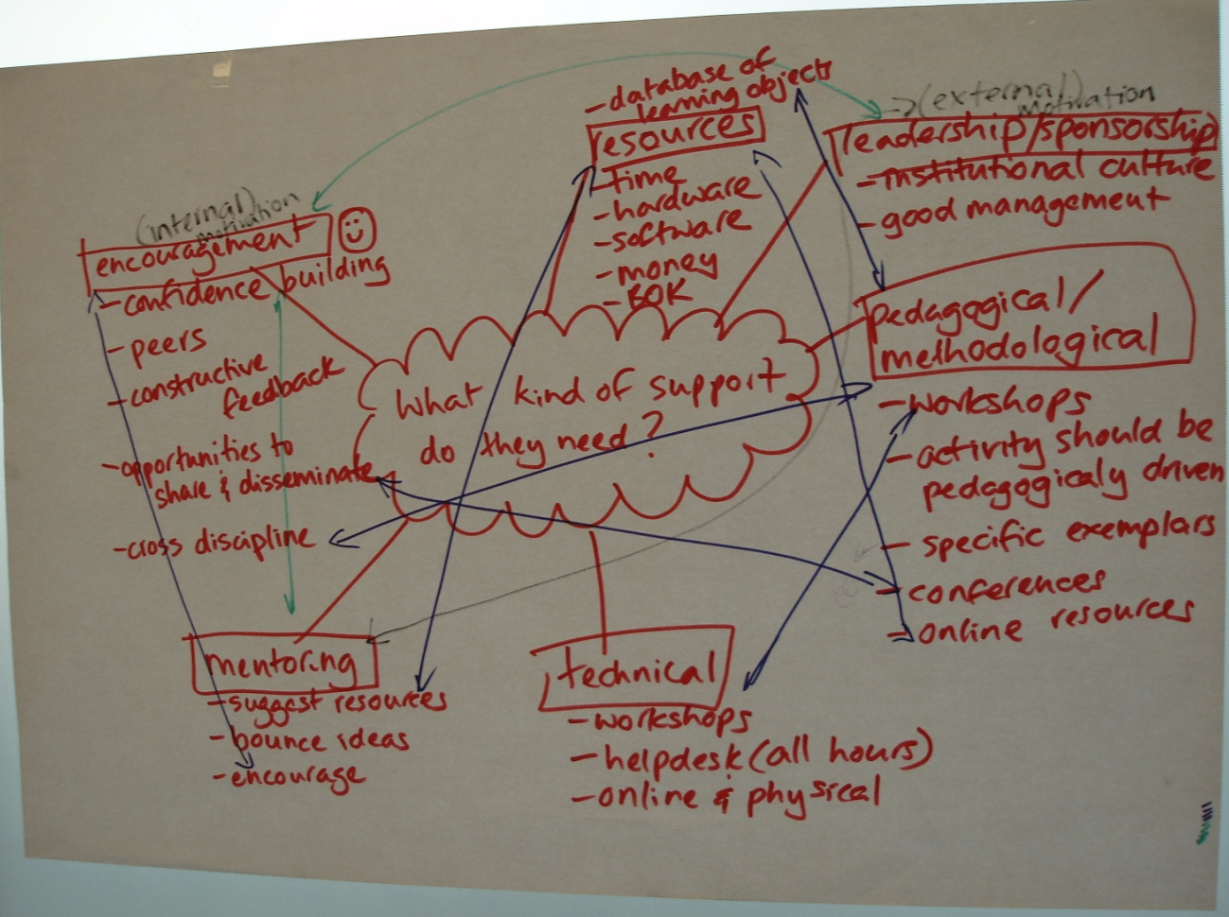
What kind of support teachers need?
political
organizational
methodological
technological

Slide 9
But what kind of training do they want ☺
They like consultations one on one
They like the live voice on the other side of the phone
They want variety of training (f2f, mixed mode and online)
Training should be interactive and engaging, they do not want to be passive participants
They want examples of good practice
They want to be part of community, yet left on their own when it suits them
They want good quality and systematic support
They do not want to read long manuals

Slide 10
What brought the pandemic…
During pandemic
A number of teachers started to use digital technologies for the first time during a pandemic
Those already using digital technologies extended their experience
Experience gained on trial and error mostly
Videoconferencing systems dominate („zoomers”)
Support units have their revival ☺
Learning designers, and educational technologists… suddenly become important
Results
Teaching methods did not change
Perception what is online education has been distorted
Experience gained in a poor way of using technologies
Teachers find themselves digitally competent
Going back to the comfort zone and the way things were before a pandemic

Slide 11
What we need to ensure in ensuring support to teachers
Helping them to be:
Knowledgeable and skilled
Creative and innovative in use
Creators, not consumers (passive users)
To know where to find and easily use support
Continuous professional development
Recognition and awarding of excellence
Networking and exchange of practice
ORGANIZED SUPPORT UNIT

Slide 12
YOU CAN’T STOP THE WAVES BUT YOU CAN LEARN HOW TO SURF!
Joseph Goldstein, 1989
Dr. Sandra Kučina Softić, M.Sc in Digital Education sskucina@srce.hr fcb: sskucina University of Zagreb Unversity Computing Centre Assistant director EDEN DLE Vice President

