Slide 1
National research e-infrastructure landscape and trends
Ivan Marić, Director
SRCE – University of Zagreb, University Computing Centre
CRIS 2022 Conference „Linking research information across data spaces”
Dubrovnik, May 14th 2022

Slide 2
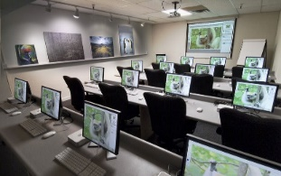
A new environment for Science and Higher Education
NOVO OKRUŽENJE ZNANOSTI I VISOKOG OBRAZOVANJA
Big data and IoT in science
Stronger application of e-infrastructure in Science and Education
Digital skills and
competences
Advanced Computing
Models & Services
International and Inter-Institutional Cooperation
Flexibility in work of students, teachers and researchers
Open Science and Open Education
Digital and Green Transformation
…

Slide 3
Research e-Infrastructures
Research e-Infrastructures are facilities that provide resources and services for the research communities to conduct research and foster innovation in their fields.
e-Infrastructure encompasses the integration and interconnection of computational hardware and software technology, data resources and services, communications protocols and networks, as well as the human resources and organisational structures required to support modern, internationally leading collaborative research.
https://ec.europa.eu

Slide 4
e-IRG e-Infrastructure Commons
(e-IRG Roadmap 2012 -> e-IRG White Paper 2013 -> e-IRG Roadmap 2016 -> e-IRG White Paper 2021)
The e-Infrastructure Commons can be defined as the integrated living ecosystem of resources and services (along with its policies and governance) that is open, user friendly and accessible to European researchers and scientists, and continuously adapts to the changing requirements of research and science.
Recommendations:
embrace e-Infrastructure coordination at the national level and build strong national e-Infrastructure building blocks, enabling coherent and efficient participation in European efforts, especially in alignment with the FAIR principles concerning data and services
together analyze and evaluate their national e-Infrastructure funding and governance mechanisms, identify best practices, and provide input to the development of the European e-Infrastructure landscape

Slide 5
European / Global e-Infrastructure
Regional e-Infrastructure
National e-Infrastructure
University / Inter-Institutional e-Infrastructure
Institutional e-Infrastructure

Slide 6
A new landscape of National e-Infrastructure
NOVI KRAJOBRAZ NACIONALNE E-INFRASTRUKTURE
New environment requires a new principle of action at the national level:
NATIONAL E-INFRASTRUCTURE
COORDINATION
CONSOLIDATION
AVAILABILITY
OPENNESS
GATHERING
COLLABORATION
COMMUNITY INVOLMENT

Slide 7
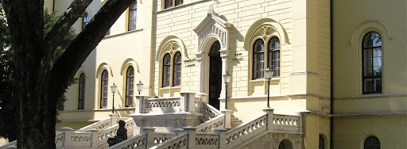
SRCE – TOWARD A VISION OF E-INFRASTRUCTURE
IT and information services to users
e - infrastructure?
Teams of professionals to develop, maintain and support usage od e-infrastructure
227 R & HE institutions
INFORMATION SYSTEMS AND SERVICES (collaboration and groupware systems, information systems, Internet applications, public registries, CRIS systems, library systems, e-learning platforms, ERP, CRM, DMS, …)
DATA LAYER (digital archives, digital repositories, dana collections, portals, …)
MIDDLEWARE LAYER (authentication and authorization systems, monitoring, security, accounting, …)
131 HE institutions
of which 106 public
(159 000 + students)
25 public scientific institutes
71 other legal entities that registered scientific activity (National and University Library, Croatian Academy of Sciences and Arts, hospitals, archives...)
COMPUTING SYSTEMS AND STORAGE RESOURCES (physical or virtual servers, clusters, IaaS, PaaS, HPC / HTC systems, supercomputers, dana storage, backup systems, …)
DATA CENTERS (national and university data centers, computer rooms, …)
NETWORKS AND NETWORKING SERVICES (international and national networks, MAN, LAN, WLAN…)
(20.000 + scientists)
Organizational and governance framework of e-infrastructure
IT and information services to users

Slide 8
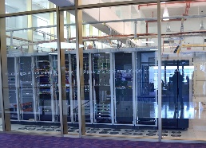
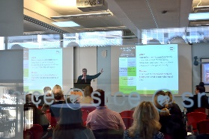
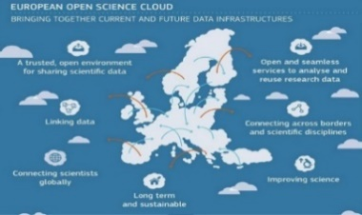
SRCE…
SRCE...
… Builds national e-infrastructure,
from data centers, through network, computer
and storage resources, all the way to information services
… Provides digital services, education of users and advanced user support
… Builds bridges to international infrastructures and initiatives
5.2
… Is a synonym for a digital transformation of science and higher education system
5.2

Slide 9
SRCE & National e-Infrastructure
Competence centre for trust and identity systems
National eduroam operator
National and university e-learning centre
National
RDA node
Support centres for information systems ISVU, ISSP,
CroRIS, ISeVO
National Competence Centre for HPC
Croatian scientific and educational cloud (HR-ZOO)
Croatian Open Science Cloud (HR-OOZ)
HR-ZOO
EDIH …
HR-OOZ
…

Slide 10
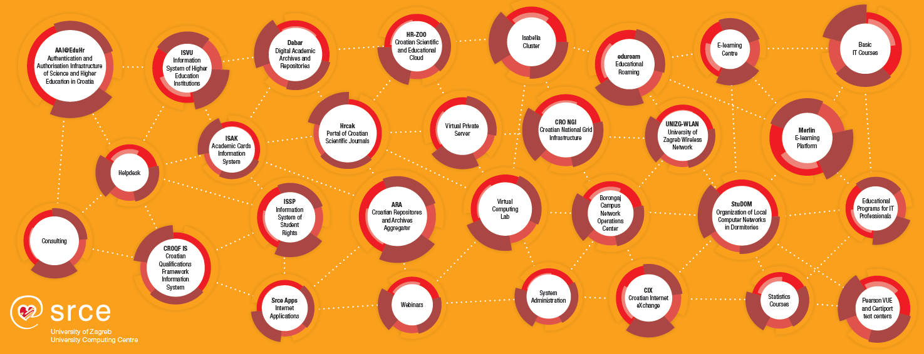
SRCE
SRCE DANAS
~ 30 public services
158 employees

Slide 11
Computing & Storage Infrastructure
SRCE Computing & Storage Infrastructure
Cloud IaaS VMware
350 / 750 VMs
1+ PB used storage
800+ TB backup
1200 TB archives (tapes)
HR-ZOO
Croatian Scientific
and Educational Cloud
(in progress)
HTC Cloud
600 CPUs
2.400 virtual CPUs
150 TB HDD
70 users
22 projects
HPC
140 TFLOPs
3.100 CPUs
12 GPUs
350 users
140 projects
266 scientific works
Cloud IaaS
340 / 400 VPS
400 VCL

Slide 12
Croatian Scientific and Educational Cloud (HR-ZOO)
Strategic project by Ministry of Science and Education of the Republic of Croatia
Coordinator: SRCE
Reference No: KK.01.1.1.08.0001
Project value: 196.802.438,11 HRK
EU contribution: 167.282.072,40 HRK
National share: 29.520.365,71‬ HRK
Implementation: 1.7.2017. - 1.5.2023.
National e-infrastructure that provides the Croatian scientific and academic community with long-term advanced computing, storage resources and network connectivity, necessary for modern and multidisciplinary science and education.
https://www.srce.hr/hr-zoo/en/
Project is co-funded by European Union from European Regional Development Fund

Slide 13
New generation of national e-infrastructure HR-ZOO
HR-ZOO ZG2
5 Data Centres
HR-ZOO ZG1
HR-ZOO OS
HR-ZOO RI
HR-ZOO Service Catalogue
Virtual Data Centers
High Performance Computing
Elastic Cloud Computing
HR-ZOO ST
Storage
Scientific Software
Specialized support to researchers
Collocation of ICT equipment

Slide 14
Croatian Competence Centre for HPC (HR HPC CC)
HR HPC CC established within the project EuroCC as part of a network of national competence centres for HPC in 33 member states of the European High-Performance Computing Joint Undertaking (EuroHPC JU).
ONE-STOP-SHOP FOR HPC
support users in the use of HPC resources
development of new competencies in the HPC field
cooperation between the academic community and industry
building the European HPC ecosystem
Technology transfer and business development
Access to EuroHPC / national resources
Training and skills development in HPC / HPDA / AI
Advisory support in funding applications
Cooperation with industry
https://www.hpc-cc.hr/

Slide 15
T&I… enabeling mobility
AAI@EduHr
Authentication and Authorisation Infrastructure of science and higher education in Croatia
eduroam
safe, easy to use and,
for the end user, completely free Internet access service in Croatia
945.786
e-identity (users)
233
institutions (identity providers)
Security
Trust
Reliability
worldwide
32 000+ locations
106 countries
Croatia
1 149 locations
407 cities / places

Slide 16
Data Infrastructure and Services
CROATIAN OA JOURNALS
Since February 2006
511 scientific & professional journals (395 active)
246.000 + OA articles
65.000+ visits daily
PRESERVATION & DISEMINATION
16 types of digital objects
150 digital repositories of research & HE institutions
170.000 digital objects
(TEMPORARY)
STORAGE & SHARING SERVICE
430+ researchers & lecturers
200 GB (default)
Notes:
HRČAK – includes support for entire editorial process: 54 journals using Open Journal System (OJS3)
DABAR: research data, publications like journal arricles, book chapters, educational content, artistic content, students theses and disertations; interoperable with Croatian e-infrastructure eg CroRIS, European eg OpenAIRE, & global eg Google Scholar
PUH various types of interfaces: web interface, native desktop & mobile clients, remote disc on pc or server

Slide 17
Information and collaboration systems
ISVU
Information System of Higher Education Institutions
110+ HE institutions, 140.000+ students, 1.700.000+ exams/ac.year
ISSP
Information System of Student Rights
115+ HE institutions 159.000+ students
ISAK
Information System of Academic (student) Cards
MOZVAG
Information System for Accreditation of HE institutions and Study Programs
110+ HE institutions 1.900+ study programs
ISRHKO
Information System of Croatian Qualifications Framework
CroRIS
Croatian Research Information System
(in development)

Slide 18
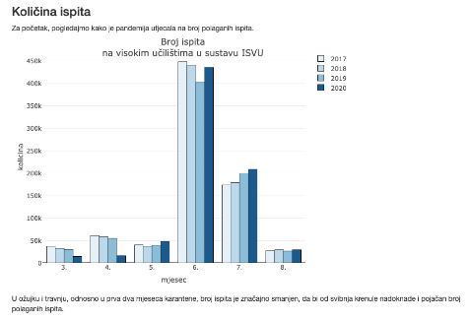
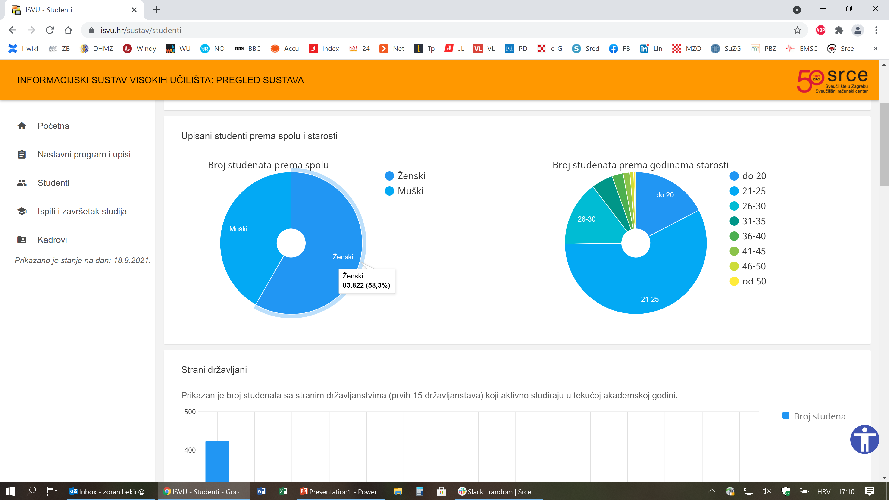
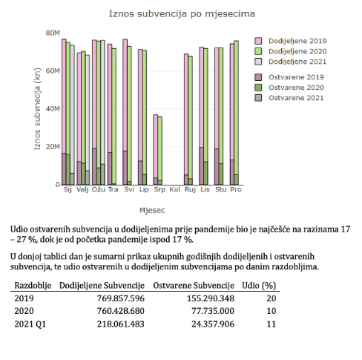
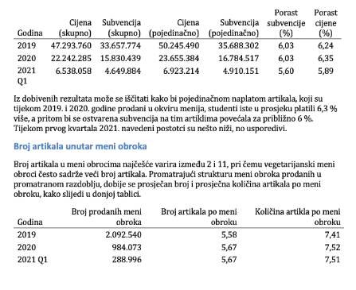
Support in Monitoring and Policy making
SKILL
Policies and decisions (MSE, university, institution)
application
KNOWLEDGE
Data analysis
analysis
INFORMATION
organize
Information and Data Infrastructure
DATA
collect

Slide 19
Croatian Research Information System – CroRIS
An element of project Scientific and Technological Foresight lead by Ministry of Science and Education of the Republic of Croatia
New national Research Information System of the Republic of Croatia, gradually being put in production
Information and processes about institutions, researches, projects, publications, equipment, patents, services, events and much more
Integration with many national systems and international platforms, such as ORCID, OpenAire, WoS, Scopus
Promote open science
Provide information reliability
Ensures openness and interoperability
Support decision making
Project is co-funded by European Union from European Regional Development Fund

Slide 20
SRCE e-Learning Centre
Distance learning system
State-of-the-art e-learning system tailored to user needs
E-portfolio
for personal use, for presentations or as a teaching activity
Webinar system
for online lectures, presentations, seminars, consultations
Adobe Connect
eduMEET
e-Course Catalogue
HE institutions
a central place for all e-courses
Open access and open educational materials
SRCE educational materials are made in open access
and available in the Open Education Portal
Software for Plagiarism Detection
a tool used by teachers, researchers and students for seminars, final and doctoral thesis

Slide 21
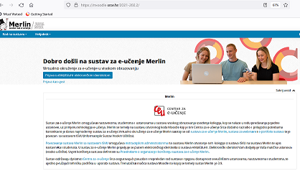
Virtual Learning Environment – Merlin
http://merlin.srce.hr
Dabar
1 Moodle installation
94 institutions on Merlin

Slide 22
Support to Researchers
COMPUTING
Advanced Computing & Cloud Services
Research Data Management and
Data Management Plan (DMP)
HPC
HTC Cloud
Cloud services
PLAN
COLLECT
ANALYSE
PRESERVE
SHARE
PROCESS
RE-USE
DATA SERVICES
during all phases of research process
Scientific papers publication
Permanent storage and research results sharing
Data storage during research process

Slide 23
Data Services and Open Science
SRCE services supporting Open Science
Education and networking with the European and global research community
National Open Science Cloud
Croatian Open Science Cloud (HR-OOZ) Initiative
National Open Science Plan
HR-OOZ Catalogue of services, tools and resources

Slide 24
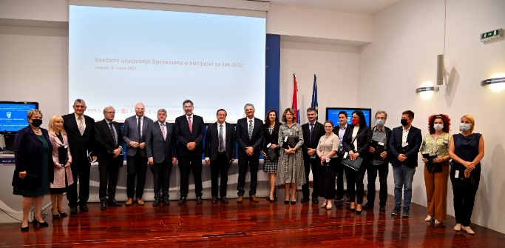
Croatian Open Science Cloud (HR-OOZ) Initiative
GOALS
National Open Science
Cloud (HR-OOZ)
National Open Science Plan
https://www.srce.unizg.hr/en/hr-ooz

Slide 25
HR-OOZ as a part of EOSC
ZG2
HR-OOZ
National Open Science Cloud
EOSC
European Open Science Cloud
ZG1
OS
RI
ST
National
e-Infrastructure
Service and service providers
Key aspects:
Open Science and FAIR data
Alliance of existing and planned infrastructures
Collaboration between different disciplines and countries
“We are creating a European Open Science Cloud now. It is a trusted space for researchers to store their data and to access data from researchers from all other disciplines. We will create a pool of interlinked information, a ‘web of research data'. Every researcher will be able to better use not only their own data, but also those of others”
Ursula von der Leyen, President of the European Commission

Slide 26
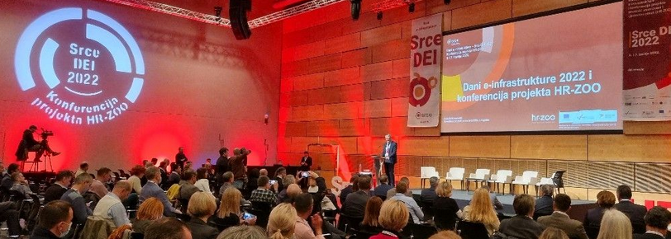
CroRIS – as a Service Catalogue of HR-OOZ
Projects
Journals
Financing
Register of Scientists
Publications
Register of Sc. Inst.
Equipment and Services
Register of HE Inst.
Citations
Science Fields and Areas
Events
Patents and Products

Slide 27
Using EU funds in building a National e-Infrastructure
Building research and innovation capacity
The digital transformation of higher education
National Recovery and Resilience Plan
2021-2026

Slide 28
Digital bridges to ERA /EHEA
National components of e-Infrastructure are connected with the
similar European ones.
HR-OOZ

Slide 29
The key to Success
KLJUČ USPJEHA
TECHNOLOGY
TALENTS
TOLERANCE

Slide 30
E-INFRASTRUCTURE IS A SOLUTION IF IT IS STRATEGICALLY WELL PLANNED!

Slide 31
Thank you! ivan.maric@srce.hr https://www.srce.hr/en National research e-infrastructure landscape and trends CRIS 2022: Linking research information across data spaces, May 14th 2022

