Slide 1
KBA event dedicated to:
Digitally competent Organization: How to Measure Readiness for Digitalisation?
Topic: Setting up the digital environment for digitally enhanced teaching and learning curriculum
February 27, 2023

Slide 2
Providing digital environment for digitally enhanced teaching and learning for HEI and schools
Assistant professor Sandra Kučina Softić, M.Sc. in Digital Education
Assistant Director
University Computing Centre SRCE
sskucina@srce.hr
EDEH KBA event, February 27, 2023

Slide 3
Education in digital age
Digital technologies are part of everyday life, work and learning
Digital transformation in education is crucial
Effective digital teaching and learning in higher education settings require significant increases in infrastructure to support these technologies
Education is undergoing massive changes as emerging technology reshapes and redefines the ways students are learning, additionally fostered by pandemic
Digital transformation of education is the process of the transformation of the content, methods, and organizational forms of educational activities improving educational quality in a rapidly developing digital environment to meet the requirements of the digital economy (A. Y. Uvarov, 2019)

Slide 4
Digital transformation in the context Educause Digital Transformation Study 2020, (Brooks & McCormack, 2020.)

Slide 5
Digital Learning Environments
serve as a platform for a student-centred framework where opportunities for learning and access to educational resources are available anytime, anywhere
Modalities
On-campus technology-enhanced
Hybrid/blended
Fully online (synchronous, asynchronous)
Hyflex
Types of learning environments
inquiry- and project-based learning
direct instruction
peer-to-peer and school-to-school learning
e-learning
mobile learning
flipped classroom

Slide 6
Common digital teaching and learning technologies
Learning management systems (LMS)
Synchronous technologies (real-time online meetings)
Multimedia applications (audio, video, and other interactive elements)
Collaborative applications (Web-based or cloud-based word processing, presentation, social participation, and whiteboard applications)
Cloud-based technologies
Emerging technologies (AI, VR, XR, AR, LA…)
Open source software

Slide 7
Case of Croatia

Slide 8
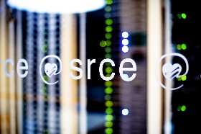
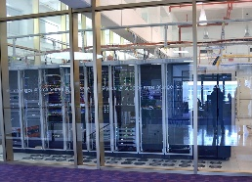
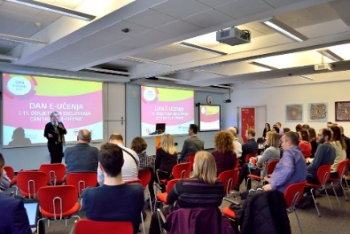
University Computing Centre SRCE
is computing centre and the architect of the e-infrastructure of the entire system of science and higher education of the Republic of Croatia
competence centre for information and communication technologies as well as the centre for education and support in the area of ICT application
in 2021 – 50th anniversary

Slide 9
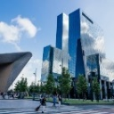
PROVIDING
advance resources and digital services for
modern education and multidisciplinary science
Specialized support to researchers
Data Storage
AAI@EduHr
eduroam
High Performance Computing (HPC)
Elastic Cloud Computing
Croatian OA journals
Preservation & disemination
(Temporary)
Storage & sharing service
Scientific
Software
Virtual Data
Centres

Slide 10
SRCE – National Centre for E-learning in Higher Education
www.srce.hr/enc
E-learning Centre@SRCE
established in 2007
to support institutions, teachers and students in the use of e-learning technologies and tools
provides infrastructure, usage support and user education
a key stakeholder in the process of digital transformation of the higher education system
Basic objectives:
to support higher education teachers, students, e-learning teams and institutions
to provide and maintain reliable and generally accessible university platform for e-learning
to support the university network of people involved or interested in e-learning
to promote and foster implementation of e-learning

Slide 11
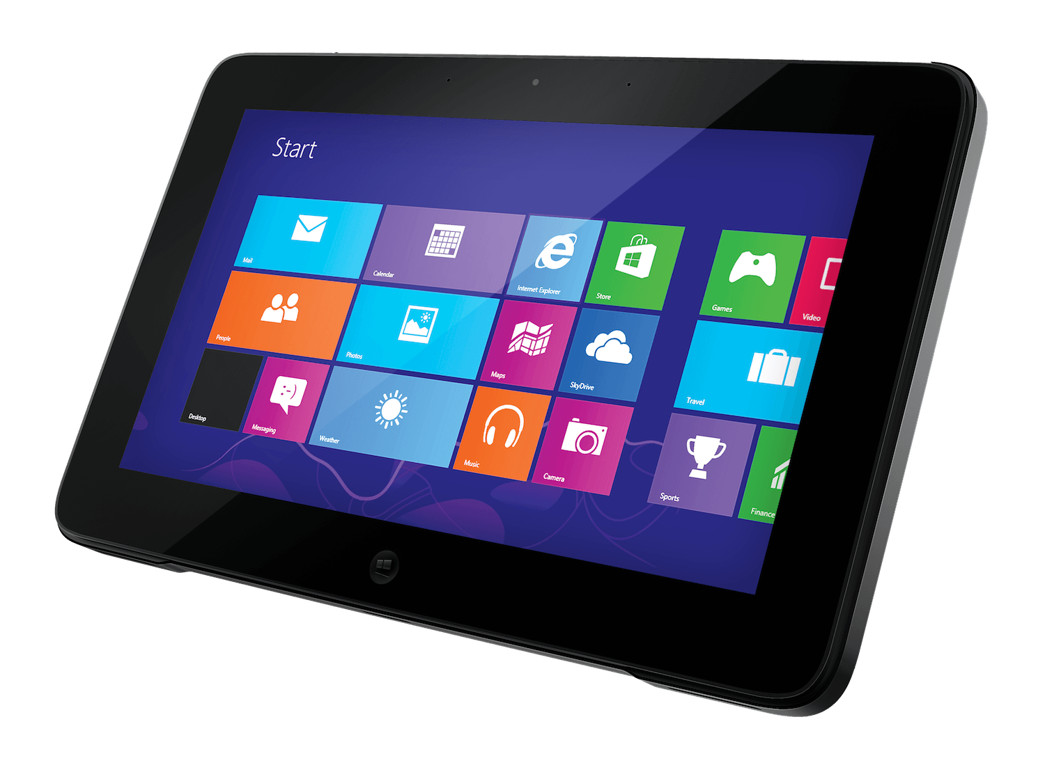
E-learning Centre@SRCE
E-learning platform for HE
state-of-the-art
e-learning system tailored to user needs
Academic e-portfolio
for personal use, for presentation or as a learning activity
Webinars
For online lectures, presentations, seminars, consultations
Adobe Connect
Edumeet
E-course Catalogue
of HEI in Croatia
a central place to find basic information about all e-courses
Promoting Open Access and OER
all educational materials develed in SRCE in Open Access
SRCE Open education portal
Antiplagiarism software
for checking students work, theses and doctoral dissertations
by students and teachers

Slide 12
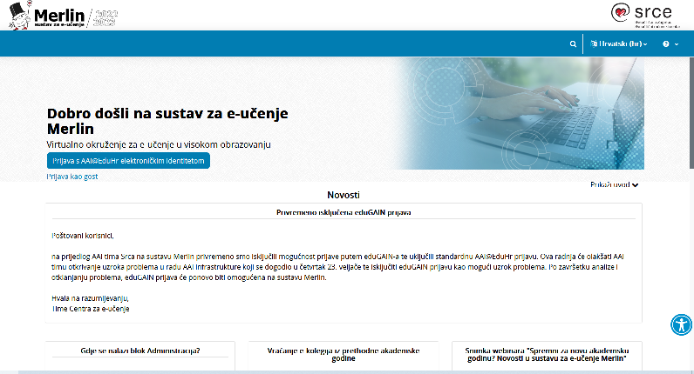
Virtual Learning Environment – Merlin
http://merlin.srce.hr
1 Moodle installation
96 institutions on Merlin
30.000 + e-courses per academic year
Dabar
PUH

Slide 13
High quality, easily accessible and sustainable support
to HEI
in the systematic
Implementation of e-learning and the process of digital transformation
to teachers
in the use of digital technologies;
in implementation of digital techoologies in teaching and learning
to students
in navigating the online environment and using digital technologies
Courses (classroom and online)
Manuals
FAQ
Quick help
Animations
Guides, additional materials
Helpdesk
Consultations
Tailor made support to teachers in implementation of e-learning into educational process
Template for an e-course creation
E-course self-assessment application
Digital badges for completed courses
Interactive guide for grading in Moodle….

Slide 14
Teachers training… designed for their needs
Courses and workshops
How to work in Moodle
E-course development
Learning Outcomes in Moodle
Student’s Assessment and Grading
E-portfolio
Teachers digital competences
ABC workshop on learning design
Interactive educational materials with H5P
Multimedia in e-courses
Educational materials as OER
How to prepare and online lecture with Adobe Connect
Individual consultations
Engaging events- building comunities of practices and enhancing networking

Slide 15
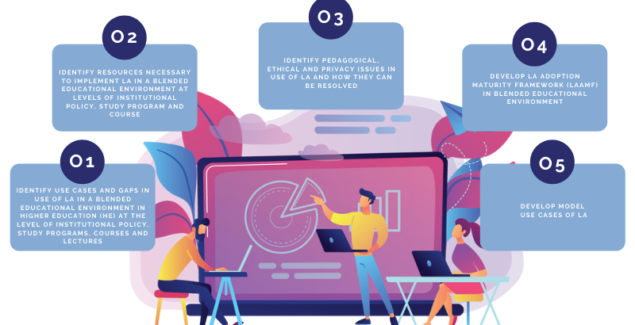
This work has been supported in part by the Croatian Science Foundation under the project IP-2020-02-5071.
HELA - Improving HEI maturity to implement learning analytics
PROJECT OBJECTIVES
The purpose of this research is to contribute to a better understanding and optimization of the teaching and learning processes supported by LA through developing a maturity framework for LA by implementation in a blended learning environment
Project leader:
Faculty of Organisation and Information University of Zagreb
Duration: 2021-2025

Slide 16
Schools in digital education
LMS
Merlin in School –maintained by SRCE
Loomen –maintained by CARNET
Radio
Television
SRCE training courses very attractive to school teachers
E-portfolio system maintained by SRCE is used by school teachers as well

Slide 17
Comprehensive informatization of school operation processes and teaching processes aimed at the creation of digitally mature schools for the 21st century”
2014- 2022

Slide 18
e-services
Infrastructure
197 LANs
Interactive & presentation classroom
12 224 laptops, tablets, hybrid computers
5 Regional Training Centres
Education & Support
Framework for the Digital Maturity of Schools
Digital Competence Framework
More than 1900 various types of training
Community of practice
e-content
240 teaching scenarios
16 digital educational resources
72 e-Lektire (compulsory reading material)
Research
Scientific research on the impact of e- schools pilot project (CPP)
Electromagnetic fields research (IMI)
Digital Content
Repository
Education Management Application
Learning Analytics and Educational Data Mining
Classroom Management System
System for the informatization of business operations
Sensors and smart
management
External evaluation
of the digital maturity level (FOI)

Slide 19
Digital maturity
e-Universities project
Digital Digital management infrastructure
Digital skills and culture
S
e c u r i t y
S
e r v i c e s
E
d u c a ti o n
Contact teaching
Hybrid teaching
Flexible education
Online learning
Duration: 2022 – 2025
Partners:
University Computing Centre – SRCE
Agency of Science and Higher Education – AZVO
National and University Library in Zagreb – NSK Funding: National Recovery and Resilience Plan Indicator: 90 % of public higher education institutions (HEI) equipped with digital infrastructure
International cooperation (European universities)
Equipment – MM studios, hybrid lecture hall
Network connection – LAN at institutions

Slide 20
Digital transformation needs
Advanced and state-of-art e-infrastructure
High-quality, easily accessible and systematic user support
Tailored made teachers training for digital skills
Professional learning communities and networks
SRCE is at the heart of the digital transformation of science and higher education
Sandra Kučina Softić
University of Zagreb
University Computing Centre
www.srce.hr/en/elc
sskucina@srce.hr

