Slide 1
OpenStack cloud for advanced computing
Emir Imamagić
University Computing Centre
11.5.2023. DORS/CLUC 2023

Slide 2
Overview
HR-ZOO
Vrančić
Deployment
OpenStack
Ceph
Future Work
Conclusion

Slide 3
Croatian Scientific and Educational Cloud (HR-ZOO)
HR-ZOO ZG2
HR-ZOO ZG1
Strategic project - providing the national e-Infrastructure for Croatian scientific and academic community
Implementation: 1.7.2017. - 1.5.2023.
Services
Virtual Data Centers – Štampar
Advanced Computing – HPC Supek & Cloud Vrančić
Collocation of ICT equipment
HR-ZOO OS
HR-ZOO RI
HR-ZOO ST

Slide 4
Vrančić
Infrastructure for:
High Throughput Computing, HTC
Big Data analysis
machine learning
interactive data analysis, processing & visualization
any other resource-demanding applications
Based on
OpenStack – cloud middleware
Ceph – distributed storage for images & VM drives

Slide 5
Vrančić
Three controller nodes
HPE ProLiant DL325 Gen10 Plus v2
2 CPUs AMD Epyc 7713 2,0 GHz
128 CPU cores
256 GB RAM
2 x 25 Gbit/s Ethernet

Slide 6
Vrančić – Hypervisors
CPU nodes
86 nodes
11.008 CPU cores
Node:
2 CPUs AMD Epyc 7713 2,0 GHz
128 CPU cores
512 GB RAM
2 x 25 Gbit/s Ethernet
GPU nodes
4 nodes
16 GPUs
256 CPU cores
Node
4 GPUs NVIDIA A100 40 GB
1 CPU AMD Epyc 7713 2,0 GHz
64 CPU cores
512 GB RAM
2 x 25 Gbit/s Ethernet
Big memory nodes
2 nodes
256 CPU cores
Node
2 CPUs AMD Epyc 7713 2,0 GHz
128 CPU cores
2 TB RAM
2 x 25 Gbit/s Ethernet

Slide 7
Vrančić – Storage
Standard storage
HDD based
6 x HPE ProLiant DL325 Gen10 Plus v2
28 x 18 TB HDD
3 x 7,68 TB NVMe SSD
4 x 25 Gbit/s Ethernet
Fast storage
NVMe SSD based
3 x HPE ProLiant DL385 Gen10 Plus v2
9 x 15,36 TB NVMe SSD
4 x 100 Gbit/s Ethernet

Slide 8
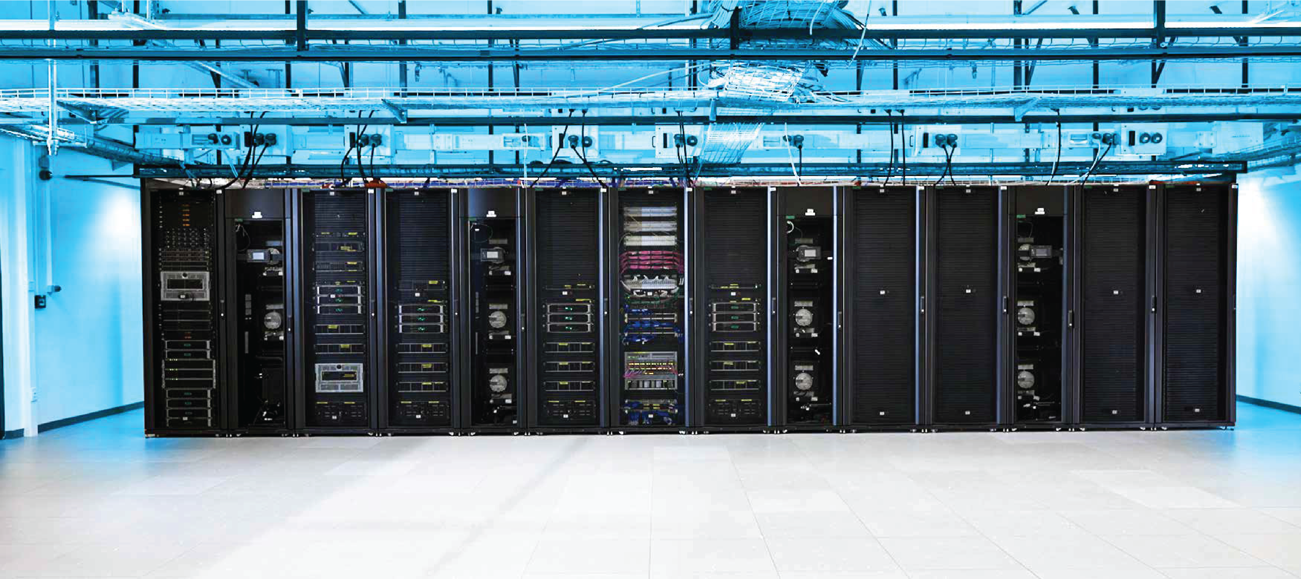
Vrančić

Slide 9
Vrančić in Numbers
180 CPUs with 11520 CPU cores
16 GPUs
57,5 TB RAM
200 TB fast Ceph storage
1 PB HDD-based Ceph storage
2 x 25 Gbit/s Ethernet
HTC Cloud
600 CPU cores
4,7 TB RAM
150 TB HDD-based Ceph storage
2 x 10 Gbit/s Ethernet

Slide 10
Deployment
Hiera:
python::python_pyvenvs:
"/opt/kolla-venv-prod":
version: "system"
systempkgs: true
python::python_requirements:
"/etc/py-kolla-venv-prod.req":
virtualenv: "/opt/kolla-venv-prod“
Manifest:
node /^gpu\d\d.vrancic$/ {
include syshpc::htc::ssh_key
include profile::base
include lldpd
include syshpc::htc::docker
file { '/etc/py-kolla-venv-prod.req':
source => 'puppet:///modules/syshpc/htc/py-kolla-venv-prod.req',
ensure => file,
owner => root,
group => root,
mode => '0400',
notify => Exec['python_requirements/etc/py-kolla-venv-prod.req'],
}
include python
}
gpu01.vrancic:
gateway: 172.24.X.1
interfaces:
bond0:
bonding_opts: miimon=100 mode=4 lacp_rate=1 xmit_hash_policy=layer3+4
interface_type: bond
ip_address: 172.24.X.Y
mtu: 9000
netmask: 255.255.255.0
static: true
em1:
interface_master: bond0
interface_type: bond_slave
mac_address: 88:e9:a4:XX:YY:f6
static: true
em2:
interface_master: bond0
interface_type: bond_slave
mac_address: 88:e9:a4:XX:YY:f7
static: true
profile: Rocky-9-x86_64-srce-mdraid
# ilorest flashfwpkg upgrade.fwpkg --url htc-cpuXX
Total 104 servers
OS Rocky Linux 8 & 9
automatization is mandatory
iLOREST
server & remote console configuration management
firmware upgrades
SRCE sysops tools
Cobbler – DHCP-based server installation
Puppet – configuration management

Slide 11
Deployment
pssh
server management
# cat control
htc-control01
htc-control02
htc-control03
# pssh -h control -i -t 0 > uname -s -r -m
[1] 09:09:09 [SUCCESS] htc-control03
Linux 5.14.0-162.23.1.el9_1.x86_64 x86_64
[2] 09:09:09 [SUCCESS] htc-control02
Linux 5.14.0-162.23.1.el9_1.x86_64 x86_64
[3] 09:09:09 [SUCCESS] htc-control01
Linux 5.14.0-162.23.1.el9_1.x86_64 x86_64

Slide 12
Deployment
# iperf -c htc-control01
...
[ ID] Interval Transfer Bandwidth
[ 1] 0.00-10.00 sec 22.0 GBytes 18.9 Gbits/sec
Network
LACP bond configuration
LLDP very useful
Network baseline measurement
multiple stream needed
# iperf -c htc-control01 –P 20
...
[ ID] Interval Transfer Bandwidth
...
[SUM] 0.00-10.01 sec 57.7 GBytes 49.5 Gbits/sec
# iperf -c storage-ssd01 -P 20
...
[ ID] Interval Transfer Bandwidth
...
[SUM] 0.00-10.02 sec 231 GBytes 198 Gbits/sec

Slide 13
OpenStack
Kolla
container + Ansible based OpenStack deployment
supports integration with existing Ceph
OpenStack Zed
Docker repository in SRCE github instance

Slide 14
OpenStack
[control]
htc-control[01:03] network_interface=bond0 api_interface=bond0 storage_interface=bond0 cluster_interface=bond0 dns_interface=bond0
[network]
htc-control[01:03] network_interface=bond0 api_interface=bond0 storage_interface=bond0 cluster_interface=bond0 tunnel_interface=bond0 dns_interface=bond0 neutron_external_interface=bond0.969,bond0.970,bond0.973
[compute]
cpu[01:76] network_interface=bond0 api_interface=bond0 storage_interface=bond0 cluster_interface=bond0 tunnel_interface=bond0 dns_interface=bond0 neutron_external_interface=bond0.969,bond0.970,bond0.973
[monitoring]
htc-control[01:03] network_interface=bond0 api_interface=bond0 storage_interface=bond0 cluster_interface=bond0 dns_interface=bond0
[storage]
htc-control[01:03] network_interface=bond0 api_interface=bond0 storage_interface=bond0 cluster_interface=bond0 dns_interface=bond0
[deployment]
htc-control[01:03] network_interface=bond0 api_interface=bond0 storage_interface=bond0 cluster_interface=bond0 dns_interface=bond0

Slide 15
OpenStack
# source /opt/kolla-venv-prod/bin/activate
# kolla-ansible deploy -i config-file
# kolla-ansible reconfigure -i config-file
# kolla-ansible reconfigure -i config-file --limit gpu01
# kolla-ansible reconfigure -i config-file --tags nova-cell

Slide 16
OpenStack – GPUs & NVMe drives
PCI passthrough configuration
somewhat tricky
hit a bug https://bugs.launchpad.net/kolla-ansible/+bug/2012821 (already fixed)
Limitations
NVIDIA A100 MIG cannot use PCI passthrough ☹
NVMe namespaces cannot use PCI passthrough
whole devices are allocated to VM

Slide 17
OpenStack - Network Performance
MTU 9k
vxlan & external network provider
Single VM – 20 Gbit/s
Multiple VMs hit ~43 Gbit/s

Slide 18
Ceph
Ceph Quincy
BlueStore
deployment via Ceph Orchestrator
Prometheus monitoring
one bond for public, one for cluster network
Standard storage cluster
size 3
single OSD per HDD
9/10 HDDs per single NVMe SSD (namespaces)
Fast storage cluster
size 2
2 OSDs per NVMe SSD

Slide 19
Ceph
# cephadm shell
# ceph status
cluster:
id: 47973c06-7fd9-11ed-aea6-88e9a451cde
health: HEALTH_OK
services:
mon: 3 daemons, quorum storage01,storage03,storage02 (age 9d)
mgr: storage01.htc(active, since 9d), standbys: storage02.dfqvue
osd: 168 osds: 168 up (since 9d), 168 in (since 4M)
data:
pools: 5 pools, 3361 pgs
objects: 1.70M objects, 6.5 TiB
usage: 145 TiB used, 2.7 PiB / 2.8 PiB avail
pgs: 3361 active+clean

Slide 20
Ceph
# ceph status
cluster:
id: 07291d34-bb42-11ed-bdd3-88e9a4591abc
health: HEALTH_OK
services:
mon: 3 daemons, quorum storage-ssd01,storage-ssd03,storage-ssd02 (age 9d)
mgr: storage-ssd01.htc(active, since 9d), standbys: storage-ssd02.lrtlxf
osd: 54 osds: 54 up (since 9d), 54 in (since 4w)
data:
pools: 3 pools, 1537 pgs
objects: 33 objects, 11 MiB
usage: 15 TiB used, 362 TiB / 377 TiB avail
pgs: 1537 active+clean

Slide 21
Ceph
[global]
rw=read
bs=1M
direct=1
ioengine=libaio
#iodepth=16
#time_based=1
#runtime=3600s
numjobs=128
group_reporting
[storage]
directory=/mnt/
filesize=50G
Performance
fio on 10 hypervisors
HDD storage
8,5 GB/s write
6,5 GB/s read
SDD storage
23 GB/s write
55 GB/s read
~1 MIOPS random read

Slide 22
Future Work
Test SRIOV & VF LAG networking options
Further improve monitoring & logging
Test K8S service Magnum
Deploy new user services
Galaxy
JupyterLab
Big Data platform
…

Slide 23
Conclusion
OpenStack + Ceph based advanced computing service
HTC Cloud in production since December 2019. Vrančić since April 2023.
successfully migrated HTC Cloud to new DC without downtime
SRCE sys-ops tools for bare-metal deployment & management
Kolla – ease of use + configuration flexibility
with some help from code ☺

Slide 24
Thank You For Your Attention!
https://www.srce.unizg.hr/napredno-racunanje/
computing@srce.hr

