Slide 1
The Role of Mandated Organisations in the EOSC-Association
Ivan Marić
Director of SRCE
President of the Council of the HR-OOZ Initiative
Representative (of the MO) in the EOSC SB

Slide 2
The European Open Science Cloud (EOSC)
The European Open Science Cloud (EOSC) is an environment for hosting and processing research data to support EU science
The ambition of the EOSC is to provide European researchers, innovators, companies and citizens with a federated and open multi-disciplinary environment where they can publish, find and re-use data, tools and services for research, innovation and educational purposes
EOSC ultimately aims to develop a Web of FAIR Data and services for science in Europe

Slide 3
EOSC-Association
European Open Science Cloud Association (EOSC Association)
The Association is the legal entity established to govern the EOSC
It was formed on 29th July 2020 with four founding members and has since grown to over 200 Members and Observers
The Association advances Open Science to accelerate the creation of new knowledge, inspire education, spur innovation and promote accessibility and transparency

Slide 4
Purpose of the EOSC-Association
The international purpose of the Association is:
to provide a single voice for advocacy and representation for the broader EOSC stakeholder community
to promote the alignment of European Union research policy and priorities with activities coordinated by the Association
to enable seamless access to data through interoperable services that address the entire research data life cycle, from discovery to storage, management, analysis and re-use across borders and scientific disciplines

Slide 5
Members and Observers
The Association is comprised of Members and Observers
Members and Observers must:
Be a legal entity established in accordance with the laws and customs of the country of origin or be constituted as an intergovernmental organisation pursuant to an international treaty in accordance with principles of international law. They cannot be a department of national governments or ministries;
Confirm in writing that they embrace and endorse the vision of the Association and adhere to its values;
Have a substantial and significant interest in, and potential contribution to or impact on EOSC.

Slide 6
From the Articles of Association
“Each Member State or Associated Country that has one or more organisations that are Members of the Association may appoint one (1) Member to act as its Mandated Organisation, to represent national interests”
SRCE is Croatian member of the EOSC-Association (from Day1) and appointed by Ministry of Science and Education as its Mandated member. RBI gain Observer status on the EOSC GA #5 (Nov 2022).
Mandated members have more weight in voting matters than ordinary members - some matters require double majority (mandated and ordinary members majority)
Roles and expectations defined in May 2022, as bidirectional:
Towards the EOSC-Association
Towards the stakeholders in their countries
This includes providing input relevant to the broader engagement and priorities relevant to their national research system to the EOSC Association, and vice-versa.

Slide 7
Towards the EOSC-Association
Coordinate the view from the stakeholders in their countries;
Consult the EOSC-A members and active participants (Task Force members, etc.) in their constituencies on important decisions to be taken by EOSC-A

Slide 8
Towards national Stakeholders
Translate and communicate the mission of EOSC in the national context;
Encourage and facilitate communication between and alignment of relevant funding agencies (public and private);
Raise any needs of the communities to the respective EOSC-SB member;
Inform Members, Observers, members of the EOSC National Initiative (if any) and other stakeholders on the development of EOSC and help to coordinate the discussion in their countries;
Translate the European developments to help structure the infrastructure within their countries;
Monitor and suggest proper alignment of infrastructures and policies within the countries and Europe;
Reach out to relevant stakeholders and help grow the EOSC-A member base in order to increase community representation and impact

Slide 9
and more…
Contribute to relevant activities on a national level:
Organisation of National Tripartite meetings and events;
Regular meetings in the respective country with EOSC-A Members and Observers, also inviting Task Force members;
Support EOSC-A in its task to produce an annual Additional Activities Plan;
Promote monitoring activities of EOSC-A;
Maintain contact with beneficiaries of relevant EU-funded projects (closing of H2020 and kick-off of HE).
(Inter-)MO activities facilitated by EOSC-A Board and Secretariat:
Regular (bimonthly or quarterly) meetings of MOs with Board and Secretariat;
Set-up of a dedicated MO area on the future EOSC-A community platform for sharing of information;
Promotion of national activities on EOSC-A website and social media channels

Slide 10
The Croatian Open Science Cloud (HR-OOZ) Initiative
The Croatian Open Science Cloud (locally HR-OOZ) Initiative’s aim is to set an organizational and technological environment that encourages and enables open science, providing the resources and services needed for collecting, processing, and storing data, and for sustainable access, reuse, and sharing of research data in Croatia, HR-OOZ

Slide 11
The Croatian Open Science Cloud (HR-OOZ)
the vision of HR-OOZ is to build a modern, high-quality, internationally relevant, and competitive science environment in Croatia based on the principles of open science, harmonized and connected with the European research area (ERA) and relevant European initiatives
the HR-OOZ will play an active role in the European Open Science Cloud (EOSC) in promoting and onboarding national services and resources to become findable, accessible, interoperable, and reusable at the European level

Slide 12
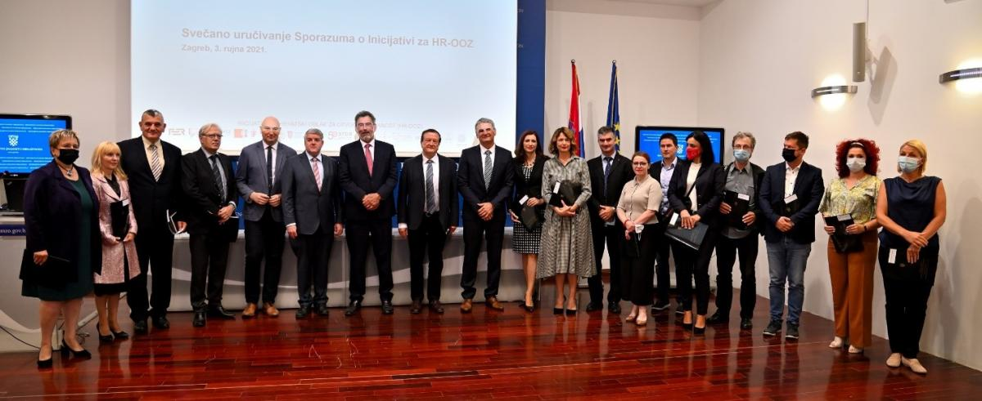
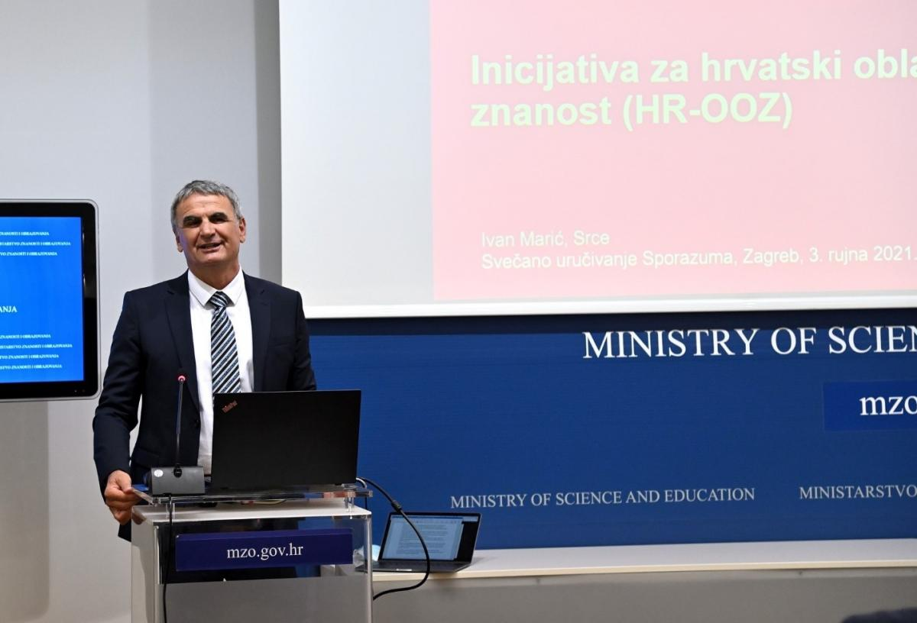
The Croatian Open Science Cloud (HR-OOZ) Initiative
The HR-OOZ Initiative marked the beginning of its activities on September 3rd, 2021 at the Ministry of Science and Education of the Republic of Croatia where founding members of the HR-OOZ Initiative (21 member) received the signed Memorandum of Understanding of the HR-OOZ Initiative

Slide 13
The Croatian Open Science Cloud (HR-OOZ) Initiative
The Initiative was launched with the support of the Ministry of Science and Education of the Republic of Croatia and the Croatian Science Foundation and gathered
all Croatian public universities,
Croatian institutions - coordinators of ERIC’s (DARIAH-HR, HR-CLARIN, CERIC-ERIC, CROSSDA the public research data service and the national service provider for the CESSDA ERIC), and
OpenAIRE NOAD, NGI and national RDA node coordinators.

Slide 14
Objectives of the Initiative
The main objectives of the Initiative are:
setting up and defining organizational and governance structures, and technical components for the long-term sustainability of HR-OOZ
drafting the proposal of the National Action Plan for Open Science and proposal of the law governing the scientific activity in the part related to the open science.

Slide 15
HR-OOZ Councile and Task Forces
The Council of the HR-OOZ Initiative is responsible for the management and coordination of the HR-OOZ Initiative
The members of the Council are leaders of contracting parties or persons authorized by them to represent the institution in the Council
Two task forces were established with aim to fufill Initative goals
Task force for drafting the proposal of the national plan and policies for open science
Task force for defining the structure and principles of HR-OOZ

Slide 16
Task force for drafting the proposal of the national plan and policies for open science
Goals:
write a proposal for a national open science plan
write a proposal for the provisions of the law governing scientific activity in the part related to the topic of open science
develop an open science policy template that institutions in the science and higher education systems can, if necessary, refine and adopt
Results:
proposal of national open science plan (draft version sent to Council)
proposal for provisions related to open science for the new law governing scientific activities (done)
open science policy template for the science and higher education institutions

Slide 17
Task force for defining the structure and principles of HR-OOZ
Goals:
define a sustainable organizational and management structure of HR-OOZ
define the principles and criteria for onboarding services in HR-OOZ
establishment of HR-OOZ services catalog
Results:
criteria for onboarding services in HR-OOZ (done)
draft of Rules of Procedure for HR-OOZ with the organizational and management structure (done)
established catalogue of HR-OOZ services and resources (in progress)

Slide 18
A (simple) way forward
EOSC-SB developments and EOSC-Association developments both need input from national stakeholders
Use of HR-OOZ (default)
Use of other channels:
National ERICs events/ mailing-lists;
OpenAIRE NOAD, National RDA and similar channels
SRCE PZZ (Program za zajednicu);
Add informal cafe-style gatherings, on regular basis, where ongoing topics can be shared and discussed
online calls via meet/zoom
once a month/6 weeks (?)
supported by a mailing list
Topics may include
EOSC-SB policy/opinion papers discussion
EOSC-Association Task-force developments
INFRA-EOSC projects update

Slide 19
Thnak you for your attention!

