Slide 1
SRCE Advanced Computing Service and bioinformatics
Marko Kvakić, Marko Hrženjak, Emir Imamagić
University Computing Centre

Slide 2
Contents
Projects
HR-ZOO & EuroCC
Supercomputers
Supek & Vrančić
Support
Advanced Computing Department & Bioinformatics
Software support and outreach

Slide 3
Projects
HR-ZOO & EuroCC

Slide 4
HR-ZOO
"Hrvatski znanstveni i obrazovni oblak" – "Croatian science and education cloud"
A nation-wide infrastructure project in the period 2018. - 2023.
Led by SRCE in partnership with three universities, one research institution and a government one
Aim
Provide a significant upgrade to the existing resources
A long-term foundation for the provision of advanced computing services to the Croatian scientific, research and education community
Key results
Cloud computing and storage resources distributed across 5 locations
High speed inter-connect network of 100 GB/s
Advanced computing – Supercomputing resources
Specialized support - E-scientists

Slide 5
Data centers
Rijeka
Osijek
Split
Zagreb @ Borongaj
Zagreb @ Marohnićeva

Slide 6
EuroCC – a wider European initiative
EuroCC
National competence centres across 33 countires
Onboarding & adoption of supercomputing in scientific and industrial activity
EuroHPC JU
Pooling of Europe's supercomputing resources
Combined power of around 700 PFLOPS
EuroCC logo

Slide 7
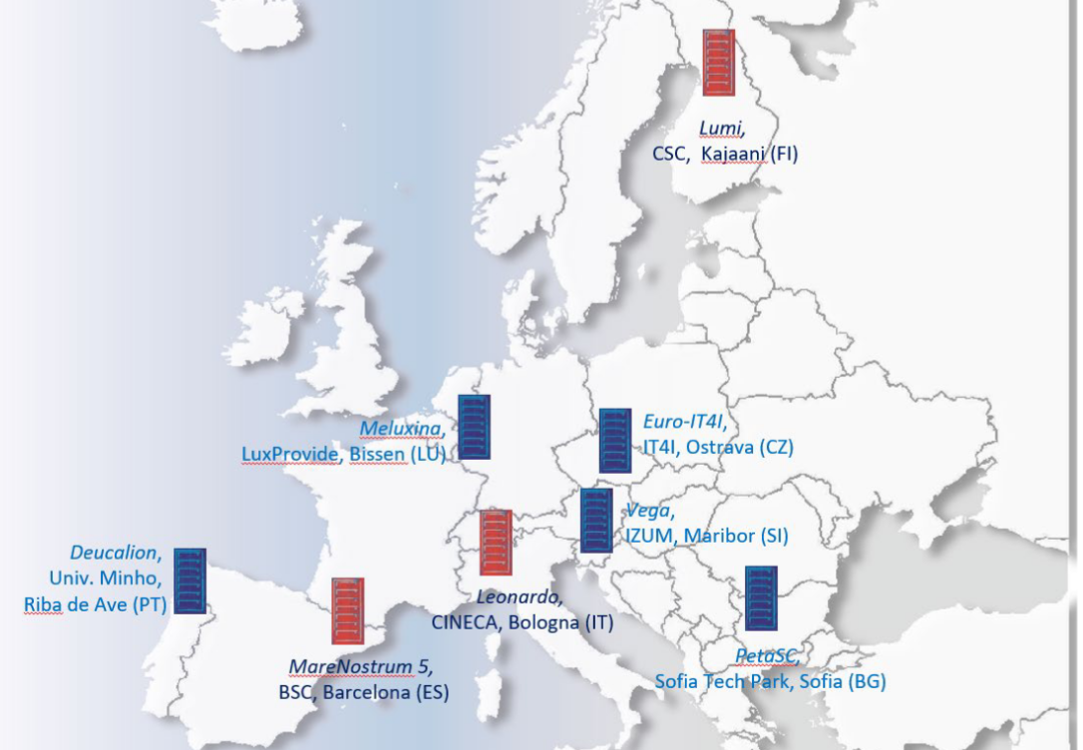
EuroCC – Europe's supercomputers
EuroHPC JU's supercomputers

Slide 8
Supercomputers
Supek & Vrančić

Slide 9
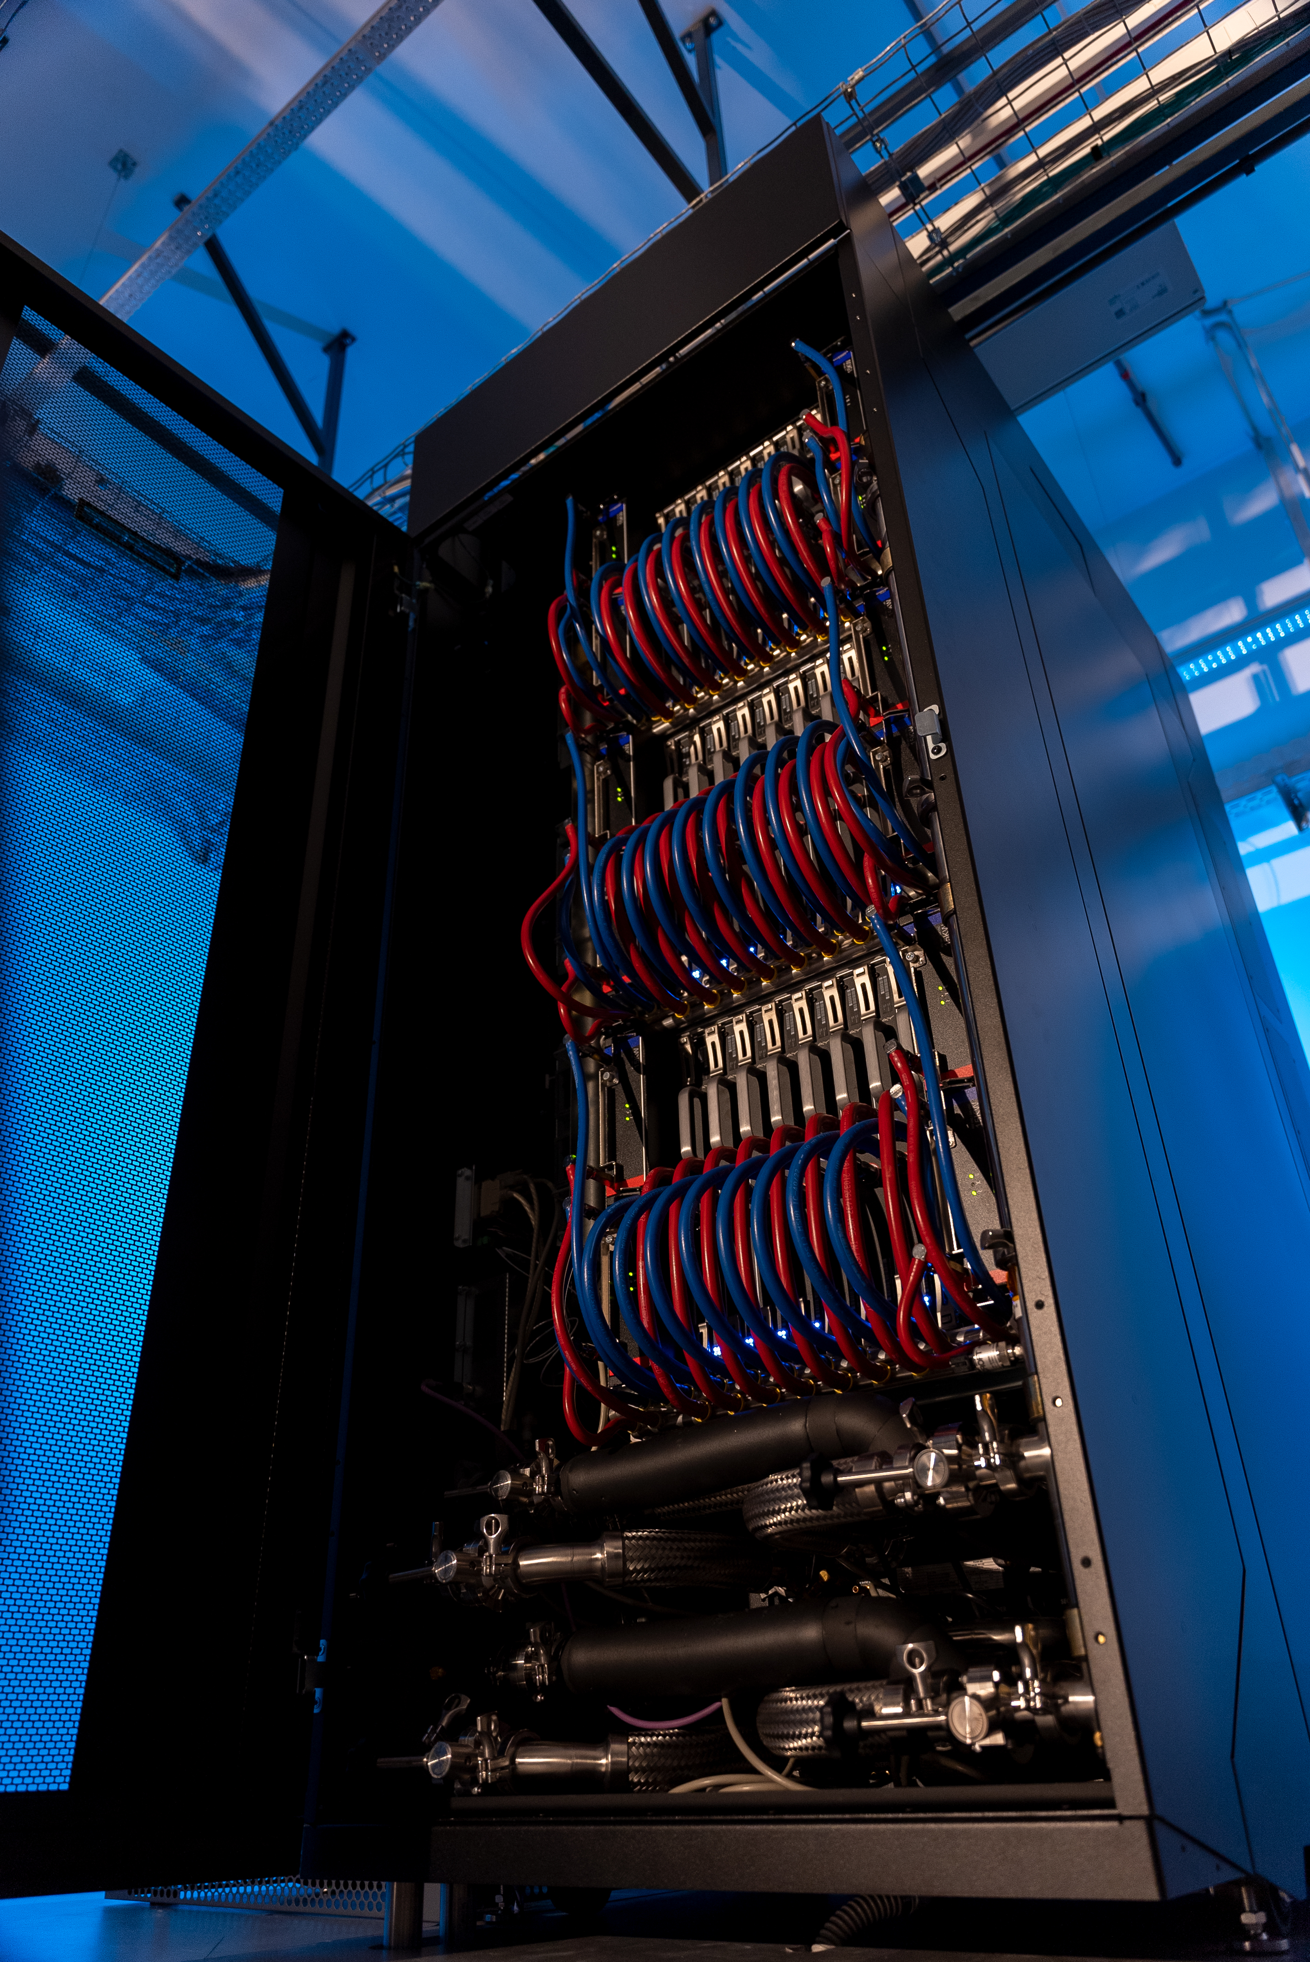
Supek & Vrančić
Ivan Supek
Velikan hrvatske znanosti

Slide 10
Terminology
Supek
HPC – "High performance computing"
A monolithic computing system for intensive computing workloads
"A lot of resources during a short period of time"
Use cases
Modelling via simulations
Analysis of large swathes of data
Artificial intelligence
Vrančić
HTC – "High throughput computing"
A sizeable computing system for long running, independent tasks
"A small amount of resources over an extended period of time"
Use cases
Flexible allocation of computing resources for specific needs
Web interfaces for interactive processing and analysis

Slide 11
Specifications
 | Supek | Vrančić
Processing | 8320 CPU + 80 GPU | 11520 CPU + 12 GPU
Memory | 27,9 TB | 57,5 TB
Network | Slingshot - 200 Gb/s | Ethernet - 25 Gb/s
Storage | 580TB + 2PB | 200TB + 1PB
Provisioning | Cray PE & PBS | OpenStack & Ceph

Slide 12
Support
Advanced Computing Department & Bioinformatics

Slide 13
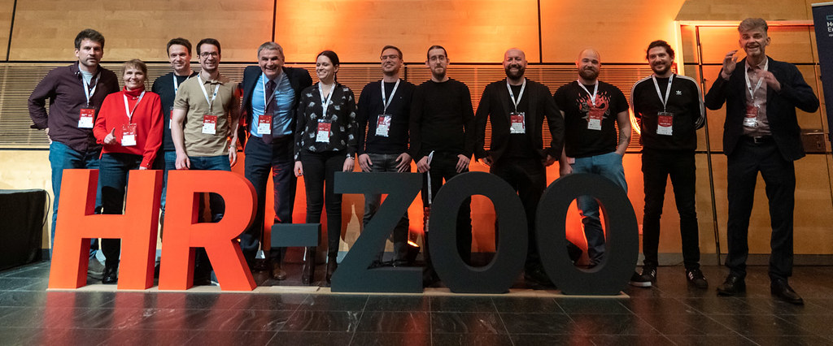
Advanced Computing Department
"Sektor za napredno računanje" - SNR
SNR @ DEI 2022

Slide 14
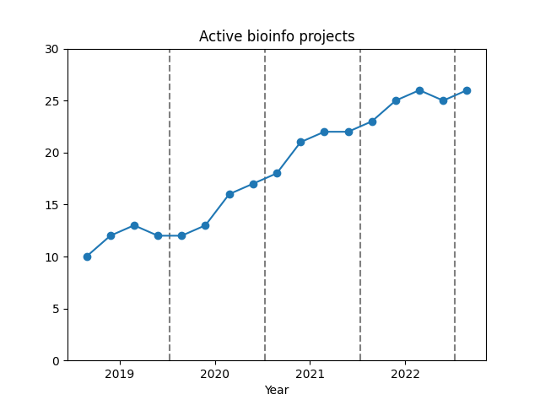
Bioinformatics @ SNR
Institutions
5 universities
2 research institutes
Topics
Ecology
Plant & animal sciences
Medical sciences

Slide 15
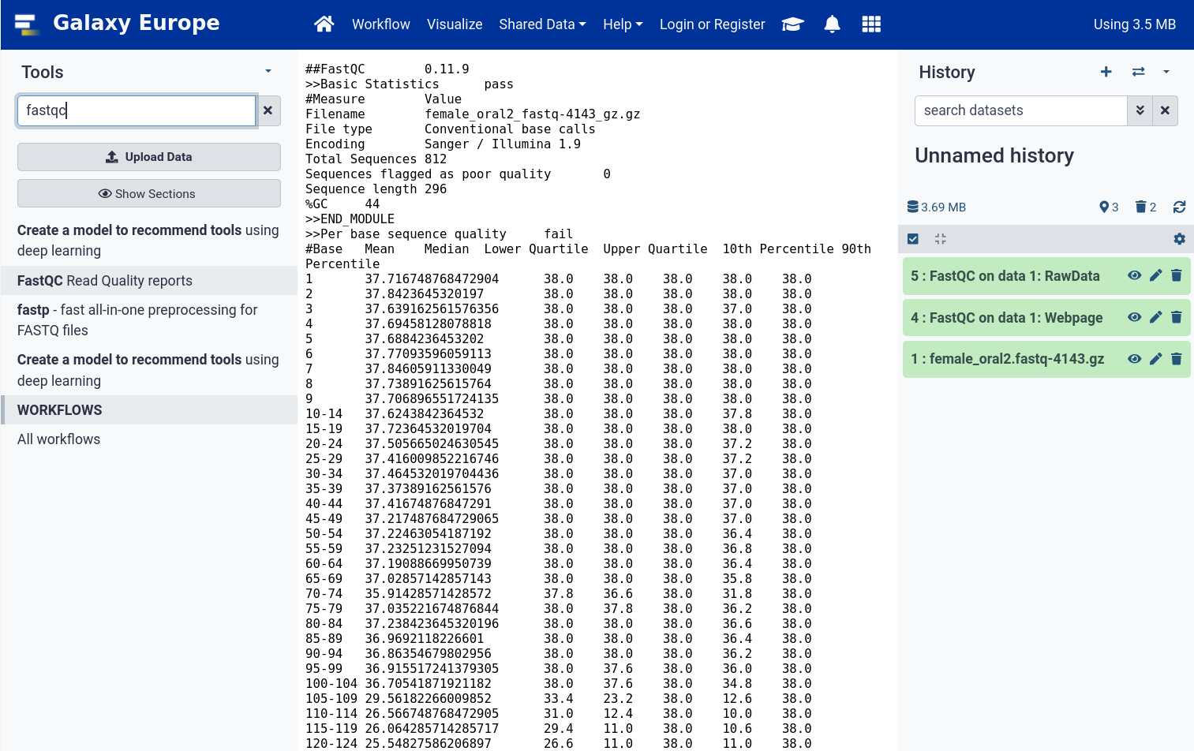
Bioinformatics support
HPC
Simulation – Alphafold
Basecalling – Bonito, Megalodon
Alignment – BLAST, Clustal Omega
Gene clustering – Structure threader
Phylogenetic analysis - MrBayes
HTC
JupyterLab – R & python
Galaxy – Web interface with common bioinfo tools
Padobran
fastqc via Galaxy

Slide 16
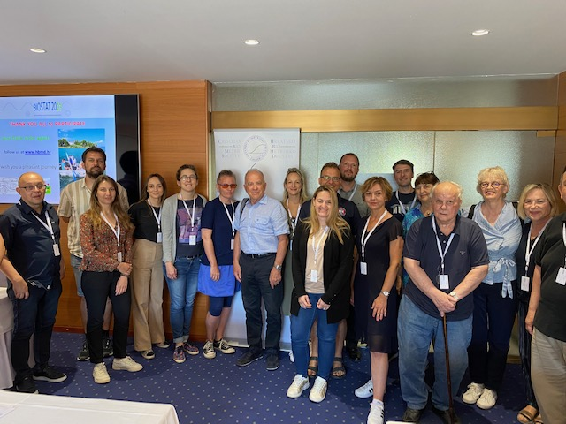
Bioinformatics & user outreach
Workshops
How to use HPC & HTC
Roundtables
Meet users & get feedback
Promotion & Support
Visiting conferences & workshops like Medils Bioinfo Summer school :)
BIOSTAT 2023

Slide 17
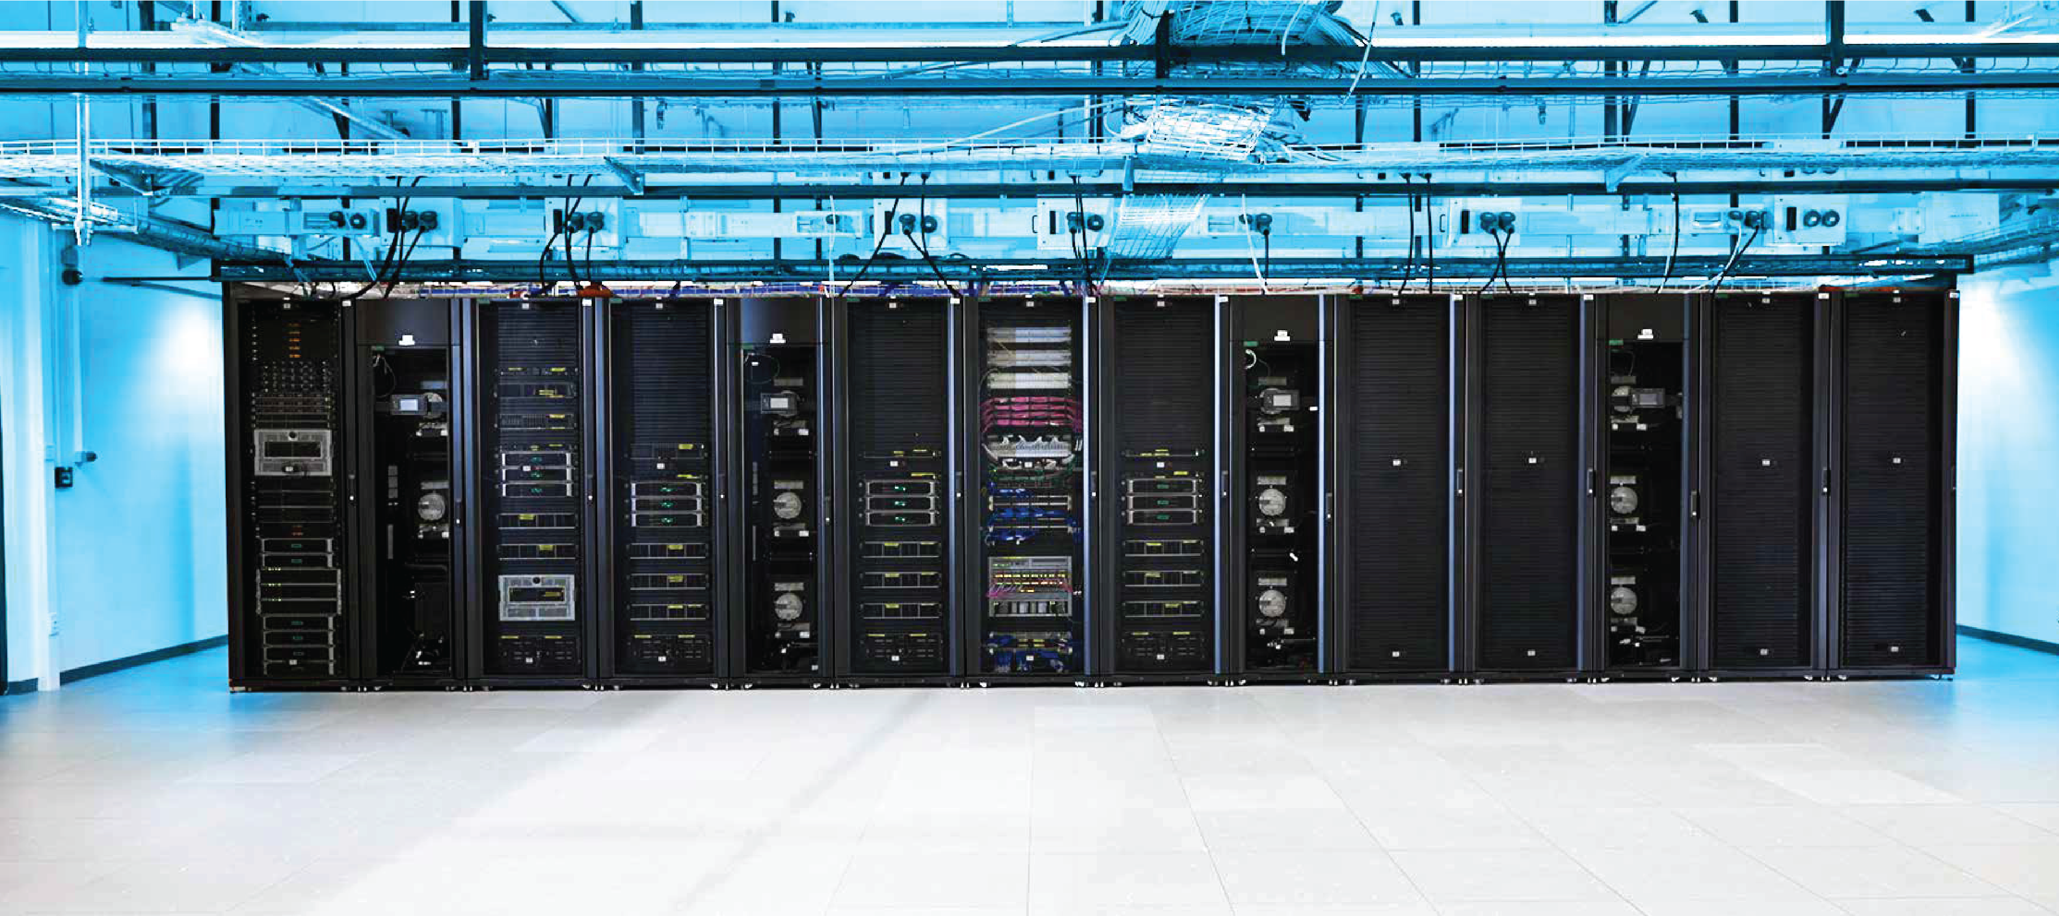
Medils bioinfo virtual machine
Specs
AMD Epyc 7713 @ 2.00 GHz
485 Gb RAM
3 TB of shared disk drive
Software
Rserver
Plink2.0 / Plink1.9
Bioconda stuff – multiqc, bcftools, samtools
Fastqc
HTC @ Vrančić supercomputer

Slide 18
Thank you for your attention!
https://www.srce.unizg.hr/napredno-racunanje/
computing@srce.hr

