Slide 1
SRCE for Open Science
National e-infrastructure and digital services
Ivan Marić, Martin Belavić, Draženko Celjak, Petra Udovičić
www.srce.unizg.hr
3rd DARIAH-HR International Conference, 25-27 October 2023
University of Zagreb, University Computing Centre – SRCE

Slide 2
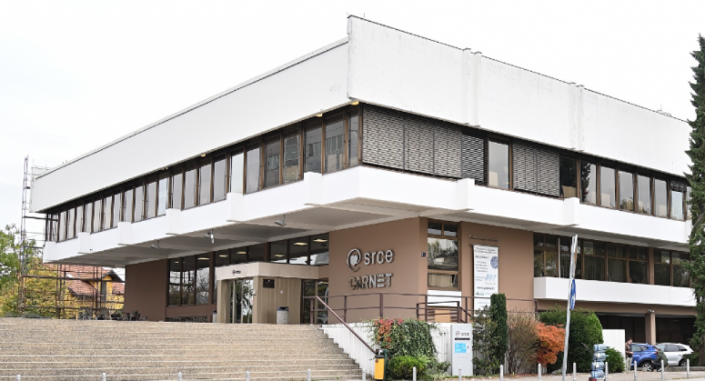
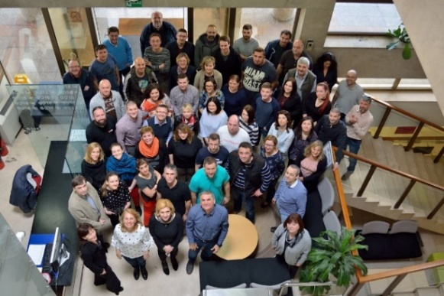
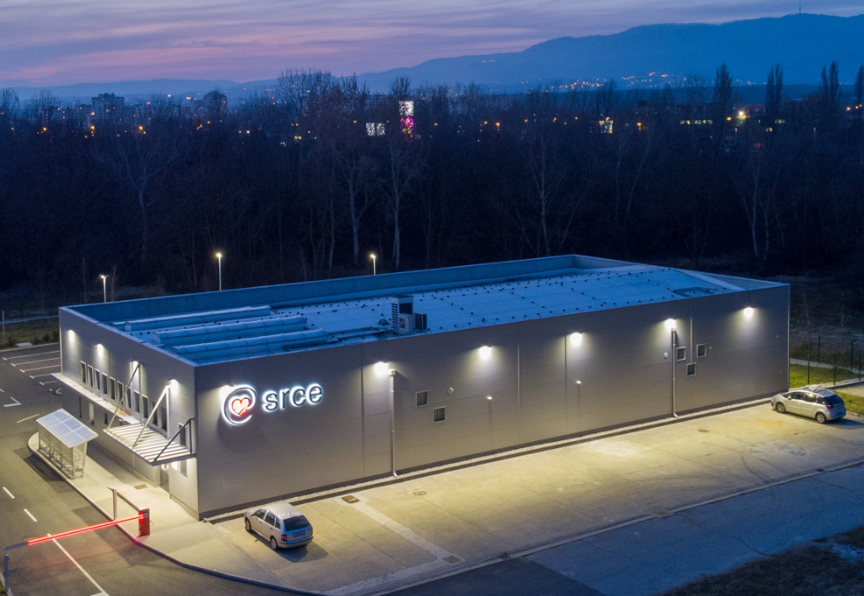
University computing centre - SRCE
Organisation
~ 170 employees
11 organizational units
3 locations
supporting digital transformation of education, research and business in the academic and science.
promoting Open Science and Open Education.
that builds and operate national e-infrastructure and digital services
30 public services for the needs of the academic and scientific community in Croatia

Slide 3
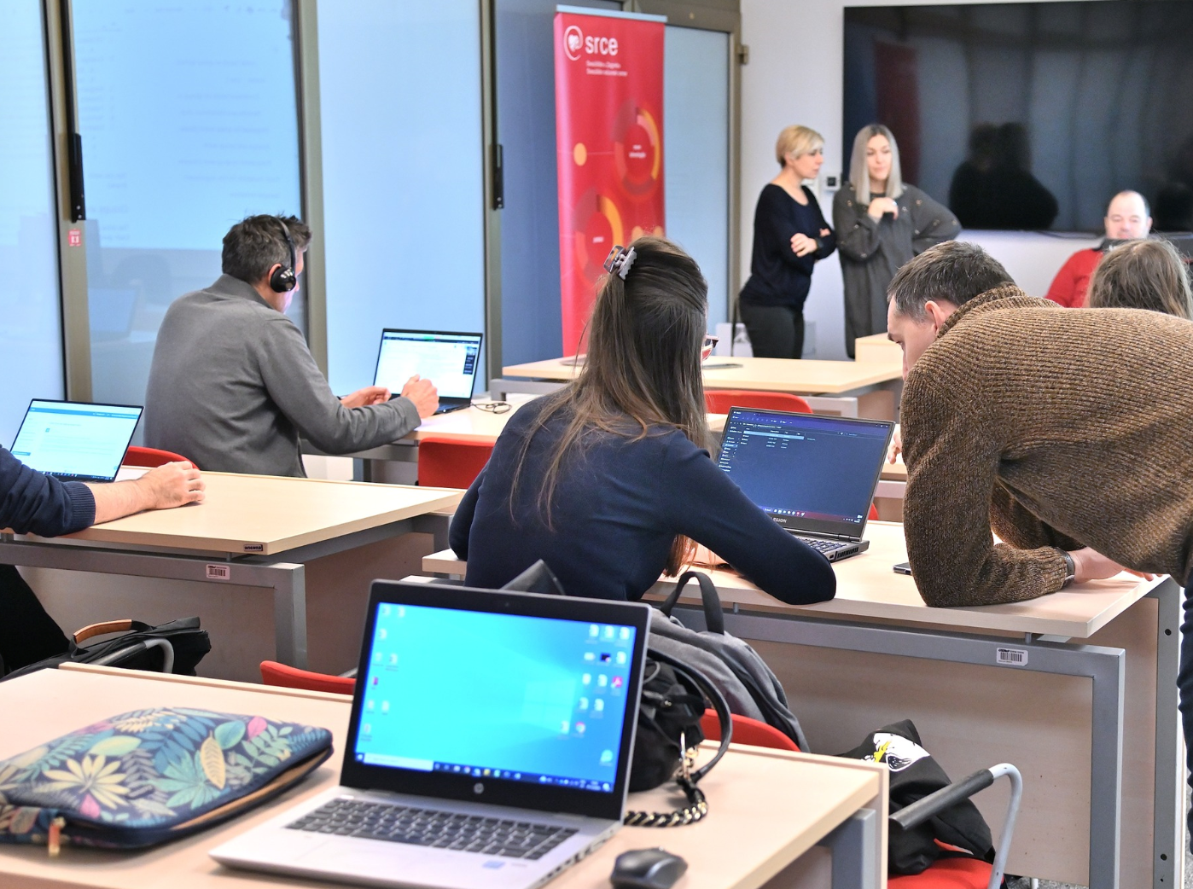
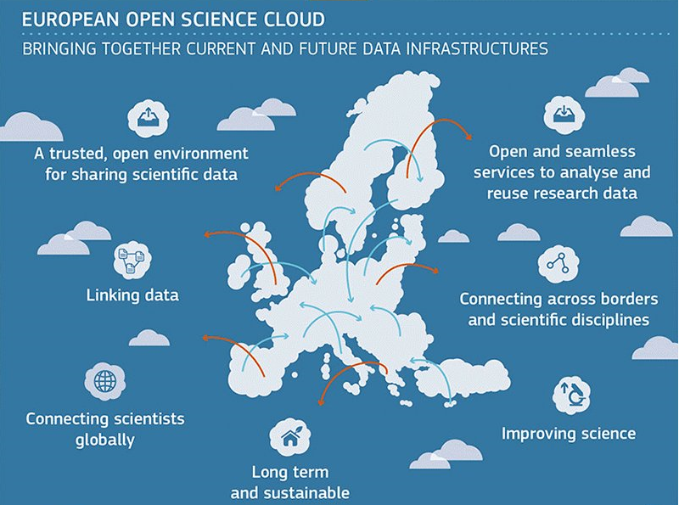
SRCE…
… Builds national e-infrastructure,
from data centres, through network, computer
and storage resources, all the way to information services
… Provides digital services, education of users and advanced user support
… Builds bridges to international infrastructures and initiative
… Is a synonym for a digital transformation of science and higher education system

Slide 4
SRCE & e-infrastucture
AAI@EduHr
National eduroam operator
Croatian scientific and educational cloud (HR-ZOO)
National
RDA node
Support centres for information systems ISVU, ISSP,
CroRIS, ISeVO
National Competence Centre for HPC
Croatian
Open Science Cloud (HR-OOZ)
National and university e-learning centre
EDIH …

Slide 5
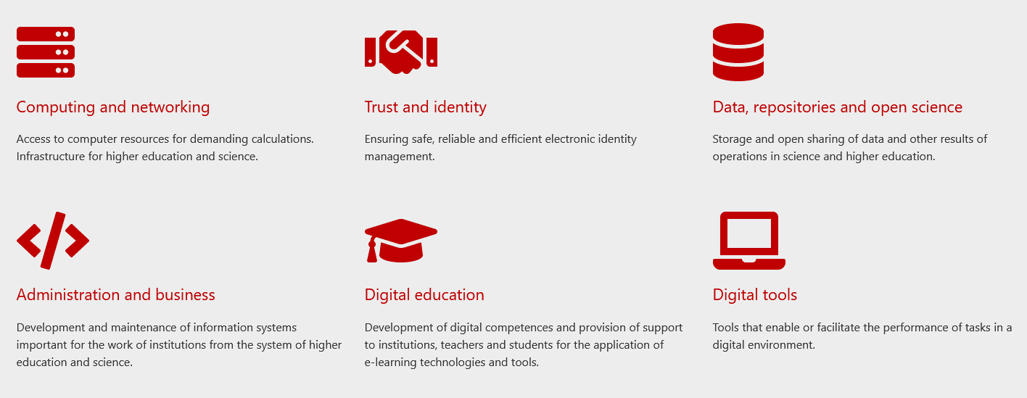
SRCE service catalogue

Slide 6
SRCE for Open Science
Computing
Advanced computing
Virtual data centres
Scientific software
Specialiased support
Data infrastructure & services
Information systems
e-identity
AAI@EduHr
Authentication and authorization infrastructure of research and higher education
Initiative & membership
Mandate organisation in EOSC Association
Coordinator of Croatian Open Science Cloud (HR-OOZ) Initiative
Croatian RDA node
and more…
CROATIAN
RESEARCH
INFORMATION
SYSTEM

Slide 7
SRCE for Open Science
COMPUTING
Advanced Computing & Cloud Services
Research data management
HPC
HTC Cloud
Cloud services
PLAN
REUSE
COLLECT
RESEARCH
DATA LIFE
CYCLE
Scientific papers publication
Permanent storage and research results sharing
Data storage during research process
DATA SERVICES
during all phases of research process
SHARE
PROCESS
PRESERVE
ANALYZE

Slide 8
Croatian Scientific and Educational Cloud (HR-ZOO)
Ivan Marić

Slide 9
Results of project HR-ZOO
New generation of e-infrastructure
Reliable and modern HR-ZOO data centres
adequate spaces for the accommodation of computer and storage resources
conditions for the development of local IRI infrastructure at the universities in Osijek, Rijeka, Split and Zagreb
Network connectivity of data centres
the new backbone of the CARNET network
Advanced ICT resources & services
High Performance Computing (HPC) – Advanced computing „Supek”
High Throughput Computing (HTC) – Advanced cloud computing „Vrančić”
High Scalability Computing (HSC) – Virtual data centres „Štampar”
storage space for preserving large data collections
Specialized teams and support
a team of top experts for specialized support to scientists, teachers and students
maintenance and further development of e-infrastructure
software support (collaboration tools and scientific software).
Project HR-ZOO
Coordinator: SRCE Reference: KK.01.1.1.08.0001 Project value: 25 mil. EUR EU contribution: 21 mil. EUR Implementation: 2017 - 2023
https://www.srce.unizg.hr/hr-zoo/en
Project is co-funded by European Union from European Regional Development Fund

Slide 10
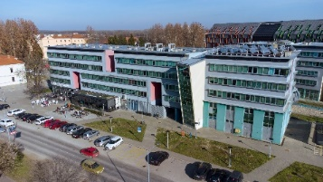
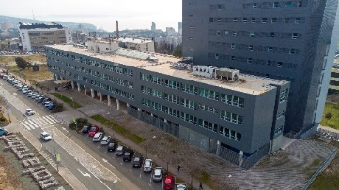
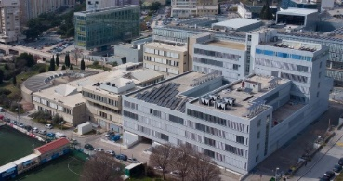
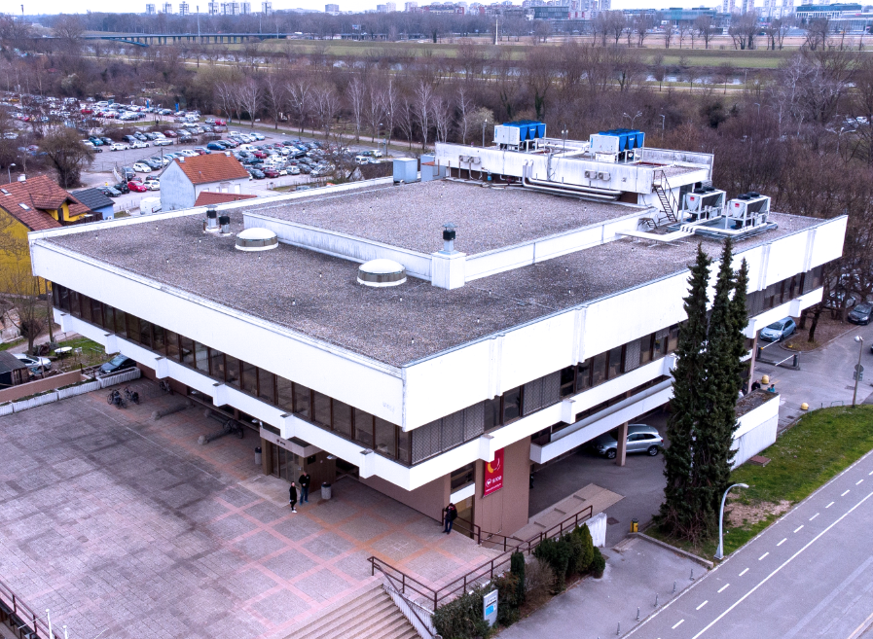
HR-ZOO data centres & network
HR-ZOO ZG2
HR-ZOO ZG1
HR-ZOO OS
HR-ZOO RI
A network of 5 data centres connected by a broadband network with a transmission capacity of 100 Gbit/s
Connected through CARNET-GÉANT, the national e-infrastructure is connected to e-infrastructures in Europe and the world
HR-ZOO ST
Ivan Supek
Andrija Štampar
HR-ZOO
Notes:
HR-ZOO represents a new generation of national e-infrastructure consisting of advanced computing and storage resources located in five data centres in four university cities, along with several associated digital services. Data centres have been connected with network capacities of 100 Gbit/s (upgrade the backbone of the national academic and research network CARNET). By connecting to the GEANT PoP, the national e-infrastructure connects to e-infrastructures in Europe and the world.

Slide 11
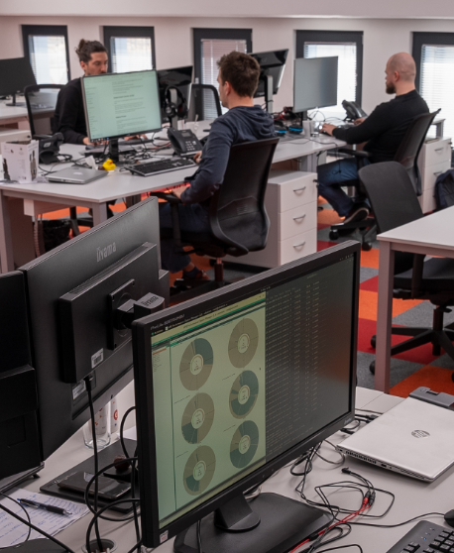
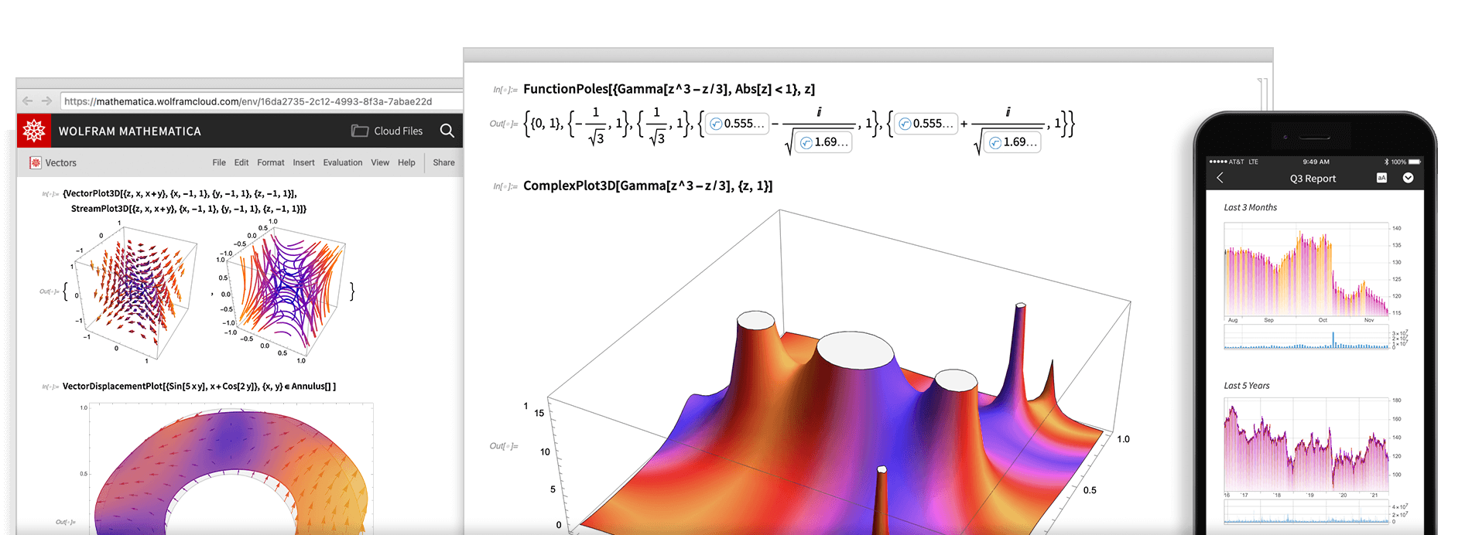
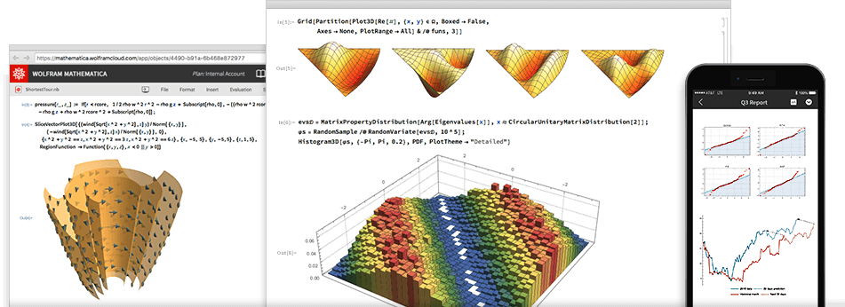
New and improved SRCE services within project HR-ZOO
ADVANCED COMPUTING
VIRTUAL DATA CENTRES
SPECIALIZED SUPPORT
SCIENTIFIC SOFTWARE
Ivan Supek
Andrija Štampar
Faust Vrančić
Notes:
„Supek” is supercomputer based on HPE Cray technology and consists of 8384 processor cores, 81 GPUs, and 32 TB of working memory providing a power of 1.25 PFLOPS, which makes it the first petascale supercomputer in Croatia. It is located in the area of the newly built data centre at University Campus Borongaj in Zagreb.
Advanced cloud computing "Vrančić" is designed for scientists in need of a flexible, elastic, and versatile computing resource capable of meeting the diverse requirements of various scientific fields. Consist of 11.000 core processors, 16 GPUs, 3 PB of high performance storage.
„Štampar” - Virtual Data Centres – based on cloud computing with 1800 redundant virtual servers in high availability mode, 10 PB of disk space.

Slide 12
Advanced Computing & Storage Infrastructure
Martin Belavić

Slide 13
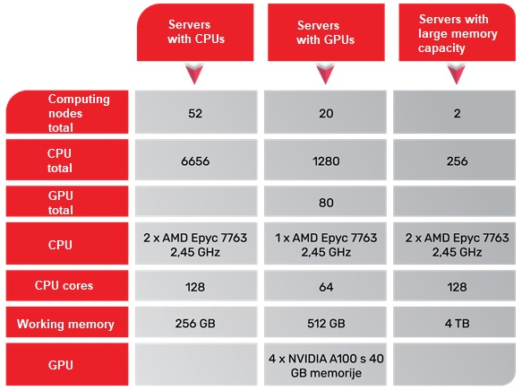
Advanced computing with „Supek”
The service is established on a High-performance computing resource (HPC) and it is intended for the execution of user applications with very high performance requirements and the capacity of various computer resources - processor cores, accelerators such as graphics processors, working memory, storage and network connectivity.
Advanced computing environment with a power of 1.25 PFLOPS with a total of:
8384 processor cores
80 graphic processors
32 TB of working memory
Ivan Supek

Slide 14
Advanced cloud computing with „Vrančić”
The service is established on a resource for High-throughput computing (HTC), intended for a wider set of user applications and systems that require a specific programming environment and significant processing and memory resources.
Adaptable, elastic and versatile computing environment.
Ivan Supek

Slide 15
Registration and access to advanced computing service
Rules for using the advanced computing service
web form for registration and submission of requests
The right to access the HPC resource is granted:
to research projects that are funded from public sources (must be verified in Croatian Research Information System – CroRIS),
to institutional research project (the request can be submitted by persons who are registered scientists, but not registered on any active project in the CroRIS system),
for the preparation of final, graduate, specialist and doctoral theses at public universities and public scientific institutes
for the purposes of conducting practical classes at public universities and public scientific institutes
The request for use is submitted by:
Project manager for research project
Teacher - mentor in the case of theses preparation
Course teacher in the case of practical classes (only Vrančić!).

Slide 16
Use cases
Projects:
Cross-lingual Event-centric Open Analytics Research Academy (CLEOPATRA) - University of Zagreb Faculty of Humanities and Social Sciences (FFZG)
Comapring the predictiveness of different representations of psycholinguistic variables for reaction times in the lexical decision task - FFZG
Image-computable model of working memory based on deep learning - FFZG
Seismic risk assessment of cultural heritage building in Croatia – University of Zagreb Faculty of Science (PMF)
Tools and applications:
Deep Learning
Artificial intelligence (AI)
Large language model (LLM)
PLAN
REUSE
COLLECT
SHARE
PROCESS
PRESERVE
ANALYZE
EGI Impact report
for 2022
88 researchers from Croatia used
the services of the
EGI federation
500 peer reviewed scientific publications
were produced by research communities from Croatia and supported by the EGI Federation

Slide 17
Croatian Competence Centre for HPC (HR HPC CC)
ONE-STOP-SHOP FOR HPC
The Croatian Competence Centre for HPC is a place where users from the academic and scientific community, industry, and public administration get support in the application of the national and European infrastructure of High Performance Computing (HPC) in their work.
Services to and Interaction with Academia and Public Administration
Collaboration
Education and skills development in HPC/HPDA/AI
Services to and Interaction with Industry
Service Portfolio and Competence Management
HR HPC CC established within the project EuroCC as part of a network of national competence centres for HPC. Project EuroCC 2 is currently underway and will further improve the centre's services and competencies.
https://www.hpc-cc.hr/

Slide 18
T&I… enabeling mobility
AAI@EduHr
Authentication and Authorisation Infrastructure of science and higher education in Croatia
eduroam
safe, easy to use and,
for the end user, completely free Internet access service in Croatia
954 195
e-identity (users)
235
institutions (identity providers)
Security
Trust
Reliability
worldwide
32 000+ locations
106 countries
Croatia
1 152 locations
407 cities / places

Slide 19
Data infrastructure & services
Draženko Celjak

Slide 20
Data infrastructure & services for Open Science
CROATIAN OA JOURNALS
Since February 2006
536 scientific & professional journals (406 active)
285.000 + OA articles
65.000+ visits daily
PRESERVATION & DISEMINATION
Digital archives and repositories
16 types of digital objects
171 digital repositories of research & HE institutions
224.000 digital objects
(TEMPORARY)
STORAGE & SHARING SERVICE
570+ researchers and lecturers
200 GB (default)
PLAN
REUSE
COLLECT
SHARE
PROCESS
PRESERVE
ANALYZE

Slide 21
DABAR and Humanities
In DABAR’s repositories there are 13 datasets from the humanities
Representation by field
Representation by data type
Openness
Representation by licenses

Slide 22
SRCE provide education for open science practices
Providing education
for researchers
the competences and skills to apply open science practices
(educational materials, handbooks & courses)
Data steward
Data curator
The handbook: How to manage research data
Webinar How to organize and manage research data in a high-quality way
Video tutorial for publishing data sets into repositories of DABAR system
Guidelines for storing the Research Data Management Plan in a institutional repositories
Online courses Platforms, tools and good practices in the research life cycle:
Documentation and anonymization of research data
Research data management
Continuously hosting and participating in webinars and workshops devoted to the management of research data and open science
More about SRCE open science support services
Be
F
A
I
R
and
C
A
R
E
FINDABLE
ACCESSIBLE
INTER-OPERABLE
REUSABLE
COLLECTIVE (BENEFIT)
AUTHORITY TO CONTROL
RESPONSIBILITY
ETHICS

Slide 23
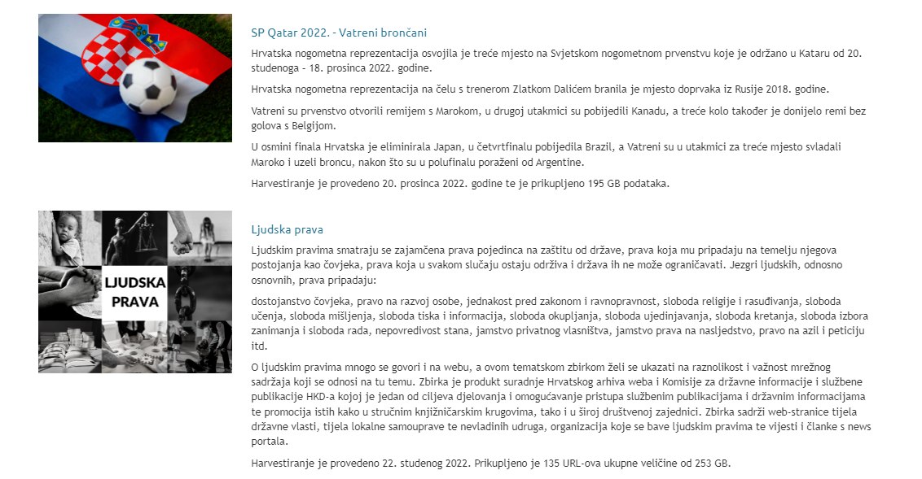
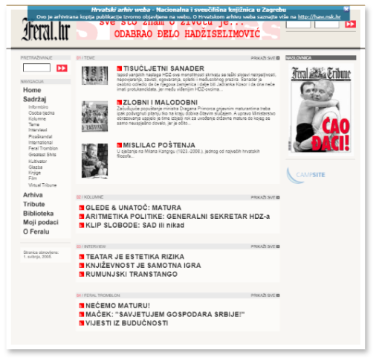
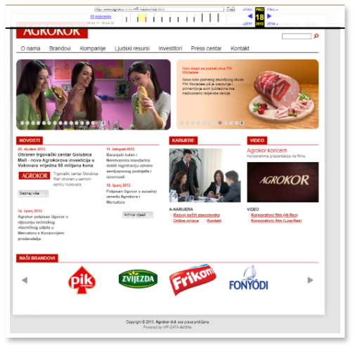
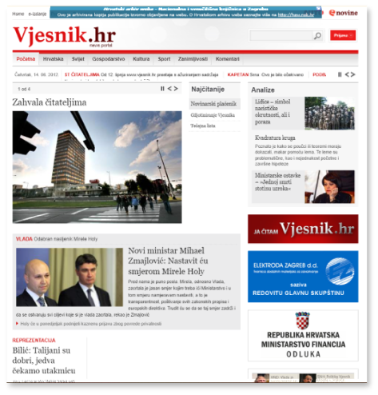
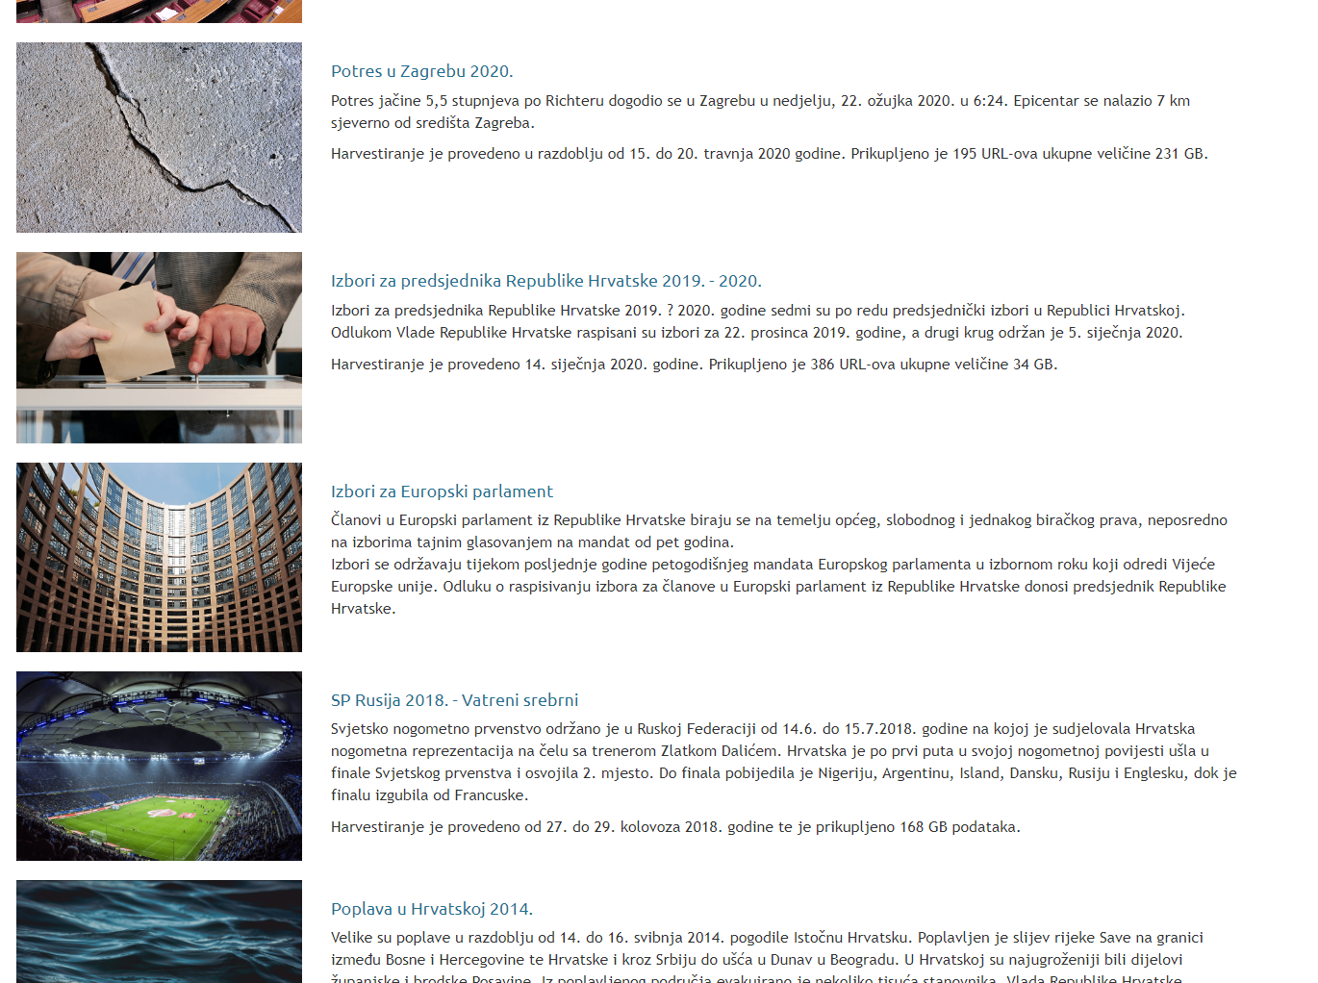
Croatian Web Archive (HAW)
An integral part of the Digital Collections of the National and University Library in Zagreb
A collection of web content, created with the purpose of downloading and permanently storing
The content on the web represents a significant part of contemporary Croatian cultural and scientific heritage
https://haw.nsk.hr/
145 TB
since 2004

Slide 24
Croatian Open Science Cloud (HR-OOZ) Initiative
Ivan Marić

Slide 25
Chronology
Open Science Policy of the University of Rijeka
Strategy of Education, Science &Technology
Declaration on the Application of Open Science Principles at the University of Zadar
Croatian Open Access Declaration
Research & Innovation Infrastructure Development Plan
HR-ZOO
HR-OOZ
CLARIN
ERIC
DARIAH
ERIC
CESSDA /
CROSSDA
EATRIS
ERIC
CRO GRID
C-ERIC (DONES)
CROSBI
HRČAK
ARA
DABAR
RDA NODE
CroRIS
CARNET
Isabella
CRO NGI
SRCE Cloud
HTC Cloud
1992
2003
2006
2012
2013
2014
2015
2016
2018
2019
2023
1997
2002
2007
2020
2024

Slide 26
Croatian Open Science Cloud (HR-OOZ) Initiative
HR-OOZ Initative
SRCE, as a mandated organization of the Republic of Croatia, became a full member of the EOSC association in December 2020, with the role of coordinating national initiative for open science
Gathering of all significant stakeholders in the Croatian science and higher education system during 2021
Memorandum of Understanding signed in September 2021
GOALS
National Open Science Cloud (HR-OOZ)
National Open Science Plan
https://www.srce.unizg.hr/en/hr-ooz

Slide 27
Achievements of HR-OOZ Initiative
Task Force
that created the proposal of the national plan and policies for open science
The National Open Science Plan - proposal
publicly presented at the EOSC National Tripartite Event in Zagreb, March 2023
The Ministry of Science and Education of Croatia is currently in proces of adoption
Council of the
HR-OOZ Initiative
constitution of the coordinating body that manages the Initiative which is composed of all signatories of the MoU
Task Force
that defined the structure and principles of HR-OOZ
HR-OOZ regulation (rulebook)
Inclusion criteria (for on boarding services and recourses)
Catalogue of HR-OOZ services and resources (in progress)

Slide 28
Croatian Open Science Plan – main goals
The Ministry of Science and Education is currently in proces of adoption
advance the understanding of the meaning, conception, advantages and practicing of open science in the academic and scientific community,
promote basic values and principles of open science such as responsibility, scientific integrity, ethics, research quality, research transparency, research reproducibility, sharing, cooperation, openness, equality, inclusiveness, diversity, flexibility, sustainability, etc.,
ensure preconditions (and remove obstacles) and create organizational, legal, financial and technical frameworks for the effective application of the principles and practices of open science in the science and higher education system in Croatia,
promote and apply a new system of evaluation and assessment in science and higher education, by using of adequate, new indicators of performance, quality and efficiency of research and education, introduce new indicators and criteria for evaluating institutions, rewarding and advancing teachers and researchers that will fully recognize the contributions to open science,
encourage and provide OA to publications and to all other results generated at different stages of research, especially those funded by public funds,

Slide 29
Croatian Open Science Plan - main goals
encourage and ensure systematic management and curation of research data complied with FAIR and CARE principles,
encourage and ensure the development and management of scientific software in accordance with open source licenses and provide OA to such software,
establish mechanisms of coordination, joint and coordinated planning, construction, maintenance, development and use of research infrastructures, including e-infrastructure, and their sustainability, integrity and interoperability with the involvement of the HR-OOZ,
ensure that researchers and teachers have the necessary competences and skills to apply open science practices and provide an adequate, sustainable and well-funded support system for the application of open science principles through a network of expert teams and institutions to support the application of the principles of open science,
provide connection of Croatian and European research area, including connection and interoperability of Croatian and European research infrastructures and e-infrastructures through interconnection of the HR-OOZ with the EOSC.

Slide 30
HR-ZOO & HR-OOZ & CroRIS
Analysis of existing research infrastructures, resources, services & e-infrastructures
Building HR-OOZ - the national infrastructure dedicated to open science
Structure and principles of HR-OOZ
HR-OOZ
CroRIS
HR-ZOO
HR HPC CC

Slide 31
HR-OOZ as a part of EOSC
HR-OOZ
Croatian Open Science Cloud
EOSC
European Open Science Cloud
ZG2
ZG1
OS
RI
ST
Key aspects:
Open science and FAIR data
A combination of existing and planned infrastructure
Cooperation between various disciplines and countries
Nacional
e-infrastructures,
services and service providers

Slide 32
Croatian Research Information System (CroRIS)
Petra Udovičić

Slide 33
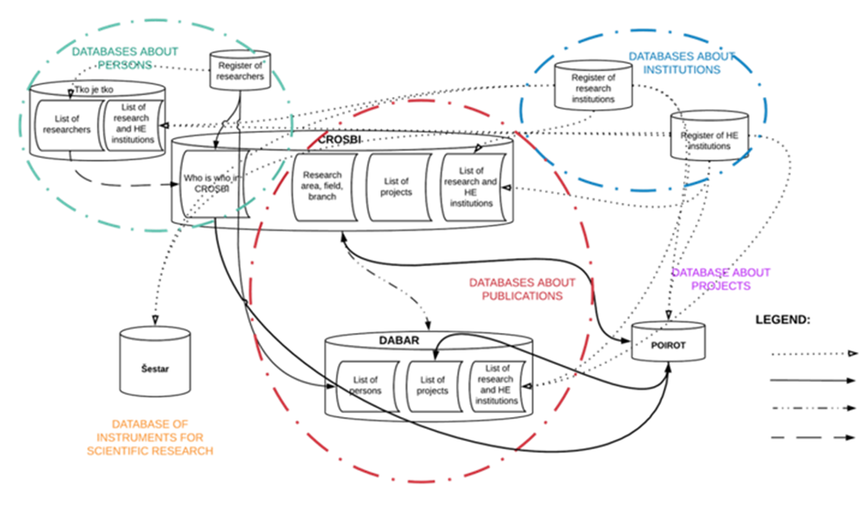
Before … data chaos

Slide 34
Croatian Research Information System (CroRIS)
Developed within project Scientific and Technological Foresight (2017-2023)
Co-funded by European Union from European Regional Development Fund.
CERIF based
Promote open science,
Provide information reliability,
Ensures openness and interoperability,
Support decision making.
www.croris.hr
Information and processes about institutions, researches, projects, publications, equipment, patents, services, events and much more,
Integration with many national systems and international platforms, such as ORCID, OpenAire, WoS, Scopus.
Ensuring data accuracy and quality,
Data verification,
Designated authorities and various user’s roles with responsibilities.

Slide 35
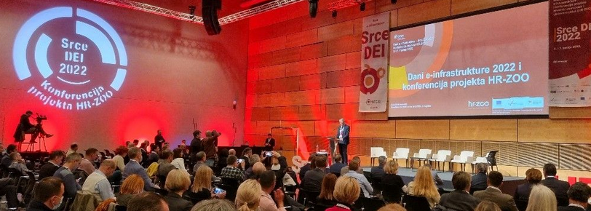
CroRIS – as Catalogue of HR-OOZ services and resources
RBI “POIROT”
Projects
Journals
MSE Register
Funding
Researchers
Publications
MSE Register
Scientific institutions
RBI “CROSBI”
RBI “Šestar”
Equipment and services
HE Institutions
Citations
Scientific disciplines
Events
Patents and products

Slide 36
CroRIS - authorities and various user’s roles
With elaborated role separation and scope limitation it is our goal to:
Raise data quality within the system,
Ensure validity of newly entered data,
Create order from disorder - establish comprehensive and accurate research information system in Croatia
Superadmin
Ruđer Bošković Institute
System admins
Coordinators
SCOPED
Editors
Institutions
Each institution appoints a CroRIS representative:
105 Coordinators
103 Project editors
86 Equipment editors
Basic user
+ Other specific roles

Slide 37
Institute of Ethnology and Folklore Research, Zagreb in CroRIS
Persons of IEF
33 registered employees
Publication of IEF
Journal article (1536)
Book chapter (943)
Proceeding paper (813)
Author's book (120)
Editorial book (120)
Assessment papers (81)
Other types of works (900)
Projects of IEF
21 registered project

Slide 38
Digital bridges to ERA / EHEA
user communities
pan-european communities

Slide 39
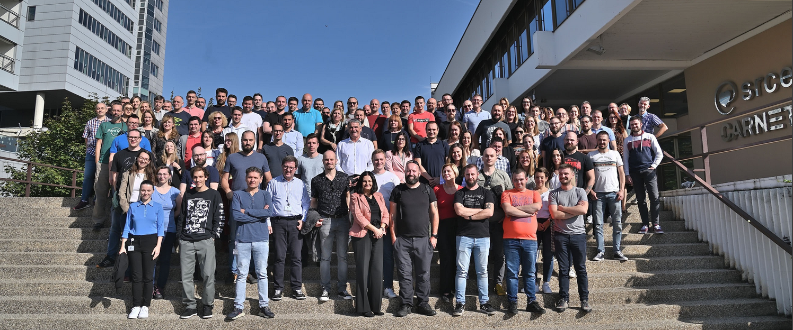
The key to Success
TECHNOLOGY
TALENTS
TOLERANCE

Slide 41
SRCE for Open Science
National e-infrastructure and digital services

