Slide 1
National (research) data storage & management service - PUH
Draženko Celjak
www.srce.unizg.hr/en
SRCE - University of Zagreb, University Computing Centre

Slide 2
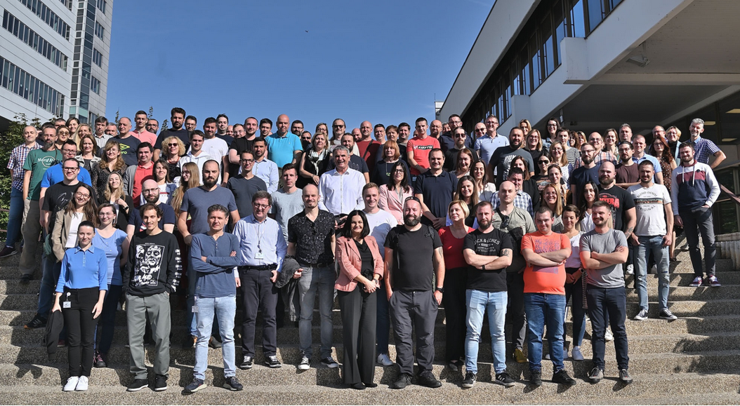
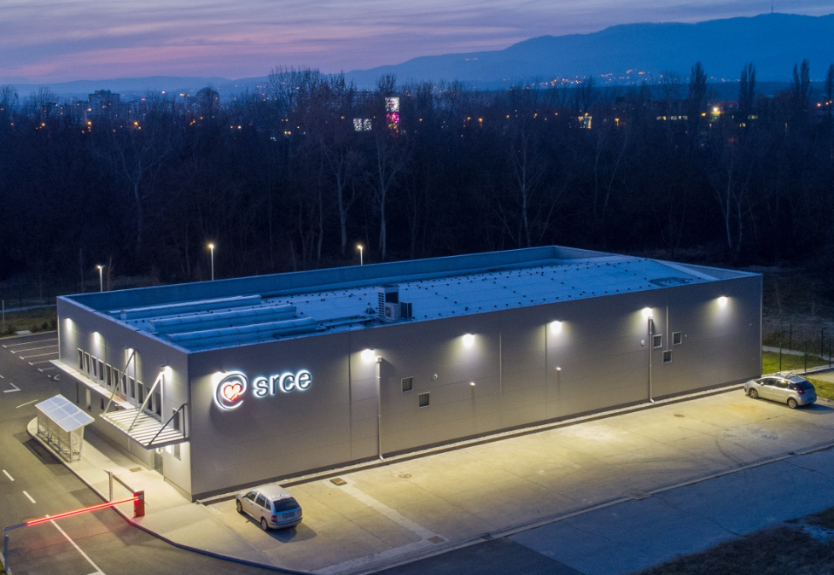
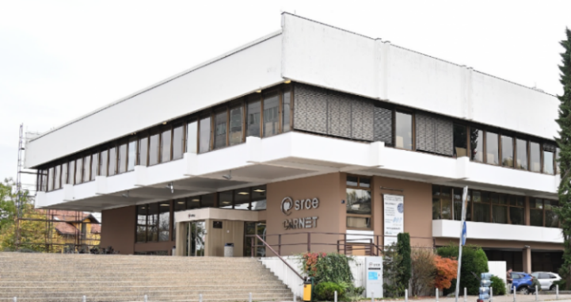
University computing centre - SRCE
Organisation
~ 170 employees
11 organizational units
3 locations
that builds and operate national
e-infrastructure and digital services
30 public services for the needs
of the academic and scientific community in Croatia
supporting digital transformation of education, research and business in the academic and science
promoting Open Science and Open Education.

Slide 3


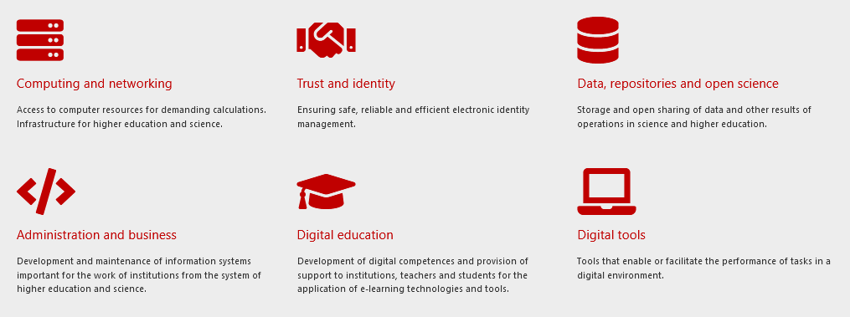





SRCE Services

Slide 4



Data infrastructure & services for Open Science
CROATIAN OA JOURNALS
Since February 2006
539 scientific & professional journals (410 active)
292.000 + OA articles
70.000+ visits daily
PRESERVATION & DISEMINATION
Digital archives and repositories
16 types of digital objects
172 digital repositories of research & HE institutions
250.000+ objects
(TEMPORARY)
DATA STORAGE & MANAGEMENT SERVICE
600+ researchers and lecturers
203 TB of data
PLAN
REUSE
COLLECT
SHARE
PROCESS
PRESERVE
ANALYZE

Slide 5
Timeline development of national storage service for active research data
2010
GSS
based on Global Storage System
July 2014
MyCloud
based on ownCloud
available to all users that had AAI@EduHr electronic identities (national AAI for HiEd and research)
large number of users
Data storage and management - PUH
based on NextCloud
changes in terms of use: focus on support to researchers & educational processes
November 2019

Slide 6
Data storage and management service PUH
in context of research:
  clearly defined as service to reliably store data and share it with the research team during the research projects
  final datasets should be published and preserved in repositories (national repository system DABAR)
minimal customizations:
  logo
  terms of use
  authorization
regular updates (~5-6 updates yearly)
using AAI@EduHr electronic identity and auto-provisioning to provide access to the service
in 2022 we switched to eduGAIN auth to support international research teams
default quota:
  200 GB
  biggest user curently: 120 TB
Nextcloud: support for web access, desktop app, mobile app, mounting of the storage as external drive on servers & PC-s

Slide 7
Current numbers and challenges
Number of users
Volume of data
Number of files
Number of research projects
600+
~203 TB
15.000.000+
179
Issue (since October 2023 / migration to new NFS): backup takes too long
NextCloud version: 26.0.1 (current version 28.0.2; lagging because of backup issues)

Slide 8
Resources
2 persons for the application, maintenance & user support
~25% and ~10% of working time
total 35% of 1 FTE + support from the Linux team + support from the infra team
8 cores
64 GB RAM
50 GB OS
150 GB DB
data - shared NFS (in use 203 TB)
8 cores
16 GB RAM
50 GB OS
150 GB DB
data - shared NFS
HUMAN
RESOURCES
HARDWARE
PRODUCTION
HARDWARE
TEST &
DEVELOPMENT

Slide 9
Plans for 2024
Terms of use
Survey among users on the need for NextCloud apps (plugins) with the goal to improve support for research and collaboration
Increase the initial
200 GB quota
Regulate how to remove (inactive) users and their data
Rely on the national
CRIS system to provide the access
Using info from DMPs that Croatian Science Foundation collects to plan resources

Slide 10
National data storage and management service - PUH
puh@srce.hr

