Slide 1
DABAR – The National Infrastructure for Digital Repositories
Draženko Celjak <drazenko.celjak@srce.hr>,
Zoran Bekić, Marko Cundeković, Ljiljana Jertec, Miroslav Milinović, Alen Zubić
SRCE – University of Zagreb, University Computing Centre

Slide 2
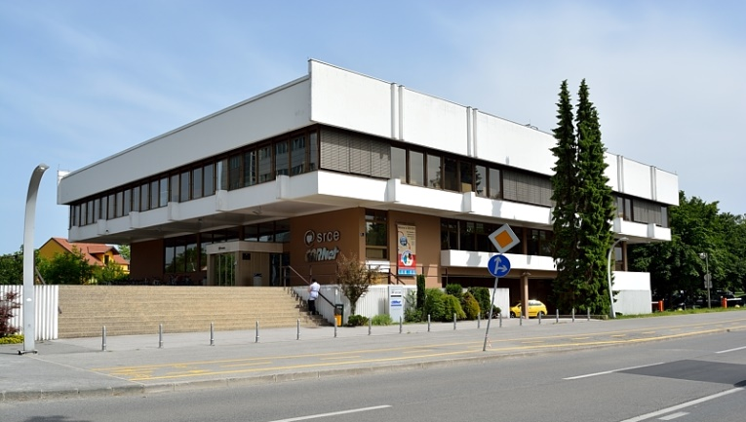
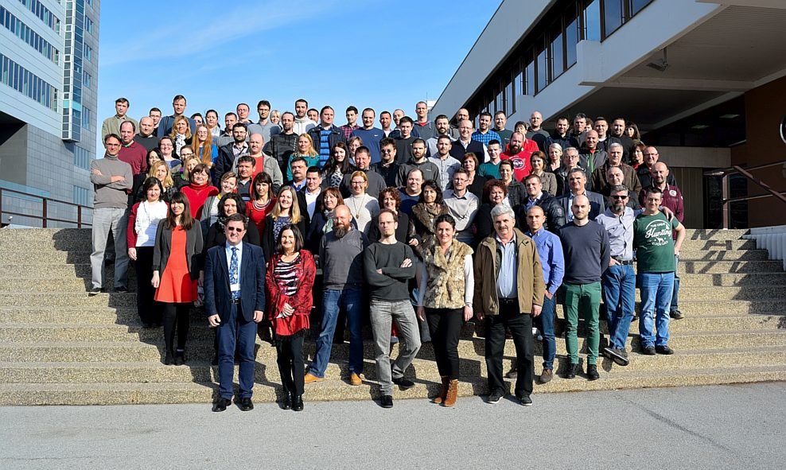
SRCE – University of Zagreb, University Computing Centre
SRCE was founded in 1971 within the University of Zagreb
SRCE is the main computing centre and the architect of the e-infrastructure, covering both the University of Zagreb and the whole research and high education system

Slide 3
Content
Context & motivation
R & HiEd community
OpenAccess in Croatia
Project
Goals
Results
DABAR service / infrastructure
Community
Conclusion

Slide 4
Context - Croatian R & HiEd
214 institutions
119 higher education institutions
25 research institutes
70 legal entities that are doing research (NUL, hospitals, archives…)

Slide 5
Context - Open Access in Croatia
2006
Science & Technology Policy of the Republic of Croatia
HRČAK (http://hrcak.srce.hr)…
2012.
Croatian OA Declaration
2013.
The Scientific Activity and Higher Education Act - requires universities and higher education institutions to permanently publish theses and dissertations in public databases
Institutional repositories?

Slide 6
Project
June 2014.
Goals
National infrastructure for digital repositories
scalable, interoperable, sustainable, flexible and suited for long term preservation
SaaS
Community (working groups)
information needs, application profiles, controlled vocabularies, education and user support
OA promotion

Slide 7
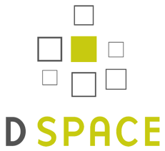
Software platform?

Slide 8
Islandora!
Islandora - designed to manage and discover digital assets
developement
multisite
https://github.com/alen-z/open-source-stamp.git
+ Jenkins, Selenium, Git, ...

Slide 9
Results: DABAR - scalable national infrastructure
Production: August 2015.
113 digital repositories
9 universities
2 national repositories

Slide 10
Results: Stored and published digital objects
37.300+ digital objects
15.750+ OA

Slide 11
Results: Community
Coordination committee + working groups
March 2016. - memorandum of understanding:
SRCE
Ruđer Bošković Institute
University of Zagreb School of Medicine
University of Zagreb Faculty of Humanities and Social Sciences
National and University Library in Zagreb
+ other institutions
Working groups (8 + 2):
Theses and disertations
Scientific and related works
Image, audio and video content
Interoperability
Long-term preservation
User functionality
Copyright
Education & Support
Research Data
Educational Resources

Slide 12
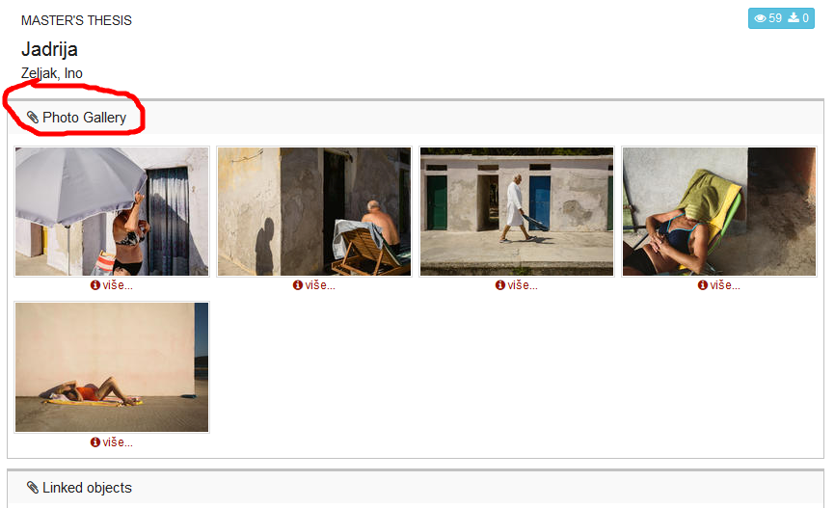
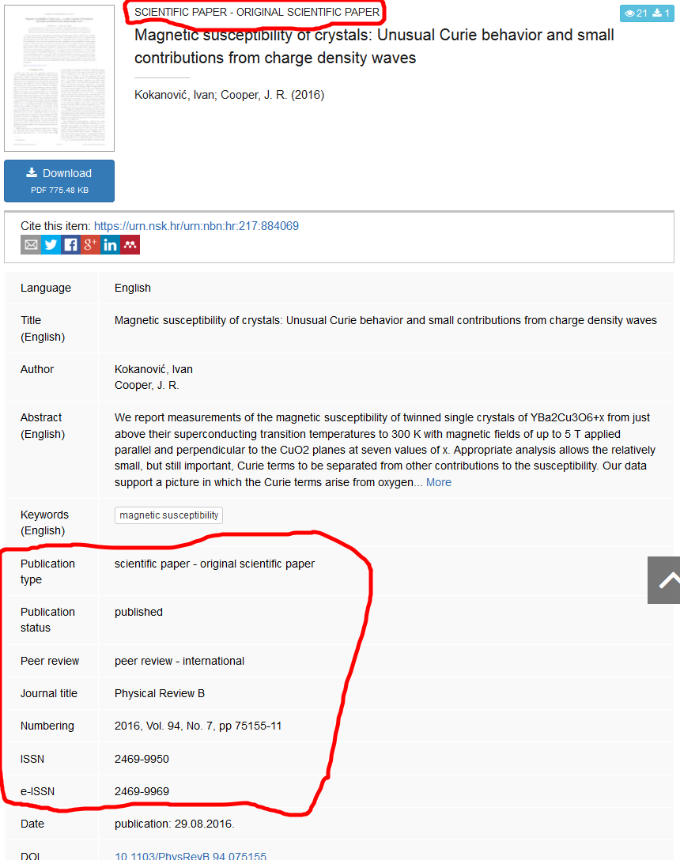
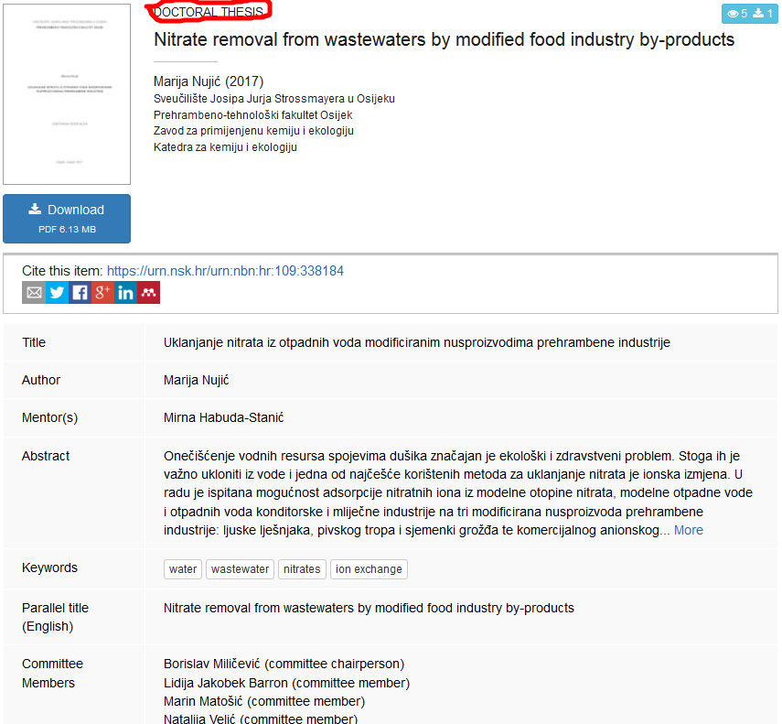
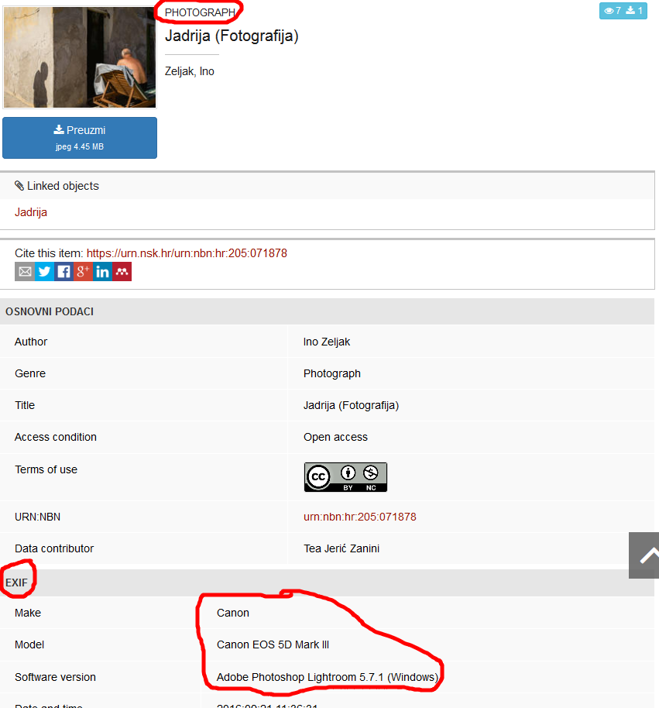
Results: 4+1 types of digital objects
Thesis Dissertations Articles published in journals Artistic works (photographs)
+ Appendices

Slide 13
Roadmap
Support for additional objects (digital asset):
Conference papers and presentations
Book chapters and books
Artisctic works (audio, video)
Research data
Educational resources
…

Slide 14
Results: Interoperability
DABAR’s integration with
national and global e-infrastructure

Slide 15
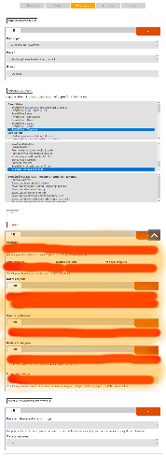
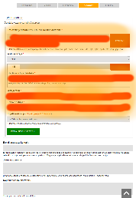
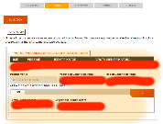
Results: rich metadata vs efficiency
Thesis
Paper published
in journal
HRČAK (OAI-PMH, KBART)
CROSBI (Web/MODS)
DOI/CrossRef (API)
Sherpa / ROMEO
AAI@EduHr
URN:NBN
PubMed Central (API)
Registry of Scientists
Croatian Higher Education Information System (ISVU)
Registry of Study Programs
AAI@EduHr
URN:NBN

Slide 16
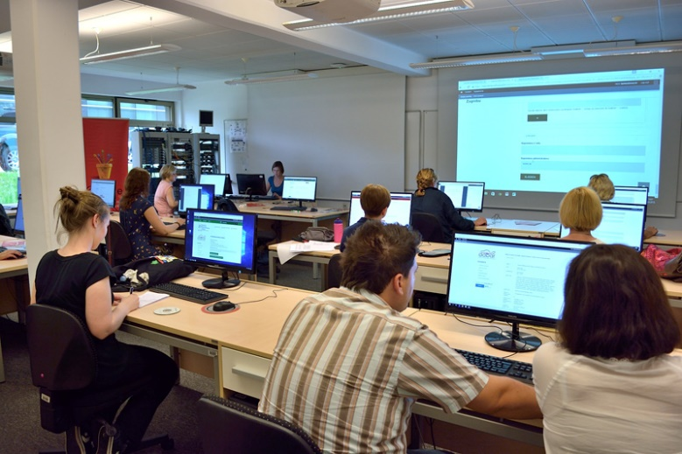
Results: Education & Support
14 workshops
182 participants

Slide 17
Conclusion
Scalable
Interoperable (standards)
Sustainable (community)
Cost effective

Slide 18
Thank you!
Questions?
https://dabar.srce.hr/en
dabar@srce.hr

