Slide 1
DABAR – Data Friendly
National Repository Infrastructure
Draženko Celjak, SRCE – University of Zagreb, University Computing Centre
5th Croatian ICARUS Days & ICARUS Convention #23
Pula, 27 March 2019

Slide 2
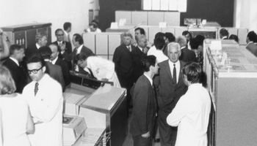
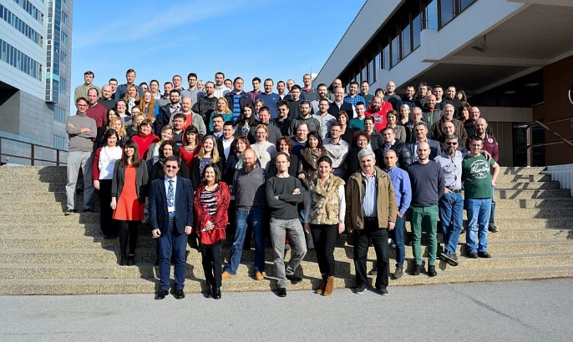
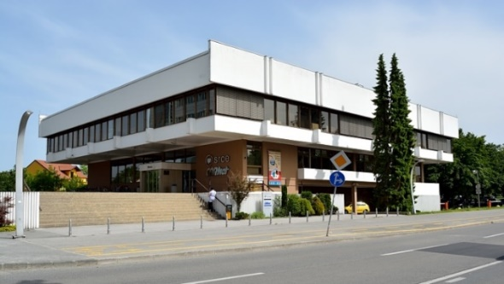
SRCE – University of Zagreb, University Computing Centre
main computing centre and the architect of the e-infrastructure
covering both the University of Zagreb and the whole research and high education system
1971.
Notes:
SRCE was founded in 1971 within the University of Zagreb

Slide 3
Croatian research and high education system?
214 institutions:
119 higher education institutions
25 public scientific institutes
70 other legal entities that registered scientific activity (National and University Library, Croatian Academy of Sciences and Arts, hospitals, archives...)
Source: Agency for science and higher education (AZVO)
Notes:
Source (2019-03-25):
https://www.azvo.hr/en/higher-education/higher-education-institutions-in-the-republic-of-croatia
https://www.azvo.hr/en/science/scientific-organisations

Slide 4

The project DABAR
June 2014
3 main goals:
National infrastructure for digital repositories
  scalable, interoperable, sustainable, flexible and suited for long term preservation
Community
  information needs, application profiles, controlled vocabularies, education and user support
Promotion of OA
Notes:
DDR 2014/03
OpenDOAR/2014: 6 repositories from Croatia: Hrčak, FOI, FFZG, MEF, FULIR, DIZBI

Slide 5
DABAR – Digital Academic Archives and Repositories
August 2015 - production
March 2019:
127 digital repositories
  10 universities
  2 national repositories
87.000+ digital objects
37.400+ OA
Notes:
43% OA
3,5 years

Slide 6
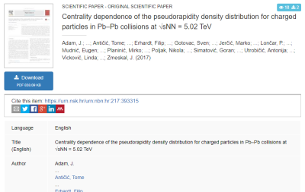
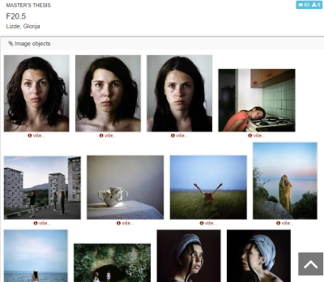
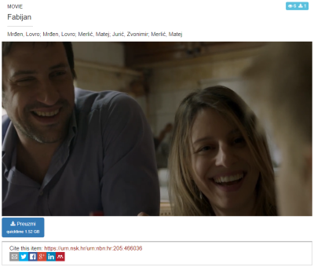
13 digital objects
(nationaly agreed)
Journal articles
Papers published in proceedings
Books
Book chapters
Conference abstracts and presentations
Theses
Artistic theses
Disertations
Appendices
Photographs
Audio objects
Audiovisual objects
Research data (datasets)
Notes:
Metadata agreed on a national level
https://urn.nsk.hr/urn:nbn:hr:205:258541 (photo)
https://urn.nsk.hr/urn:nbn:hr:205:466036 (video)
https://urn.nsk.hr/urn:nbn:hr:205:126638 (audio)

Slide 7
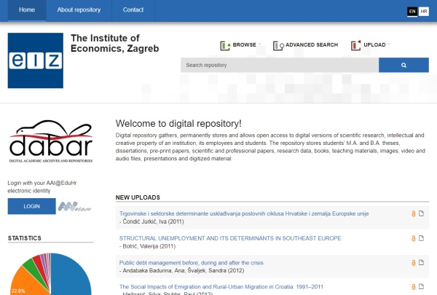
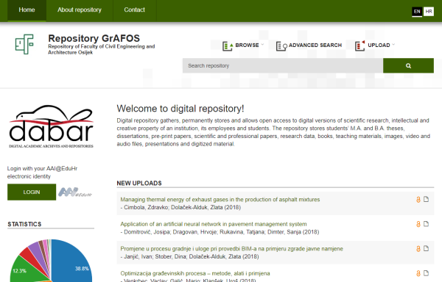
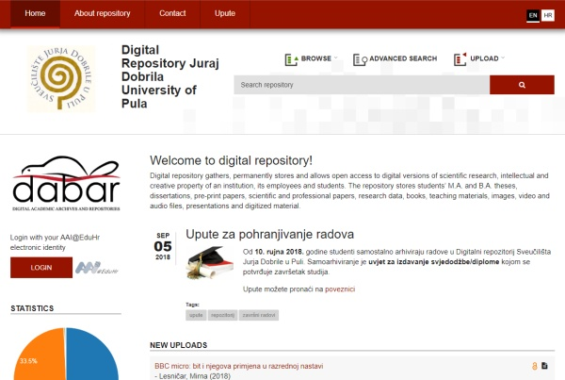
Repositories...
https://repozitorij.eizg.hr
https://repozitorij.gfos.hr
https://repozitorij.unipu.hr
CMS (Drupal)
Notes:
Installed and maintained repositories
No need for a dedicated technical support for the repository at the institution

Slide 8
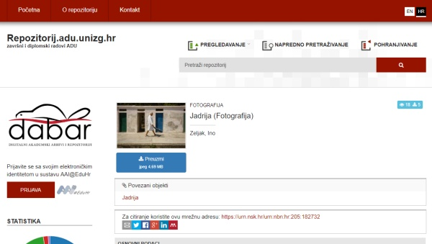
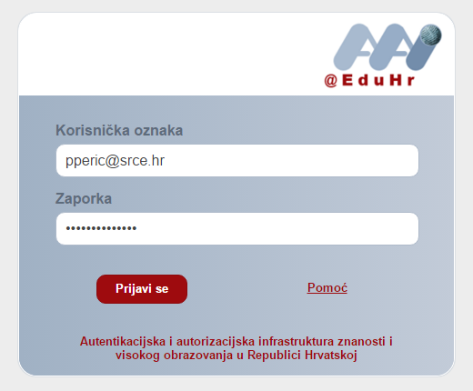
Repositories...
Linking objects
Persistent identifier
(URN:NBN)
Sharng: social networks
Notes:
4 institutions changed their name and domain – all URLs changed

Slide 9
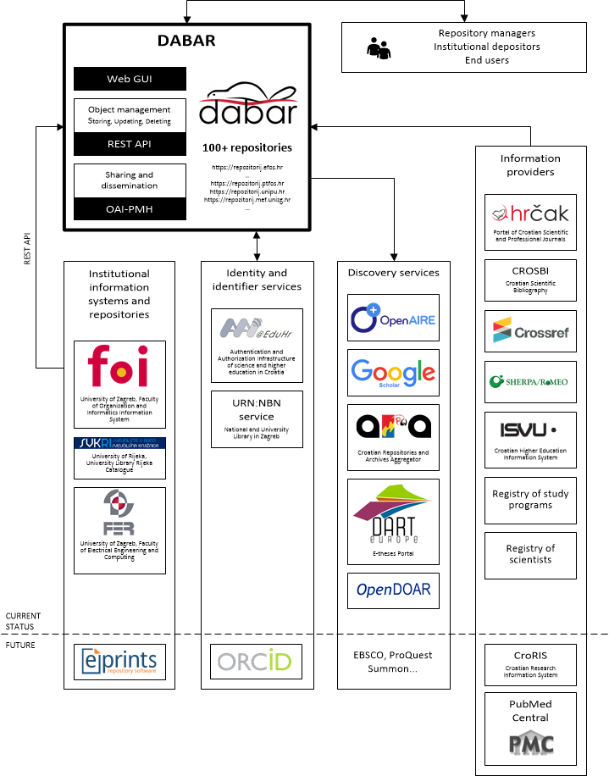
Interoperability
DABAR’s integration with national and global e-infrastructure

Slide 10
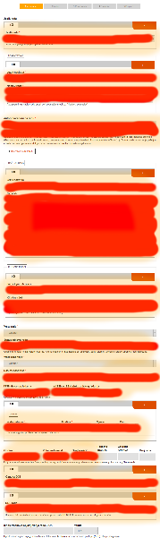
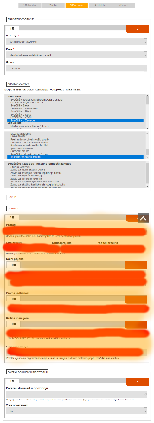
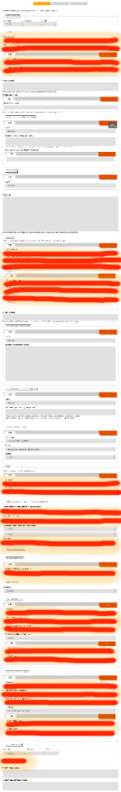
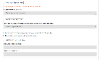
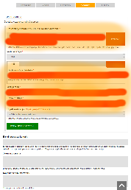
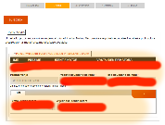
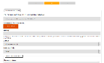
Rich metadata vs efficiency
HRČAK (OAI-PMH, KBART)
CROSBI (Web/MODS)
DOI/CrossRef (API)
Sherpa / ROMEO
AAI@EduHr
URN:NBN
Registry of Scientists
PubMed Central (API)
Croatian Higher Education Information System (ISVU)
Registry of Study Programs
AAI@EduHr
URN:NBN
Notes:
MeSH (Medical Subject Headings)
UDC (Universal Decimal Classification)

Slide 11
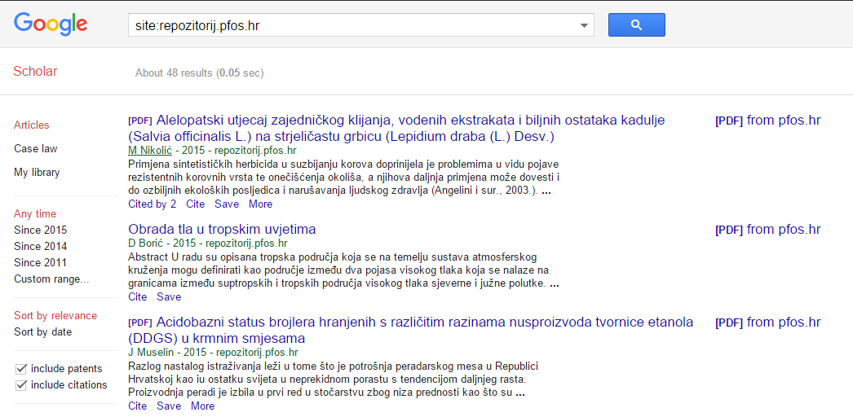
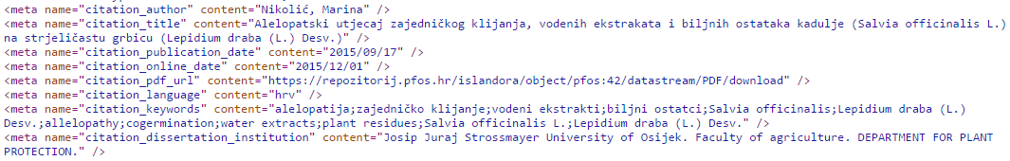
DABAR &
Google Scholar

Slide 12
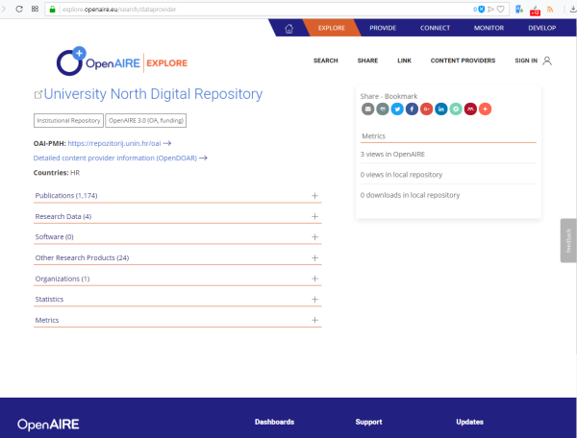
DABAR &
OpenAIRE

Slide 13
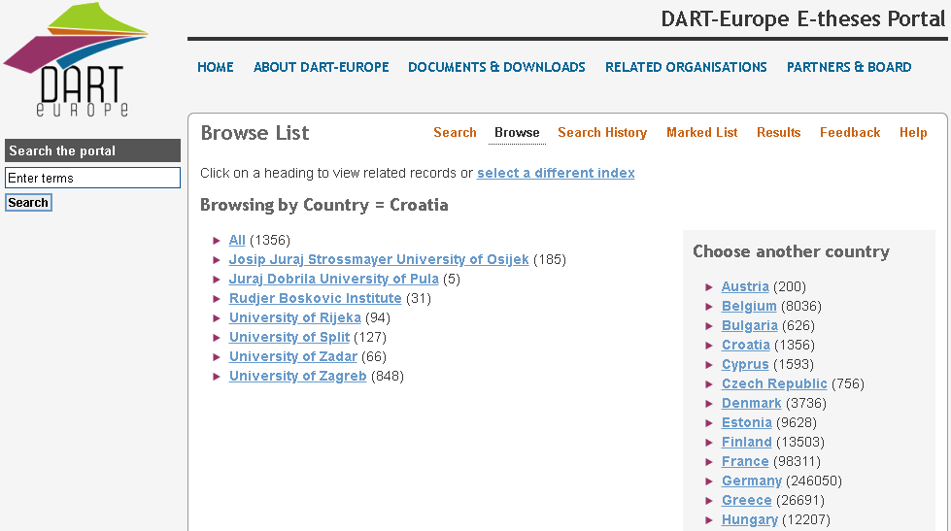
DABAR &
DART Europe
http://www.dart-europe.eu/browse-list.php?country=Croatia
“DART-Europe is a partnership of research libraries and library consortia who are working together to improve global access to European research theses.” (http://www.dart-europe.eu/About/info.php)

Slide 14
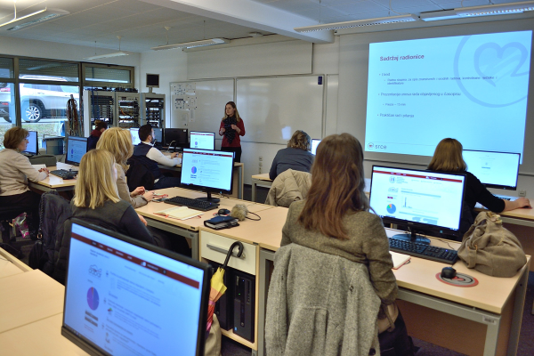
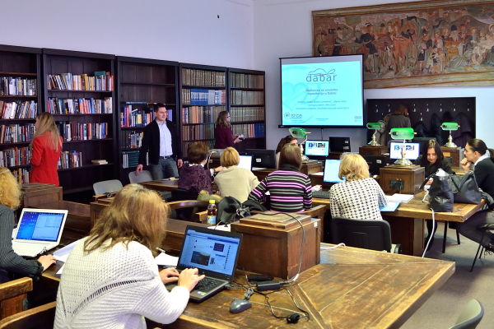
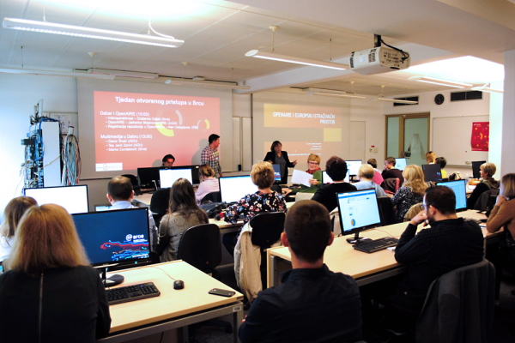
Workshops
25 workshops for repository managers in
Zagreb, Rijeka, Osijek, Split & Dubrovnik
with 276 participants
Topics:
Introduction to repositories in DABAR
Journal articles in DABAR
DABAR & OpenAIRE
Multimedia in DABAR
Soon:
Research data in DABAR

Slide 15
Community!
10 working groups:
Theses and disertations
Scientific and related works
Image, audio and video content
Interoperability
Long-term preservation
User functionality
Copyright
Education & Support
Research Data
Educational Resources
March 2016. - memorandum of understanding:
SRCE
Ruđer Bošković Institute
University of Zagreb School of Medicine
University of Zagreb Faculty of Humanities and Social Sciences
National and University Library in Zagreb
29 institutuions:
ADU, DHMZ, DZIV, FFOS, FFZG, FOI, FSB, HRZ, IEF, IPU, IRB, IRO, KIF, MEDRI, MEF, MEFST, MUZA, NCVVO, NSK, PMF, PRAVRI, PTFOS, Srce, SVKRI, SVKST, UFZG, UNIOS, UNIPU, UNIZD

Slide 16
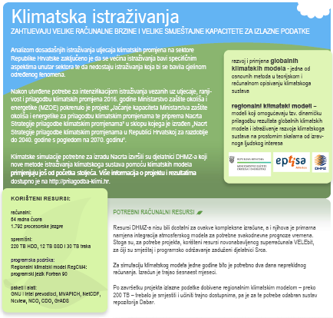
Research data
Research data (datasets)
  First dataset: https://urn.nsk.hr/urn:nbn:hr:232:359736
  RegCM4 Climate Change Adaptation Simulations
  (Croatian Meteorological and Hydrological Service)
Infrastructure for FAIR data?
Findable (PID, rich metadata, search funct., services)
Accessible (HTTP)
Interoperable (open formats, MODS/DC/DataCite, links)
Re-usable (License, domain standards?)
Notes:
RegCM4 - reducing vulnerability of society from the negative impact of climate change
Chalenges:
DMP
Volume & complexity
Research tools integration
Software (reproducibility)

Slide 17






Open infrastructure!
multisite
https://github.com/alen-z/open-source-stamp.git
+ Jenkins, Selenium, Git, ...
Notes:
Open infrastructure
DSpace, Invenio, ePrints

Slide 18

Conclusion?
87.000+ digital objects
37.400+ OA
...
-------------------------------
Academic integrity
Visibility
Innovation
Cooperation
...
Created by Uwe Kils (iceberg) and User:Wiska Bodo (sky). [CC BY-SA 3.0 (http://creativecommons.org/licenses/by-sa/3.0/)]
Notes:
https://commons.wikimedia.org/wiki/File:Iceberg.jpg
Created by Uwe Kils (iceberg) and User:Wiska Bodo (sky). [CC BY-SA 3.0 (http://creativecommons.org/licenses/by-sa/3.0/)]

Slide 19
Thank you!
https://dabar.srce.hr
dabar@srce.hr

