Slide 1
Research Data Infrastructure for Digital Art History
Draženko Celjak <drazenko.celjak@srce.hr>,
SRCE – University of Zagreb, University Computing Centre
2019 Digital Art History Conference
Zagreb, 5 November 2019

Slide 2
Initiatives in the (research) data layer of e-infrastructure
national platform for repositories and archives with the support for research data sharing
H2020 project – support for the on-boarding of services and repositories in EOSC
global organization that promotes and supports data sharing

Slide 3
DABAR – Digital Academic Archives and Repositories
August 2015 - production
November 2019:
134 digital repositories
10 universities
2 national repositories
103.500+ digital objects
44.600+ OA
Notes:
43% OA
3 main goals:
National infrastructure for digital repositories: scalable, interoperable, sustainable, flexible and suited for long term preservation
Community - information needs, application profiles, controlled vocabularies, education and user support
Promotion of OA

Slide 4
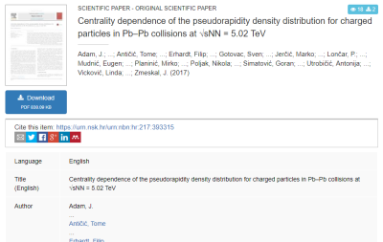
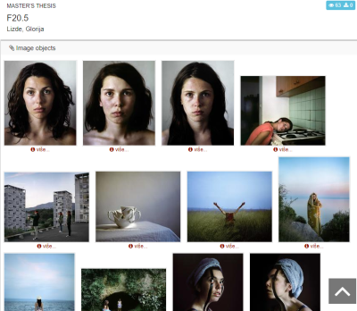
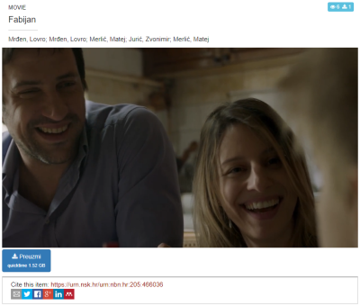
14 digital objects (nationaly agreed)
Journal articles
Papers published in proceedings
Books
Book chapters
Conference abstracts and presentations
Theses
Artistic theses
Disertations
Appendices
Photographs
Audio objects
Audiovisual objects
Research data (datasets)
Educational resurces
Notes:
Metadata agreed on a national level
https://urn.nsk.hr/urn:nbn:hr:205:258541 (photo)
https://urn.nsk.hr/urn:nbn:hr:205:466036 (video)
https://urn.nsk.hr/urn:nbn:hr:205:126638 (audio)

Slide 5
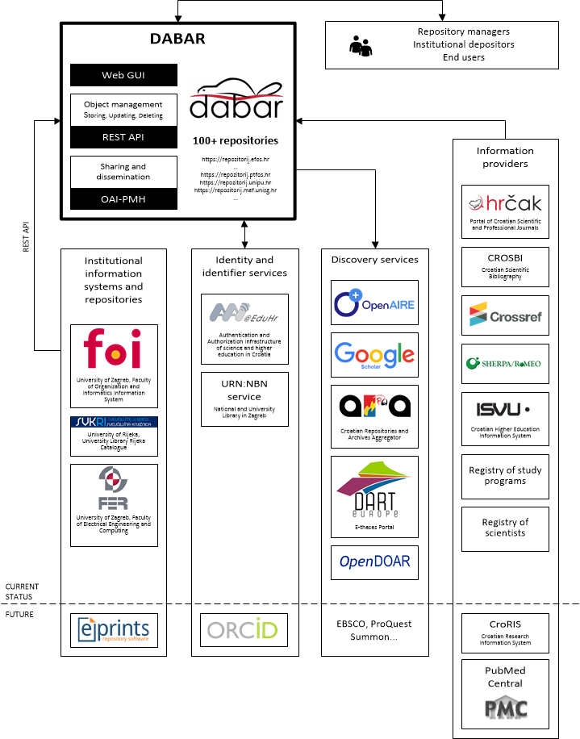
Interoperability
DABAR’s integration with national and global e-infrastructure

Slide 6
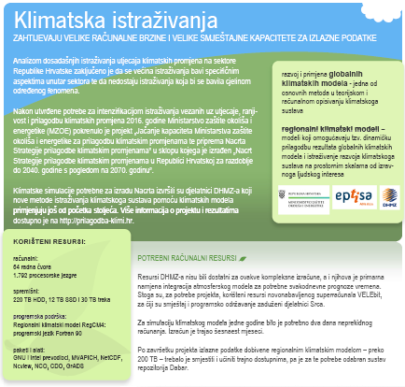
Research data in Dabar
Infrastructure for FAIR data
Findable (PID, rich metadata, search funct., services)
Accessible (HTTP)
Interoperable (open formats, MODS/DC/DataCite, links)
Re-usable (License, domain standards?)
Research data (datasets)
Croatian Meteorological and Hydrological Service
RegCM4 Climate Change Adaptation Simulations
Ruđer Bošković Institute
The Institute of Economics Zagreb
Faculty of Humanities and Social Sciences
Notes:
Interoperable = across disciplines
First dataset: https://urn.nsk.hr/urn:nbn:hr:232:359736
RegCM4 - reducing vulnerability of society from the negative impact of climate change
https://data.fulir.irb.hr/islandora/object/irb%3A5
https://repozitorij.unizg.hr/islandora/object/ffzg%3A475
https://repozitorij.eizg.hr/islandora/object/eizg%3A263

Slide 7
National Initiatives for Open Science in Europe (NI4OS-Europe)
Horizon H2020: 1 September 2019 – 31 August 2022
22 partners from 15 different counties
SRCE & RBI
The objective of the project is to
support the development and inclusion of the national Open Science Cloud initiatives in 15 member states and associated countries in the EOSC governance
spread the EOSC and FAIR principles in the community and train it
provide technical and policy support in on-boarding of the existing and future service providers into EOSC, including generic services (compute, data storage, data management), thematic services, repositories and data sets.
Notes:
Grant agreement ID: 857645
https://ni4os.eu/overview/
Mission and vision of the project are to be a core contributor to European Open Science Cloud service portfolio, commit to EOSC governance and ensure inclusiveness on the European level.
It will federate the existing EOSC-relevant services in the target countries by making them compatible with, and visible in core building blocks of EOSC.

Slide 8
The RDA Vision: Researchers and innovators openly share data across technologies, disciplines, and countries to address the grand challenges of society.
The RDA Mission: RDA builds the social and technical bridges that enable open sharing and re-use of data.
RDA was launched in 2013 by the European Commission, the United States Government's National Science Foundation and National Institute of Standards and Technology, and the Australian Government’s Department of Innovation

Slide 9
Research Data Alliance
Interest groups & Working groups
Notes:
https://www.rd-alliance.org/rda-output-adoption-webinar-series-outputs-support-reproducible-health-research-0
IG will provide a forum for sharing practical experience and developing joint projects

Slide 10
RDA membership & groups
Individual Membership (9300+ members; free)
https://www.rd-alliance.org/get-involved/individual-membership.html
Working and Interest Groups (88 WG & IGs)
https://www.rd-alliance.org/groups
RDA Recommendations and Outputs
https://rd-alliance.org/recommendations-and-outputs/all-recommendations-and-outputs
RDA in Croatia ☺
https://www.rd-alliance.org/groups/rda-croatia

Slide 11
Croatian National RDA Node: SRCE
The objective of RDA Europe 4.0 is to become the centrepiece for an EU Open Science Strategy through a consolidated European network of National Nodes...
Activities:
Communication with funding bodies: Croatian Science Foundation (HRZZ) & Ministry of Science and Education (MZO)
Incentives for data sharing, Data Management Plans (DMPs)
Building capacitiy (skills) of HE & Research libraries to manage research data and support researchers at their institutions; starting with 4 major university libraries
4 events / trainings between February 2020 and April 2020
Promoting CoreTrustSeal (Trustworthy Data Repositories)
Notes:
Researchers, funders, digital infrastructures, policy makers, industry

Slide 12
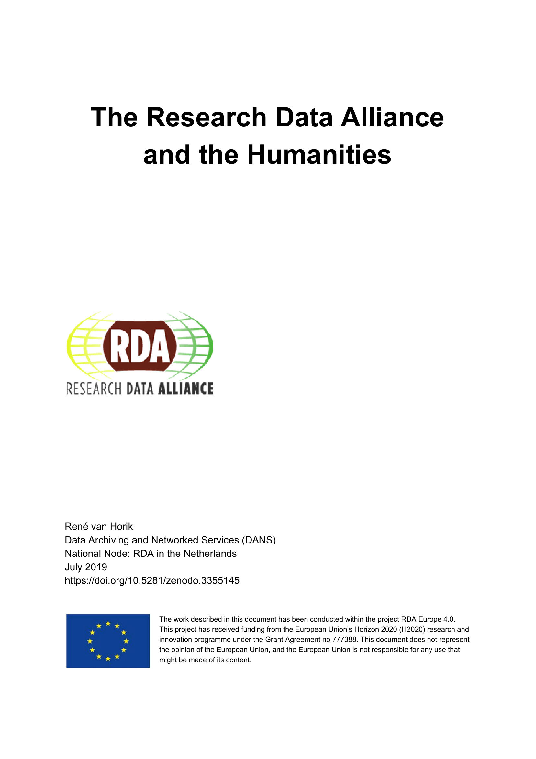
RDA for the Humanities - groups
Digital Practices in History and Ethnography IG
works to advance data standards, practices and infrastructure for historical and ethnographic research
Empirical Humanities Metadata WG
Linguistics Data IG
aims to publish a set of recommendations for citing research data in linguistics
Initiated: Social Sciences & Humanities Research Data (SSHRD) IG
https://doi.org/10.5281/zenodo.3355145

Slide 13
RDA for the Humanities - outputs
Metadata Standards Directory Working Group Recommendations
contains an overview of metadata standards for a wide range of disciplines, also for arts and humanities
http://rd-alliance.github.io/metadata-directory/standards/
Repository Audit and Certification Catalogues
CoreTrustSeal (CTS): Core Trustworthy Data Repositories Requirements
https://doi.org/10.17026/dans-22n-gk35
https://doi.org/10.5281/zenodo.3355145

Slide 14
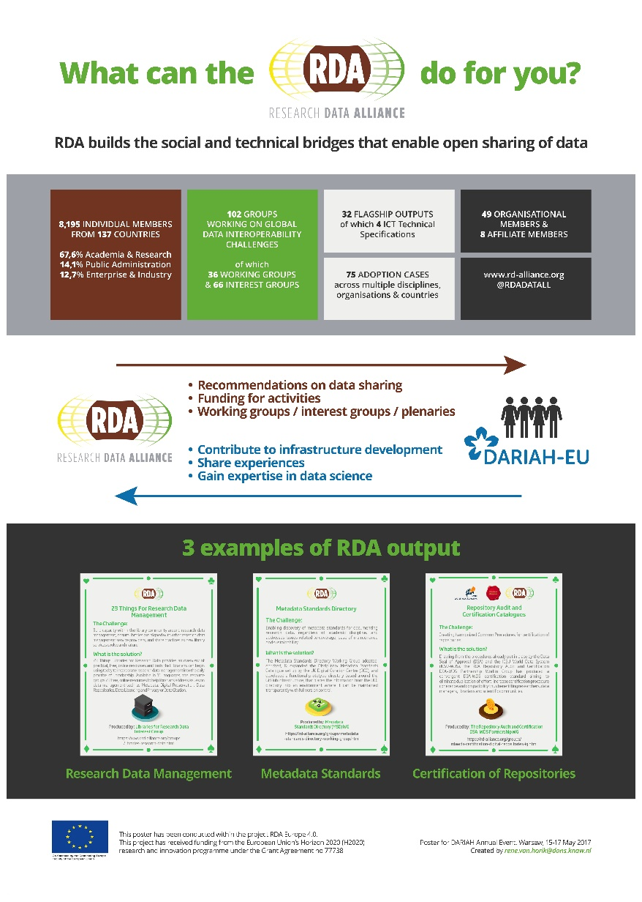
Poster “What can the RDA do for you?” Presented at the DARIAH Annual Event, May 2019, Warsaw.
Notes:
https://www.rd-alliance.org/sites/default/files/attachment/RDA-Poster-ReneVanHorik-DARIAH-2019.pdf

Slide 15
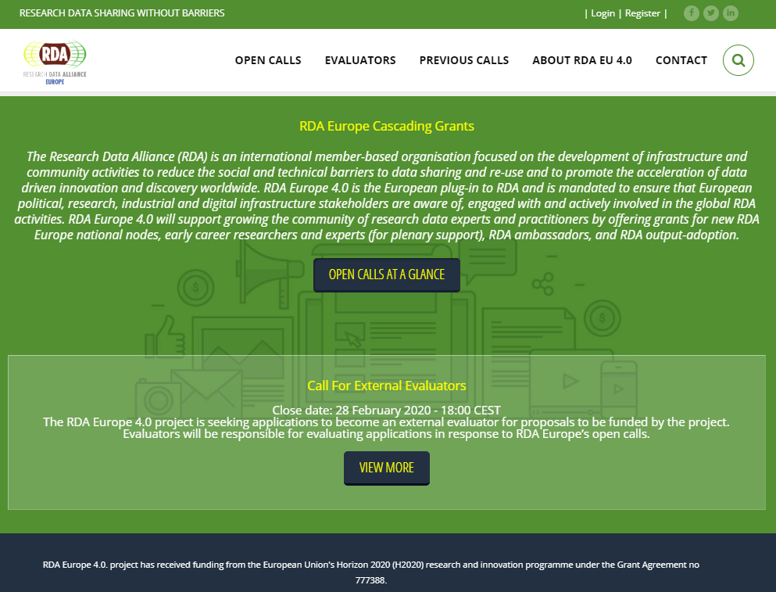
RDA Europe Cascading Grants
Expected calls:
financial support to European Eary Career Researchers working with data to attend plenaries
financial support to European Experts, mid-career or senior data professional / scientist to attedns plenaries
https://grants.rd-alliance.org

Slide 16
Conclusion? Why share research data?
validation & reproducibility = good science
data re-use
increased visibility > impact > collaboration
„the data link papers in total received about 25% more citations per paper on average while this number is more like 40% more citations since 2009.”, https://doi.org/10.18352/lq.10149
educational resurce
requirement of funders (transparency), journals (reproducibility)
EC H2020 since 2017.: Data Management Plan & „as open as possible” Research Data

Slide 17
Thank you!
https://dabar.srce.hr <dabar@srce.hr>
https://ni4os.eu <ni4os-europe@srce.hr>
https://www.srce.unizg.hr/rda <rda@srce.hr>

