Slide 1
Research Data Alliance (RDA)
Draženko Celjak, Sveučilište u Zagrebu, Sveučilišni računski centar (Srce)
Koordinator nacionalnog RDA čvora
Istraživački podaci – što s njima?
Rijeka, 27. veljače 2020.
Webinar, 25. svibnja 2020.

Slide 2
RDA was launched in 2013 by the European Commission, the United States Government's National Science Foundation and National Institute of Standards and Technology, and the Australian Government’s Department of Innovation
The RDA Vision: Researchers and innovators openly share data across technologies, disciplines, and countries to address the grand challenges of society.
The RDA Mission: RDA builds the social and technical bridges that enable open sharing and re-use of data.

Slide 3
Research Data Alliance
Interest groups & Working groups
Notes:
IG will provide a forum for sharing practical experience and developing joint projects

Slide 4
RDA membership & groups (27. 2. 2020.)
Individual Membership (9940+ members from 144 countries; free)
https://www.rd-alliance.org/get-involved/individual-membership.html
Working and Interest Groups (90 WG & IGs)
https://www.rd-alliance.org/groups
RDA Recommendations and Outputs (32)
https://rd-alliance.org/recommendations-and-outputs/all-recommendations-and-outputs
RDA in Croatia
https://www.rd-alliance.org/groups/rda-croatia
Notes:
IG/WG examples:
Data Citation WG, RDA/WDS Certification of Digital Repositories IG,
Chemistry Research Data IG, Agrisemantic WG, Empirical Humanities Metadata Working Group,
Drone Data IG (Small Unmanned Aircraft Systems’ Data IG)

Slide 5
RDA membership & groups (25. 5. 2020.)
Individual Membership (10670+ members from 145 countries; free)
https://www.rd-alliance.org/get-involved/individual-membership.html
Working and Interest Groups (103 WG & IGs)
https://www.rd-alliance.org/groups
RDA Recommendations and Outputs (45)
https://rd-alliance.org/recommendations-and-outputs/all-recommendations-and-outputs
RDA in Croatia
https://www.rd-alliance.org/groups/rda-croatia
Notes:
IG/WG examples:
Data Citation WG, RDA/WDS Certification of Digital Repositories IG,
Chemistry Research Data IG, Agrisemantic WG, Empirical Humanities Metadata Working Group,
Drone Data IG (Small Unmanned Aircraft Systems’ Data IG)

Slide 6
Croatian National RDA Node: SRCE
The objective of RDA Europe 4.0 is to become the centrepiece for an EU Open Science Strategy through a consolidated European network of National Nodes...
Activities:
Communication with funding bodies: Croatian Science Foundation (HRZZ) & Ministry of Science and Education (MZO)
position and plan on DMPs as obligatory part of project proposal, incentives for data sharing
Building capacitiy (skills) of HE & Research libraries to manage research data and support researchers at their institutions; starting with 4 major university libraries
4 events / trainings between February 2020 and April 2020
Promoting RDA outputs: 23 Things: Libraries for Research Data, CoreTrustSeal...
Notes:
Researchers, funders, digital infrastructures, policy makers, industry

Slide 7
Croatian National RDA Node: SRCE (1/2)
„The objective of RDA Europe 4.0 is to become the centrepiece for an EU Open Science Strategy through a consolidated European network of National Nodes...”
Aktivnosti:
komunikacija s financijerom (HRZZ) i donositeljem politika (MZO):
način uvođenja DMP-a u projektne prijedloge
izgradnja vještina istraživačkih i visokoškolskih knjižnica potrebnih za upravljanje podacima i podršku istraživačima na ustanovama - 4 najveće sveučilišne knjižnice: NSK, SVKRI, SVKST, GISKO
promocija RDA rezultata: 23 Things: Libraries for Research Data, FAIRsharing, Engaging Researchers with Data Management: The Cookbook, CoreTrustSeal...
Notes:
Researchers, funders, digital infrastructures, policy makers, industry

Slide 8
Croatian National RDA Node: SRCE (2/2)
Događanja i webinari u razdoblju veljača – lipanj 2020. (https://www.srce.unizg.hr/rda):
Rijeka: 27. veljače 2020.
Split: 13. ožujka 2020.
Osijek: 1. travnja 2020.
Zagreb: Srce Dani e-infrastrukture 7. i 8. travnja 2020. https://dei.srce.hr
Webinar 25. svibnja 2020.
Webinar 1. lipnja 2020.

Slide 9
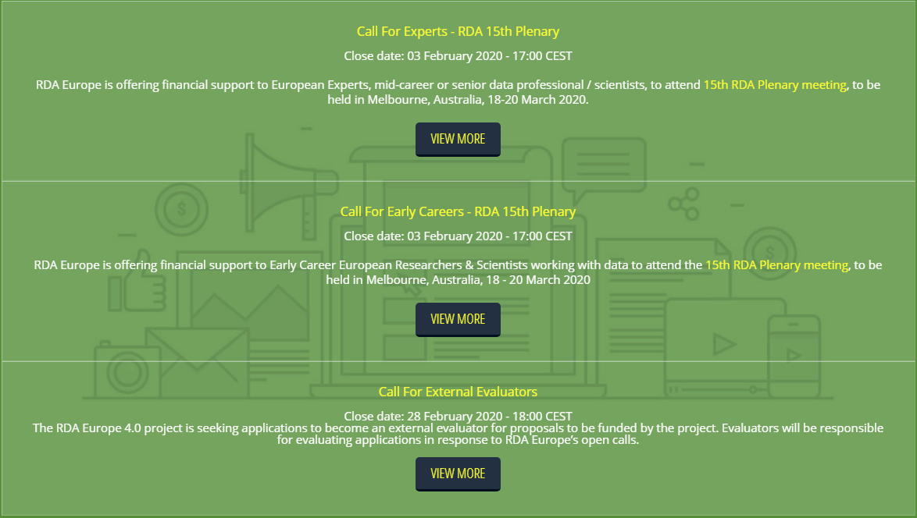
RDA Europe Cascading Grants
Sufinanciranje sudjelovanja na 15th RDA Plenary Meeting u Melbourneu (ožujak 2020.):
7 mladih istraživača
5 iskusnih istraživača i stručnjaka
1 iz Hrvatske!
https://www.rd-alliance.org/group/rda-croatia/post/otvoreni-pozivi-za-sufinanciranje-sudjelovanja-na-15th-rda-plenary-meeting

Slide 10
https://www.rd-alliance.org/groups/rda-croatia
rda@srce.hr
https://www.srce.unizg.hr/rda

