Slide 1
Research Data Policies for Croatian Journals
Palma Dizdarević, Draženko Celjak
SRCE – University of Zagreb, University Computing Centre
PUBMET2020, September 17, 2020

Slide 2
Data Sharing
Research data becomes findable, accessible, interoperable and reusable (FAIR)
More connection and collaboration between scientists and researchers
Increases data circulation and merging data from different studies
Allows building upon the work of others
Exploration of additional hypotheses or important new findings

Slide 3
Research Data Policies
What, when and where will be available
A research data policy framework for all journals and publishers (February 2020)
output of the Data policy standardisation and implementation Interest Group of the Research Data Alliance
Research Data Alliance (RDA)
global non-profit organisation that builds the social and technical bridges to enable the open sharing and re-use of data
more than 10.000 members

Slide 4
A research data policy framework for all journals and publishers
First version available for public comments
Result 14 features 6 policy types
„The TOP Guidelines”
8 transparency standards
TOP Guidelines Committee (advisory group for journals and funders)
supported by the Center for Open Science
Research data policy framework has passed RDA community review and is now an RDA supporting output (August 2020)

Slide 5
14 features
Definition of research data
Definition of exceptions
Embargoes
Supplementary materials
Data repositories
Data citation
Data licensing
Researcher/author support
Data availability statements
Mandatory data sharing (specific papers)
Data formats and standards
Mandatory data sharing (all papers)
Peer review of data
Data Management Plans

Slide 6
 | Policy 1 | Policy 2 | Policy 3 | Policy 4 | Policy 5 | Policy 6
Definition of the research data
Exceptions to policy
Embargoes
Supplementary materials
Data repositories
Data citation
Data licensing
Researcher / author support
Data availability statements
Data formats and standards
Mandatory data sharing (specific data types)
Mandatory data sharing (all papers)
Peer review of data
Data Management Plans

Slide 7
Provide information
Provide information and action
The text for the policy feature will be included in the policy template but it is clear that the feature will not be enforced and checked as part of the publishing or peer review process.
The text of the policy feature is included and makes clear where applicable that the feature will be checked and enforced in the publishing or peer review process.
Policy feature standard texts for policy template construction: https://doi.org/10.5334/dsj-2020-005.s1
Policy texts can be implemented by journals in their Information for Authors

Slide 8
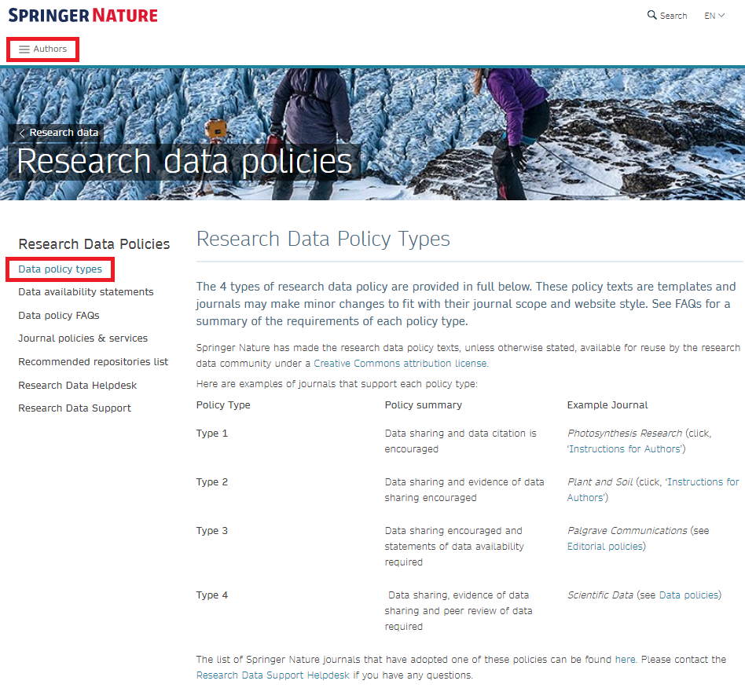

Slide 9
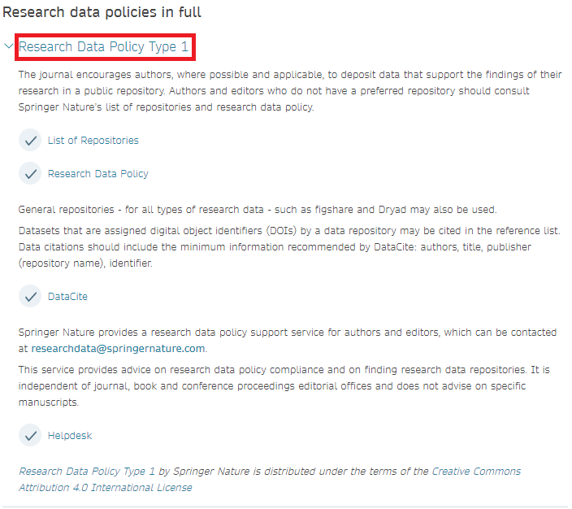

Slide 10
CONTACT US:
HRČAK
hrcak@srce.hr
DABAR
dabar@srce.hr

Slide 11
Literature
Transparency and Openess Promotion (TOP) Guidelines. Available at: https://osf.io/9f6gx/wiki/Guidelines/
Hrynaszkiewicz, I., Simons, N., Hussain, A., Grant, R. and Goudie, S., 2020. Developing a Research Data Policy Framework for All Journals and Publishers. Data Science Journal, 19(1), p.5. http://doi.org/10.5334/dsj-2020-005

