Slide 1
Croatian Open Science Cloud Initiative (HR-OOZ Initiative)
Draženko Celjak,
SRCE – University of Zagreb, University Computing Centre
Digital Art History – Methods, Practices, Epistemologies III
International Conference, 12 – 13 October, 2021

Slide 2



EOSC Vision
“We are creating a European Open Science Cloud now. It is a trusted space for researchers to store their data and to access data from researchers from all other disciplines. We will create a pool of interlinked information, a ‘web of research data'. Every researcher will be able to better use not only their own data, but also those of others”
Ursula von der Leyen, President of the European Commission
Key aspects:
  Open Science and FAIR data
  Alliance of existing and planned infrastructures
  Collaboration between different disciplines and countries
The National Open Science Cloud is significant on two levels:
  National – brings together all significant stakeholders and resources
  International - optimizes and coordinates the participation of organizations in initiatives such as EOSC, EuroHPC, PRACE, EGI, etc.
e infrastructures
Commons
Karel Luyben: Next steps towards EOSC, GB Meeting 11 Sep 2019

Slide 3
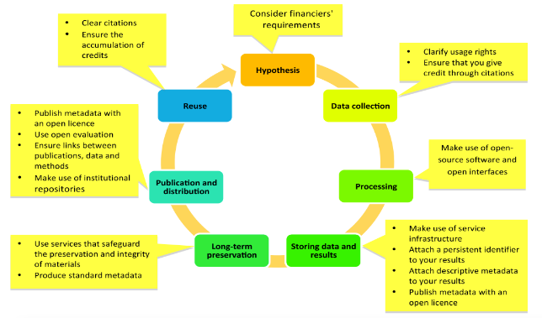
Open Science
Definition (MoU, HR-OOZ Initiative):
„A modern, collaborative and publicly open transparent research process aimed at the rapid use of results in the economy and society in general; such a process relies on digital tools and services, i.e. the possibilities of information and communication technology, and is recognizable by the openness and FAIR principles in accessing research data.”
Openness in different stages of research process. Reference: Open Science and Research, 2014.

Slide 4
A Brief Chronology
Strategy of Education, Science and Technology
Declaration on the Application of Open Science Principles
at the University of Zadar
Declaration of the University of Rijeka European Open Science
Croatian Research and Innovation Infrastructures Roadmap
Croatian Open Access Declaration
HR-ZOO
HRČAK
DARIAH-ERIC
CLARIN-ERIC
CESSDA/CROSSDA
HR-OOZ
CRO GRID
AAI
EATRIS ERIC
JKP
ARA
DABAR
C-ERIC (DONES)
RDA ČVOR
CROSBI
CroRIS
CARNET
CRO NGI
Cloud Srca
HTC Cloud
Isabella
2013
2018
2019
1992
1997
2002
2006
2007
2011
2012
2014
2016
2020
2021
2022
2003
2015

Slide 5

















Croatian Scientific and Educational Cloud (HR-ZOO)
Strategic project by Ministry of Science and Education
Coordinator: SRCE
Reference No: KK.01.1.1.08.0001
Project value: 196.802.438,11 HRK
EU contribution: 167.282.072,40 HRK
National share: 29.520.365,71‬ HRK
Implementation : 1.7.2017. - 30.4.2023.
Distributed national e-infrastructure of computing, storage and network resources for different purposes, designed for strengthening the capacity of the Croatian academic and research community for research, technological development and innovation.
STORAGE
COMPUTING
NETWORK CONNECTIVITY
SCIENTIFIC SOFTWARE
SPECIALIZED SUPPORT TO RESEARCHERS
COLOCATION OF ICT EQUIPMENT

Slide 6
Croatian Open Science Cloud – An Installation Guide
Use and connect the existing national elements of open science for the development of HR-OOZ and connect them with the European / international network
Ensure that there is a national plan for the development of research infrastructure (including e-infrastructure)
Develop and maintain national cooperation and bring together all relevant stakeholders :
  horizontal: joint projects for the development of new infrastructures, services and resources
  vertical: joint projects for building data standards, catalog of services, joint application for large (scientific) and challenging projects
Ensure funding and sustainability of research infrastructures (including e-infrastructure)

Slide 7
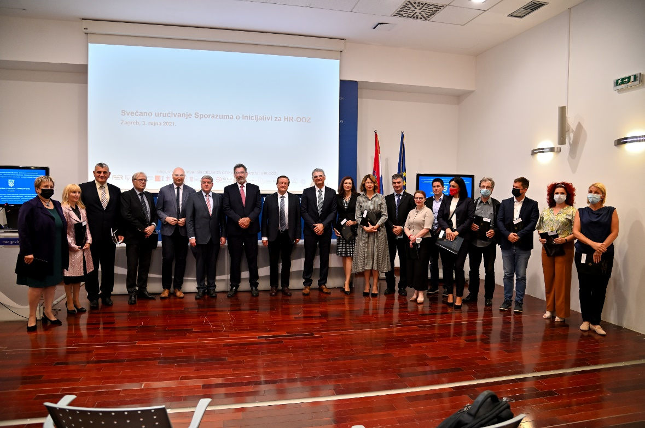
Croatian Open Science Cloud Initiative
Handing over ceremony of the MoU for members of the HR-OOZ Initiative on September 3rd 2021

Slide 8


















HR-ZOO Initiative – Members (11 Oct 2021)

Slide 9
HR-OOZ Initiative - Goals
GOALS
Setting up and defining organizational and governance structures, and technical components for the long-term sustainability of HR-OOZ
Drafting the proposal of the National Plan for Open Science and proposal of the law governing the scientific activity in the part related to the open science

Slide 10
HR-OOZ Initiative - Timeline
Realization of the goals of the MoU
Establishment and work of TF of the Council of the HR-OOZ Initiative
Establishment of the Council of HR-OOZ Initiative
Handing over ceremony of the MoU for members of the HR-OOZ Initiative
Signing MoU
SRCE DEI 2021
Announcement of the HR-OOZ Initiative 28.4.
Preparation of the MoU for the Croatian Open Science Cloud Initiative (HR-OOZ)
Q
Q
Q
Q1
Q2
Q1
Q2
Q3
Q4
Q
Q
Q
Q
Q4
April 2021
June 2021 – August 2021
September 2021
October 2021 - June 2022

Slide 11
HR-OOZ Initiative - Structure
HR-OOZ Initiative
stakeholders in the Croatian science and higher education system who are working together to achieve goals related to open science in Croatia
The Council of the HR-OOZ Initiative
the coordinating body that manages the Initiative which is composed of all signatories of the MuO
Task Forces
achieving individual goals or groups of goals of the Initiative
Administrative support to the Council and HR-OOZ Initiative is provided by
SRCE - http://www.srce.hr/hr-ooz

Slide 12
First meeting of the HR-OOZ Council
3rd Sep 2021 (MSE)
Next meetings: Dec 2021, Mar 2022, Jun 2022
Decisions and Actions:
  HR-OOZ Council ToR approved
  President (Ivan Marić, SRCE) and two vice-presidents (Dr. David M. Smith, RBI & Assoc. Prof. Dr. Irena K. Martinović, CSF) were elected
  The Criteria for accession of the new members approved
  Two Task Forces approved, established and started working:
    TF for drafting the proposal of the national plan and policies for open science
    TF for defining the structure and principles of HR-OOZ
University of Zagreb Faculty of Organization and Informatics joined Initiative on September 20, 2021

Slide 13
HR-OOZ Initiative - Task Forces
TF for drafting the proposal of the national plan and policies for open science
TF for defining the structure and principles of HR-OOZ
Tasks
Activities
Tasks
Activities
Proposal of national open science plan
Proposal for provisions related to open science for the new law governing scientific activities
Open science policy template for the science and higher education institutions which can be used or adopted by institution needs
Mapping OS activities, initiatives, projects, stakeholders and services in Croatia
Gathering information about national plans and laws about OS
Developing proposal of national plan for OS
Tracking adoption of OS policies
Defining sustainable organizational and management structure
Defining principles and criteria for on boarding services and recourses into HR-OOZ
Establishing catalogue of HR-OOZ services and resources
Drafting Rules of Procedure for HR-OOZ
Defining elements of catalogue for HR-OOZ services and resources
Developing Terms of Use template for services and resources in HR-OOZ
Kick-off meeting took place on 8th October 2021

Slide 14
Members of Task Forces
dr. sc. Lovorka Barać Lauc, Croatian Science Foundation
dr. sc. Zoran Bekić, University of Zagreb University Computing Centre SRCE
TF for defining the structure and principles of HR-OOZ
izv. prof. dr. sc. Marko Badrić, University of Zagreb Faculty of Teacher Education
prof. dr. sc. Gordan Jelenić, University of Rijeka
prof. dr. sc. Leandra Vranješ Markić, University of Split
dr. sc. Koraljka Kuzman Šlogar, Institute of Ethnology and Folklore Research
dr. sc. Kristina Romić, National and University Library in Zagreb
dr. sc. Bojan Macan, Ruđer Bošković Institute
izv. prof. dr. sc. Anamarija Musa, University of Zagreb The Faculty of Law
izv. prof. dr. sc. Sven Maričić, Juraj Dobrila University of Pula
izv. prof. dr. sc. Goran Sedmak, The Croatian Institute for Brain Research
prof. dr. sc. Marko Tadić, University of Zagreb Faculty of Humanities and Social Sciences
prof. dr. sc. Diana Šimić, University of Zagreb Faculty of Organization and Informatics
izv. prof. dr. sc. Jadranka Stojanovski, University of Zadar
TF for drafting the proposal of the national plan and policies for open science
izv. prof. dr. sc. Igor Balaban, University of Zagreb Faculty of Organization and Informatics
dr. sc. Dejana Carić, Croatian Science Foundation
Draženko Celjak, University of Zagreb University Computing Centre SRCE
doc. dr. sc. Kristina Feldvari, Josip Juraj Strossmayer University of Osijek
Marijana Glavica, University of Zagreb Faculty of Humanities and Social Sciences
Karolina Holub, National and University Library in Zagreb
dr. sc. Pero Hrabač, University of Zagreb School of Medicine
Lea Lazzarich, University of Rijeka
dr. sc. Ognjen Orel, University of Zagreb University Computing Centre SRCE
prof. dr. sc. Kristian Vlahoviček, University of Zagreb Faculty of Science
Alen Vodopijevec, Ruđer Bošković Institute
dr. sc. Tvrtko Zebec, Institute of Ethnology and Folklore Research

Slide 15

HR-OOZ Initiative Task Forces - Timeline
TF1
Drafting the proposal of the National Action Plan for Open Science
TF1
Proposal for provisions related to open science for the new law governing scientific activities
TF1
Final version of the National Action Plan for Open Science
TF1
Open science policy template for the science and higher education institutions
TF2
Defining criteria for on boarding services and recourses into HR-OOZ
TF2
Drafting Rules of Procedure for HR-OOZ
TF2
Established catalogue of HR-OOZ services and resources
Q1
Q2
Q3
Q1
Q2
Q3
Q4
Q
Q
Q
Q
Q
Q
Q4
December 2021
February 2022
March 2022
April 2022
June 2022

Slide 16
Thank you! and
JOIN us!
https://www.srce.unizg.hr/hr-oo
hr-ooz@srce.hr

