Slide 1
E-learning Centre @ SRCE –
Supporting HE Teachers in Digital Education
Assistant professor Sandra Kučina Softić, M.Sc. in Digital Education
Assistant Director
University Computing Centre SRCE
sskucina@srce.hr
Varaždin, March 15th, 2022
Erasmus+ project AMED

Slide 2

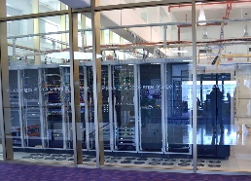
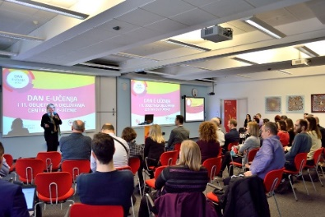
University Computing Centre SRCE
is computing centre and the architect of the e-infrastructure of the entire system of science and higher education of the Republic of Croatia
competence centre for information and communication technologies as well as the centre for education and support in the area of ICT application
in 2021 – 50th anniversary

Slide 3
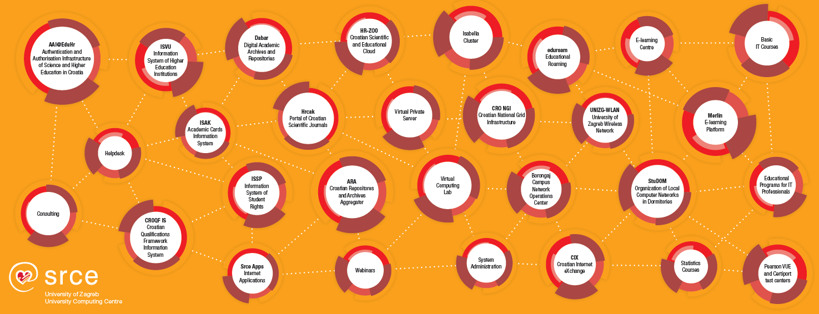
SRCE today
e-infrastructure – reliable services 24/365, access to state-of-the-art ICT
education – enabling users to use ICT & support usage of ICT in education and research
consultancy, support and partnership in research and education
~ 50 services
158 employees
2 data centres
3 locations in Zagreb

Slide 4
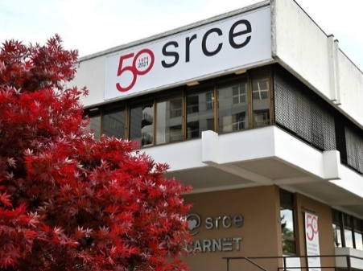




SRCE – e-infrastructure for higher education and research
SUPPORTING
227 R & HE institutions,
Ministry of Science and Education,
Agency for Science and Higher Education
IT and information services to users
e - infrastructure?
Teams of professionals to develop, maintain and support
usage od e-infrastructure
INFORMATION SYSTEMS AND SERVICES
(collaboration and groupware systems, information systems, Internet applications, public registries, CRIS systems, library systems, e-learning platforms, ERP, CRM, DMS, …)
DATA LAYER
(digital archives, digital repositories, dana collections, portals, …)
131 HE institutions
of which
106 public
(159 000 + students)
25 public scientific institutes
71 other legal entities that registered scientific activity (National and University Library, Croatian Academy of Sciences and Arts, hospitals, archives...)
MIDDLEWARE LAYER
(authentication and authorization systems, monitoring, security, accounting, …)
COMPUTING SYSTEMS AND STORAGE RESOURCES
(physical or virtual servers, clusters, IaaS, PaaS, HPC / HTC systems, supercomputers, dana storage, backup systems, …)
DATA CENTERS
(national and university data centers, computer rooms, …)
NETWORKS AND NETWORKING SERVICES
(international and national networks, MAN, LAN, WLAN…)
(20.000 + scientists)
Organizational and governance framework of e-infrastructure
IT and information services to users

Slide 5




SRCE - building and supporting information systems for HE (Ministry of Science and Education and Agency for Science and Education)
ISVU
Information System of Higher Education Institutions
110+ HE institutions, 140.000+ students, 1.700.000+ exams/ac.year
since 2001
ISSP
Information System of Student Rights
115+ HE institutions 159.000+ students
since 1998
ISAK
Information System of Academic (student) Cards
MOZVAG
Information System for Accreditation of HE institutions and Study Programs
110+ HE institutions 1.900+ study programs
since 2004
ISRHKO
Information System of Croatian Qualifications Framework
since 2016
CroRIS
Croatian Research Information System
(in development)
2021 gradually in production

Slide 6

SRCE – National Centre for E-learning in Higher Education
www.srce.hr/enc
E-learning Centre@SRCE
established in 2007
to support institutions, teachers and students in the use of e-learning technologies and tools
provides infrastructure, usage support and user education
a key stakeholder in the process of digital transformation of the higher education system
Basic objectives:
  to support higher education teachers, students, e-learning teams and institutions
  to provide and maintain reliable and generally accessible university platform for e-learning
  to support the university network of people involved or interested in e-learning
  to promote and foster implementation of e-learning

Slide 7






E-learning Centre@SRCE
E-learning platform for HE
state-of-the-art
e-learning system tailored to user needs
Academic
e-portfolio
for personal use, for presentation or as a learning activity
Webinars
For online lectures, presentations, seminars, consultations
Adobe Connect
Edumeet
E-course Catalogue
of HEI in Croatia
a central place to find basic information about all e-courses
Promoting Open Access and OER
all educational materials develed in SRCE in Open Access
SRCE Open education portal
Antiplagiarism software
for checking students work, theses and doctoral dissertations
by students and teachers

Slide 8


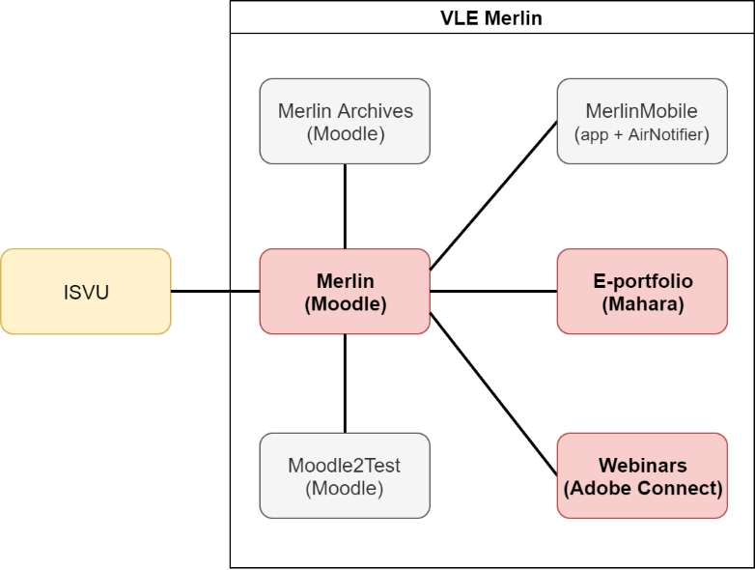
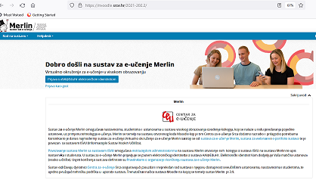
Virtual Learning Environment – Merlin
http://merlin.srce.hr
Dabar
1 Moodle installation
94 institutions on Merlin

Slide 9
Merlin – numbers…
73.752
archived
e-courses

Slide 10
High quality, easily accessible and sustainable support
to HEI
in the systematic
Implementation of e-learning and the process of digital transformation
to teachers
in the use of digital technologies;
in implementation of digital techoologies in teaching and learning
to students
in navigating the online environment and using digital technologies
Courses (classroom and online)
Manuals
FAQ
Quick help
Animations
Guides, additional materials
Helpdesk
Consultations
Tailor made support to teachers in implementation of e-learning into educational process
Template for an e-course creation
E-course self-assessment application
Digital badges for completed courses
Interactive guide for grading in Moodle….

Slide 11
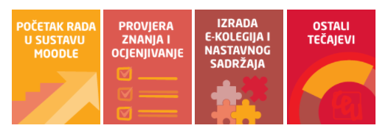
Teachers training… designed for their needs
Courses and workshops
How to work in Moodle
E-course development
Learning Outcomes in Moodle
Student’s Assessment and Grading
E-portfolio
Teachers digital competences
ABC workshop on learning design
Interactive educational materials with H5P
Multimedia in e-courses
Educational materials as OER
How to prepare and online lecture with Adobe Connect
Individual consultations
Engaging events- building comunities of practices and enhancing networking

Slide 12
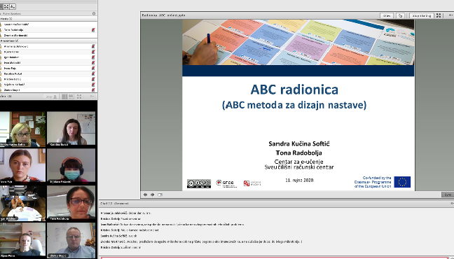
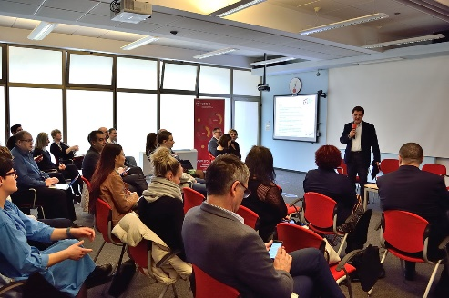
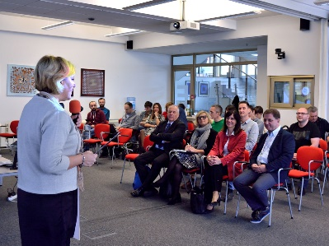
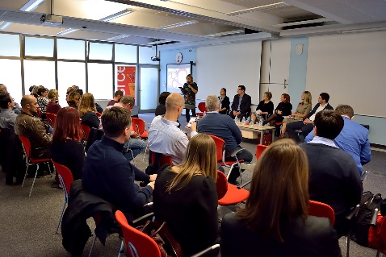
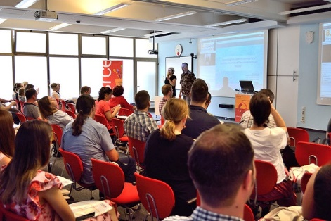
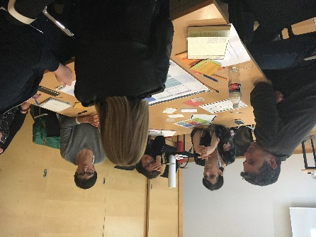
Rising Awareness and Dissemination about E-learning
ELC web pages…
Open Education Week
MoodleM oot Croatia - June
E-learning Day – December
Articles is SRCE newsletter…
mailing lists….
Training courses, workshops
E-learning Centre Week – end of September

Slide 13

How we sucessfully supported HEI when pandemic started...
(and earhquake)
10.000
e-courses opened in two months
(81% more corses than in previous ac. Year)
65%
more teachers started using Merlin and e-learning in relation to previous academic year
18.000
succesffuly answered user inquires in 2020
255% growth
Live communication as the preffered way by users for communication and support
institutions
teachers
parents
students
Reliable and well designed infrastructure
ensured continuity and proper functioning
Easy accessible and systematic support helped users to focus on teaching and learning

Slide 14

Higher education in Croatia till March 2020
Still dominantly oriented to classical (f2f) teaching and learning
Digital technologies mostly as addition to enhance the quality of teaching and learning
Few accredited online studies (only for part-time students)
Strategy of Science, Education and Technology (Ministry of Science and Education, 2014)– Action plan with defined activities - low level of realisation
Left upon HEI and teachers to decide on implementation of digital technologies and e-learning into their study programs and courses
Research dominant in relation to teaching, especially in the rules for the advancement
Teaching efforts not recognized nor awarded

Slide 15
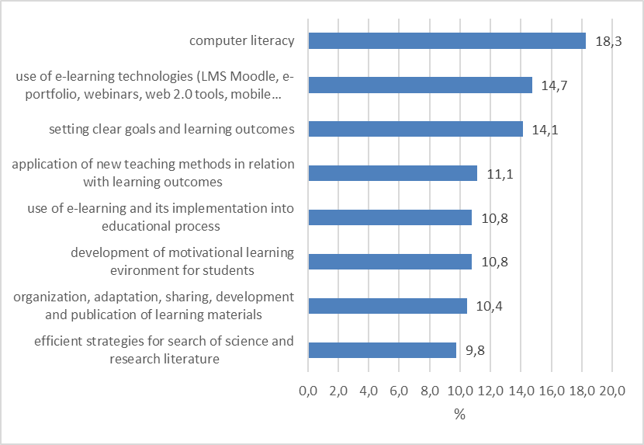
Teachers identified competencies they need to efficiently implement e-learning
E-learning Centre survey on HE teachers competences, S. Kučina Softić, 2019

Slide 16
Teacher training
E-learning Centre survey on HE teachers competences, S. Kučina Softić, 2019
Usually organized
Mostly passive structure similar to the classroom teaching where information goes from educator to participant (sit and listen model)
Needed physical presence
Self directed
Lacks active learning how to deal with specific scenarios in the classroom or participation in the practical learning about new teaching methods
Usually left upon teachers to decide if they want to attend, to organize it themselves and to pay for it – results in their participation only rarely and unsystematically
What teachers want
They like consultations one on one
They want variety of training (f2f, mixed mode and online)
Training should be interactive and engaging, they do not want to be passive participants
They want examples of good practice
They want to be part of community yet left on their own when it suits them
They want good quality and systemaytic support
They do not want to read long manuals

Slide 17

Obstacles to academics’ participation in professional development
E-learning Centre survey on HE teachers competences, S. Kučina Softić, 2019
academics’ unwillingness to move away from traditional teaching practices
lack of formal requirements or incentives for teaching development at HEIs
lack of time for professional development among university staff
lack of financial, organisational, and institutional capacity to develop effective PD schemes at the HEI level
emphasis on research

Slide 18
Teaching and learning after lockdown
Those teachers who have used e-learning before, easier and faster moved their teaching online
Those teachers who did not use any digital tools in their teaching had more difficulties to find out how to organize their teaching in online environment
High increase on the video conferencing systems in order to organize classroom lectures in online environment - Adobe Connect, Zoom, Microsoft teams, BBB, Google Suite, edumeet….
Move to online environment with courses prepared for the classroom teaching- emergency remote teaching
Technical issues- some institutions did not have adequate infrastructure, teachers and students did not have broadband or adequate laptops
Lack of teachers’ digital skills resulted in low use of possibilities of digital technologies, high workload and stress
Lack of students’ digital skills resulted in confusion and high stress
Online oral and written exams – additional stress for students (did not meet technical requirements, first time experience, lack of enough information and testing how to participate in online exams)
Goal to ensure the continuation of teaching and learning and finish of academic year

Slide 19
Reflection on present situation
Teachers and students
  acquired new skills and knowledge in use of digital technologies in teaching and learning
  tired of emergency remote teaching- not prepared for it
  lack social interaction, mental health issues
  still no systematic and continuous professional development of HEI teachers, especially in digital pedagogy
HEI
  Investment in videoconferencing systems, growing interest for SRCE services
  Some institutions invested into teacher training
  Reflection on study programmes
  Some institutions started with development of tools and criteria for digital transformation
    Framework for digital maturity of HEI
    Framework for development and evaluation of the e-courses

Slide 20
Education in post-pandemic
Pandemic as a catalyst for digital transformation of education
  Periodical surveys on teaching and learning in pandemic serve as a base for reflection and planning future steps
It is no more a question if it is classroom or online teaching but how to combine both of these to ensure the best students learning experience
We need to prepare our students to be lifelong learners, skilled to be able to live, work and contribute to the world they are living in
We need skilled teachers who will be able to design such teaching and learning
Decision to be made:
  to return to the status quo f2f teaching they did before
  to adapt what you have learned so far and make it your way of teaching
  to evolve and do a bit more than in the „new normal”
  to transform more radically study programs

Slide 21




Research results on
Higher education teachers and pandemic: academic and psychological challenges
March 2022

Slide 22
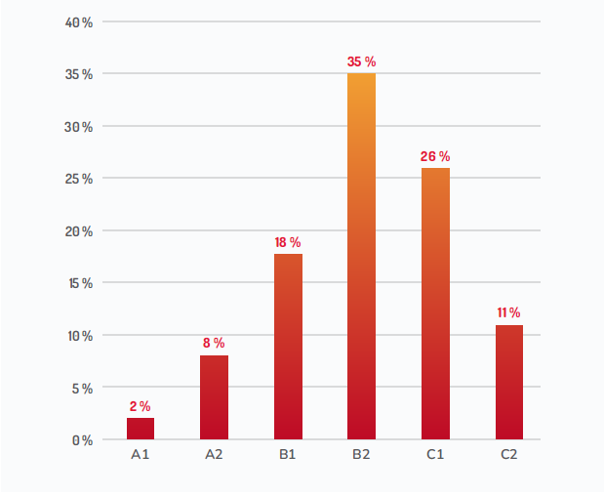
Teachers’ self-evaluation on digital competencies
Agency for Science and Higher Education, 2022
Levels according to DigiCompEdu Framework
A1- lowest
C2 - highest

Slide 23
Teachers’ self-assessment of knowledge in the field of application of e-learning technologies
Agency for Science and Higher Education, 2022

Slide 24
For which parts of teaching and learning do you use ICT and e-learning technologies
Agency for Science and Higher Education, 2022

Slide 25
Teachers identified competencies they need to efficiently implement e-learning
Agency for Science and Higher Education, 2022

Slide 26
2019
2022

Slide 27
Summary
72% teachers consider they have good and very good digital competencies
87% teachers consider they have good and very good in e-learning technologies application
79% teachers consider they are digitally competent for e-learning application in higher education
64% teachers consider they are sure and quite sure in choosing e-learning tools and technologies in educational process
46% teachers is not sure about advantages of ICT and e-learning in education, they are using them just because of pandemic, they do not know how they could contribute to education or they think ICT and e-learning are not relevant for their teaching
ICT and e-learning are used dominantly in education for
  learning material and dissemination
  information about course
  online lectures
  communication

Slide 28
Summary
teachers’ stated that they need additional professional development in
  59% digital pedagogies
  54% digital technologies
23% teachers did not take any professional development in ICT and e-learning
teachers stated that they need support in preparation and development of teaching and learning
87% in use of e-learning technologies
86% in use of ICT
78% in preparation and performance of e-courses
76% related to new teaching methods

Slide 29
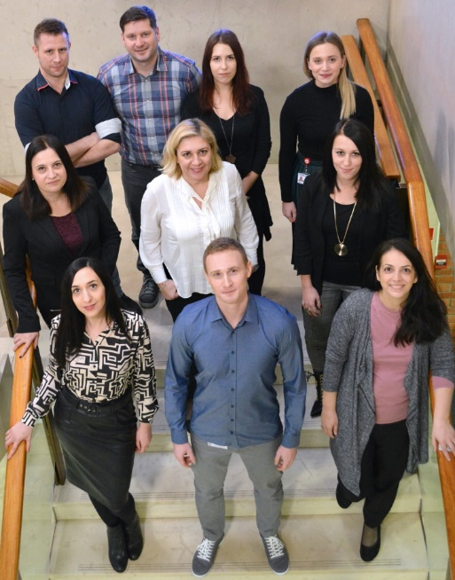
E-learning Centre moto: be humble, listen and collaborate both internally and externally
E-learning Centre
University of Zagreb
University Computing Centre
www.srce.hr/en/elc
ceu@srce.hr

