Slide 1





Croatian National CRIS
Advances and Challenges
Ognjen Orel, Ph.D., University of Zagreb University Computing Centre (Srce)
Bojan Macan, Ph. D., Ruđer Bošković Institute

Slide 2

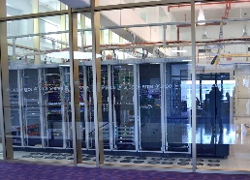
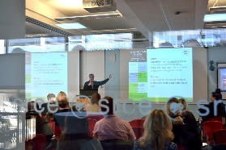
University Computing Centre - Srce
founded in 1971, part of the University of Zagreb
is heart of Croatian academic and research e-infrastructure
is one of the key subjects in planning, designing, construction and maintenance of the advanced computing, communication and information systems and services for A&R community in HR
ensures connection of Croatian A&R e-infrastructure with related European and global e-infrastructures
provides consulting, expert and educational support in the field of ICT to all subjects of the academic and research community
promotes, fosters and supports innovative usage of ICT in education and research
~160 employees
2 data centers

Slide 3
Ruđer Bošković Institute
founded in 1950
Croatia's leading scientific institute in the fields of natural sciences, biomedicine and environmental research due to its size, scientific productivity, international reputation in research, quality of its scientific staff and research facilities
  more than 900 employees (>75% scientists and researchers)
  more than 300 active competitive national and international projects
Centre for Scientific Information – RBI's organization unit which supports its research activities
  develops and maintains interoperable information systems for the RBI and the whole Croatian research community such as:
    Croatian Scientific Bibliography – CROSBI (since 1997)
    Database of project activities in science and higher education in the Republic of Croatia – POIROT (since 2015)
    Database of instruments for scientific research - Šestar (since 2006)
    Who is Who in Science in Croatia (since 2002) etc.

Slide 4

Project Info

Slide 5
The Scientific and Technological Foresight Project
Led by Ministry of Science and Education, with Srce as a partner
Approx. 2M €, 85% funded by EU
Three main components:
  Legal adjustments regarding the data about research in Croatia
  Development and implementation of CroRIS
  Scientific and technological mapping and foresight exercise

Slide 6
Work on CroRIS
Planning
Development
Data cleansing and migration
Integrations
Promotion
Education
Maintenance and further development

Slide 7
Our Vision of CroRIS
CroRIS will
ensure comprehensive and accurate data about all elements of the research system in Croatia
be the decision-making ground when it comes to research, on all levels
enable and promote open science
efficiently support business processes on all levels (MSE, institutions, researchers, ...)
be open and interoperate with other systems (national and international)
integrate existing information and incorporate them into unique and sustainable information system
enable the connection between research and the real sector

Slide 8
Entities
Products
Patents
Events
Publications
Journals
Services
Equipment
Projects & Funding
Researchers
A&R institutions

Slide 9

Development

Slide 10
System and Data Migration
Products
Patents
CROSBI
Events
Publications
Journals
RBI
Services
Šestar
Equipment
POIROT
Projects & Funding
MSE Register
Researchers
MSE Register
A&R institutions

Slide 11
MSE – Srce – RBI agreement
November 2021 - Agreement on cooperation in the construction, maintenance and further development of CroRIS
  CROSBI, POIROT and Šestar will be reimplemented in CroRIS
  All data from CROSBI, POIROT and Šestar will be migrated to the new modules in CroRIS
  RBI will provide information support to the CroRIS and editors of the CroRIS modules in Croatian academic and research institions and participate in CroRIS's further development
  Srce will provide IT support to CroRIS and its further development

Slide 12
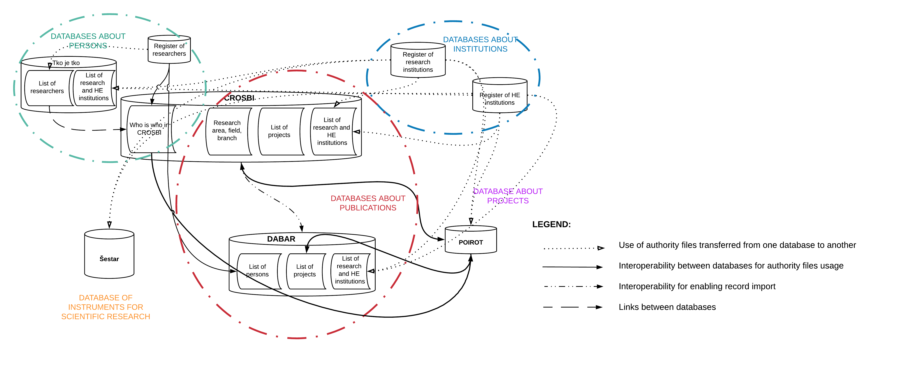
Croatian Research Information Landscape Before CroRIS

Slide 13
System and Data Migration challenges
Data model migration
Vocabularies migration
Cleansing the data
Taking care of active integration to other systems during migration (API migration)

Slide 14
CERIF Model
CERIF – Common European Research Information Format
Why CERIF?
  standards based: SQL + XML
  in comparison to more abstract/rich generic semantic frameworks it was simple
  designed from ground up as a relational data model - our area of expertise
  extremely flexible: capable of modeling and meta-modeling just about any high-level concept using its semantic layer
  support for vocabulary formalization: key enabling point for EU-wide (potentially global) CRIS systems standardization and interoperability

Slide 15
CERIF Challenges
Temporal aspect
  Temporal support in relational databases is defined in the SQL:2011 standard, but current RDBMSs are yet to implement it in this regard
  We kept some of the temporal information on some entities, disregarded the rest
Too complex for everyday developer use
  Since information consist of data which is stored in many relations, we ended wrapping CRUD operations in database views or stored procedures
Over-/under-semantical
  We removed some part of the semantic layer which was used only to confirm the existance of the entity
  Some classifications needed extra atributes, so those schemas became separate vocabularies
Too strict in some parts of the model (mandatory attributes etc.)
We also extended it with a number of attributes and tables needed for our use
D. Kremenjaš, P. Udovičić, O. Orel, Adapting CERIF for a national CRIS: A case study,
in: 2020 43rd International Convention on Information, Communication and Electronic Technology (MIPRO), IEEE, 2020, pp. 1633–1638.

Slide 16

Implementation into community

Slide 17
Data entry
Data import from other systems – trusted and pre-verified
Manual data entry by community
  Approx 30-40k users
  Each entry should be verified

Slide 18







User roles in CroRIS
Superadmins (system admins)
Management
< Global Institutional >
CroRIS Coordinator
Module admins
Data editors
End-users
Researchers
Librarians
...
Global user support

Slide 19
CroRIS Coordinator
Administrates institutional editors
Can be an editor as well
Is appointed by the head of an institution
Is administered by system administrator and central helpdesk
CroRIS Coordinator should be well acquainted with research activities and data (e.g., vice dean for research or science)

Slide 20
CroRIS - institutional data editors
Specialized for a specific module:
  CROSBI (publications)
  Projects
  Institutions
  Researchers and staff
  Equipment and services
  ...
In charge of editing the data related to their institution
Helping the end-users and verifying their entries (data curation / verification)
Supporting institutional end-users

Slide 21
Openness

Slide 22
CroRIS and Open Science
Most of the data will be publicly available (research institutions, researchers, projects, publications, patents, facilities, equipment, services, ...)
CroRIS will:
  enable the visibility and transparency of the research projects and results
  link together the already publicly available data (publications and research data) with projects, researchers etc.
  actively promote open science by “pushing” the idea of publishing full texts, research methods and data bound to projects, publications and patents to project leaders, publication authors etc.
We will implement the connection to OpenAIRE
The data will be available to third parties via generic programming interface as well

Slide 23








Croatian Open Science Cloud (HR-OOZ) Initiative
ZG2
HR-OOZ
National Open Science Cloud
EOSC
European Open Science Cloud
ZG1
OS
RI
ST
National
e-Infrastructure
Service and service providers
Key aspects:
Open Science and FAIR data
Alliance of existing and planned infrastructures
Collaboration between different disciplines and countries
CroRIS will also serve as a NOSC Service catalogue

Slide 24

Thank you
croris@srce.hr; croris@irb.hr
www.srce.unizg.hr/croris

