Slide 1
Quality concept of DABAR (Digital Academic Archives and Repositories)
Ljiljana Jertec Musap
SRCE – University Computing Centre, University of Zagreb
ENCORE+ Quality Workshop 2, „Good Practices of OER repositories”
29 April 2022

Slide 2
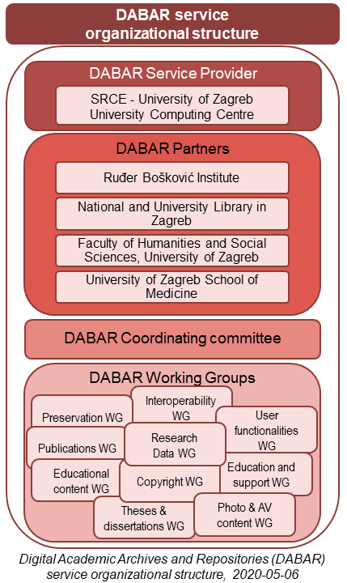
National e-infrastructure for digital repositories

Slide 3
Digital Academic Archives and Repositories
Since August 2015:
156 digital repositories
184.000+ digital objects → 47.3% OA
16 types of objects (nationally agreed)
Undergraduate and master’s theses | Dissertations | Art undergraduate and master’s theses | Educational material
Articles in journals | Conference papers | Book chapters | Conference presentations
Audio files | Images | Video files | Generic object
Datasets (Research Data) | Books | Virtual collections | Appendixes

Slide 4
Community
Repository owners: HiEd&Science institutions
Repository managers: appointed by repository owner (only 1 person)
Repository editors: technical role in repository (1 or more persons)
Education - 50+ workshops / 400+ participants
Monthly consultations
Mailing-lists: dabar-oo@srce.hr / dabar-l@srce.hr

Slide 5
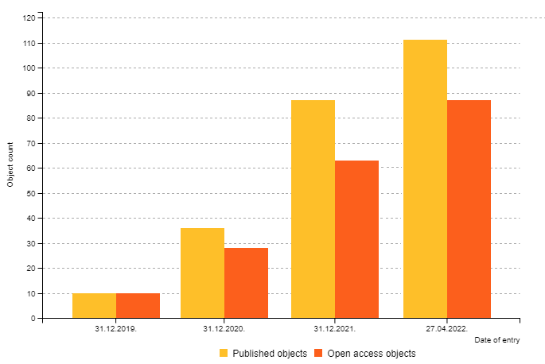
OER in DABAR
115 published objects
OA: 90 objects = 78.3%

Slide 6
Thank you! https://dabar.srce.hr/en
dabar@srce.hr

