Slide 1

Use of OER in Teaching and Learning
Dr. Sandra Kučina Softić, Assistant professor, M.Sc. in Digital Education
University of Zagreb University Computing Centre (SRCE)
sskucina@srce.hr
DESS 2022 - Hildesheim, August 25th, 2022

Slide 2

What is Open Education?
A way of carrying out education, often using digital technologies. Its aim is to widen access and participation to everyone by removing barriers and making learning accessible, abundant, and customisable for all. It offers multiple ways of teaching and learning, building and sharing knowledge. It also provides a variety of access routes to formal and non-formal education, and connects the two.
Opening up Education: A Support Framework for Higher Education Institutions, 2016, EC JRC
Open Education is approach to modernizing education in a systematic and holistic way, which embraces the use of digital technologies and goes beyond it.
Going Open: Policy Recommentations on Open Education in Europe, 2017, EC JRC
https://www.victoriahendrickson.com/single-post/2016/11/09/Learning-From-Unexpected-Places

Slide 3
The potential of open education
Increase the quality and the relevance of the educational offer by:
Using open approaches to teaching and learning via digital technologies (free and open courses, MOOC, OER, flipped classroom…)
Making research available as open access publications
Facilitating digital credentials and encouraging personalized learning portfolios
Recognizing open learning and new ways of issuing and registering verifiable credentials
Creating and using open source software and encouraging open standards
Promoting new funding opportunities for universities and diverse carrier paths for lecturers and researchers who are committed to open education
Including multiple stakeholders in the making of a relevant and transparent higher education sector (ministries, regional authorities, decision makers, headmasters, educators, parents…)

Slide 4

“
Openness is not the opposite of closed-ness, nor is there simply a continuum between the two…
An important question becomes not simply whether education is more or less open, but what forms of openness are worthwhile and for whom; openness alone is not an educational virtue.
Richard Edwards (2015)
Notes:
OPEN tends to bias those already privileged. This can be hard to SEE, first of all -- and takes effort to address.
But having a critical, reflexive approach – and listening to those who are doing work in this vein – are two ways forward.

Slide 5
Open education is not a short-term fix to a passing problem—it is a long-term solution to ensuring equitable, inclusive access to effective educational resources and learning opportunities
Education in times of crisis and beyond: maximizing copyrightflexibilities Creative Commons, blog, 2020

Slide 6


What does open education mean to you?
ⓘ Start presenting to display the poll results on this slide.

Slide 7
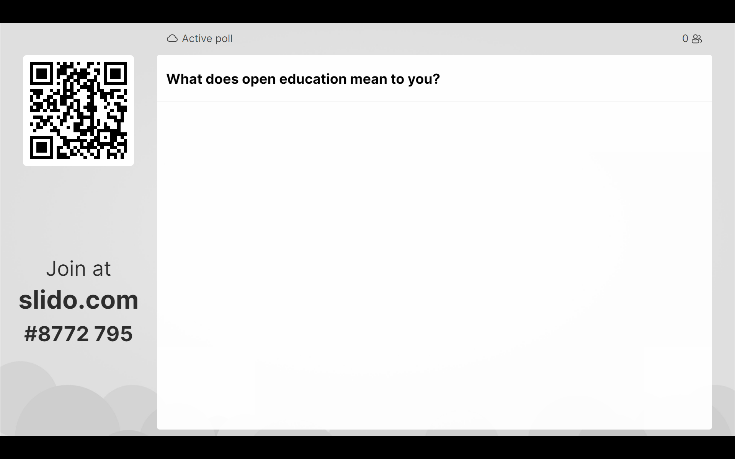

Slide 8

Open Educational Resources (OERs)
term adopted in 2002 by UNESCO’s Global Forum on Open
Courseware
OER are teaching, learning and research materials
in any medium – digital or otherwise - that reside in
the public domain or have been released under an
open license that permits no-cost access, use, adaptation, and redistribution by with no or limited restrictions (UNESCO, 2021)
Image by Jonathas Mello licensed under
CC BY 3.0 license.

Slide 9
OER can include
full courses/programmes, course materials, modules, student guides, teaching notes, textbooks, research articles, videos, assessment tools and instruments, interactive materials such as simulations and role plays, databases, software, apps and any other tools, materials, or techniques used to support access to knowledge

Slide 10
Discussion
What OER do you use for learning?
Does it matter to you if something is OER or not?

Slide 11
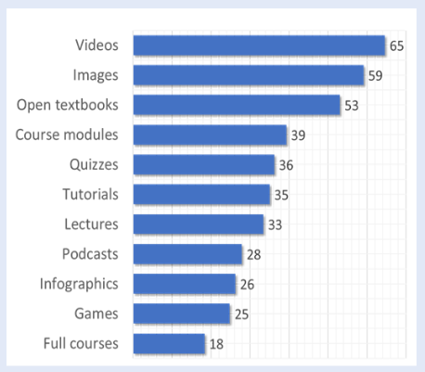
Types of OER and the frequency of their use by the educators
Guidelines on the development of open educational resources policies, UNESCO (2019)

Slide 12
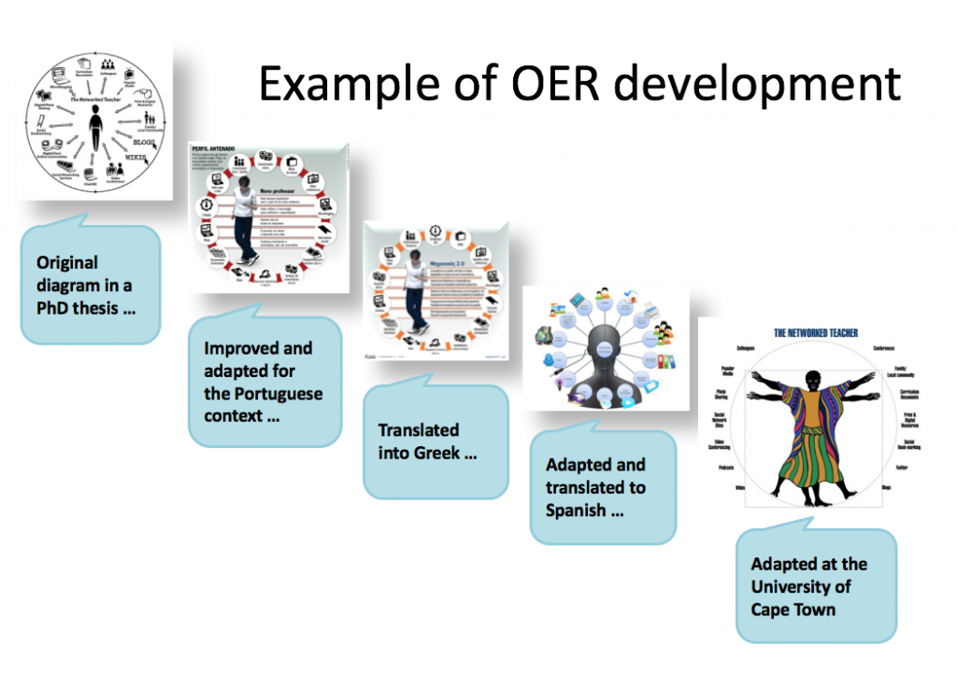
Michael Paskevicius – Introduction to Open Educational Resources 2012 (CC-Attrib-ShareAlike)

Slide 13
The Power of Open Educational Resources
Improved access to textbooks
Improved quality of student learning and learning materials
Improved teacher professional practice
Improved access to resources in local languages but also world wide
Cost savings for learning
Support for lifelong learning
Cultural diversity
The use of open licences ensures that teaching and learning materials are rich not only in terms of quality of the content but also in terms of the possibility for the materials to be retained, reused, remixed and redistributed

Slide 14
The Power of Open Educational Resources (2)
OER provide freedom to educators to reuse, adapt, update, translate and/or enhance existing learning materials
OER can be adapted for specific contexts (e.g., country, region, discipline, programme, specific learners)
OER can be used to help diversify the curriculum, adding content or perspectives that may be missing
Use and creation of OER provides opportunities for partnership and collaboration
Students can become involved in co-creating learning materials
Use and creation of OER provides opportunities for authentic assessment, with students connecting with issues that are current and meaningful to them
Students can contribute to public knowledge, e.g. editing Wikipedia
Use and creation of OER provide opportunities to teach and model key digital literacies and digital competences
Use of OER within specific teaching contexts can enhance engagement with cultural heritage collections, many of which are openly licensed

Slide 15
OERs – why are they important?
„Education is a matter of sharing, and the open educational resources approach is designed specifically to enable extremely efficient and affordable sharing.”
The purpose of OER is to remove unnecessary barriers to access knowledge and equalize access to education by making high quality educational materials and opportunities more broadly available
Why Openness in Education? In. D. G. Oblinger (Ed.), Game Changers: Education and Information Technologies (pp. 81-89). Wiley, D. and Green, C. (2012).

Slide 16
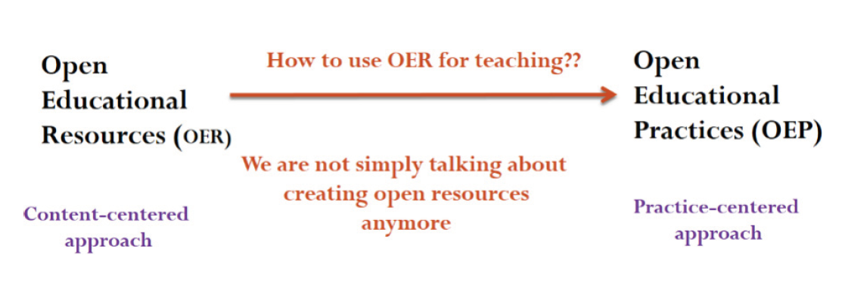
Open Education Practices (OEP)
Collaborative practices which include the creation, use and reuse of OER and pedagogical practices employing participatory technologies, peer learning, knowledge creation and sharing, and empowerment of learners. (Cronin, 2018)
some examples: co-creating open textbooks with students, collaboratively annotating web-based texts, creating OER assignments, encouraging students to publish their work openly, supporting students in editing Wikipedia
use of OEP can support students in developing digital and web literacies
Image from „Guidance on Open Educational Practices during School Closures, UNESCO (2020)

Slide 17
In practice, educators who use OEP seek to build opportunities for learners to
access education, open educational resources, open textbooks, and open scholarship,
collaborate with others, across the boundaries of institutions, institutional systems, and geographic locations,
create and co-create knowledge openly, and
integrate formal and informal learning practices, networks, and identities
Using OER and OEP for Teaching and Learning

Slide 18
How to find OERs?
Generic search engines
Dedicated search engines
Specific OER repositories
searching tips
CC search
Openly Available Sources Integrated Search (OASIS)
AIT OER Index per subject
OER Commons
Merlot
OpenLearn
MIT OCW
OpenStax
Mason (MOM)
Guidance on Open Educational Practices during School Closures: Utilizing OER under COVID-19 Pandemic in line with UNESCO OER Recommendation, UNESCO (2020)

Slide 19
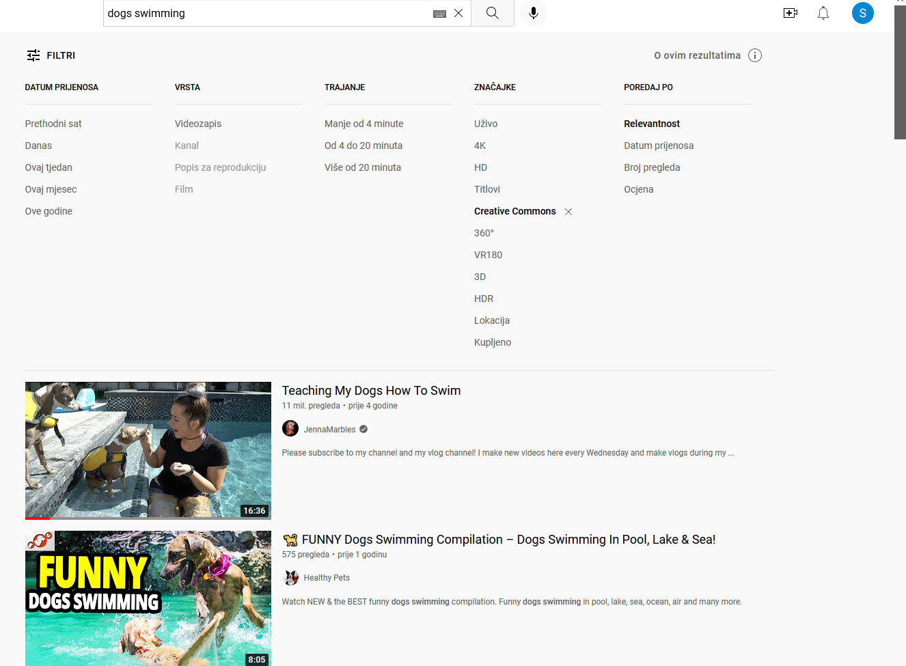
on youtube...

Slide 20
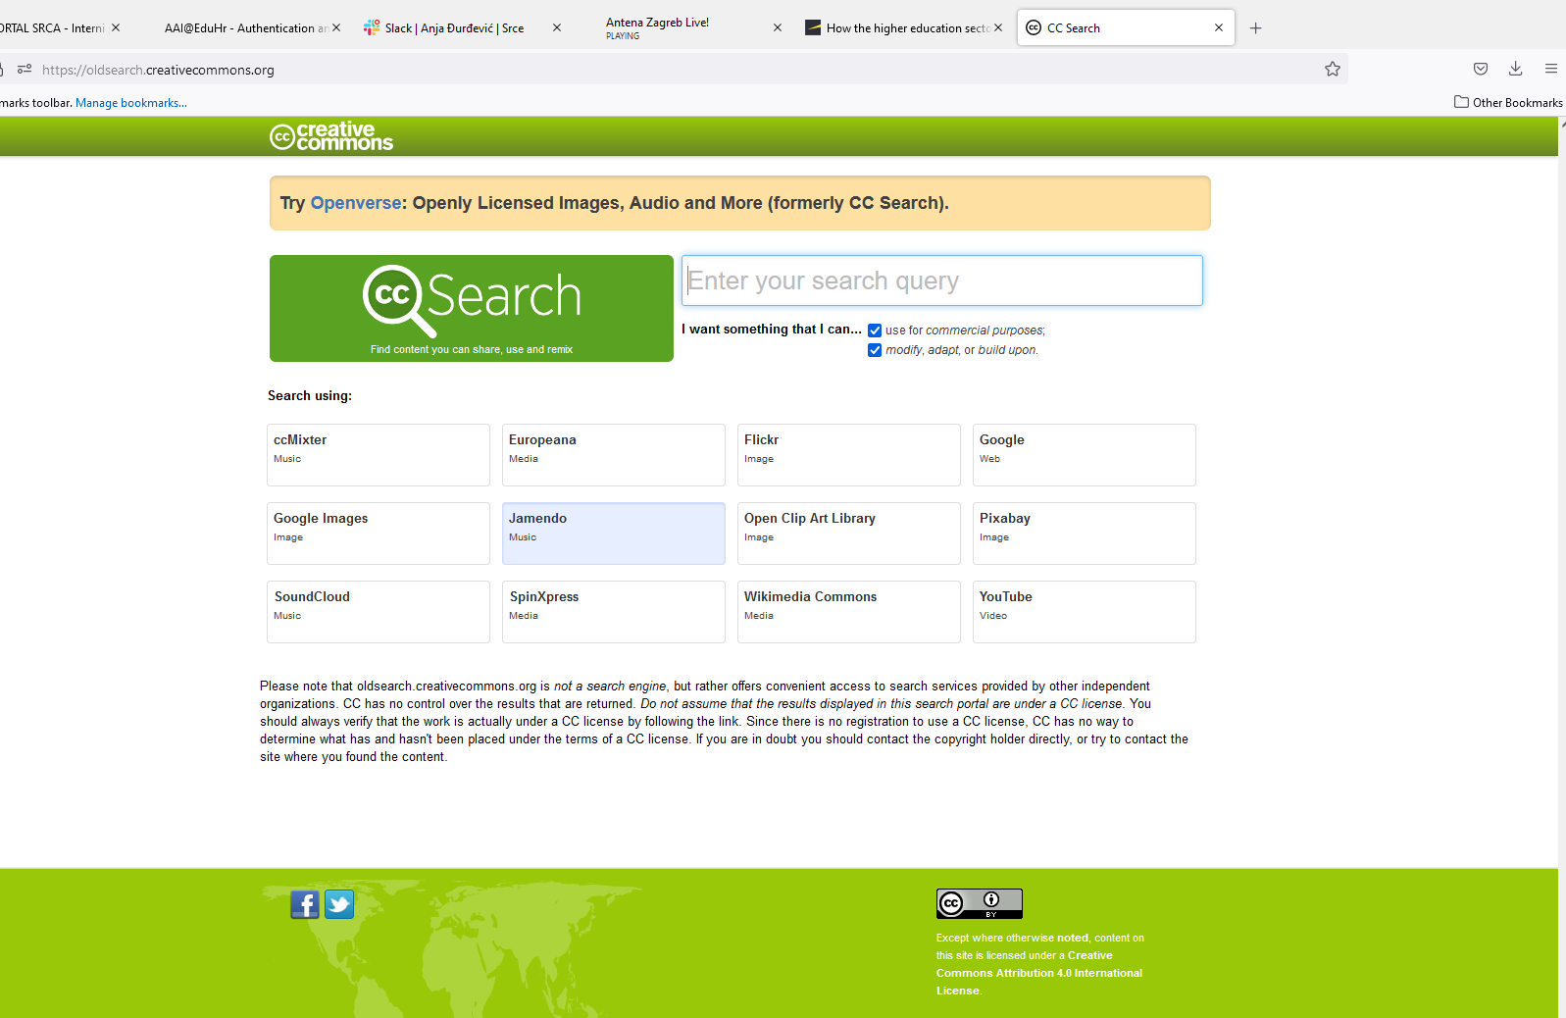
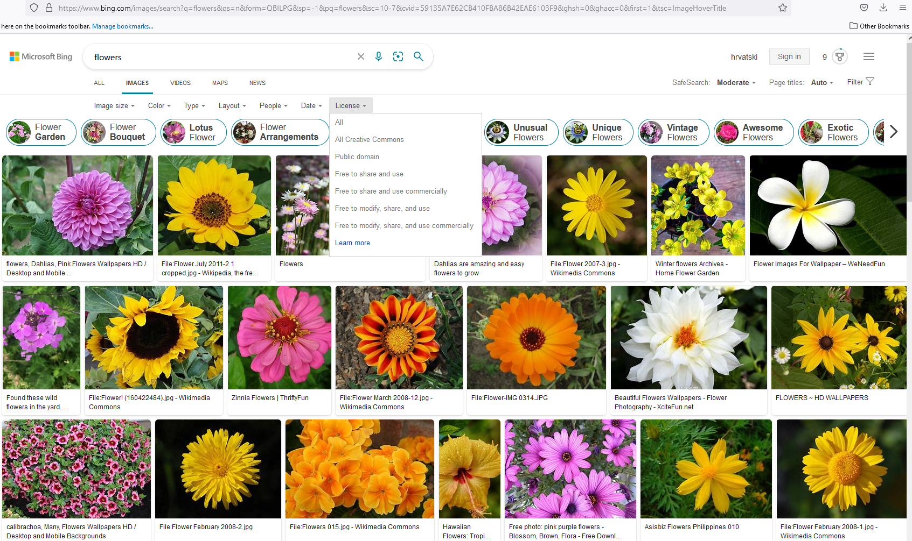

Slide 21
Sharing your work
If you do not put open licences it means that you work is free but not open to share
Open licences help you to share your work
Each license offers your work to other people under different terms
Open licences enable anyone to use your work for varying degrees, governed by the specific license you choose. The open license makes it very clear what people are (and aren’t) allowed to do with your work.

Slide 22
open ≈ free
open > free
open = free + permissions
Notes:
The ENTIRE INTERNET is free

Slide 23

puts the “open” in OER

Slide 24
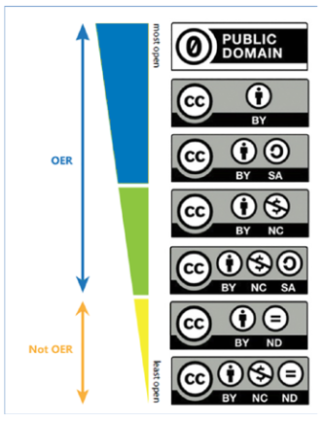
„Openness” and the 5Rs
free (no cost) access to the OER and free (no cost) permission to engage in the „5R” activities when using OER:
  Retain – make, own, and control a copy of the resource (e.g., download and keep your own copy)
  Revise – edit, adapt, and modify your copy of the resource (e.g., translate into another language)
  Remix – combine your original or revised copy of the resource with other existing material to create something new (e.g., make a mashup)
  Reuse – use your original, revised, or remixed copy of the resource publicly (e.g., on a website, in a presentation, in a class)
  Redistribute – share copies of your original, revised, or remixed copy of the resource with others (e.g., post a copy online or give one to a friend)
Defining the „Open” in Open Content and Open Educational Resources, Wiley
Image from Guidelines on the development of open educational resources policies, UNESCO (2019)

Slide 25







most freedom
OER
Not OER
least freedom
Notes:
25

Slide 26

This license allows others to remix, modify and adapt the work for non-commercial purposes, provided that they credit the author of the original work and share (license) their work under the same conditions

Slide 27

What does licence CC BY mean? choose correct answers
ⓘ Start presenting to display the poll results on this slide.

Slide 28
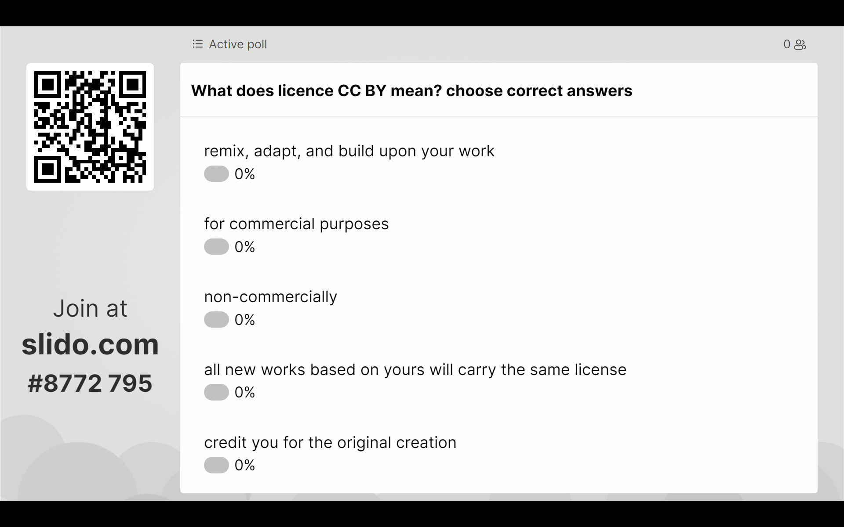

Slide 29
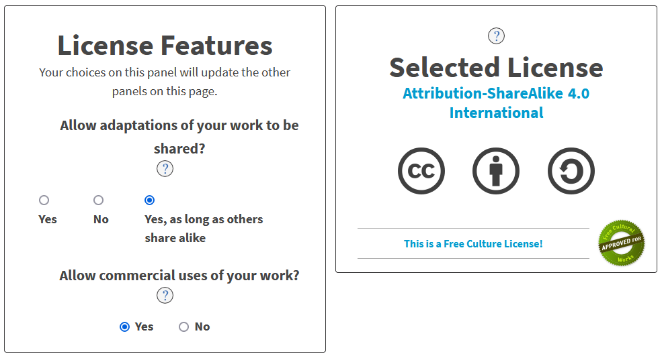
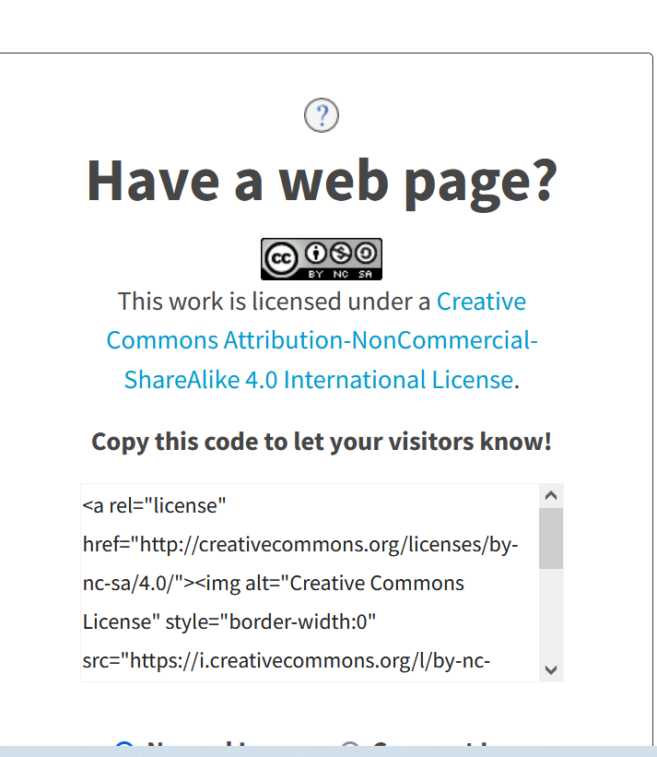
How can you share your work?
https://creativecommons.org/choose/

Slide 30
Copyright Law
Copyright is legal right that protects the use of your work once your idea has been physically expressed
Copyright law lays out a framework of rules around how that work can be used. It sets out the rights of the owner, as well as the responsibilities of other people who want to use the work. You can do many things with your copyright work including for example: copy, change or sell it, share it online or rent it to someone as well as prevent other people from doing those things
For your work to be protected by copyright law it needs to be original and tangible
Copyright protection arises automatically as soon as your work is created
You have to give permission to each person who want to use your work

Slide 31
What are the authors’ rights
moral right
  the author's spiritual ties to the work are protected
  right of first publication
  the right to respect copyright
  the right to respect the honor and reputation of the author
  the right of revocation
  the right to recognition of authorship

Slide 32
What are the authors’ rights
property right
  multiplication
    production in one or more copies
    in whole or in parts
    temporarily or permanently
  distribution, rental and public lending
  communicating the author's work to the public
  making it available to the public
  adaptation

Slide 33
What does it mean that the work has been published publicly?
the work is publicly published when it is communicated to the public with the permission of the author (legally published)
What is the public?
the public is a circle of people who are outside the usual narrow circle of people closely connected by family or other personal ties
examples: posting on a blog, placing it in an e-course, placing in the institution's repository, posting on social networks...
public publication does not mean acquiring the right to use...

Slide 34
Discussion
Would you share your work (homework, seminars, articles, videos, pictures...) as OER?
if no, please explain why
if yes, under which CC licence

Slide 35
What is allowed with other people's works?
“all rights reserved” or“©” or no label-content restrictions
not allowed to reuse, remix, redistribute, revise and retain
BUT because of content restrictions - strictly prescribed by law
allowed is: duplication for private use without authors permission
  for private persons
  for non-commercial purpose
  from a legally published source
  on any surface
  not intended for or accessible to the public
A book? No, unless it's been sold out for two years...

Slide 36
So what does it mean for students? what are they allowed?
copy learning material for private use
allowed
prepare a script from one or more materials? (adaptation)
sharing scripts? (distribution)
saleing script? (distribution for commercial purposes)
not allowed
recording a lecture?
secret recording - not allowed
the issue of copyright but also the issue of teacher privacy
when recording is allowed - teacher's or institution's permission - instructions to students about recording ...
still publishing on social networks (distribution and communication to the public is not covered by the restriction) is not allowed

Slide 37
Use in teaching - without the permission of the author....
public performance or stage presentation
giving examples in class or in scientific research
under conditions:
  non-commercial purpose
  indicating the source and the name of the author or rights holder
  usually in parts or clips for the purpose of supporting, enriching or supplementing teaching and learning

Slide 38
... other people's photos, animations, texts for teaching preparation
for the purpose of giving examples in class
indicating the source and author of the work
non-commercial
allowed
using just to make your ppt looking better – not allowed
better search for materials under CC licence and use them in ppt
Scientific articles in pdf? remember only "parts and clips" - better provide a link...
  It is best to refer to the website where the material is located...
  Link to legally published content, e.g. repository or collection (avoid private and unknown websites)

Slide 39
OER Advantages for Learners
Enhanced quality and flexibility of resources
Seeing/applying knowledge in a wider context than their course would otherwise allow, e.g. international dimension
Freedom of access (e.g. at work/home/on placement) and enhanced opportunities for learning - the Cape Town declaration)
Support for learner-centred, self-directed, peer-to-peer and social/informal learning approaches
Skills development (e.g. numeracy) through release of generic OER that can be re-used and re-contextualised in different subject areas
The opportunity to test out course materials before enrolling – and compare with other similar courses
Opportunities to be involved in OER initiatives either through contributing towards OER development, testing or evaluation, marketing activities, acting as an ambassador for OER with other learners or staff
Authentic or ‘real-life’ learning experiences through OER that link to employer or professional sector activities
Jisc. (2010, 2014). Guide: Open educational resources (OERs)

Slide 40
OER Advantages for Learners (2)
make students' learning interesting
gets students more engaged
directly improves the quality of students’ learning experience
enable them to learn at their own pace and convenience
helps students to prepare for classes, and serves as supplementary materials to their course modules

Slide 41
Possible challenges while applying OEP
Schools and universities | Teachers | Students
adaptation of the existing pedagogy to OEP framework | fear of loosing control of the teaching process when inviting learners to be active participants by co-creating and contributing to the course activities | more familiar with traditional learning approaches; they might find it difficult to be self-regulated and adapt to an OEP-structured course
OEP is not recognized in promotion and tenure policies | lack of needed skills to incorporate OEP in teaching process
OEP requires practitioners including teachers, learners as well as educators, to be more open, active participatory and innovative.
Guidance on Open Educational Practices during School Closures: Utilizing OER under COVID-19 Pandemic in line with UNESCO OER Recommendation, UNESCO (2020)

Slide 42
Open Education and pandemic
adoption of more online resources than ever before
OER become an important method of providing access to, and enhancing, the teaching and learning experience for both lecturers and students

Slide 43
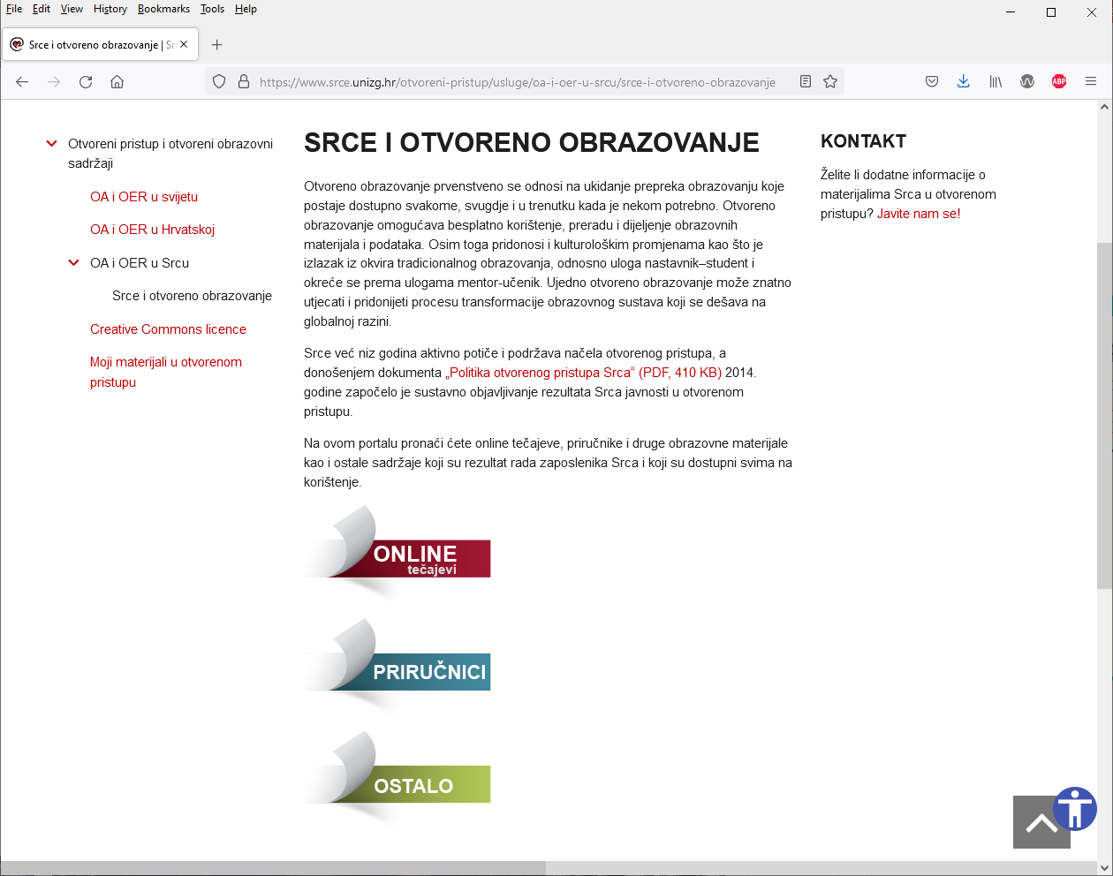
SRCE and Open Education
SRCE – actively encourages and
supports the open education and
the principles of open access, and
with the adoption of the
document „Open Access Policy
in SRCE” in 2014, SRCE began
systematic publishing of its results
in open access
https://www.srce.unizg.hr/otvoreni-
pristup/usluge/oa-i-oer-u-srcu/srce-i-
otvoreno-obrazovanje
(in Croatian)

Slide 44
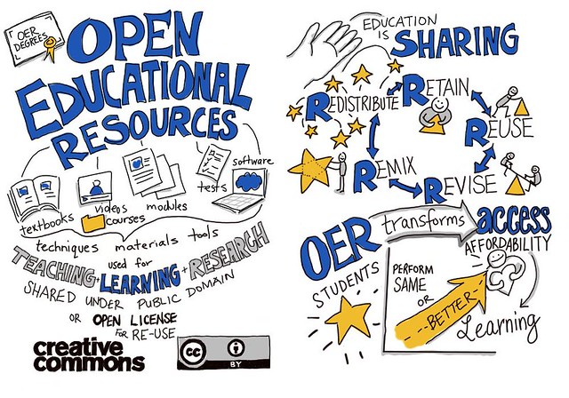
Questions and discussion
Do you think OER and OEP can enrich learning experience?
How often do you look if materials that you search for on Internet are open and under which licence?
Do you think open education will become mainstream in 2-5 years?

