Slide 1
ABC method for online course design – from f2f to online workshop in Croatian perspective
Sandra Kučina Softić
Tona Radobolja
Univeristy of Zagreb University Computing Centre SRCE

Slide 2
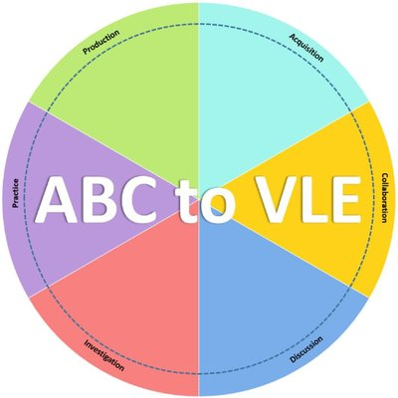
ABC to VLE project
Erasmus+ project ABC to VLE: beyond curriculum design
From 2018. – 2020.
Coordinator: UCL, UK
12 partners- SRCE one of them
Aim to develop support structures to help teaching teams to implement ABC learning designs within the local VLE or LMS
Focus on institutional adoptions of ABC Learning, user experience and how design could link to the technical environment, particularly VLE
The goal was to adapt the ABC method which will help teachers to improve their courses by applying new technologies by applying new technologies

Slide 3
ABC method and ABC workshop
The ABC curriculum design method is an effective and engaging hands-on, card-based approach to curriculum design.
Why ABC?
student centered rapid curriculum development engaging academics in informed dialogue about the learning design or a review of programmes and modules
addresses need to develop richer learning designs for blended learning
it is built on learning types from ‘Conversational Framework’ (Laurillard 2012)
Workshop is prepared for face-to-face environment
Workshop authors: C. Young and N. Perović, UCL

Slide 4
The Conversational Framework – D. Laurillard

Slide 5
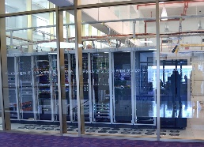
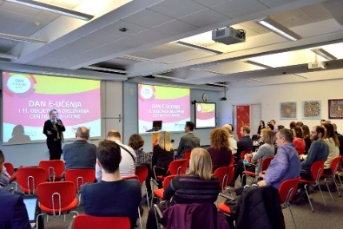
University Computing Centre SRCE
is computing centre and the architect of the e-infrastructure of the entire system of science and higher education of the Republic of Croatia
competence centre for information and communication technologies as well as the centre for education and support in the area of ICT application
in 2021 – 50th anniversary

Slide 6
SRCE – National Centre for E-learning in Higher Education
www.srce.hr/enc
E-learning Centre@SRCE
established in 2007
to support institutions, teachers and students in the use of e-learning technologies and tools
provides infrastructure, usage support and user education
a key stakeholder in the process of digital transformation of the higher education system
Basic objectives:
to support higher education teachers, students, e-learning teams and institutions
to provide and maintain reliable and generally accessible university platform for e-learning
to support the university network of people involved or interested in e-learning
to promote and foster implementation of e-learning

Slide 7
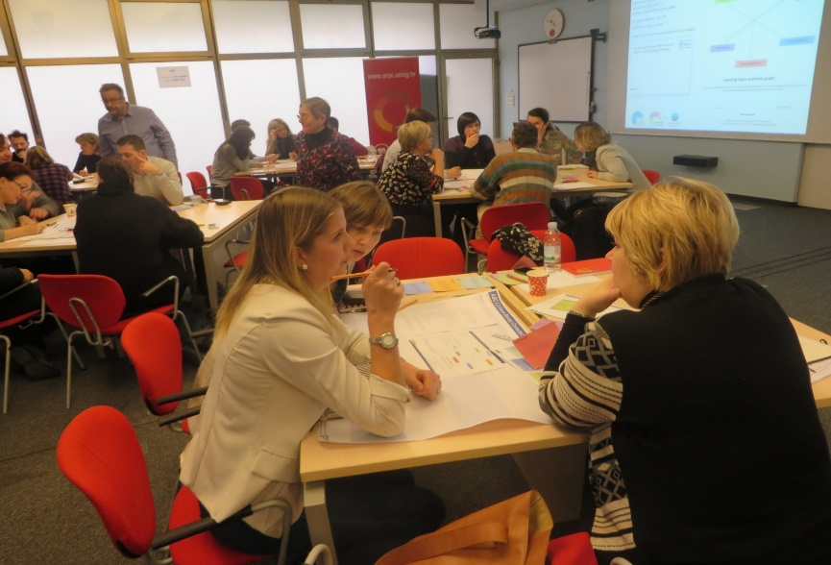
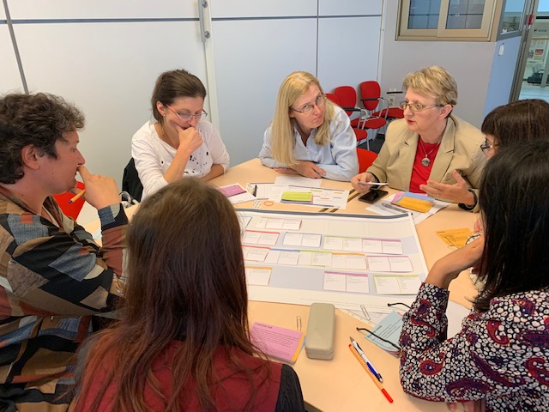
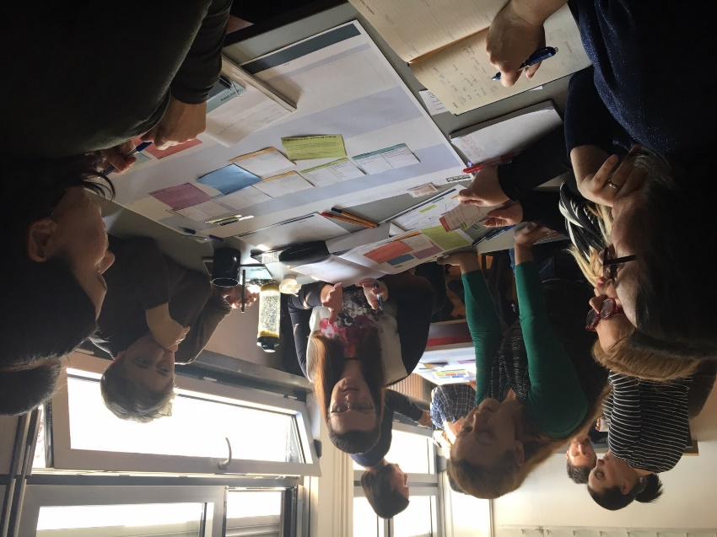
ABC workshop

Slide 8
Localisation of ABC workshop for the Croatian Education Environment
Training the trainers
Translation to the Croatian and adaptation to the Croatian education environment, educational policies and practices
Cards with learning types consisted of both languages – Croatian and English
Changes in the course information sheet
Short course description instead of Tweet
Added ECTS points and learning outcomes
Extension of workshop (90 minutes)
face to face workshop to 120 minutes
Online workshop to180 minutes

Slide 9
ABC workshop online

Slide 10
Moving workshop online during pandemic
Using videoconferencing system Adobe Connect for a learning environment
MS Excel for storyboard with cards
Moodle for workshop materials
2 workshop leaders
2 breakout rooms
12-15 participants
Intensive interactive workshop

Slide 11
Course Information Sheet adopted for Croatian version of ABC workshop

Slide 12
ABC cards with learning types in Croatian

Slide 13
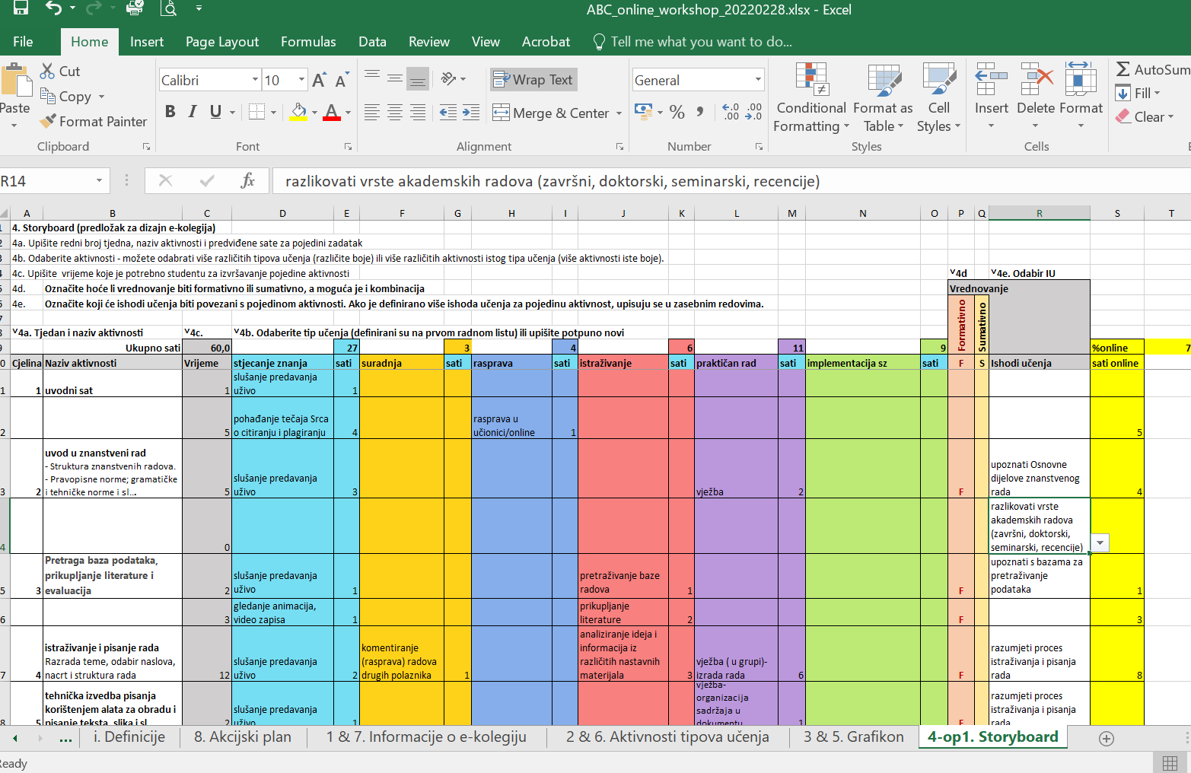
Storyboard in the Excel in online ABC workshop

Slide 14
Participants feedback
F2f workshop
average grade of the lecturer’s presentation quality and engagement: 4,83/5
average grade for the workshop: 4,63/5
Online workshop
average grade of the lecturer’s presentation quality and engagement: 4,91/5
average grade for the workshop: 4,83/5
Only praise, I will implement the acquired knowledge in existing courses. Thank you!
Excellent workshop, very useful and interesting, well prepared and done!
Thanks for the new perspective on course planning.
This should be mandatory education for teachers at UNIZG

Slide 15
E-learning Centre
University of Zagreb
University Computing Centre
www.srce.hr/en/elc
https://www.srce.unizg.hr/centar-za-e-ucenje/medunarodna-suradnja/abc-vle
ceu@srce.hr
abctovle@srce.hr

