Slide 1
What if the dataset contains personal data: anonymization of the research data
Digital Art History – Methods, Practices, Epistemologies III
International Conference, 3 – 4 October, 2022
Dr Kristina Posavec, University of Zagreb, University Computing Centre SRCE

Slide 2
Personal Data
IDENTIFIERS
DIRECT
INDIRECT
name
surname
inicials
e-mail
phone number
personal identification number
registration
IP address
biometric data
photo
Audio record
specific dates (date of birth, wedding, etc.)
name of physician
place of medical treatment
sex
rare dissesses
place of birth
socioeconomic data geographical data
houshold
year of birth
age
interview transcripts
Personal data is any information that relates to an identified or identifiable living individual. Different pieces of information, which collected together can lead to the identification of a particular person, also constitute personal data. (European Commission)

Slide 3
Anonymization
UK Data Service:
Anonymisation is the process of removing personal identifiers, both direct and indirect, that may lead to an individual being identified.
An individual may be directly identified from their name, address, postcode, telephone number, photograph or image, or some other unique personal characteristic.
An individual may be indirectly identifiable when certain information is linked together with other sources of information, including, their place of work, job title, salary, their postcode or even the fact that they have a particular diagnosis or condition.
Once data is truly anonymised and individuals are no longer identifiable, the data will not fall within the scope of the GDPR and it becomes easier to use.

Slide 4
Pseudonymization
Pseudonymisation is defined within the GDPR as “the processing of personal data in such a way that the data can no longer be attributed to a specific data subject without the use of additional information, as long as such additional information is kept separately and subject to technical and organizational measures to ensure non-attribution to an identified or identifiable individual” (Article 4(3b)).
INDIRECT | DIRECT | INDIRECT
Gender | E-mail | City
M | mark@example.com | Zagreb
F | jane@example.com | Osijek
F | carry@example.com | Pula
INDIRECT | DIRECT | INDIRECT
Gender | E-mail | City
M | 456@example.com | A35
F | 245@example.com | B45
F | 321@example.com | C25

Slide 5
K-anonymization
K-anonymity is a property of a dataset that indicates the re-identifiability of its records. A dataset is k-anonymous if quasi-identifiers for each person in the dataset are identical to at least k – 1 other people also in the dataset.
a method for providing privacy protection by ensuring that data cannot be traced to an individual. In a k-anonymous dataset, any identifying information occurs in at least k times.
can compute the k-anonymity value based on one or more columns, or fields, of a dataset.
Nergiz, M. E., & Clifton, C. (2007). Thoughts on k-anonymization. Data & Knowledge Engineering, 63(3), 622-645.

Slide 6
K-anonymization
Gender | Age | City | State | Income (€)
M | 20 | Zagreb | Croatia | 2250
F | 22 | Zagreb | Croatia | 1680
F | 48 | Wiena | Austria | 1050
F | 22 | Zagreb | Croatia | 2079
M | 63 | Pula | Croatia | 1855
Gender | Age | City | State | Income (€)
M | 18-23 | ***** | Croatia | 1500-2500
F | 23-28 | ***** | Croatia | 1500-2500
F | 43-48 | ***** | Austria | 500-1500
F | 18-23 | ***** | Croatia | 1500-2500
M | 63-67 | ***** | Croatia | 1500-2500

Slide 7
Qualitative data anoynimization
UK Data Service recommendations:
do not ask for full names if they cannot be used in the data
plan anonymisation at the time of transcription, or initial write up
use pseudonyms or replacements that are consistent within the research team
use ‘search and replace’ techniques carefully
keep unedited versions of data for use within the research team
create an anonymisation log of all replacements, aggregations or removals made and store such a log separately from the anonymised data files
consider redacting statements where there is an increased risk of harm or disclosure

Slide 8
Quantitive data anoynimization
UK Data Service recommendations:
Remove direct identifiers
Aggregate or reduce the precision of a variable, such as age or place of residence
Generalise the meaning of a detailed text variable by replacing potentially disclosive free-text responses with more general text
Restrict the upper or lower ranges of a continuous variable to hide outliers if the values for certain individuals are unusual or atypical within the wider group researched
Anonymise relational data where relations between variables in related, linked datasets or in combination with other publicly available outputs, may disclose identities
Anonymise geo-referenced data by replacing point coordinates with non-disclosing features or variables; or, preferably, keep geo-references intact and impose access restrictions on the data instead

Slide 9
Recommodations by UK Data Service
Find and highlight direct identifiers
Quantitative: Visually scan variables.
Qualitative: Read the transcript.
Assess indirect identifiers
Can the identity of a participant be known from information in the data file?
Can a third party be disclosed or harmed from information in the data file?
Assess the wider picture
Quantitative: Run descriptive statistics and crosstabs to find unique cases and combinations of variables that can identify an individual in the dataset.
Qualitative: Which identifying information about an individual participant can be noted from all the data and documentation available to a user.
Remove (or psuedonymise) direct identifiers
Aggregate or blur (in)direct indentifiers
Redact indirect identifiers
Re-assess any remaining disclosure risk

Slide 10
Why is anonymization important?
Benefits of data sharing:
Greater visibility of data, leading to increased citations and future collaborations
Demonstration of research integrity and validation of research results
Compliance with funder and institutional policies and expectations
Greater impact of research through knowledge transfer
Research advances through reuse of data by researchers around the world

Slide 11
E-course: Documentation and Anonymization of Research Data
Dejana Carić
Online and self-paced
Validation
Digital badge and certification
Target groups:
PhD students
teachers in the higher education system
researchers
librarians
Marta Matijević
Dejana
Kristina Posavec

Slide 12
Structure of e-course
Data Managment Plan (Croatian Science Fondation)
Documentation of Research Data
Anonymization of Research Data

Slide 13
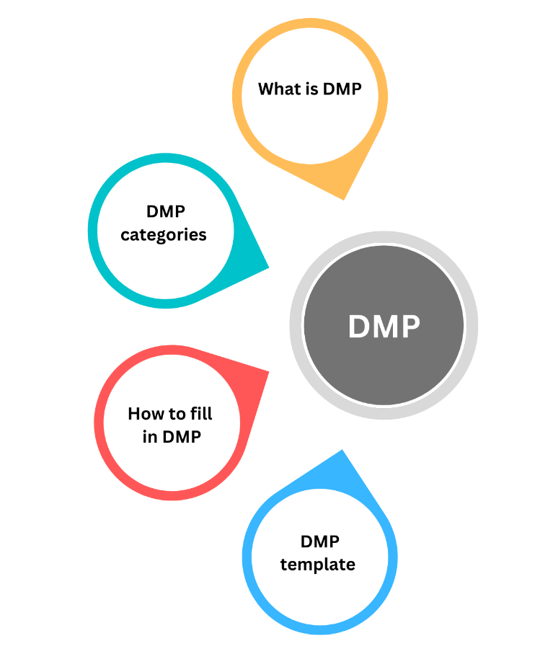
1. Data Managment Plan (Croatian Science Fondation)
What is DMP
DMP template of Croatian Science Fondation
How to fill in DMP
Categories of Croatian Science Fondation DMP
Data collection and documentation
Ethics, legal and security issues
Data storage and preservation
Data sharing and reuse
Importance of DMP development

Slide 14
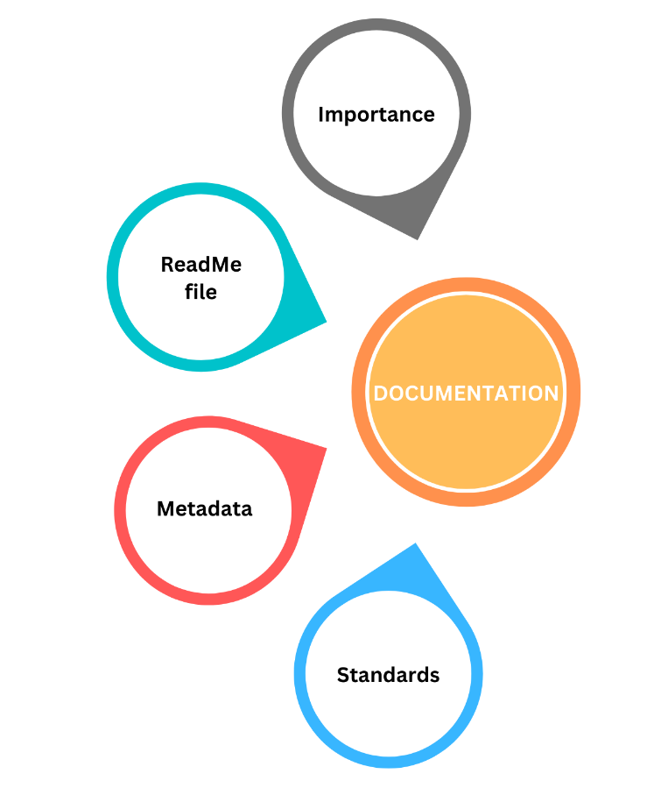
2. Documentation of Research Data
Importance of reserach data managment
What is considerd as documentation for research data
What are metadata and of which elements they consist
What are data standards and how resercher needs to use them
What is ReadMe file, how to create it and what is it purpose

Slide 15
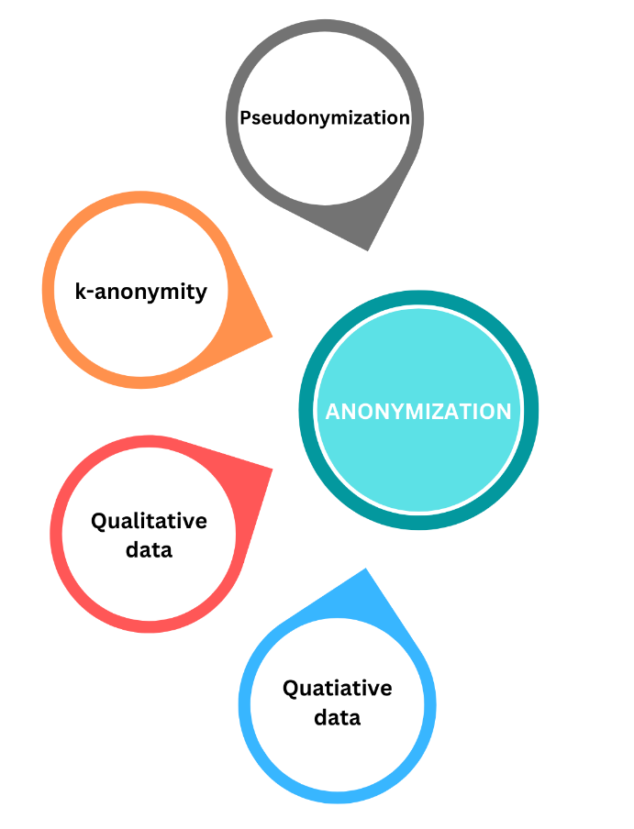
3. Anonymization of Research Data
Definitions of anonymization, pseudonymization and k-anonymity
Process of k-anonymity
Anonymization on qualitative and quatiative data
Tools for anonymization:
Amnesia – OpenAIRE anonymization tool
Text anonymisation helper tool
Microsoft Paint

Slide 16
Additional materials
E-courses about RDM: Platforms, tools and good practices in the research life cycle
Handbook for RDM: How to manage research data

Slide 17
Thank you for your attention

