Slide 1
Services for researchers: European & Croatian open science marketplaces
Draženko Celjak, SRCE – University of Zagreb, University Computing Centre
Digital Art History – Methods, Practices, Epistemologies IV
Zagreb, 3 – 4 October, 2022

Slide 2
Open Science
Early 90s – Worl Wide Web (Web of documents)
February 14, 2002. Budapest Open Access Initiative
  open access: „free availability on the public internet, permitting any users to read, download, copy, distribute, print, search, or link to the full texts of these articles, crawl them for indexing, pass them as data to software, or use them for any other lawful purpose, without financial, legal, or technical barriers...”
Open Science is about extending the principles of openness to the whole research cycle, fostering sharing and collaboration as early as possible thus entailing a systemic change to the way science and research is done.” , FOSTER portal
Notes:
The current way of sharing research was built upon the emergence of the printing process. During the seventeenth century, the first research journals were conceived by academies of sciences… Since then, the publications process has developed in volume but the principles of their use have remained largely identical. Articles are published in journals. Journals are acquired by libraries. Scientists visit their libraries to access the knowledge delivered by their predecessors and colleagues.
openness, speed of access to scientific results, reproducibility and multi-disciplinarity

Slide 3
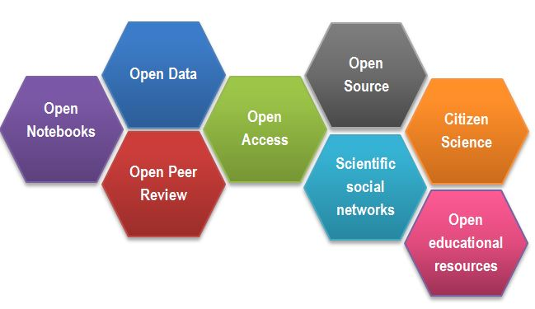
Open Science
Technology supports science and presents an opportunity to improve the conduct of research in multiple directions
Open Science (OS) paradigm affects the wole research lifecycle and it implies sharing knowledge and tools:
  „as early as possible” in research process
  „as openly as possible”
  „as FAIR as possible”.
Open Science Facets as a beehive, https://www.fosteropenscience.eu/content/what-open-science-introduction
Notes:
Open Science Facets as a beehive, https://www.fosteropenscience.eu/content/what-open-science-introduction
Openness, speed of access to scientific results, reproducibility and multi-disciplinarity
Justified reasons

Slide 4

European Commission
Open Science is a policy priority because it is the most efficient and effective way of carrying out research to increase knowledge circulation, open collaboravite work and the wide and rapid sharing of research outputs
To enable the development and uptake of Open Science in Europe, the EC proposed the creation of a European Open Science Cloud (EOSC).
May 2016, EC
Notes:
https://op.europa.eu/en/publication-detail/-/publication/3213b335-1cbc-11e6-ba9a-01aa75ed71a1

Slide 5
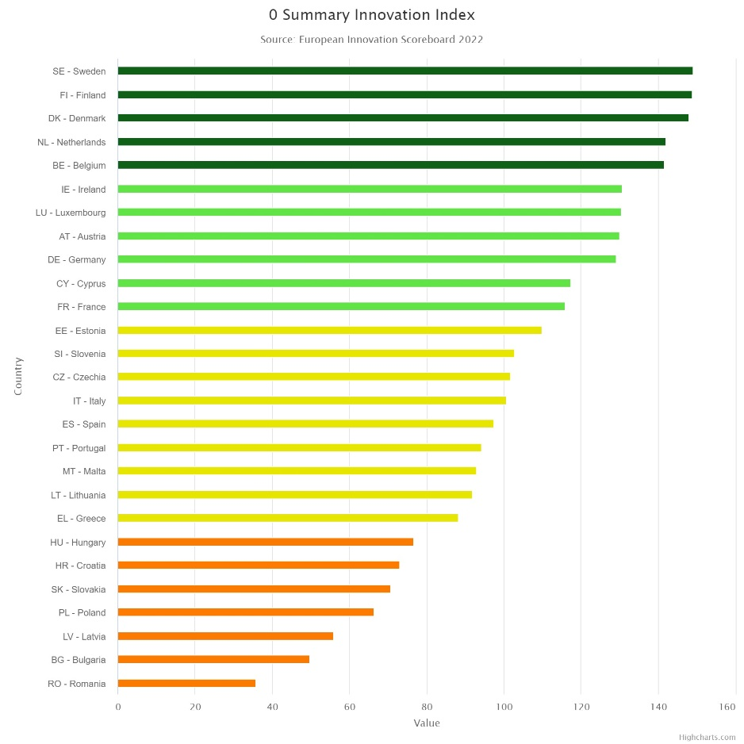
European Paradox
failure of European countries to transfer scientific advances to marketable innovations

Slide 6

European Open Science Cloud (EOSC)
EOSC is about developing, deploying and evolving a trusted environment providing two million European researchers with seamless access to research data, research infrastructures, e-infrastructures and related services, enabling them to share, curate, discover, access, process and reuse research outputs of all kinds across borders and scientific disciplines
EOSC will essentially involve the federation of existing research data infrastructures and the realisation of a Web of FAIR Data and Related Services for Science, making research data interoperable and machine-actionable following the FAIR guiding principles

Slide 7
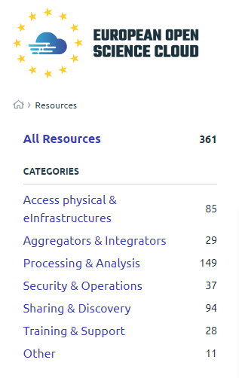
European Open Science Cloud (EOSC)
EOSC will improve the situation for researchers in many ways, namely:
Seamless access to content and services via common AAI
Access to data from various sources which is FAIR and ideally open
Access to services for storage, computation, analysis, preservation and more
Adoption of standards so data and services can be combined
Helpdesk, training and support to improve use of EOSC.
https://marketplace.eosc-portal.eu
Notes:
Nije lako, usluga mora imati neke elemente…

Slide 8

National Open Science Cloud Initiatives (NOSCI)
Five regional projects aim to coordinate the efforts of national and thematic initiatives in contributing to EOSC through groupings of European countries: NI4OS-Europe
Lines of action:
Support the development and inclusion of the national Open Science Cloud initiatives in 15 Member States and Associated Countries in the EOSC governance
Promote within the community the EOSC philosophy and FAIR principles for data Findability, Accessibility, Interoperability and Reusability
Provide technical and policy support for on-boarding of service providers into EOSC, including generic services (compute, data storage, data management), thematic services, repositories and data sets.

Slide 9
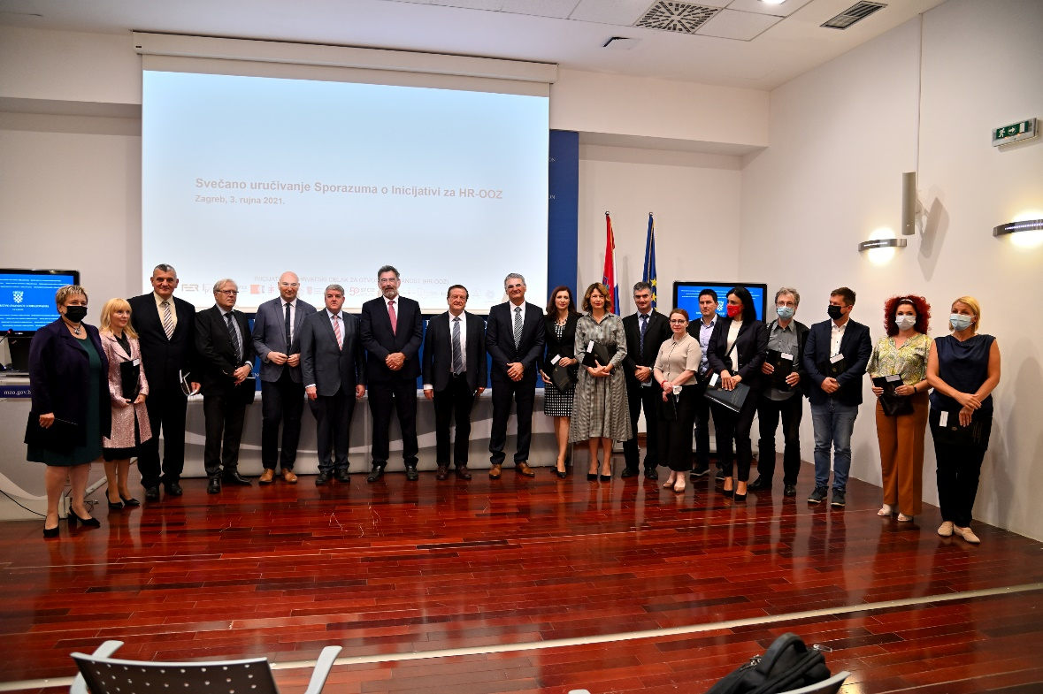
Croatian Open Science Cloud (HR-OOZ) Initiative
Handing over ceremony of the MoU for members of the HR-OOZ Initiative on September 3rd 2021
Notes:
Specific for Croatia?
MoU
// So HR-OOZ, similar to EOSC the idea is to use and connect existing… and to connect them to EOSC.
Funding and sustainability
We had the ceremony. Importatnt to get to media. Imporant people: ministar, rectors, vide recors, directors, deans…

Slide 10
HR-OOZ Initiative - Goals
Goals
Setting up and defining organizational and governance structures, and technical components for the long-term sustainability of HR-OOZ
Drafting the proposal of the National Plan for Open Science and proposal of the law governing the scientific activity in the part related to the open science
Notes:
Define and create organizacion and governance strucutre, organigram, criteria for inclusion, define technical aspects of HR-OOZ

Slide 11
HR-OOZ Initiative - results
TF for the national plan & policies
Proposal for provisions related to open science for the new law governing scientific activities - DONE
National Action Plan for Open Science - IN PROGRESS
Open science policy template for the science and higher education institutions - TODO
TF for structure & principles of HR-OOZ
Rules of Procedure for HR-OOZ - DONE
Criteria for on boarding services and resources into HR-OOZ - DONE
Catalogue of HR-OOZ services and resources - IN PROGRESS

Slide 12
HR-OOZ - Criteria for on boarding services and resources into HR-OOZ
Terms of use, licences,…
User manual
Helpdesk
Appropriate policies/notices
TRL7 – TRL9
Monitoring
Security regulations
Disaster recovery
Authentication (AAI@EduHr)
Notes:
TRL

Slide 13
HR-OOZ Catalogue / Marketplace
Why national catalogue?
Visibilitiy
Trust
Help with the on-boarding process (fulfilling the criteria)
Candidates:
National and univeristy library in Zagreb: PID service (URN:NBN), Croatian web archive
Ruđer Bošković Institute: Revigo
University of Zadar: GlagoLab
Institute of Ethnology and Folklore & ACDH-CH: Consent Form Wizzard
SRCE: PUH,…

Slide 14
Thank you!
hr-ooz@srce.hr
https://www.srce.unizg.hr/hr-ooz
https://www.srce.unizg.hr/en/hr-ooz

