Slide 1
Training and skills development
GA#5 session “EOSC in Practice: Showcasing Additional Activities”

Slide 2
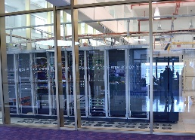
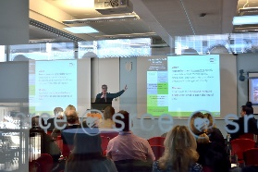
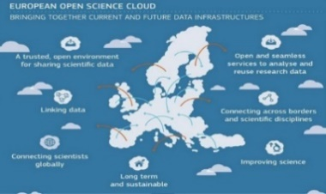
SRCE
University of Zagreb, University Computing Centre
… Builds national e-infrastructure,
from data centers, through network, computer
and storage resources, all the way to information services
… Provides digital services, education of users and advanced user support
… Builds bridges to international infrastructures and initiatives
5.2
… Is a synonym for a digital transformation of science and higher education system
5.2
Notes:
The University Computing Centre (SRCE) has a long tradition in the area of information and communication technologies. It was founded in 1971 within the University of Zagreb, the only Croatian university at the time, with the purpose to enhance the implementation of information technologies in the academic community as well as in Croatia in general.
Today, SRCE is the main computing centre and the architect of the e-infrastructure, covering both the University of Zagreb and the whole research and high education system. Furthermore, SRCE is the competence center for information and communication technologies as well as the center for education and support in the area of ICT application.

Slide 3
Open Science Services for Researchers & Roles
SRCE provides e-infrastructure & data services for Open Science
Member of EOSC Association
COMPUTING
Advanced Computing & Cloud Services
HPC
HTC Cloud
Cloud services
Croatian Open Science Cloud (HR-OOZ) Initiative
DATA SERVICES
during all phases of research process
Scientific papers publication
Permanent storage and research results sharing
Data storage during research process

Slide 4
Training and skills development
Croatian OA Journals
529 OA journals
266.000 OA papers
Journal Article Tag Suite (JATS) XML
Open Journal Systems (OJS3) for journal editors
Open Monograph Press (OMP) for conference proceedings publishing
…
hrcak.srce.hr/en
Archives and Repositories
157 repositories
206.000 objects
Managing repositories for repository managers
Metadata description for dataset and long term preservation in repository
OpenAIRE registration of v4 interface
…
dabar.srce.hr/en
RDA National node
Research Data Management and FAIR data and principles
Handbook & series of webinars: How to manage research data
Documentation and Anonymization of Research Data (2022)
…
www.srce.unizg.hr/rda
EOSC-A,
HR-OOZ initiative (NOSCI),
NI4OS-Europe, ...
Brochures (EOSC, FAIR data…) & EOSC promoters activities
EOSC services & repositories on-boarding
(TODO) Institutional policies
…
www.srce.unizg.hr/en/hr-ooz
www.srce.unizg.hr/NI4OS-Europe
Notes:
Hrčak since February 2006

