Slide 1
Digital repositories for education
Ljiljana Jertec Musap
SRCE – University Computing Centre, University of Zagreb
25 November 2022, Hybrid Multiplier Event of the Erasmus+ Project DECriS

Slide 2
DABAR
Digital academic archives and repositories - https://dabar.srce.hr/en
Croatian national e-infrastructure for digital repositories
Users?
Scientific and educational institutions registered in the Republic of Croatia
What do users get?
Reliable and interoperable institutional and/or thematic repository
Repository under the institution’s web domain
Total control over access rights and repository content usage
No costs
Without dealing with the technical issues related to the implementation and maintenance of repository

Slide 3
DABAR (how it all started...)
2013 - The Scientific Activity and Higher Education Act - universities and higher education institutions are required to permanently publish theses and doctoral dissertations in public databases (repositories)
2014 – initiative (SRCE + HiEd&Science institutions + experts and scientists)
2015 – DABAR was released
Source: https://dabar.srce.hr/en/2015-08-24/digital-academic-archives-and-repositories-dabar-released
Notes:
during 2014 SRCE initiated a network of experts and scientists that were interested in digital repositories or had already been working on archiving digital assets for their institutions. Furthermore, SRCE established contact with research and higher education institutions as well as research institute libraries.

Slide 4
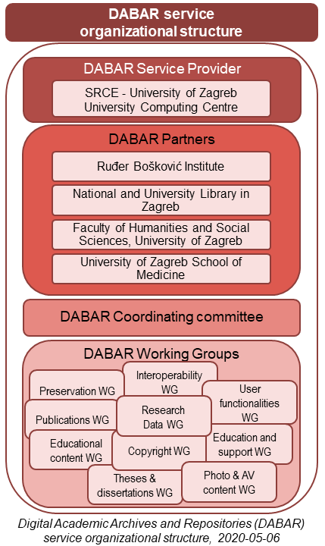

Slide 5
DABAR in numbers
157 digital repositories
200.000+ digital objects → 48.3% OA
16 types of digital objects
Undergraduate and master’s theses | Dissertations | Art undergraduate and master’s theses | Educational material
Articles in journals | Conference papers | Book chapters | Conference presentations
Audio files | Images | Video files | Generic object
Datasets (Research Data) | Books | Virtual collections | Appendixes

Slide 6
DABAR objects
Nationally agreed
Specifications based on standardized metadata description
Defined by working groups
Datastreams behind the object (metadata schemas):
Metadata Objects Description Schema (MODS)
detailed description
standardized elements + customized <extension> elements
Dublin Core
narrow description
interoperability

Slide 7
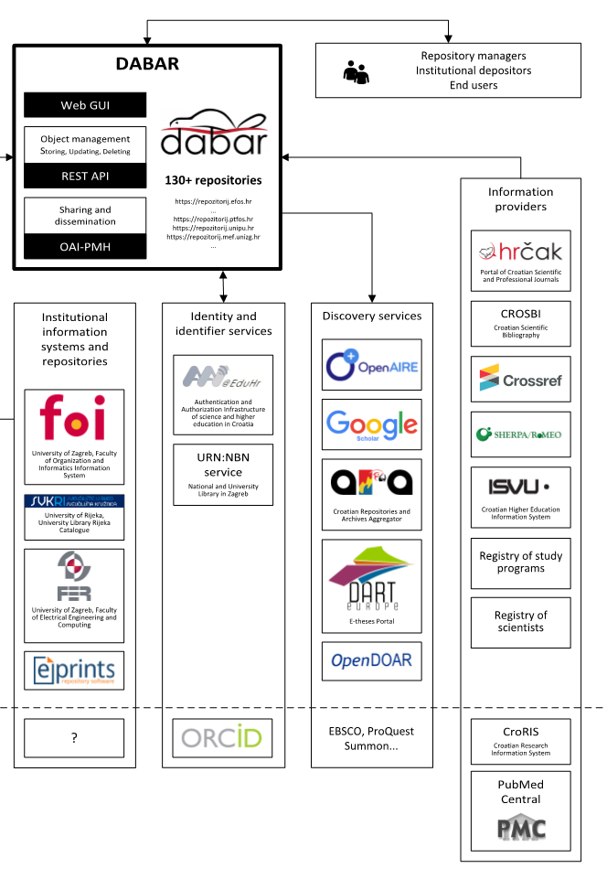
DABAR interoperability
OAI-PMH (Open Archives Initiative Protocol for Metadata Harvesting)
a protocol that defines the metadata collection mechanism; supports DC and MODS
FAIR principles
Findable
Accessible
Interoperable
Reusable
Image is from 2019

Slide 8
OER in Dabar
Object: Educational material (since July 2019)
Based on LOM
IEEE 1484.12.1-2002 – revised in 2011
IEEE Standard for Learning Object Metadata
Superseded by IEEE 1484.12.1-2020
Data model, usually encoded in XML, used to describe a learning object and similar digital resources used to support learning
Educational material Working Group
Specification: https://dabar.srce.hr/en/objects

Slide 9
OER in DABAR
Supported types of OER:
Supported file formats:
exercise
simulation
survey
diagram
figure
graph
index
slide
table
exam
experiment
self assessment
demonstration
animation
glossary
reference material
methodology
video
audio
question bank
textbook (manual, book)
lesson
curriculum
.pdf .txt .docx .xslx .pptx .xml .mbz .png .jpg .jpeg .wav .mp3 .mp4 .mov .avi .mpeg .mpg .zip .sav

Slide 10
OER in Dabar
Access rights
Repository administrators and authors decide access rights for the full text of the object
Metadata – always open
4 types of access:
Open access
Institutional access (only for institutional AAI@EduHr users)
Restricted access (only for AAI@EduHr users)
Closed access
Embargoed access
Open access is strongly recommended!
Terms of use
CC licences
Copyright – all rights reserved

Slide 11
OER in Dabar
Example: https://urn.nsk.hr/urn:nbn:hr:195:345721

Slide 12
DABAR for education
Storing all institutional educational material at one place
Greater visibility and findability
Gathering the objects in virtual collections - courses
Connecting objects with other objects in the repository, in DABAR or anywhere online
pointing to previous/following version
drawing attention to other similar material
Each object gets PID (URN:NBN) – persistent locator in case URL changes
Persistent archiving
Moodle -> DABAR -> Moodle = sharing and reuse

Slide 13
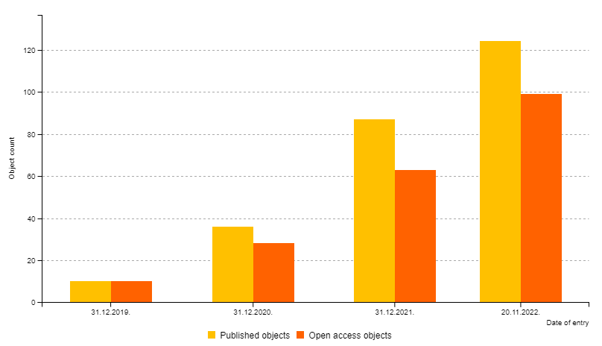
OER in Dabar
22 November 2022:
128 published objects
OA: 102 objects = 79.8%
32 repositories

Slide 14
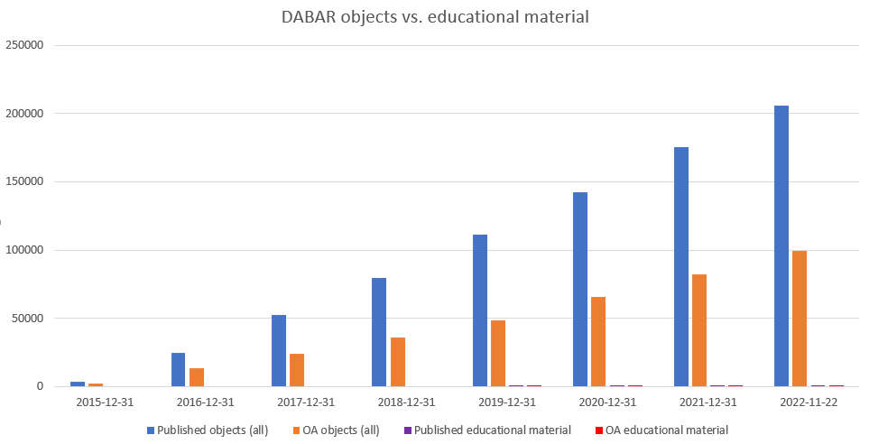

Slide 15
OER in Dabar – reasons of low usage?
Not promoted enough?
Lack of education?
Passive working group?
Lack of interest?
Not defined who should upload educational objects in repository – teachers or repository administrators (mostly librarians)?
Complicated metadata desription?
No legal obligations?
Access rights and terms of use not defined?

Slide 16
Thank you! https://dabar.srce.hr/en
dabar@srce.hr

