Slide 1



Supporting digital education in pandemic – SRCE perspective
Dr. Sandra Kučina Softić, Assistant director, M.Sc. in Digital Education
University Computing Centre SRCE, assistant director
Zagreb, November 24, 2022

Slide 2

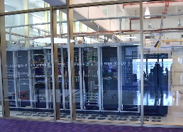
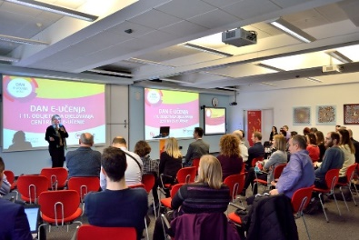
University Computing Centre SRCE
is computing centre and the architect of the e-infrastructure of the entire system of science and higher education of the Republic of Croatia
competence centre for information and communication technologies as well as the centre for education and support in the area of ICT application
in 2021 – 50th anniversary

Slide 3

SRCE – National Centre for E-learning in Higher Education
www.srce.hr/enc
E-learning Centre@SRCE
established in 2007
to support institutions, teachers and students in the use of e-learning technologies and tools
provides infrastructure, usage support and user education
a key stakeholder in the process of digital transformation of the higher education system
Basic objectives:
  to support higher education teachers, students, e-learning teams and institutions
  to provide and maintain reliable and generally accessible university platform for e-learning
  to support the university network of people involved or interested in e-learning
  to promote and foster implementation of e-learning

Slide 4







E-learning Centre@SRCE
E-learning platform for HE
state-of-the-art
e-learning system tailored to user needs
Academic
e-portfolio
for personal use, for presentation or as a learning activity
Webinars
For online lectures, presentations, seminars, consultations
Adobe Connect
Edumeet
E-course Catalogue
of HEI in Croatia
a central place to find basic information about all e-courses
Promoting Open Access and OER
all educational materials develed in SRCE in Open Access
SRCE Open education portal
Antiplagiarism software
for checking students work, theses and doctoral dissertations
by students and teachers

Slide 5


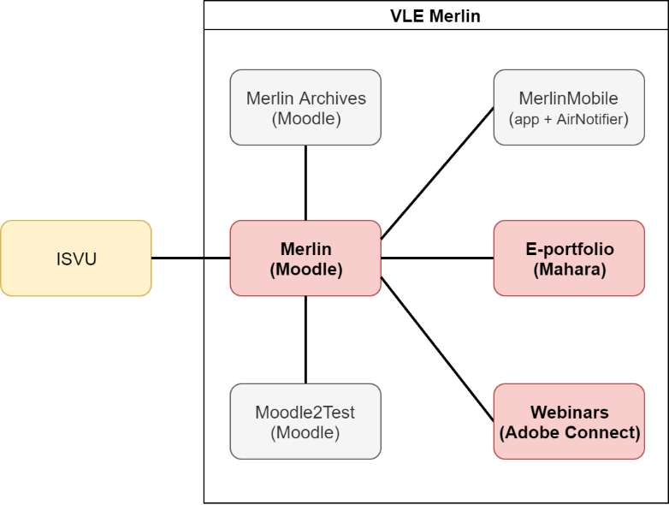
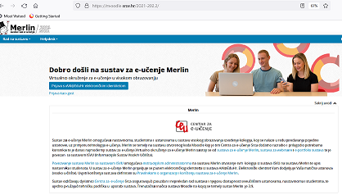
Virtual Learning Environment – Merlin
http://merlin.srce.hr
Dabar
1 Moodle installation
94 institutions on Merlin

Slide 6
Merlin – numbers…

Slide 7
High quality, easily accessible and sustainable support
to HEI
in the systematic
Implementation of e-learning and the process of digital transformation
to teachers
in the use of digital technologies;
in implementation of digital techoologies in teaching and learning
to students
in navigating the online environment and using digital technologies
Courses (classroom and online)
Manuals
FAQ
Quick help
Animations
Guides, additional materials
Helpdesk
Consultations
Tailor made support to teachers in implementation of e-learning into educational process
Template for an e-course creation
E-course self-assessment application
Digital badges for completed courses
Interactive guide for grading in Moodle….

Slide 8
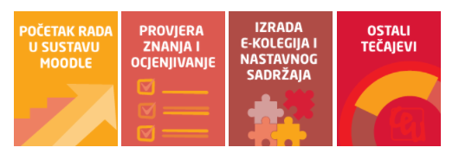
Teachers training… designed for their needs
Courses and workshops
How to work in Moodle
E-course development
Learning Outcomes in Moodle
Student’s Assessment and Grading
E-portfolio
Teachers digital competences
ABC workshop on learning design
Interactive educational materials with H5P
Multimedia in e-courses
Educational materials as OER
How to prepare and online lecture with Adobe Connect
Individual consultations
Engaging events- building comunities of practices and enhancing networking

Slide 9
Number of inquiries by users answered by the E-learning Centre SRCE team

Slide 10
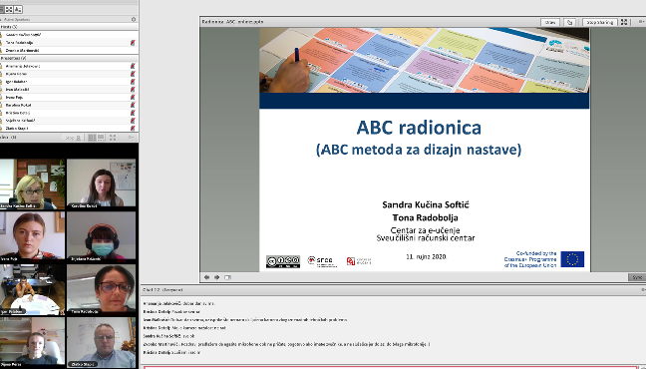
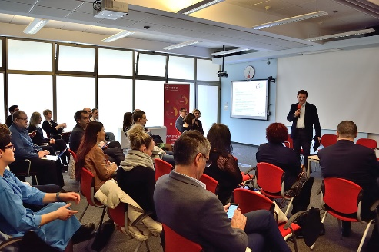
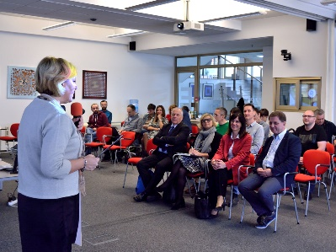
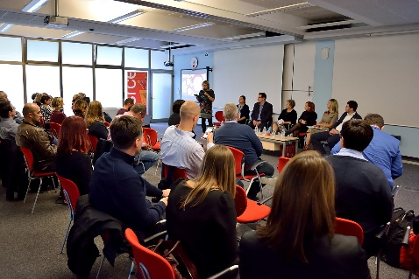
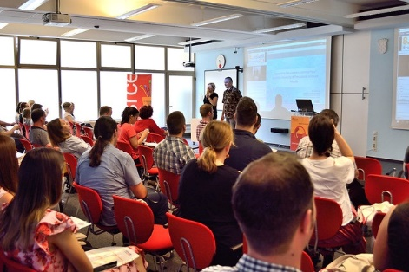
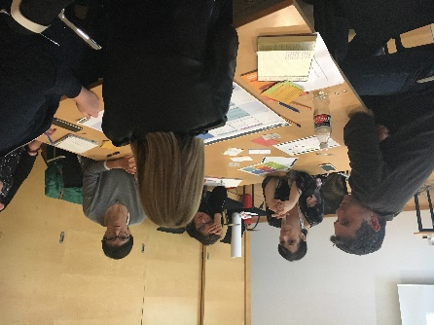
Rising Awareness and Dissemination about E-learning
ELC web pages…
Open Education Week
MoodleMoot Croatia - June
E-learning Day – December
Articles is SRCE newsletter…
mailing lists….
Training courses, workshops
E-learning Centre Week – end of September

Slide 11
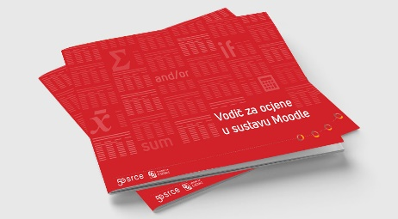
How we sucessfully supported HEI when pandemic started...
(and earhquake)
10.000
e-courses opened in two months
(81% more corses than in previous ac. Year)
65%
more teachers started using Merlin and e-learning in relation to previous academic year
18.000
succesffuly answered user inquires in 2020
255% growth
Live communication as the preffered way by users for communication and support
institutions
teachers
parents
students
Reliable and well designed infrastructure
ensured continuity and proper functioning
Easy accessible and systematic support helped users to focus on teaching and learning

Slide 12

Higher education in Croatia till March 2020
Still dominantly oriented to classical (f2f) teaching and learning
Digital technologies mostly as addition to enhance the quality of teaching and learning
Few accredited online studies (only for part-time students)
Strategy of Science, Education and Technology (Ministry of Science and Education, 2014)– Action plan with defined activities - low level of realisation
Left upon HEI and teachers to decide on implementation of digital technologies and e-learning into their study programs and courses
Research dominant in relation to teaching, especially in the rules for the advancement
Teaching efforts not recognized nor awarded

Slide 13
Teaching and learning after lockdown
Those teachers who have used e-learning before, easier and faster moved their teaching online
Those teachers who did not use any digital tools in their teaching had more difficulties to find out how to organize their teaching in online environment
High increase on the video conferencing systems in order to organize classroom lectures in online environment - Adobe Connect, Zoom, Microsoft teams, BBB, Google Suite, edumeet….
Move to online environment with courses prepared for the classroom teaching- emergency remote teaching
Technical issues- some institutions did not have adequate infrastructure, teachers and students did not have broadband or adequate laptops
Lack of teachers’ digital skills resulted in low use of possibilities of digital technologies, high workload and stress
Lack of students’ digital skills resulted in confusion and high stress
Online oral and written exams – additional stress for students (did not meet technical requirements, first time experience, lack of enough information and testing how to participate in online exams)
Goal to ensure the continuation of teaching and learning and finish of academic year

Slide 14







Research results on
Higher education teachers and pandemic: academic and psychological challenges
March 2022

Slide 15
Summary
72% teachers consider they have good and very good digital competencies
87% teachers consider they have good and very good in e-learning technologies application
79% teachers consider they are digitally competent for e-learning application in higher education
64% teachers consider they are sure and quite sure in choosing e-learning tools and technologies in educational process
46% teachers is not sure about advantages of ICT and e-learning in education, they are using them just because of pandemic, they do not know how they could contribute to education or they think ICT and e-learning are not relevant for their teaching
ICT and e-learning are used dominantly in education for
  learning material and dissemination
  information about course
  online lectures
  communication

Slide 16
Teachers need support
2017
2021
In use of ICT (84,8%)
In use of e-learning technologies (82,1%)
In preparation and development of e-courses (73,6%)
In pedagogy and teaching methods (56%)
In use of ICT (86 %)
In use of e-learning technologies (87 %)
In preparation and development of e-courses (78 %)
In pedagogy and teaching methods (76%)

Slide 17
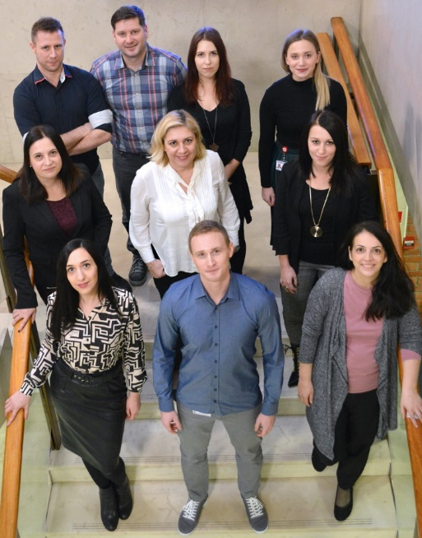
E-learning Centre
University of Zagreb
University Computing Centre
www.srce.hr/en/elc
ceu@srce.hr
sskucina@srce.hr
moto of the E-learning Centre: be humble, listen and collaborate both internally and externally

