Slide 1
Croatian Plan for Open Science
(first public presentation of the draft)
Zoran Bekić, PhD
a
SRCE
Member of the HR-OOZ "policy" WG

Slide 2
"Travel" diary... so far
September 2021 - Initiative for Croatian Open Science Cloud, Council and WGs established
January 2022 - Proposal of articles for the new Croatian Act on Higher Education and Science submitted to the Ministry
January 2022 - "Policy" Working group began the work on the Croatian Plan for Open Science; three subgroups were defined for three basic chapters
March 2023 - After 13 months ☹ and a series of WG and subgroup meetings, the draft Plan was sent to the Council of HR-OOZ Initiative

Slide 3
"Policy" WG of the Council of HR-OOZ
dr.sc. Lovorka Barać Lauc, HRZZ
dr.sc. Zoran Bekić, SRCE, UNIZG
prof.dr.sc. Gordan Jelenić, UNIRI
dr.sc. Koraljka Kuzman Šlogar, IEF
dr.sc. Bojan Macan, IRB
izv.prof.dr.sc. Sven Maričić, UNIPU
doc.dr.sc. Teo Matković, IDI
izv.prof.dr.sc. Anamarija Musa, PF, UNIZG
dr.sc. Kristina Romić, NSK
izv.prof.dr.sc. Goran Sedmak, HIIM
izv.prof.dr.sc. Jadranka Stojanovski, IRB / UNIZD
prof.dr.sc. Diana Šimić, FOI, UNIZG
prof.dr.sc. Marko Tadić, FF, UNIZG
prof.dr.sc. Leandra Vranješ Markić, UNIST
+
dr.sc. Davor Davidović, IRB
Marijana Glavica, FF, UNIZG
Iva Melinščak Zlodi, FF, UNIZG
dr.sc. Slaven Mihaljević, SRCE, UNIZG

Slide 6
Structure of the Plan
Introduction
Vision and the main objectives of the plan
1. Open science as a basic model of conducting research
2. Open access to results of the research
3. Open research infrastructures
Glossary of terms and abbreviations

Slide 7
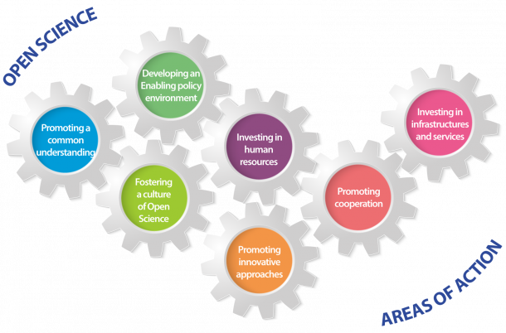
Introduction
Open science and why it matters
Open science in Europe
Open science in Croatia
Source: UNESCO
Source: https://en.unesco.org/sites/default/files/open_science_brochure_en.pdf

Slide 8

Vision
Science, research and higher education
respect and follow
the principles, values and practices of open science
and
therefore effectively contribute to
faster advancement, sustainable development and international relevance of Croatia
Source: UNESCO

Slide 9
Main goals (1/2)
◎
advance the understanding of the meaning, conception, advantages and practicing of open science in the academic and scientific community,
promote basic values and principles of open science such as responsibility, scientific integrity, ethics, research quality, research transparency, research reproducibility, sharing, cooperation, openness, equality, inclusiveness, diversity, flexibility, sustainability, etc.,
ensure preconditions (and remove obstacles) and create organizational, legal, financial and technical frameworks for the effective application of the principles and practices of open science in the science and higher education system in Croatia,
promote and apply a new system of evaluation and assessment in science and higher education, by using of adequate, new indicators of performance, quality and efficiency of research and education, introduce new indicators and criteria for evaluating institutions, rewarding and advancing teachers and researchers that will fully recognize the contributions to open science,
encourage and provide OA to publications and to all other results generated at different stages of research, especially those funded by public funds,

Slide 10
Main goals (2/2)
◎
encourage and ensure systematic management and curation of research data complied with FAIR (Findable, Accessible, Interoperable, and Reusable) and CARE (Collective benefit, Authority to control, Responsibility, Ethics) principles,
encourage and ensure the development and management of scientific software in accordance with open source licenses and provide OA to such software,
establish mechanisms of coordination, joint and coordinated planning, construction, maintenance, development and use of research infrastructures, including e-infrastructure, and their sustainability, integrity and interoperability with the involvement of the Croatian Open Science Cloud (HR-OOZ),
ensure that researchers and teachers have the necessary competences and skills to apply open science practices and provide an adequate, sustainable and well-funded support system for the application of open science principles through a network of expert teams and institutions to support the application of the principles of open science,
provide connection of Croatian and European research area, including connection and interoperability of Croatian and European research infrastructures and e-infrastructures through interconnection of the Croatian Open Science Cloud (HR-OOZ) with the European Open Science Cloud (EOSC).

Slide 11
1. Open science as a basic model of conducting research
1.1. Changes to the evaluation / assessment system in science and research
1.2. Open responsible research and innovation
1.3. Promotion of culture and application of the principles of open science
1.4. Coordination, funding and monitoring of the open science
18
specific goals
28
implementation
activities

Slide 12
2. Open access to all results of the research
2.1. Open access to publications
2.2. Management and sharing of research data
2.3. Management and sharing of research software
12
specific goals
12
implementation
activities

Slide 13
3. Open research infrastructures
3.1. Open research infrastructures and
e-infrastructures
3.2. Support system and improvement of competences for open science
3.3. Croatian and European Open Science Clouds (HR-OOZ and EOSC)
10
specific goals
18
implementation
activities

Slide 14

Next steps
publication of the draft of the Croatian plan for open science at the web pages of the Initiative for HR-OOZ as proposal (https://www.srce.hr/hr-ooz) - draft continuously open for suggestions and proposals
official submission of the draft to the Ministry of Science and Education (MSE) for the further processing
public consultations under the auspices of the MSE
adoption of the Croatian plan for open science
by MSE

Slide 15
Thank you for your attention!
Visit https://www.srce.hr/hr-ooz
All comments, suggestions, proposals are welcome at hr-ooz@srce.hr

