Slide 1
Data and open science from the perspective of service provider
Draženko Celjak,
SRCE – University of Zagreb University Computing Centre
<drazenko.celjak@srce.hr>

Slide 2
Which services we provide in the research data lifecycle?
COMPUTING
Advanced Computing & Cloud Services
Research Data Lifecycle
HPC
HTC Cloud
Cloud services
PLAN
COLLECT
ANALYSE
PRESERVE
SHARE
PROCESS
RE-USE
DATA SERVICES
during all phases of research process
Scientific papers publication
Permanent storage and research results sharing
Data storage during research process

Slide 3
Services?
Portal of Croatian scientific and professional journals – HRČAK
Open Journal Systems (OJS) for ~ 50 journals
Open Monograph Press (OMP) since November 2022.
533
OA journals
275.000+
articles
70.000
visits daily

Slide 4
Services?
Digital Academic Archives and Repositories – DABAR
15 types of digital objects
161
repositories
219.000+
digital objects
48,4%
OA

Slide 5
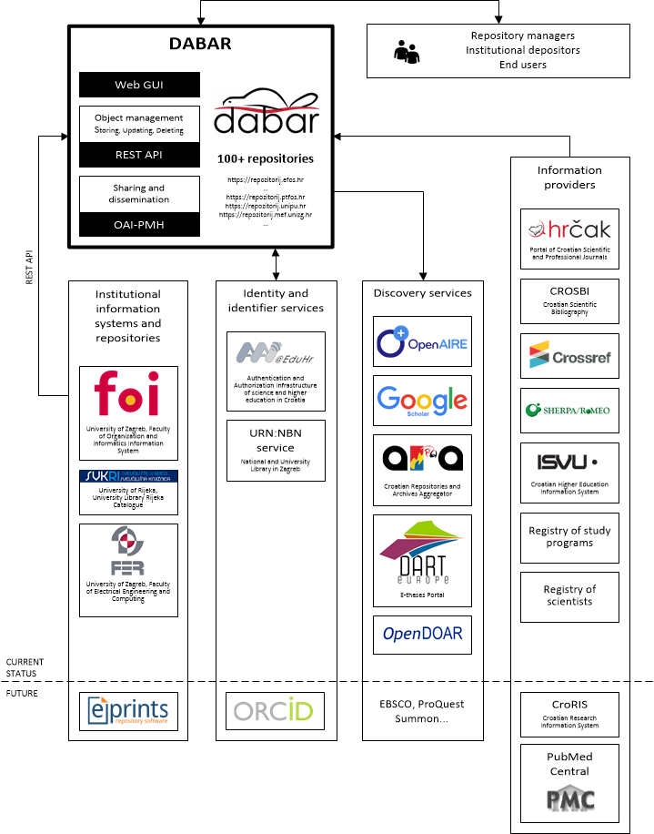
Services?
DABAR is FAIR!

Slide 6
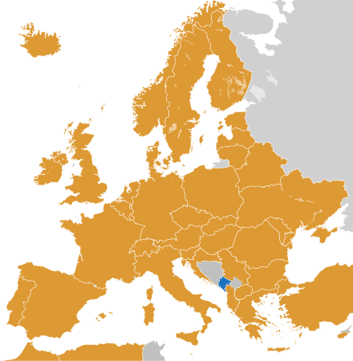
Services?
Data storage and sharing – PUH
200 GB of storage available via web, desktop app, mobile app, network drive
eduGAIN auth
540+
researchers & lecturers
20,3 TB
data
137+
research projects
Notes:
https://technical.edugain.org/status

Slide 7
Services?
Trainings
Research data management (P200)
Documenting and anonymization of research data (P250)
50+
workshops
600+ TB
participants
2
online selfpaced courses

Slide 8
Current developments & plans
HRČAK / diamond OA
JATS XML - Journal Article Tag Suite (NISO standard) – in progress
WoS & Scopus – in progress

Slide 9
Current developments & plans
DABAR / repositories
analytics – almost done
support for Data Management Plans (DMP) – in progress
CoreTrustSeal (CTS) certification – in progress
research software sharing
enabling eduGAIN authentication
(better) integration with national CRIS system (CroRIS)

Slide 10
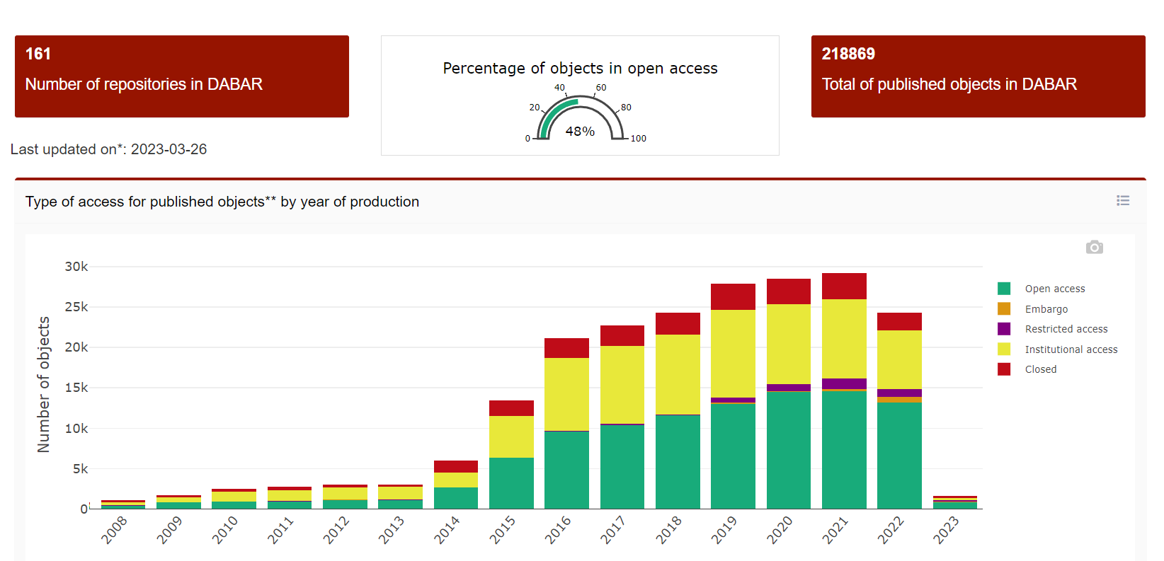
Challenges & hindrances
Open?
OS Policies
Data stewards network

Slide 11
Thank you ☺

