Slide 1
Creating JATS XML from DOCX
Ljiljana Jertec Musap
Draženko Celjak, Nino Katić
University of Zagreb University computing centre (SRCE)
13 September 2023, PubMet2023

Slide 2
Topics
HRČAK
JATS XML
demonstration of creating JATS XML from DOCX via HRČAK
Q&A&Comments&Impressions...

Slide 3
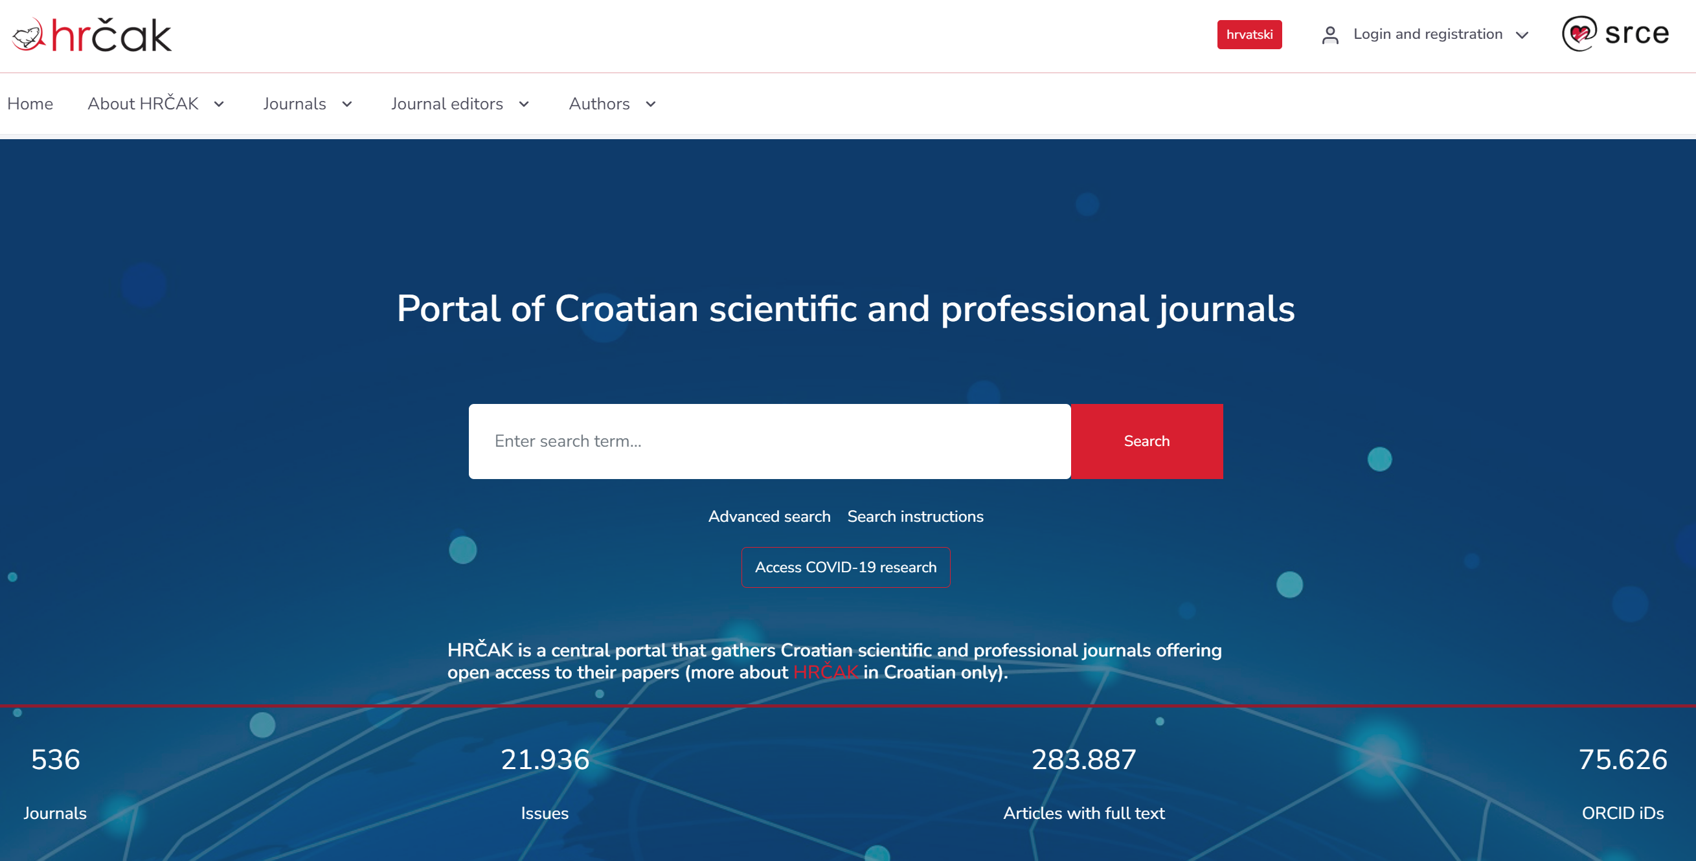
HRČAK - Portal of Croatian Scientific and Professional Journals
Open Access journals
released in 2006
530+ journals
OJS
OMP
Inclusion criteria
Open Access
connection to the Republic of Croatia
at least 1 issue ready to publish
editorial board
instructions for authors
review policy
categories of papers
impressum
Notes:
I believe many of you are familiar HRČAK but hovewer it is worth mentioning some of the main facts. HRČAK is a central portal of Croatian scientific and professional journals that exists since 2006 and serves as a publishing platform for more than 530 journals. In the beginning it wasn’t mandatory to publish full-texts in open access so there are journals and articles that only have metadata, but since 2017 it is mandatory. We can say that there are more than 280.000 articles with full text on HRČAK.
Besides the portal that offers a place for publishing the final product of the journals, HRČAK also offers a technical support for usage of OJS and OMP. There are around 50 journals on HRČAK OJS and a couple of conference proceedings on HRČAK OMP. We have released OMP around a year ago.
For inclusion in HRČAK, journals have to fullfil 9 mandatory criteria which are listed here.

Slide 4
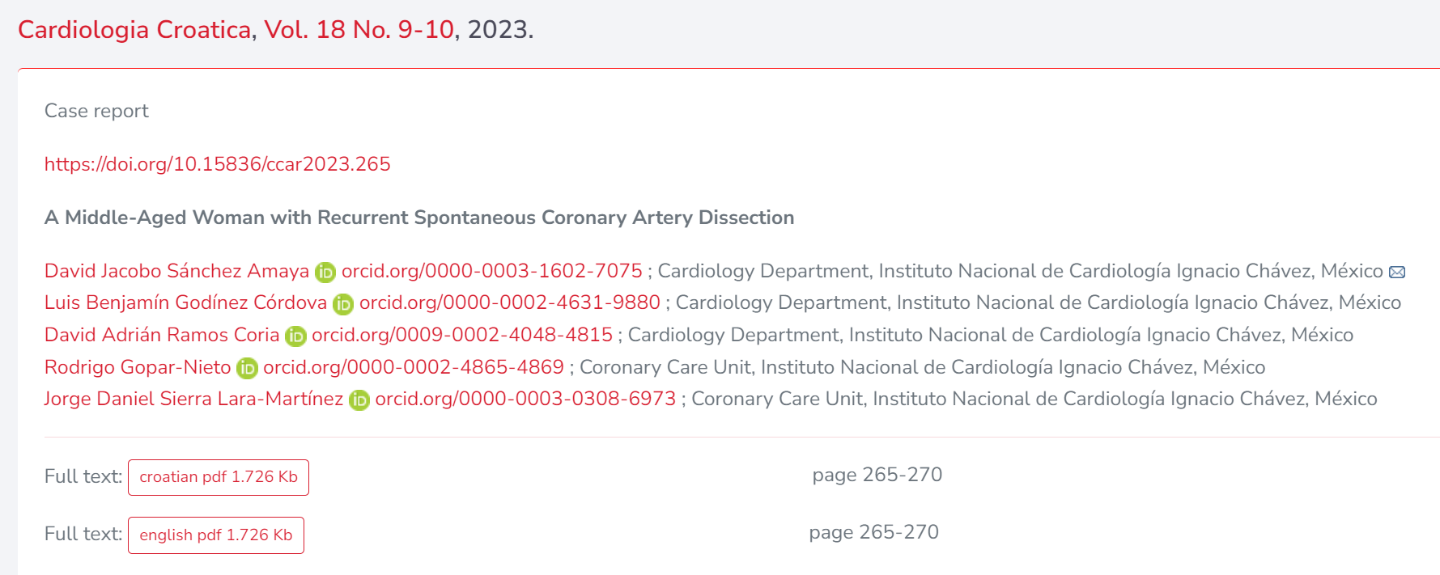
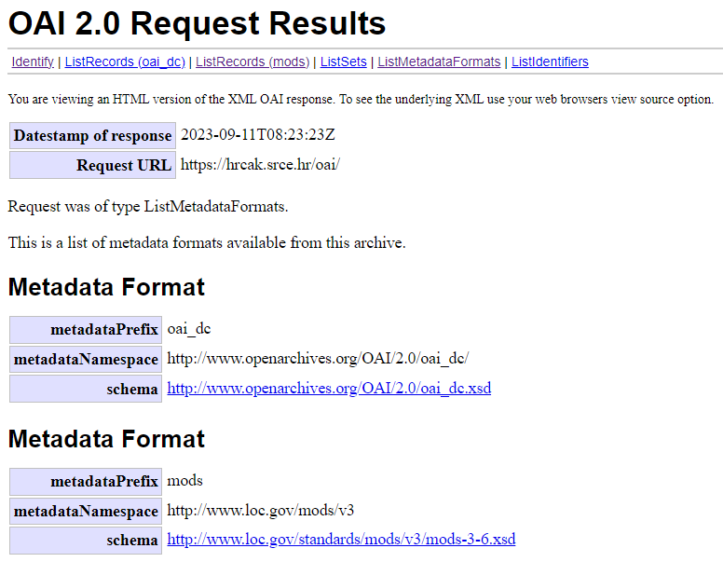
Interoperability & Unique Identifiers
OAI-PMH
KBART
OpenAIRE Guidelines for Literature Repository Managers 3.0. compliant
ORCID
28.100+ ORCID IDs
55.000+ papers connected with ORCID ID
funder / project information
OpenAIRE (FP7, H2020...)
IRB project database (MZO, HRZZ)
supplementary files / datasets
Notes:
We strive to make HRČAK as interoperable as possible. In order to achive this, HRČAK offers all journal and articles metadata to crawl via OAI-PMH protocol. It is a protocol for metadata harvesting for search engines, crawler, indexes etc. Also, metadata about HRČAK journals are available in KBART compliant list and furthermore, since 2015 HRČAK is registered in OpenAIRE as data source which was achieved by ensuring compliance with Guidelines for Literature Repository Manager version 3.0.
All authors of articles on HRČAK can link their ORCID ID to their paper. That is automated process in which authors get invitation link from HRČAK and link their ORCID to their papers themselves by confirming their authorship. There are more than 28.000 unique ORCID on HRČAK and more than 55K papers connected with an ORCID of at least one of the authors.
Each article can be linked to the project within which it was created.
Each article can have associated supplementary files and datasets used in its creation.
*KBART (“Knowledge Bases and Related Tools”) is a NISO Recommended Practice that facilitates the transfer of holdings metadata from content providers to knowledge base suppliers and libraries.

Slide 5
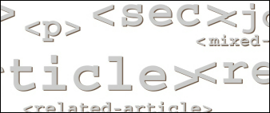
Advanced formats
JATS XML – since 2017
Journal Article Tag Set (Publishing, version 1.1)
set of elements and attributes for tagging journal articles
semantic description of the structure, metadata and body of the article
open standard
machine-readability
facilitates distribution of the article
content & reference mining
increases findability and visibility of the article
independent of text processor
Notes:
Until 2017, only PDF was accepted as a format in HRČAK. Then, five years ago we have implemented support for publishing in XML format in accordance with JATS tagging standard.
JATS stands for Journal Article Tag Set and in HRČAK we are using version 1.1. It is de facto standard for XML representation of journal articles. It is open, machine-readable and tool-independent format.
Tagging parts of the article with JATS elements give semantic description to the structure and the body of the article while also includes detailed metadata about the article. And why sould editors do that? Why is that important?
We can agree that the primary objective of a journal article is to have its contents disseminated as widely as possible. Articles undergo a complex journey to fulfill that goal. They go through multiple stages, passing through peer review systems, publisher websites, databases, aggregators, search engines, various discovery platforms, partner publishers, repositories, archives, and beyond. Considering the huge number of journal articles created daily, achieving widespread content dissemination really becomes a challenge.
This is where a publishing in a format such as JATS XML comes on stage. Not only it contains a whole body and appendicex of the article, but also article metadata and metadata are a guide for the gatekeepers of desired article destinations. These details are extremely valuable in facilitating smooth distribution to a wide audience and it is really important that they are written in open format, machine readable format.
Beside metadata, full-text of the article created in JATS XML facilitates content & reference mining that increases findability and visibility of the article. Also, that opens gates to some new features and opportunities for publishing platforms in the future.
The last argument which I’ll mention is that since JATS XML carries only the article data and structure information and not information about layout of the article, it gives a lot of opportunites in visual presentation of the article on the web page, which makes it independent of browsers and text processors.

Slide 6
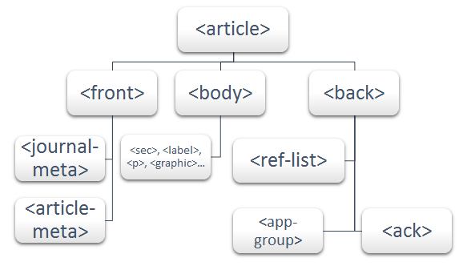
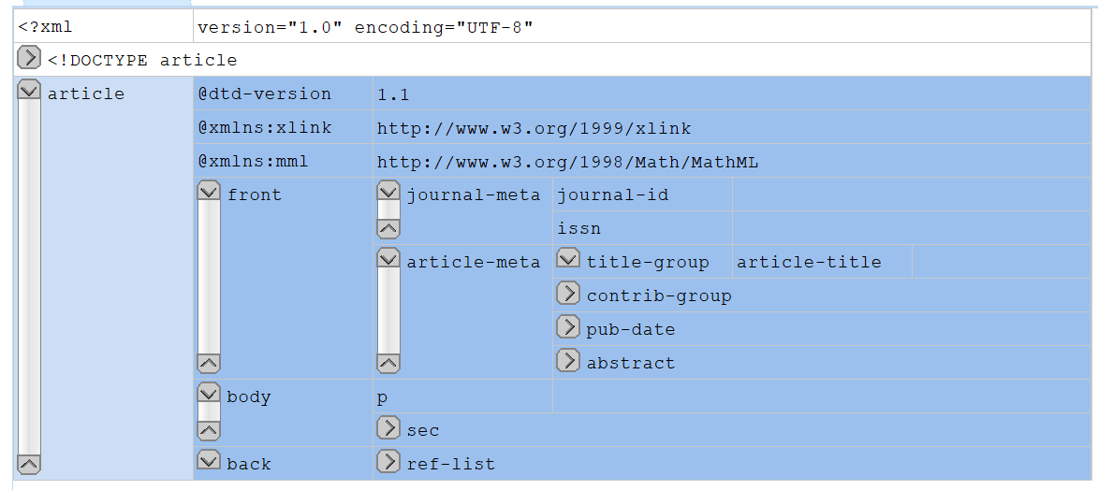
JATS XML structure
Notes:
Here you can see three types of representation of JATS structure that all show the same. The first image shows the grid view of the structure, the second one is XML document and the third one is visually the easiest to understand so I’ll stick to that.
On third image you can see how it looks like when it’s written in XML, of course this is empty and collapsed and a real document is much much bigger.

Slide 7
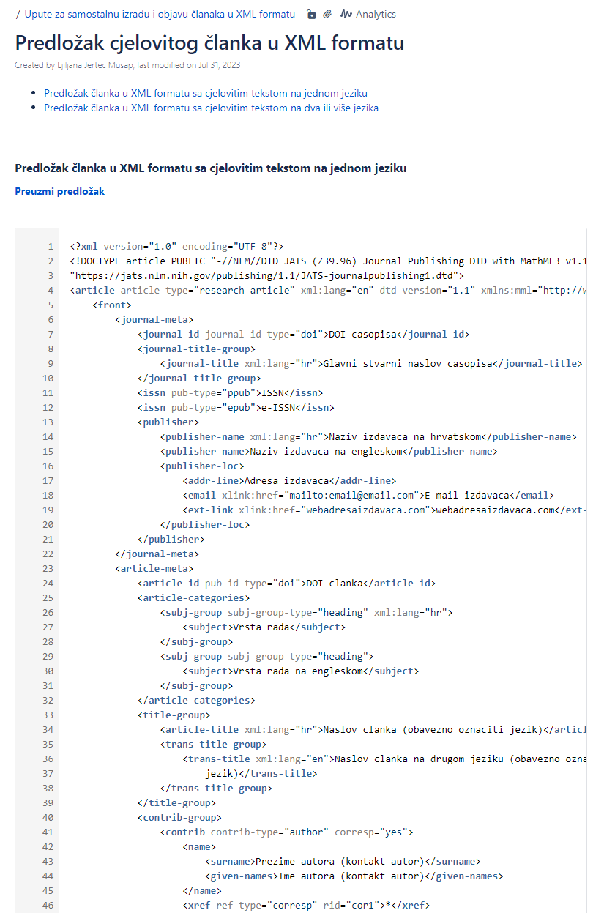
User support
Educating editors
workshops (in person and online)
monthly consultations (online)
Guidelines for editors (in Croatian)
Usage in HRČAK: 43 journals / 3800+ articles
Notes:
When it was implemented in HRČAK, the term JATS wasn’t really widespred yet. So we started on spreading the news and educating editors. We held workshops in person and online – the number is around 10-15 and since the beginning of 2022 we hold monthly consultations regarding this topic. Also, we wrote guidelines for editor that include examples and templates of the article in XML. The result of these efforts is that we have around 3800 articles in XML in HRČAK and 43 journals that have published at least one XML.
Compared to the number od 280.000 of articles in HRČAK in general, that number is not much.

Slide 8
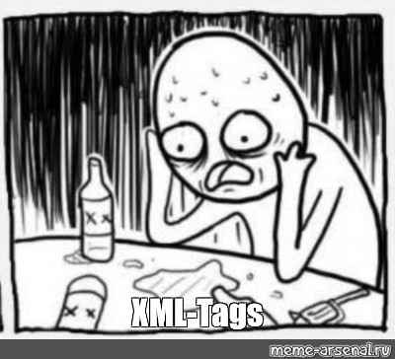
Challenges
expensive tools
time consuming
outsourcing?
no simple solution
Notes:
Creating JATS is not simple. It involves the usage of expensive tools if editors want to perform this task conveniently. The other way around is to educate people and write XML themselves, maybe even from scratch but that is time consuming which can be challenging when journal produces a lot of articles per year. The third solution is outsourcing this task but that can be also financial challenging. However, there is no simple solution. So how to motivate editors to take on this task?

Slide 9
Creating JATS XML from DOCX via HRČAK admin interface
Let’s enable editors to create JATS XML – as simple and automated as possible!
chosen tools:
Pandoc – a universal document converter (https://pandoc.org/)
AnyStyle (https://anystyle.io/)
<front> - created on-the-fly using data from HRČAK db
<body> - Pandoc
<back> - Pandoc & AnyStyle

Slide 10
Demonstration
http://hrcak-as4.srce

Slide 11
Adaptations and pre-steps for editors
HRČAK
elimination of metadata (Header, Footer/Page numbers, Title, Authors, Abstract, Keywords...)
recognition of headings (Introduction, INTRODUCTION, Uvod...)
modifications to references (elimination of unnecessary punctuation marks...)
AnyStyle – training the machine
Editors - preparing a Word file is mandatory
using a standardized citation style (APA, MLA, Vancouver, Harvard...)
images have to be in the desired position within the text (included in text)
formatting the text using the Word Styles (Normal, Heading 1, Heading 2...)
links on literature

Slide 12
Future plans and visions
tool upgrade
multilingual articles
references
captions
user requirements
other formats (odt, latex...)
stand-alone tool
onboarding to EOSC
testing, testing, testing...
Notes:
So what’s in front of us? In the near future we have to do some tool upgrade since we are aware that now we don’t have the solution for some cases, for instance multilingual articles. JATS has specific rules how to tag articles in two languages so we have to deal with that challenge next. Also, there is always some room for improvements in references and part of the team has already started to teach the tool (AnyStyle) to recognize and tag elements of the references a little bit better.

Slide 13
Thank you!
hrcak@srce.hr

