Slide 1
The Croatian Open Science Cloud (HR-OOZ)
Ivan Marić, Director SRCE - University of Zagreb University Computing Centre www.srce.unizg.hr/en

Slide 2
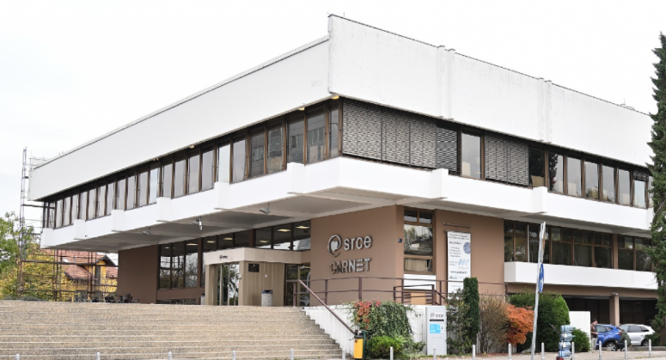
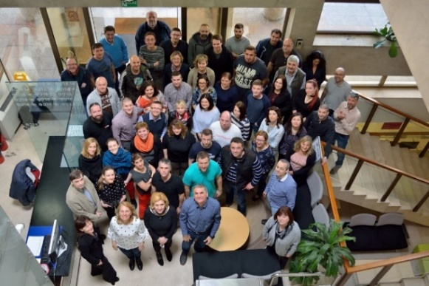
University computing centre - SRCE
Organisation
~ 170 employees
11 organizational units
3 locations
supporting digital transformation of education, research and business in the academic and science.
promoting Open Science and Open Education.
that builds and operate national e-infrastructure and digital services
30 public services for the needs of the academic and scientific community in Croatia

Slide 3
SRCE & e+d+t-infrastructure
AAI@EduHr
National eduroam operator
Croatian scientific and educational cloud (HR-ZOO)
National
RDA node
Support centres for information systems ISVU, ISSP,
CroRIS, ISeVO
National Competence Centre for HPC
Croatian
Open Science Cloud (HR-OOZ)
National and university e-learning centre
EDIH …
The EOSC Festival 2023 - EOSC National Tripartite Event Poland
7th November 2023

Slide 4
SRCE for Open Science
Computing
Advanced computing
Virtual data centres
Scientific software
Specialiased support
Data infrastructure & services
Information systems
e-identity
AAI@EduHr
Authentication and authorization infrastructure of research and higher education
Initiative & membership
Mandate organisation in EOSC Association
Coordinator of Croatian Open Science Cloud (HR-OOZ) Initiative
Croatian RDA node
and more…
CROATIAN
RESEARCH
INFORMATION
SYSTEM
The EOSC Festival 2023 - EOSC National Tripartite Event Poland
7th November 2023

Slide 5
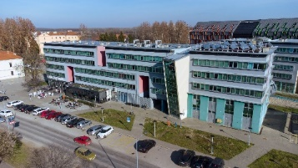
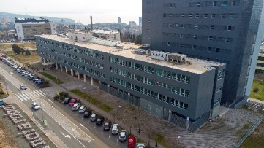
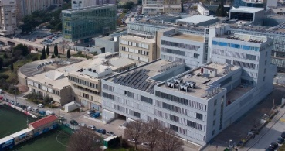
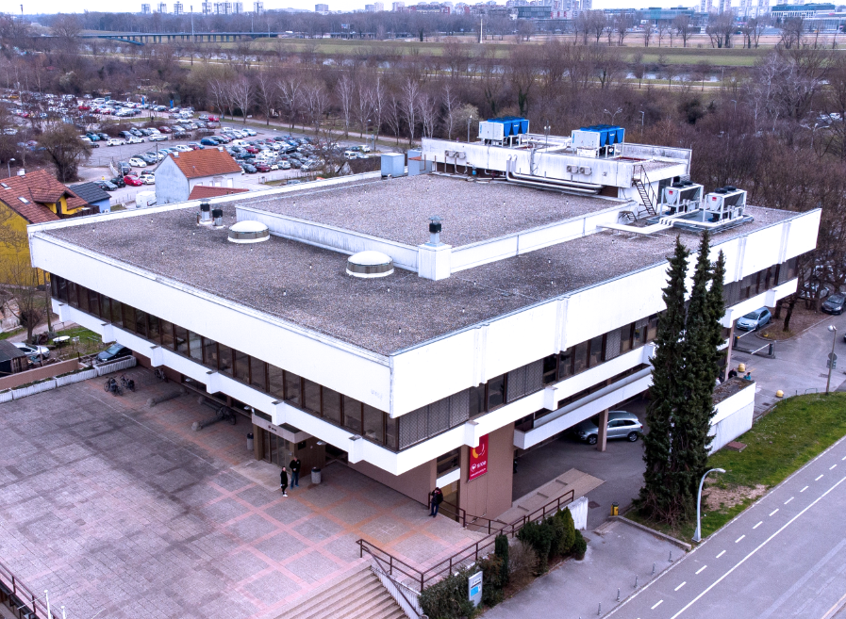
Croatian Scientific and Educational Cloud (HR-ZOO)
DATA CENTRES
HR-ZOO ZG2
HR-ZOO ZG1
HR-ZOO OS
HR-ZOO RI
Coordinator: SRCE Reference: KK.01.1.1.08.0001 Project value: 25 mil. EUR EU contribution: 21 mil. EUR Implementation: 1.7.2017 - 1.5.2023
https://www.srce.unizg.hr/hr-zoo/en
HR-ZOO ST
Ivan Supek
Andrija Štampar
HR-ZOO
Project is co-funded by European Union from European Regional Development Fund
The EOSC Festival 2023 - EOSC National Tripartite Event Poland
7th November 2023
Notes:
HR-ZOO represents a new generation of national e-infrastructure consisting of advanced computing and storage resources located in five data centres in four university cities, along with several associated digital services. Data centres have been connected with network capacities of 100 Gbit/s (upgrade the backbone of the national academic and research network CARNET). By connecting to the GEANT PoP, the national e-infrastructure connects to e-infrastructures in Europe and the world.

Slide 6
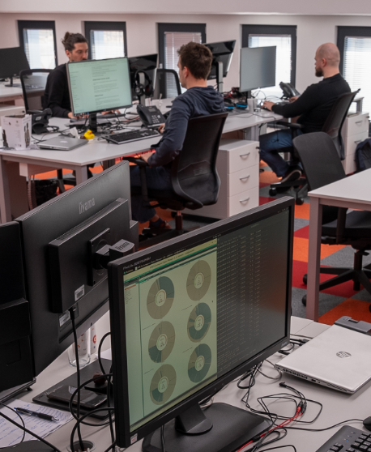
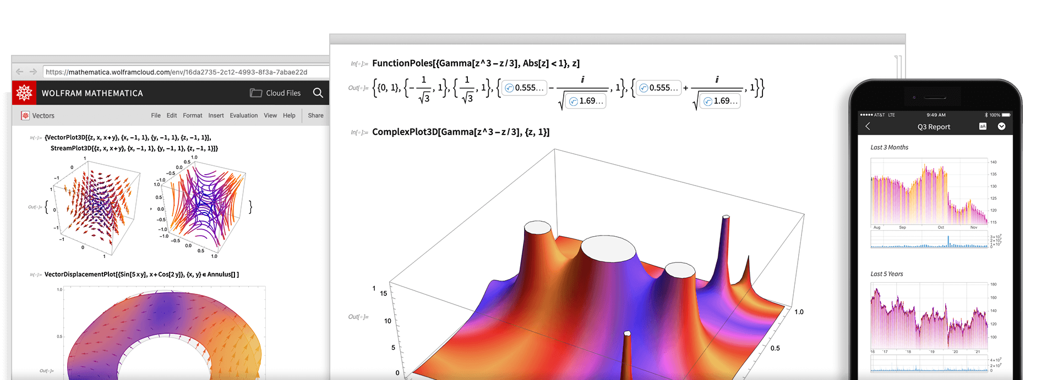
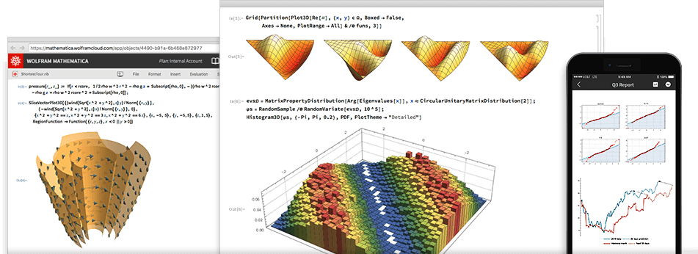
New and improved SRCE services within project HR-ZOO
ADVANCED COMPUTING
VIRTUAL DATA CENTRES
SPECIALIZED SUPPORT
SCIENTIFIC SOFTWARE
Ivan Supek
Andrija Štampar
Faust Vrančić
The EOSC Festival 2023 - EOSC National Tripartite Event Poland
7th November 2023
Notes:
„Supek” is supercomputer based on HPE Cray technology and consists of 8384 processor cores, 81 GPUs, and 32 TB of working memory providing a power of 1.25 PFLOPS, which makes it the first petascale supercomputer in Croatia. It is located in the area of the newly built data centre at University Campus Borongaj in Zagreb.
Advanced cloud computing "Vrančić" is designed for scientists in need of a flexible, elastic, and versatile computing resource capable of meeting the diverse requirements of various scientific fields. Consist of 11.000 core processors, 16 GPUs, 3 PB of high performance storage.
„Štampar” - Virtual Data Centres – based on cloud computing with 1800 redundant virtual servers in high availability mode, 10 PB of disk space.

Slide 7
Chronology
Open Science Policy of the University of Rijeka
Strategy of Education, Science &Technology
Declaration on the Application of Open Science Principles at the University of Zadar
Croatian Open Access Declaration
Research & Innovation Infrastructure Development Plan
HR-ZOO
HR-OOZ
CLARIN
ERIC
DARIAH
ERIC
CESSDA /
CROSSDA
EATRIS
ERIC
CRO GRID
C-ERIC (DONES)
CROSBI
HRČAK
ARA
DABAR
RDA NODE
CroRIS
CARNET
Isabella
CRO NGI
SRCE Cloud
HTC Cloud
1992
2003
2006
2012
2013
2014
2015
2016
2018
2019
2023
1997
2002
2007
2020
2024
The EOSC Festival 2023 - EOSC National Tripartite Event Poland
7th November 2023

Slide 8
Croatian Open Science Cloud (HR-OOZ) Initiative
HR-OOZ Initative
SRCE, as a mandated organization of the Republic of Croatia, became a full member of the EOSC association in December 2020, with the role of coordinating national initiative for open science
Gathering of all significant stakeholders in the Croatian science and higher education system during 2021
Memorandum of Understanding signed in September 2021
GOALS
National Open Science Cloud (HR-OOZ)
National Open Science Plan
https://www.srce.unizg.hr/en/hr-ooz
The EOSC Festival 2023 - EOSC National Tripartite Event Poland
7th November 2023

Slide 9
Achievements of HR-OOZ Initiative
Task Force
that created the proposal of the national plan and policies for open science
The National Open Science Plan - proposal
publicly presented at the EOSC National Tripartite Event in Zagreb, March 2023
The Ministry of Science and Education of Croatia is currently in proces of adoption
Council of the
HR-OOZ Initiative
constitution of the coordinating body that manages the Initiative which is composed of all signatories of the MoU
Task Force
that defined the structure and principles of HR-OOZ
HR-OOZ regulation (rulebook)
Inclusion criteria (for on boarding services and recourses)
Catalogue of HR-OOZ services and resources (in progress)
The EOSC Festival 2023 - EOSC National Tripartite Event Poland
7th November 2023

Slide 10
Croatian Open Science Plan – main goals
The Ministry of Science and Education is currently in proces of adoption
advance the understanding of the meaning, conception, advantages and practicing of open science in the academic and scientific community,
promote basic values and principles of open science such as responsibility, scientific integrity, ethics, research quality, research transparency, research reproducibility, sharing, cooperation, openness, equality, inclusiveness, diversity, flexibility, sustainability, etc.,
ensure preconditions (and remove obstacles) and create organizational, legal, financial and technical frameworks for the effective application of the principles and practices of open science in the science and higher education system in Croatia,
promote and apply a new system of evaluation and assessment in science and higher education, by using of adequate, new indicators of performance, quality and efficiency of research and education, introduce new indicators and criteria for evaluating institutions, rewarding and advancing teachers and researchers that will fully recognize the contributions to open science,
encourage and provide OA to publications and to all other results generated at different stages of research, especially those funded by public funds,
The EOSC Festival 2023 - EOSC National Tripartite Event Poland
7th November 2023

Slide 11
Croatian Open Science Plan - main goals
encourage and ensure systematic management and curation of research data complied with FAIR and CARE principles,
encourage and ensure the development and management of scientific software in accordance with open source licenses and provide OA to such software,
establish mechanisms of coordination, joint and coordinated planning, construction, maintenance, development and use of research infrastructures, including e-infrastructure, and their sustainability, integrity and interoperability with the involvement of the HR-OOZ,
ensure that researchers and teachers have the necessary competences and skills to apply open science practices and provide an adequate, sustainable and well-funded support system for the application of open science principles through a network of expert teams and institutions to support the application of the principles of open science,
provide connection of Croatian and European research area, including connection and interoperability of Croatian and European research infrastructures and e-infrastructures through interconnection of the HR-OOZ with the EOSC.
The EOSC Festival 2023 - EOSC National Tripartite Event Poland
7th November 2023

Slide 12
HR-OOZ & EOSC
Building HR-OOZ - the national infrastructure dedicated to open science of existing research infrastructures, resources, services & e-infrastructures (in progress)
Connecting HR-OOZ as a part of EOSC
HR-OOZ
CroRIS
HR-ZOO
HR HPC CC

Slide 13
The Croatian Open Science Cloud (HR-OOZ)
Ivan Marić SRCE - University of Zagreb University Computing Centre www.srce.unizg.hr/en

