Slide 1
On-site, Online or Hybrid? From ad hoc solutions to meaningful processes
Sandra Kučina Softić, Ph. D., University of Zagreb University Computing Centre, Croatia
Marko Odak, Ph. D. University of Mostar, Faculty of Humanities and Social Sciences, Bosnia and Herzegovina
16th annual International Conference of Education, Research and Innovation Seville (Spain). 13th - 15th of November, 2023.

Slide 2
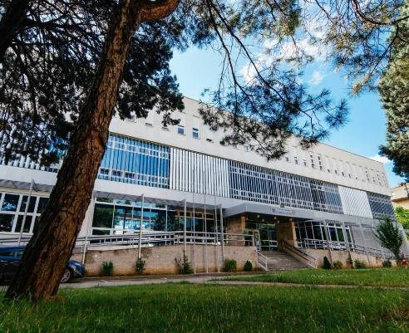
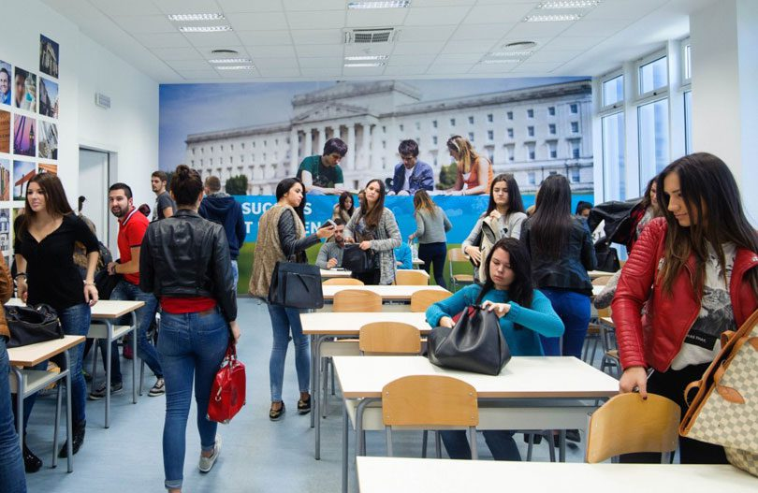
University of Mostar Faculty of Humanities and Social Sciences
https://ff.sum.ba/en
17 study programmes from various fields of the social sciences and humanities.
~ 2,000 students and 250 teachers.
Undergraduate and graduate cycles offer 47 study programmes conducted by 17 departments.
The undergraduate programme offers 11 single-major and 12 double-major studies.
The graduate programme offers 9 single-major and 12 double-major
Joint Degree Master's programme of Political Sciences in English. (UniMostar and Matej Bel University, Slovakia)

Slide 3
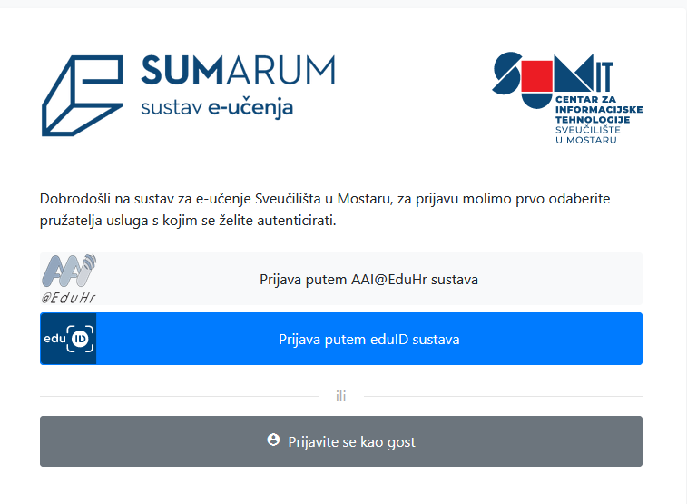
Education before and during pandemic
Before pandemic
Teaching and learning in the classroom
Exams in a traditional way
E-learning platform as an addition to classroom teaching
During pandemic
Teaching, learning and exams conducted remotely
Blended model
E-learning portal SUMARUM (based on Moodle) and GSuite for education
Video conferencing systems
Support to teachers and students

Slide 4
Research
After the experience with online education during the pandemic, research was conducted to get information on the attitude of teachers towards e-learning technologies in higher education and what digital competencies they need in order to be able to apply e-learning in the educational process in a high-quality manner
Quantitative research
The survey was conducted in April 2022, online, anonymous
Target group: teaching staff
Aim:
to gain insight into how teachers view e-learning after the experience they gained during the pandemic
what they can single out as advantages and what disadvantages of this form of teaching
Results are used to revise the existing study programs and prepare new ones and adopt strategies and policies that will accompany the digital transformation and investment in the necessary infrastructure.

Slide 5
Survey
survey contained
32 questions
additional 5 demographic questions
participants needed about 20 minutes for the survey
the questions in the survey were divided into four parts:
the higher education teachers' attitude towards digital technologies in education and which technologies and tools teachers use in teaching
support to teachers in the use of digital technologies in the educational process;
teachers’ professional development and digital competences for the application of ICT and e-learning in the educational process;
education after the pandemic.
definitions of the two most important terms used in the survey - e-learning and digital competence

Slide 6
Survey results – demographic part
87% of teachers from the Faculty of Humanities and Social Sciences University of Mostar participated
58.1% of teachers participating in the survey were men
67.7.% of participants were aged 41 to 50 and 31 to 40 years old
36.5 % of participants have 11 to 20 years of experience
28.4% have experience of 4 to 10 years
28.4% have more than 20 years of experience
82.4% of teachers have an e-component in their e-courses

Slide 7
Questions related to the e-learning application
Figure 1: Teachers’ attitude toward ICT and e-learning application in education

Slide 8
74.5% crucial and important
25.7% contributes but not significantly
Figure 2: Teacher’s attitude towards the role of e-learning and ICT in the improvement of the educational process.

Slide 9
Teachers who do not use e-learning
17.6% do not use e-learning
Reasons:
50% - e-learning is not relevant to their courses
18.8% - work invested in e-learning is not valued
12.5% - lack of time
6.3% - not sure that e-learning can improve the quality of teaching

Slide 10
Application of e-learning technologies
50.0% of teachers use blended learning (part of the teaching is held in the classroom and part online)
43.2% of the teachers use e-learning as an addition to classroom teaching
6.8% of teachers have courses that are conducted entirely online
Tools and technologies used in teaching and learning
25.9% e-mail
20.3% e-learning system based on the Moodle
19.3% videoconferencing systems
14.6% websites
11.8% systems for creating and sharing documents
8.0% other e-learning systems

Slide 11
Questions related to the education after pandemic
64.5% satisfied
Figure 3: Answer to the question of how much are teachers satisfied with the way of teaching and learning during the past academic year (2020/2021)

Slide 12
Figure 4: Teachers' response to the question of what would be their preferred way of teaching

Slide 13
Challenges
a poor Internet connection and old computers
online assessment
interaction and communication with students
preparation of online learning materials and their sharing in a way that unauthorised distribution among students is possible.

Slide 14
Conclusions
education in the pandemic – emergency remote teaching
Gained experience in the use of digital technologies in education
existing way of teaching and teaching methods did not significantly change during the pandemic
majority of teachers are satisfied with their way of teaching during a pandemic
teachers do have a positive attitude towards digital technologies
many teachers still lack sufficient knowledge and understanding of the benefits e-learning can bring
Associate Professor Marko Odak, marko.odak@ff.sum.ba
Assistant Professor Sandra Kučina Softić
sskucina@srce.hr

