Slide 1
University of Zagreb, University Computing Centre - SRCE
Overview of organization, services and main activities
www.srce.unizg.hr
26th February 2024

Slide 2
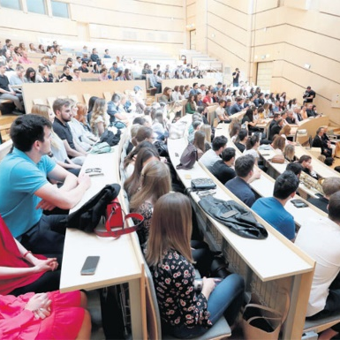
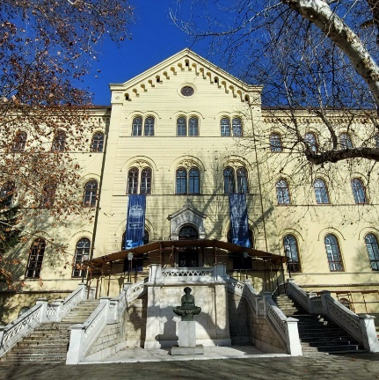
A National Landscape of Science and Higher Education
25
public research institutes
20.000 + scientists
227
Research
& Higher Education institutions
131
HE institutions
of which 106 public
159 000 + students

Slide 3
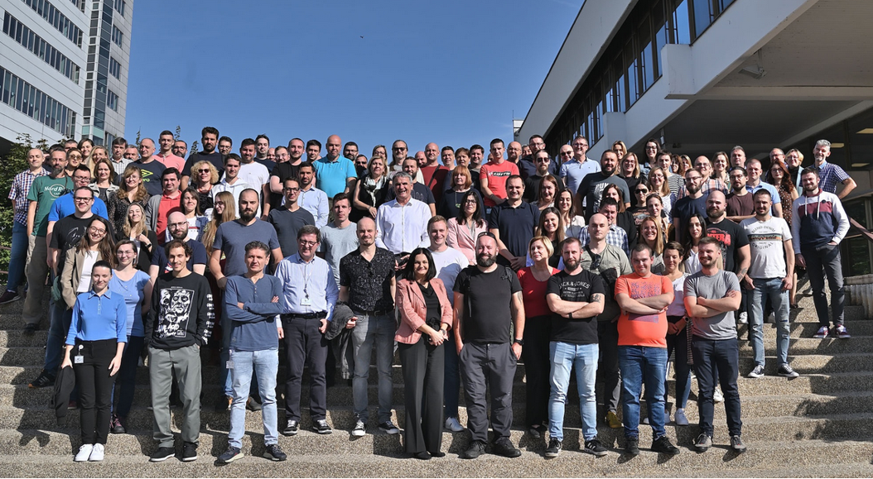
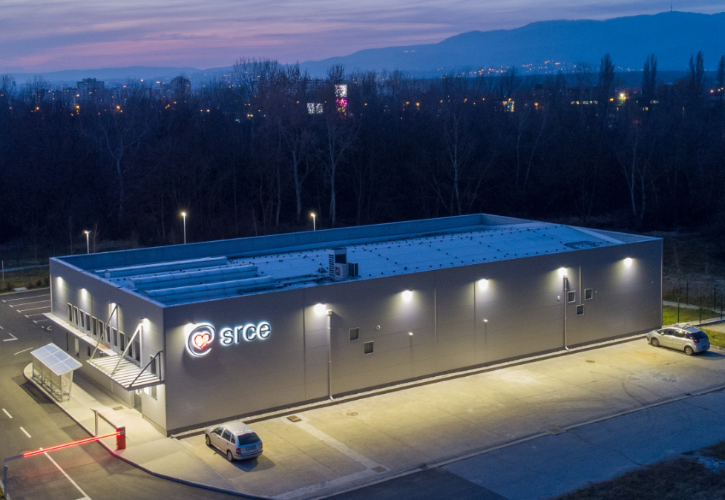
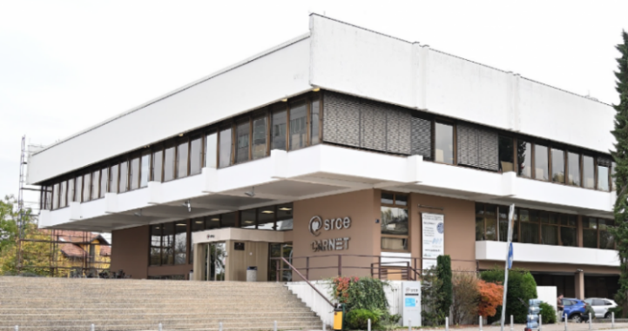
University Computing Centre - SRCE
Organisation
~ 170 employees
11 organizational units
3 locations
Builds and operates national
e-infrastructure and digital services
30 public services for the needs of the academic and scientific community in Croatia
Supports digital transformation of education, research and business
Promotes Open Science and POpen Education
University of Vienna & Vienna University of Technology visit
26th February 2024

Slide 4
Governance structure
Supervisory Board
4 persons appointed by the Senate of the University of Zagreb
1 employee representative
Director of SRCE
Management Board
Technical Council
Director / CEO
Deputy Director
4 Assistant Directors
Director / CEO
10 Heads of Department
University of Vienna & Vienna University of Technology visit
26th February 2024

Slide 5
The organizational structure of the SRCE
SRCE DIRECTORATE
NETWORK INFRASTRUCTURE AND DATA CENTERS DEPARTMENT
CENTRAL COMPUTING AND STORAGE INFRASTRUCTURE DEPARTMENT
ADVANCED COMPUTING DEPARTMENT
BUSINESS OPERATIONS DEPARTMENT
MIDDLEWARE AND INFORMATION SECURITY DEPARTMENT
DATA MANAGEMENT DEPARTMENT
INFORMATION INFRASTRUCTURE DEPARTMENT
DEPARTMENT OF EDUCATION AND EDUCATIONAL TECHNOLOGIES
SERVICE DEVELOPMENT AND MANAGEMENT DEPARTMENT
COOPERATION AND COMMUNICATION DEPARTMENT
Dana Centres Office
Computer and Communication
Network office
Internet Exchange
Office
Internal IT Infrastructure Office
Central Computer Resources Office
Computer Systems Administration Office
Advanced Computing Systems Office
Support Office for the Application of Advanced Computing Technologies in Research & Education
Authentication and Authorisation Infrastructure Office
Collaboration Systems Office
Information Security Office
Digital Repository Office
Data Services Office
Data Analysis Office
Higher Education Information
Infrastructure Office
Science Information Infrastructure Office
Business Information Infrastructure Office
Internal Information Infrastructure Office
SRCE Educational Programs Office
Office for Development and Management of Technologies in Education
Office for the Application of Technologies in Education
Service and Project Management Office
Central Support Office
Business Continuity & Risk Management Office
Community Cooperation Office
Promotion & Communication Office
User Experience Design Office
International Cooperation and EU Projects Office
Finance & Accounting Office
Human Resources and Business Premises Office
Legal, General and Procurement Office
University of Vienna & Vienna University of Technology visit
26th February 2024

Slide 6
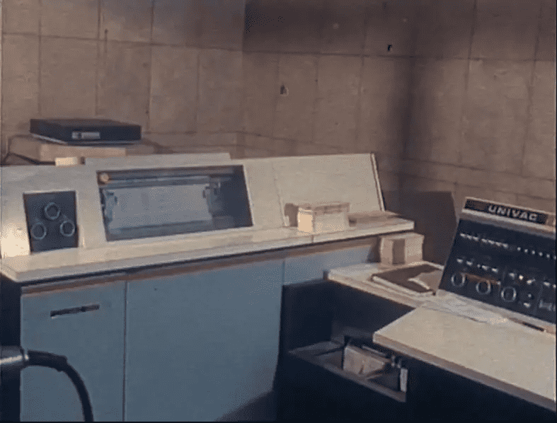
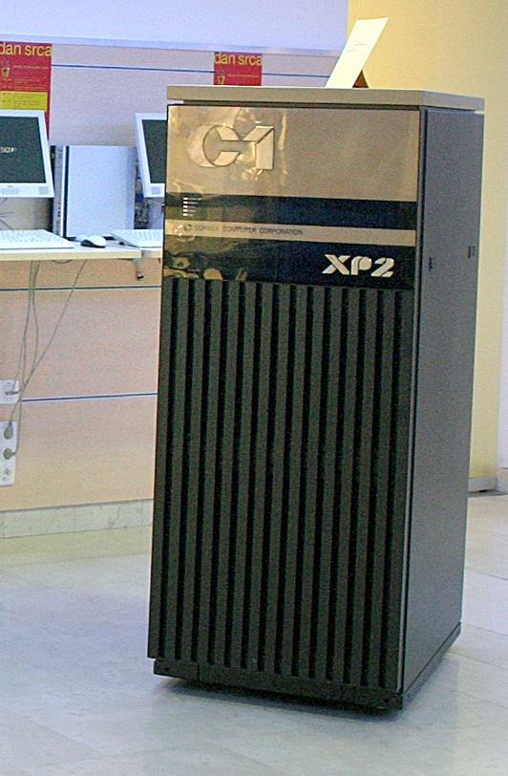
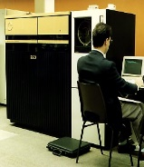
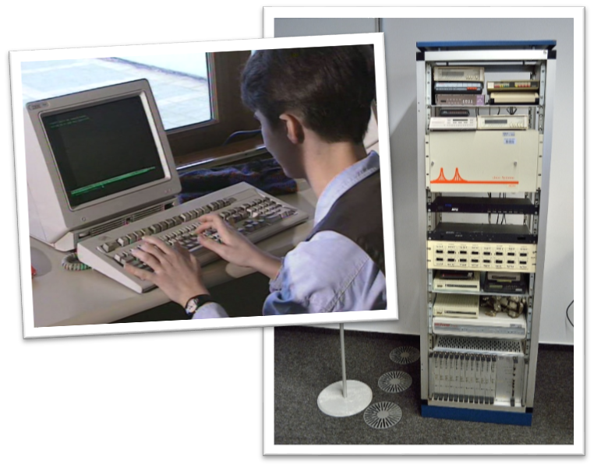

SRCE … 20th century
  29 April 1971 SRCE Birthday
  1972 - First training courses for end-users at temporary UNIVAC 1106 System
  1974 - UNIVAC 1100 - the biggest & fastest computer "in this part of Europe" - new building specially designed for SRCE
  1981 - SIZIF - System of Scientific Information of Croatia
  1984 - Information System for Sarajevo'84 Olympic Games
  1987 - First supercomputer in Srce (CONVEX)
  1989 - First UNIX based production servers
  1990 - BITNET connection
  1991 – CARNet (Croatian Academic and Research Network) 1992 - First Internet connection
  1993 - Croatian Internet Top Level Domain - .hr
  1995 - First ATM (155 Mbps) connection within academic network

Slide 7

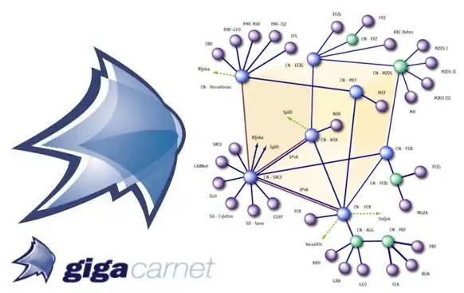
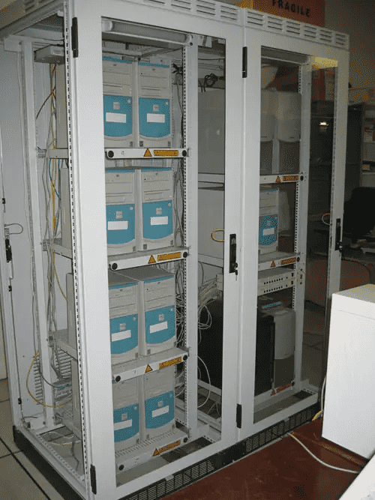


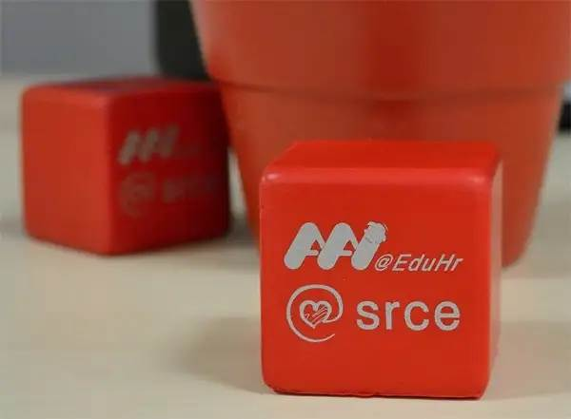
SRCE … 21th century
  2000 Croatian Internet eXchange (CIX)
  2001 Information system for HE
  2002 GĖANT Point of Presence (PoP)
  2002 HPC cluster Isabella established (part of EDG)
  2002 National grid project CRO-GRID
  2005 National grid infrastructure CRO NGI up & running
  2006 AAI@EduHr - national authentication and authorization infrastructure
  2006 Portal of Croatian scientific and professional journals - Hrčak
  2007 SRCE E-learning Centre established
  2011 SRCE Computing Cloud (VPS/VCL)
  New DC SRCE2 - Data Center at Borongaj Campus
  2015 Dabar – national infrastructure of Digital Academic
  Archives and Repositories
  2015 - edu4IT-education program and certification of IT professionals

Slide 8






SRCE … 21th century
  2017 Conference „Days of e-infrastructure - Srce DEI“
  2019 SRCE become national RDA node
  2020 SRCE become a full member of EOSC Association
  2021 Croatian Open Science Cloud Initiative (HR-OOZ)
  2022 Croatian Competence Centre for HPC (HR HPC CC)
  2023 Croatian Research Information System (CroRIS)
  2023 Croatian Scientific and Educational Cloud (HR-ZOO)
  2023 project e-Universities
    Digital Transformation of Higher Education
    Information system of records in higher education (ISeVO)

Slide 9
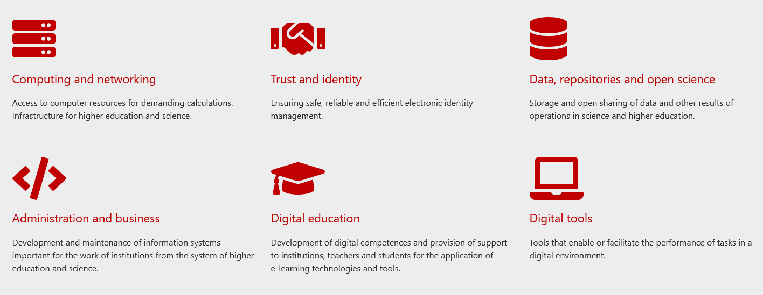
Service Catalogue

Slide 10




SRCE & e-infrastucture
National eduroam Operator
AAI@EduHr
Croatian Scientific and Educational Cloud (HR-ZOO)
National
RDA node
National Competence Centre for
HPC
information systems ISVU, ISSP,
CroRIS, ISeVO
Croatian
Open Science Cloud
(HR-OOZ)
National and University
e-learning centre
EDIH …

Slide 11
SRCE Supports Science

Slide 12



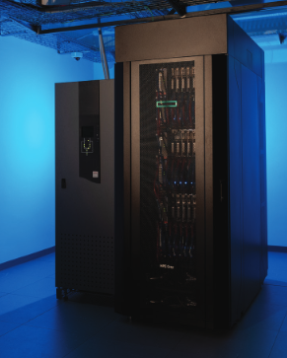





SRCE for Research & Open Science
Computing
Advanced computing
Virtual data centres
Scientific software
Specialiased support
Data Infrastructure
& Services
Information
Systems
e-identity
AAI@EduHr
Authentication and authorization infrastructure of research and higher education
Initiative &
Membership
Mandate organisation in EOSC Association
Coordinator of Croatian Open Science Cloud
(HR-OOZ) Initiative
Croatian RDA node
and more…
CROATIAN
RESEARCH
INFORMATION
SYSTEM

Slide 13




SRCE for Research & Open Science
COMPUTING
Advanced Computing &
Cloud Services
Research data management
HPC
HTC Cloud
Cloud services
PLAN
REUSE
COLLECT
RESEARCH
DATA LIFE
CYCLE
Scientific papers publication
Permanent storage and research results sharing
Data storage during research process
DATA SERVICES
during all phases of research process
SHARE
PROCESS
PRESERVE
ANALYZE

Slide 14

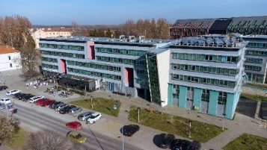

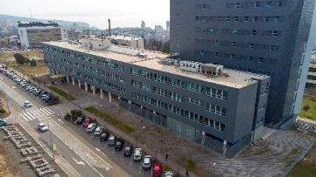

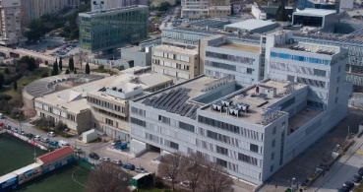

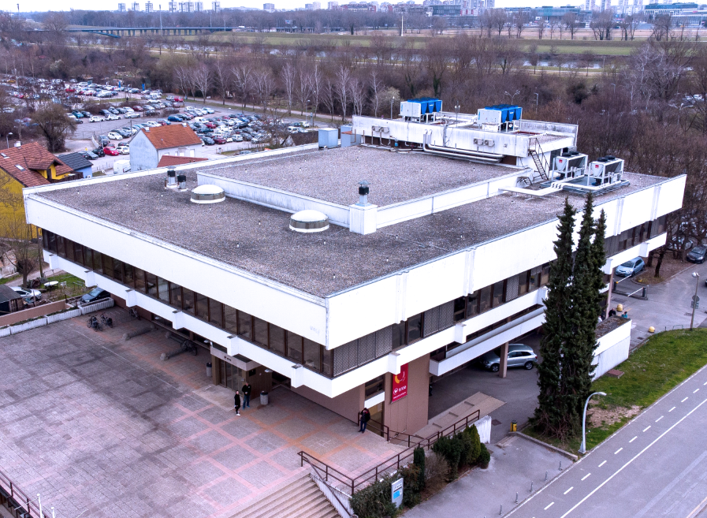
HR-ZOO data Centres & Network
HR-ZOO
ZG2
HR-ZOO
ZG1
HR-ZOO
OS
HR-ZOO
RI
A network of 5 data centres connected by a broadband network with a transmission capacity of 100 Gbit/s
Connected through CARNET-GÉANT, the national
e-infrastructure is connected to
e-infrastructures in Europe and the world
HR-ZOO
ST
Ivan Supek
Andrija Štampar
HR-ZOO
Notes:
HR-ZOO represents a new generation of national e-infrastructure consisting of advanced computing and storage resources located in five data centres in four university cities, along with several associated digital services. Data centres have been connected with network capacities of 100 Gbit/s (upgrade the backbone of the national academic and research network CARNET). By connecting to the GEANT PoP, the national e-infrastructure connects to e-infrastructures in Europe and the world.

Slide 15
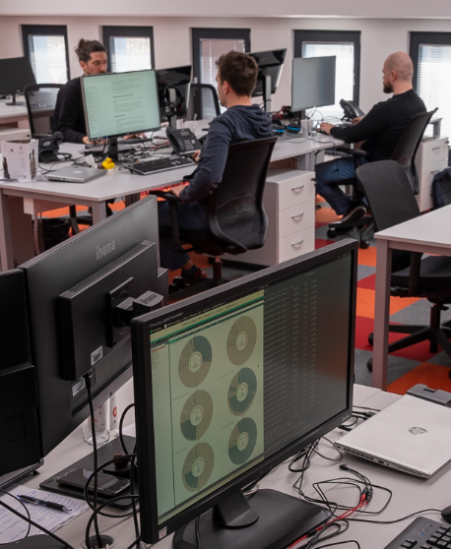


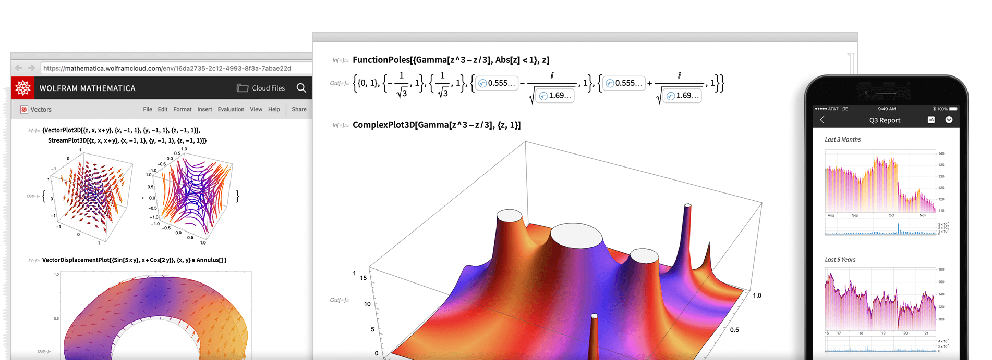
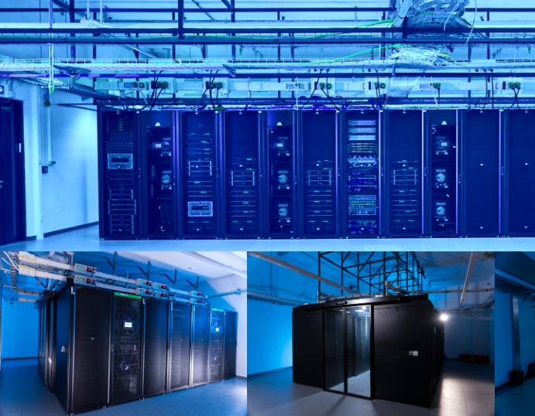
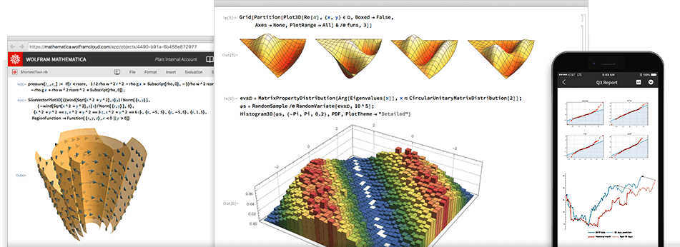
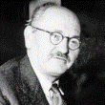

New and Improved SRCE Services
ADVANCED COMPUTING
VIRTUAL DATA
CENTRES
SPECIALIZED SUPPORT AND
SCIENTIFIC SOFTWARE
Ivan Supek
Andrija Štampar
Faust Vrančić
Notes:
„Supek” is supercomputer based on HPE Cray technology and consists of 8384 processor cores, 81 GPUs, and 32 TB of working memory providing a power of 1.25 PFLOPS, which makes it the first petascale supercomputer in Croatia. It is located in the area of the newly built data centre at University Campus Borongaj in Zagreb.
Advanced cloud computing "Vrančić" is designed for scientists in need of a flexible, elastic, and versatile computing resource capable of meeting the diverse requirements of various scientific fields. Consist of 11.000 core processors, 16 GPUs, 3 PB of high performance storage.
„Štampar” - Virtual Data Centres – based on cloud computing with 1800 redundant virtual servers in high availability mode, 10 PB of disk space.

Slide 16




Croatian Competence Centre for HPC (HR HPC CC)
ONE-STOP-SHOP FOR HPC
The Croatian Competence Centre for HPC is a place where users from the academic and scientific community, industry, and public administration get support in the application of the national and European infrastructure of High Performance Computing (HPC) in their work.
Services to and Interaction with Academia and Public Administration
Collaboration
Education and skills development in HPC/HPDA/AI
Services to and Interaction with Industry
Service Portfolio and Competence Management
HR HPC CC established within the project EuroCC as part of a network of national competence centres for HPC. Project EuroCC 2 is currently underway and will further improve the centre's services and competencies.
https://www.hpc-cc.hr/

Slide 17



T&I… enabling mobility
AAI@EduHr
Authentication and Authorisation Infrastructure of science and higher education in Croatia
eduroam
safe, easy to use and,
for the end user, completely free Internet access service in Croatia
954 195
e-identity (users)
235
institutions
(identity providers)
Security
Trust
Reliability
worldwide
32 000+ locations
106 countries
Croatia
1 152 locations
407 cities / places

Slide 18

Data infrastructure & services
CROATIAN OA JOURNALS
Since February 2006
536 scientific & professional journals (406 active)
285.000 + OA articles
65.000+ visits daily
PRESERVATION & DISEMINATION
Digital archives and repositories
16 types of digital objects
171 digital repositories of research & HE institutions
224.000 digital objects
(TEMPORARY)
STORAGE & SHARING SERVICE
570+ researchers and lecturers
200 GB (default)
PLAN
REUSE
COLLECT
SHARE
PROCESS
PRESERVE
ANALYZE

Slide 19
Croatian Open Science Cloud (HR-OOZ) Initiative

Slide 20

Chronology
Open Science Policy of
the University of Rijeka
Strategy of Education,
Science &Technology
Declaration on the Application
of Open Science Principles
at the University of Zadar
Croatian Open
Access Declaration
Research & Innovation
Infrastructure
Development Plan
HR-ZOO
HR-OOZ
CLARIN
ERIC
DARIAH
ERIC
CESSDA /
CROSSDA
EATRIS
ERIC
CRO GRID
C-ERIC
(DONES)
CROSBI
HRČAK
ARA
DABAR
RDA NODE
CroRIS
CARNET
Isabella
CRO NGI
SRCE
Cloud
HTC
Cloud
1992
2003
2006
2012
2013
2014
2015
2016
2018
2019
2023
1997
2002
2007
2020
2024
University of Vienna & Vienna University of Technology visit

Slide 21





















Croatian Open Science Cloud (HR-OOZ) Initiative
HR-OOZ Initative
SRCE became a full member of the EOSC Association in December 2020
As a mandated organization of the Republic of Croatia with a role of coordinating national initiative for open science during 2021 gathered all significant stakeholders in the Croatian science and higher education system
Memorandum of Understanding signed in September 2021
GOALS
National Open Science Cloud
(HR-OOZ)
National Open Science Plan
https://www.srce.unizg.hr/en/hr-ooz

Slide 22


HR-ZOO & HR-OOZ & CroRIS
Analysis of existing research infrastructures, resources, services & e-infrastructures
Building HR-OOZ - the national infrastructure dedicated to open science
Structure and principles of the HR-OOZ
HR-OOZ
CroRIS
HR-ZOO
HR HPC CC

Slide 23
SRCE Supports Higher Education

Slide 24




Developing and supporting information systems for HE
(with Ministry of Science and Education and Agency for Science and Education)
ISVU
Information System of Higher Education Institutions
110+ HE institutions, 140.000+ students, 1.700.000+ exams/ac.year
ISSP
Information System of Student Rights
115+ HE institutions 159.000+ students
ISAK
Information System of Academic (student) Cards
MOZVAG
Information System for Accreditation of HE institutions and Study Programs
110+ HE institutions 1.900+ study programs
ISRHKO
Information System of Croatian Qualifications Framework
CroRIS
Croatian Research Information System

Slide 25
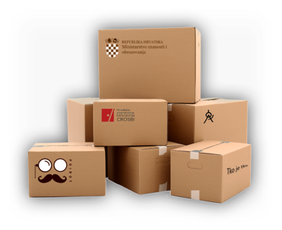






Croatian Research Information System (CroRIS)
Developed within project Scientific and Technological Foresight (2017-2023)
Co-funded by European Union from European Regional Development Fund
CERIF based
Promotes open science
Provides information reliability
Ensures openness and interoperability
Support decision making
www.croris.hr
Information and processes about institutions, researches, projects, publications, equipment, patents, services, events and much more,
Integration with many national systems and international platforms, such as ORCID, OpenAire, WoS, Scopus.
Ensuring data accuracy and quality
Data verification
Designated authorities and various user’s roles with responsibilities
University of Vienna & Vienna University of Technology visit
26th February 2024

Slide 26





Croatian Landscape of Information Systems
e-Universities
ISpPU
System for monitoring program funding for HEI
CroRIS
Croatian Research Information System
Promotes open science
Provides information reliability
Ensures openness and interoperability
Supports decision making
ISeVO
Information system of records in higher education

Slide 27



National Centre for E-learning in Higher Education
… is a key stakeholder in the process of digital transformation of the higher education system
Objectives:
to support higher education teachers, students, institutions in implementation of e-learning in educational process
to provide and maintain reliable and generally accessible HE platform for
e-learning
to train and educate teachers in digital competences
to promote and foster implementation of e-learning
e-LEARNING
CENTRE
… provides infrastructure, support and training to users
established in 2007
https://www.srce.hr/en/elc

Slide 28



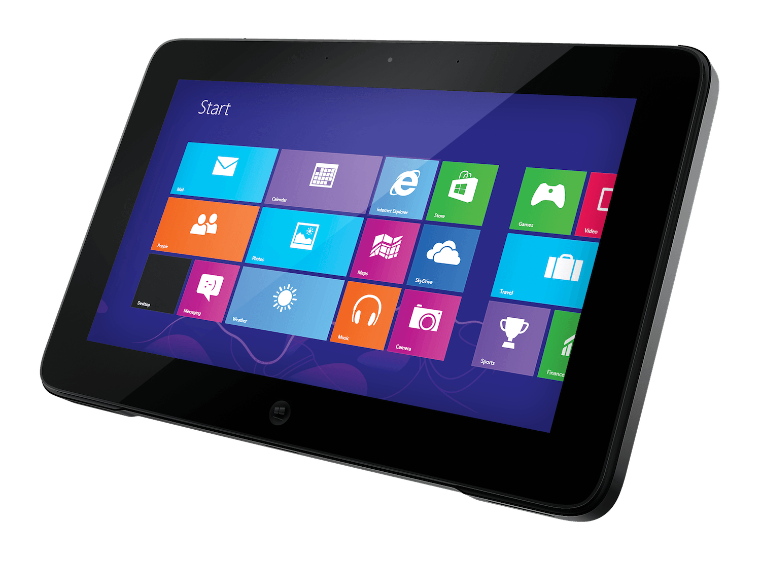


E-learning Centre@SRCE
E-learning platform for HE
state-of-the-art
e-learning system tailored to user needs
Academic
e-portfolio
for personal use, for presentation or as a learning activity
Webinars
For online lectures, presentations, seminars, consultations
Adobe Connect
Edumeet
E-course Catalogue
of HEI in Croatia
a central place to find basic information about all e-courses
Promoting Open Access and OER
all educational materials develed in SRCE in Open Access
SRCE Open education portal
Antiplagiarism software
for checking students work, theses and doctoral dissertations
by students and teachers

Slide 29
Digital bridges to ERA / EHEA

Slide 30






Digital bridges to ERA / EHEA
User communities
Pan-european communities

Slide 31













SRCE & EU projects
EU PROJECTS
SRCE contributes to the development of the European Research Area and the European Higher Education Area

Slide 32











SRCE & Memberships
MEMBERSHIPS
as a national representative SRCE represents Croatian interests and commitments in international bodies and organizations

Slide 33
Community Programme and Outreach

Slide 34

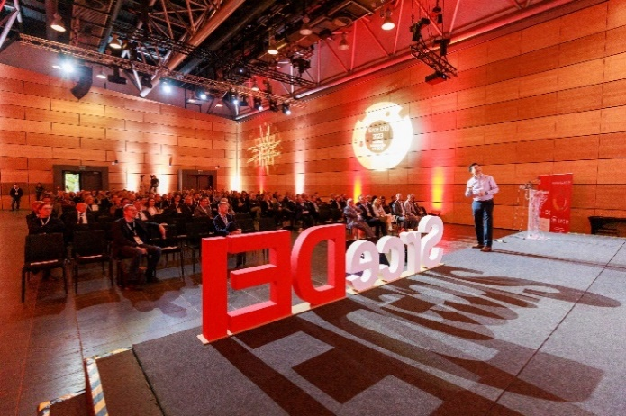
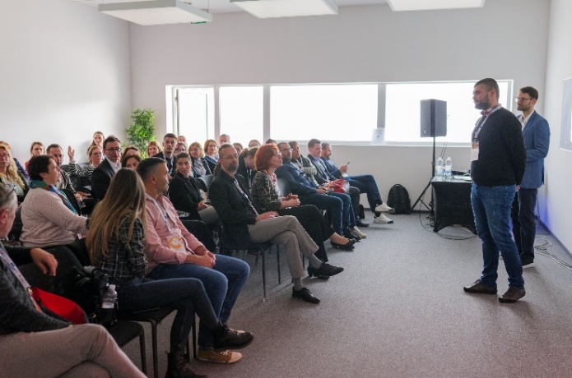

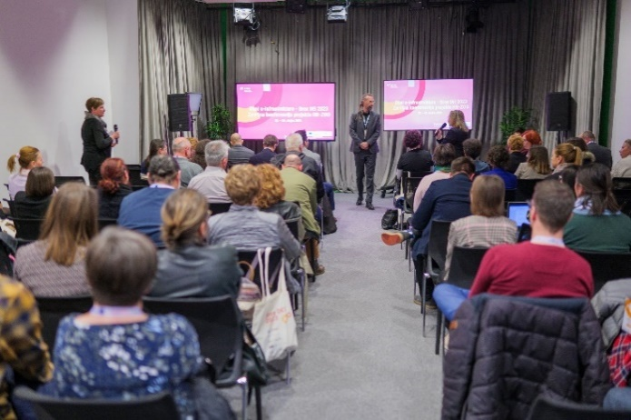
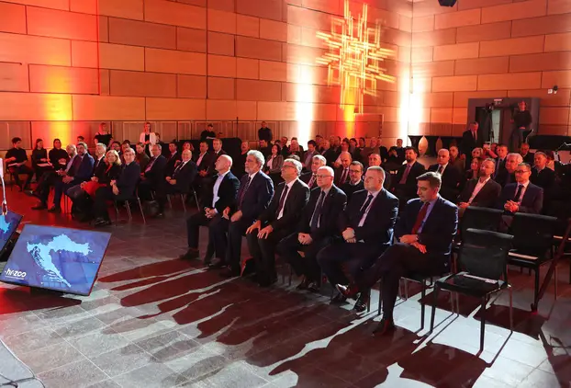

Days of e-infrastructure SRCE DEI
Eng Lim Goh
dr. sc. Giorgio Rossi

Slide 35




SRCE Community Programme
26th February 2024

Slide 36
Promotion and Communication

Slide 37

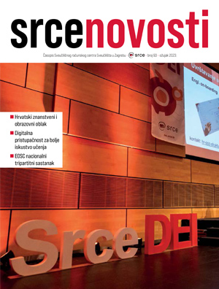

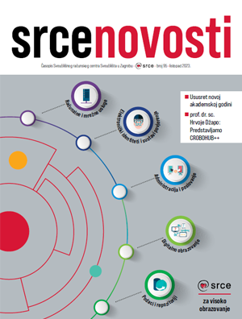

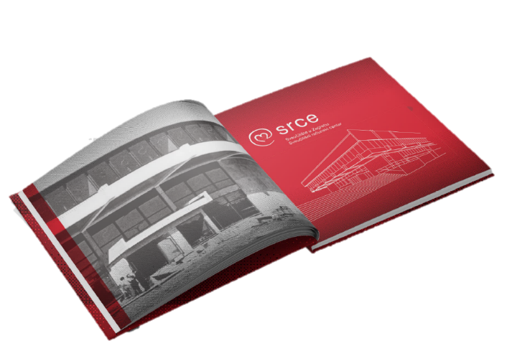

Promotion and Communication
Publication:
A brief chronology of achievements (1971-2023)

Slide 38
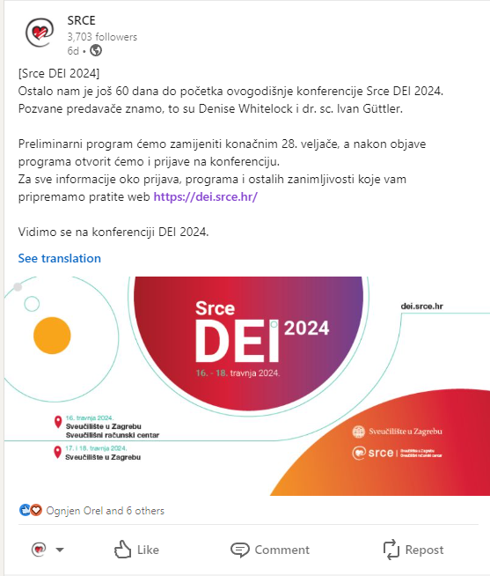
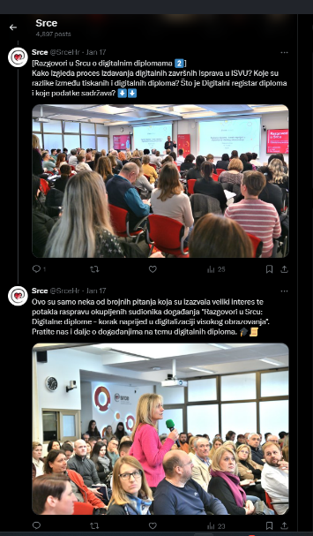
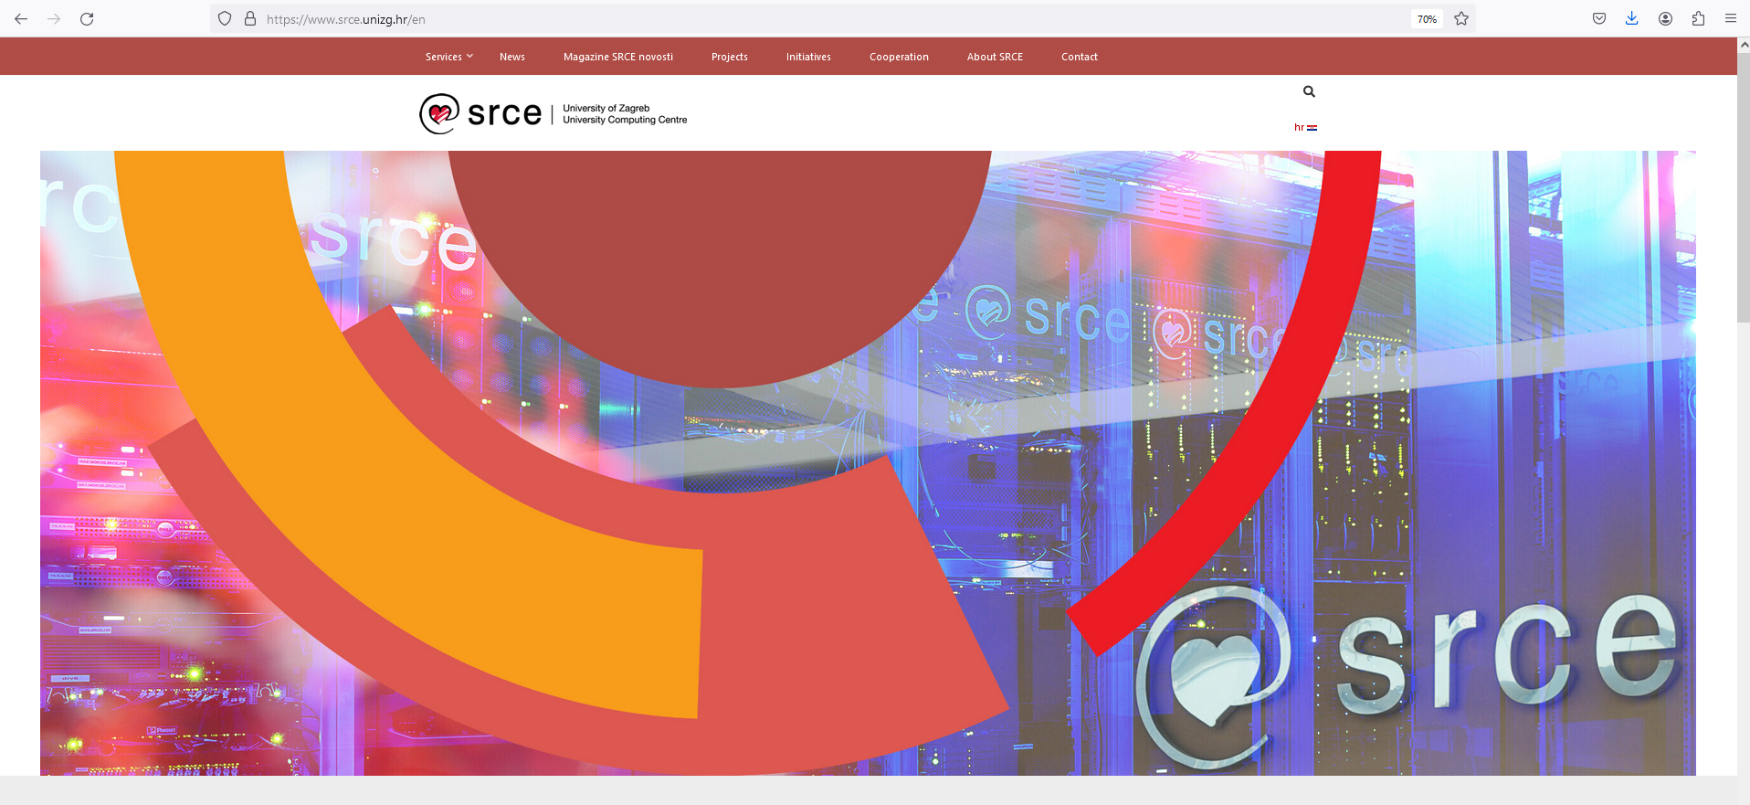
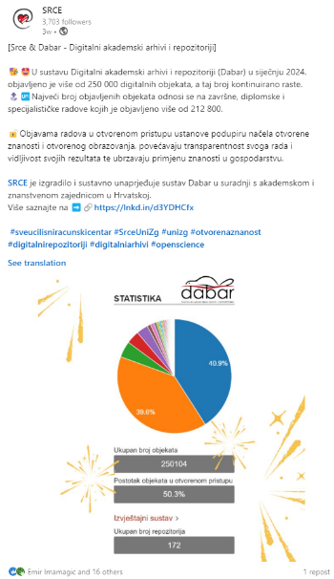
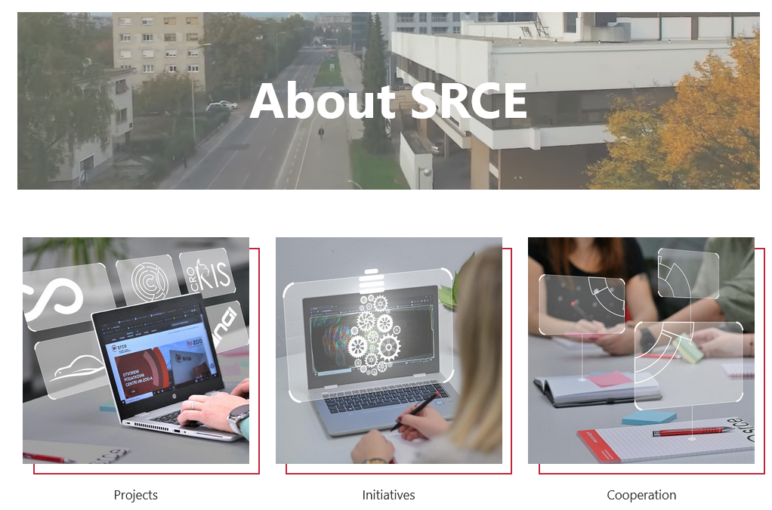
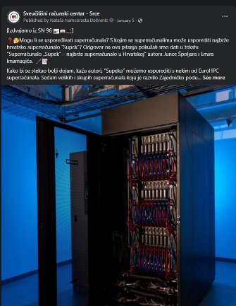
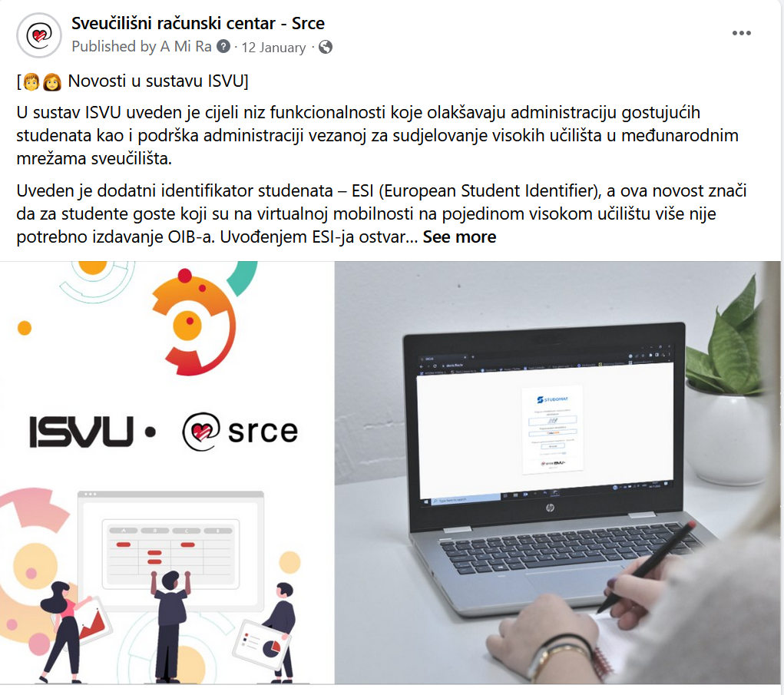
Web and Social Media
26th February 2024

Slide 39
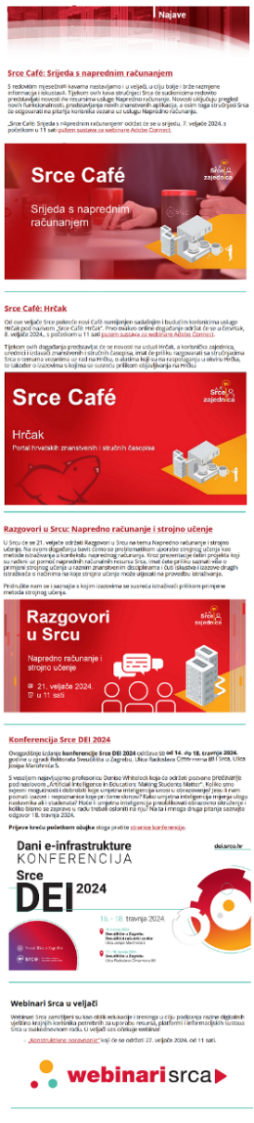
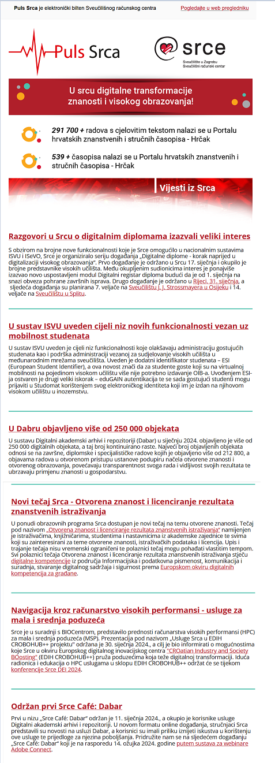
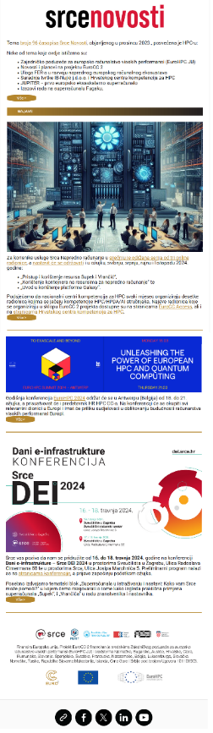
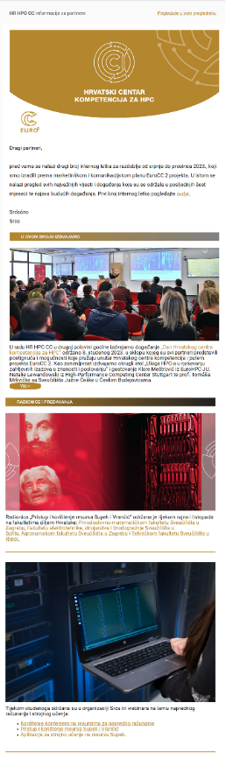
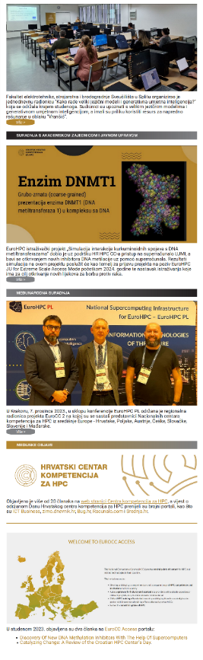
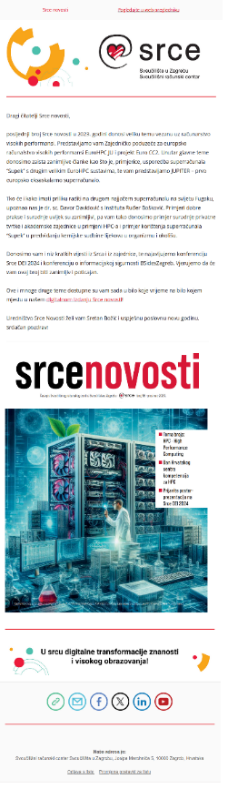
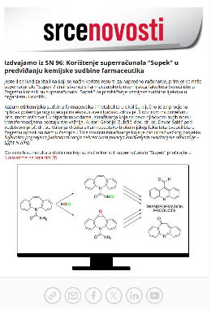
Puls Srca
E-newsletters
University of Vienna & Vienna University of Technology visit
26th February 2024

Slide 40
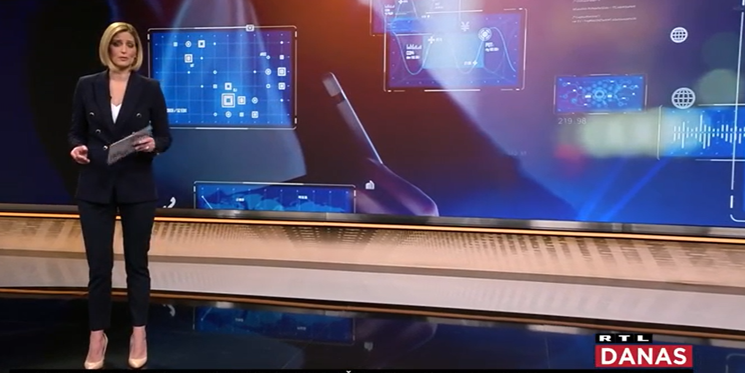
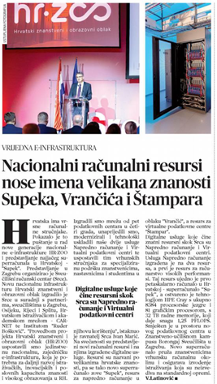
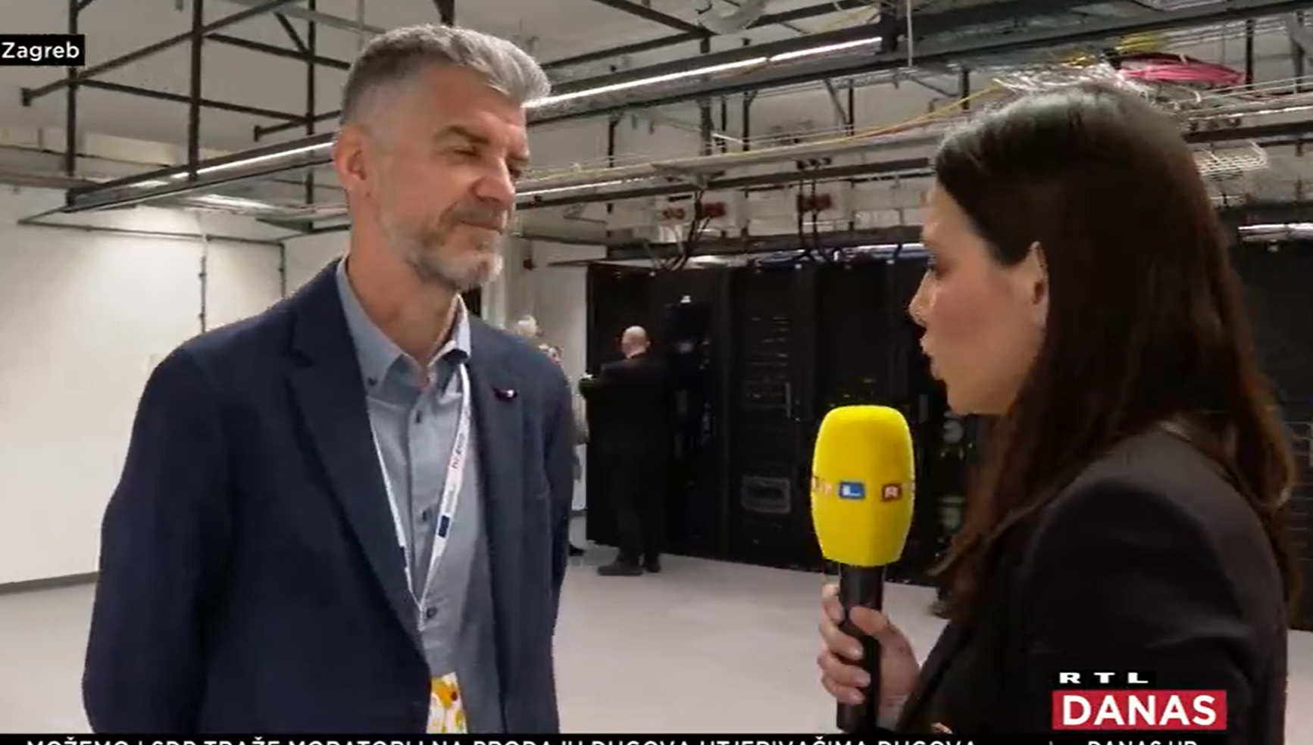
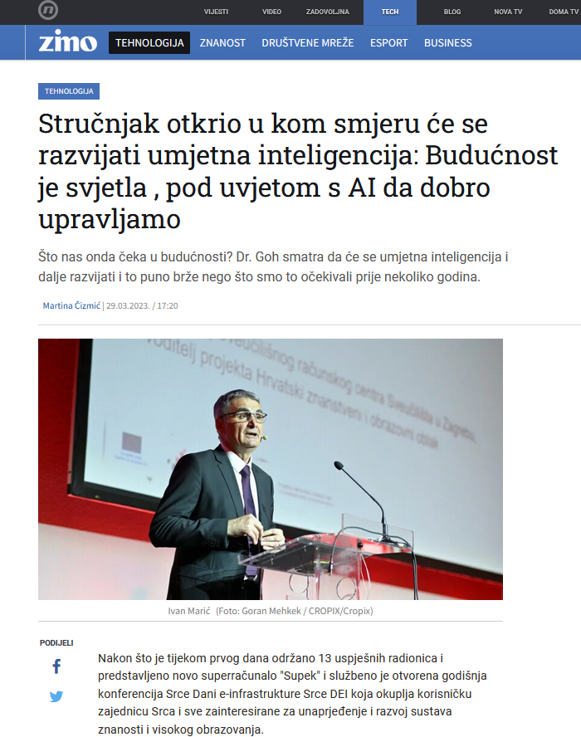







Srce in Media
University of Vienna & Vienna University of Technology visit
26th February 2024

Slide 41




Srce for Freshmen

Slide 42


The key to Success
TECHNOLOGY
TALENTS
TOLERANCE
University of Vienna & Vienna University of Technology visit
26th February 2024

Slide 43

University of Vienna & Vienna University of Technology visit
26th February 2024

Slide 44
University of Zagreb, University Computing Centre - SRCE
Overview of activities & projects
University of Vienna & Vienna University of Technology visit
26th February 2024

