Slide 1
AAI@EduHr – Croatian identity federation, ESI, ESC, etc.. ☺
Zagreb, 26. 02. 2024. Mijo Đerek

Slide 2
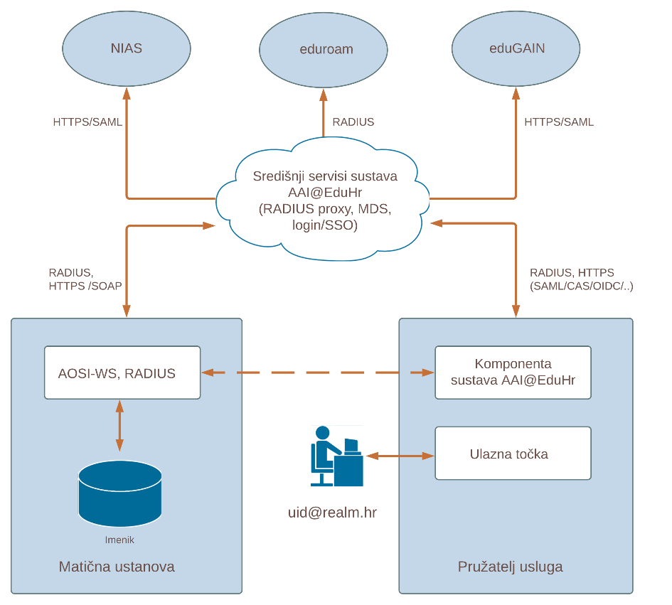
AAI@EduHr
Authentication and Authorisation Infrastructure of science and (higher) education in Croatia
hub-and-spoke architecture
in production since March 1, 2006.
connected to the global services eduroam and eduGAIN
connected to the Croatian eIDAS node (NIAS).
web: https://www.aaiedu.hr
e-mail: aai@srce.hr

Slide 3
How it all started...
the challenges we had in 2000.
directory services implementation
remote authentication of dial-in users (Internet connectivity)
solution
distributed LDAP directories as user database
RADIUS (Remote Authentication Dial In User Service) authentication

Slide 4
We would also like to use it...
for authorisation, not only authentication
need to know more about the user
hrEduOrg and hrEduPerson schemas based on eduOrg and eduPerson schemas
e-identities
to connect with other identity federations
eduroam (2003.)
early adopter
existing RADIUS infrastructure

Slide 5
So we started from...

Slide 6
What about applications?
RADIUS clients for authentication
RAIDUS as protocol is not suitable for delivering user attributes to the SP
2003. CAS authentication for web (only internal) applications
2003. HLS (Home Location Service)
2004. joint project of SRCE and CARNET financed by Ministry
2005. FWS (Federation Web Service) – SOAP over HTTP(S) for authentication and delivering user attributes to SP
AOSI – an application for maintaining the content of the LDAP directory, access tool for LDAP
Each application had to have own login form – insecure
We decided to implement SSO based on SAML protocol

Slide 7
FWS / AOSI (2005.)
Central AAI@EduHr services (RADIUS proxy, FWS/HLS)
RADIUS
HTTPS / SOAP
RADIUS
HTTPS / SOAP
Identity provider
Service provider
AOSI-WS & RADIUS server
AAI@EduHr component
LDAP directory
User uid@realm.hr
Entry point
Srce – Univie - Tuwien

Slide 8
AAI@EduHr is officially in production
since March 1st, 2006. AAI@EduHr has been in full production
developed as a result of a joint project of SRCE and CARNET
supported and financed by the Ministry of Science and Education (MZO)
SRCE managed the project and today independently hosts, maintains and enhances central services of AAI@EduHr and cares about the whole system.
AAI@EduHr policy
hrEduOrg and hrEduPerson schemas
formalised status of IdPs and SPs

Slide 9
hrEduOrg and hrEduPerson schemas
Data stored in the LDAP directory is defined by hrEduPerson (user data) and hrEduOrg (institution data) schemas
Schemas define the syntax of attributes, their semantics, whether they are required or not, and whether they can have multiple values or only one value.
A set of allowed values (vocabulary) is also defined for some attributes
Directory schemes are defined to meet local needs using international experience
Extensions to the eduPerson and eduOrg shemas – modifyed to fit our needs.
Always keep in mind - some attributes can have multiple values, some (optional) attributes may not have a value

Slide 10
AAI@EduHr today
233 home institutions (identity providers)
over to 940K e-identities
services
116 network access services (RADIUS)
862 web applications (SSO)
in 2023. over 1B successful RADIUS authentications
in last 30 days:
88M+ successful RADIUS authentications
6M successful SSO authentications

Slide 11
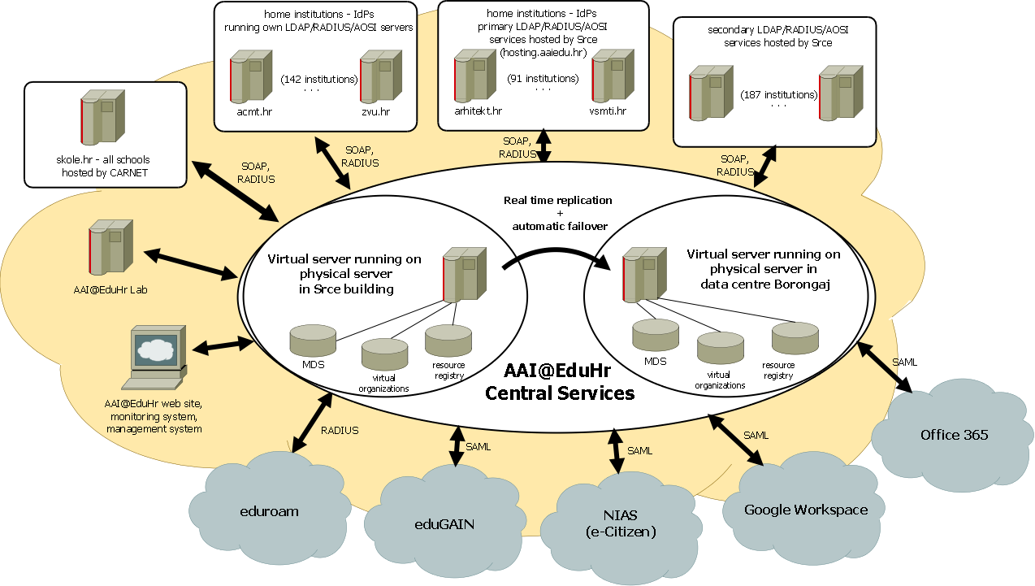

Slide 12
AAI@EduHr home institution – identity provider
AAI@EduHr
IdP
RADIUS
Office 365
LDAP
AOSI - WS
Google
AOSI - Web

Slide 13
AAI@EduHr home institution – identity provider
All components are available as installation packages for Debian linux.
LDAP directory
a hierarchical database used to strore all user data (e-identities)
hrEduOrg and hrEduPerson schemas
OpenLDAP
RADIUS server
Implements RADIUS protocol
Used by central RADIUS servers to authenticate users
Can be used as SP (service provider) for local services
Local eduroam access points
PAM RADIUS (ssh, mail…)
FreeRADIUS

Slide 14
AAI@EduHr home institution – identity provider
AOSI web service
Written in perl
Implements SOAP over HTTPS
Implements some rules that can’t be implemented using OpenLDAP
Directory administration, delegation of user privileges, data validation: checks semantic and syntax for some attributes
Vocabularies
Used by SSO to authenticate users
If user is successfully authenticated sends user data to the SSO
Extendable - plugins can be used for synchronisation – data provisioning with any IS (O365, Google, MSAD,…)
enables directory administration using Information System of Higher Education Institutions - ISVU
AOSI web interface
Web application used for directory administration

Slide 15
Plugins for AOSI web service
AOSI-WS
ISVU
Some API
AOSI-WS
LDAP
?
LDAP
Azure
Web service plug-in
O365 plug-in

Slide 16
AAI@EduHr central services
Central RADIUS servers
Forwards authentication requests received from the service provider to the identity provider’s RADIUS server, and returns received response back to the service provider
Extracts the domain part from the username and queries the MDS database (or cache) to find out the IP address of IdP’s RADIUS server
If the IdP’s primary RADIUS server is inaccessible, it sends authentication request to the IdP’s secondary RADIUS server
3 instances
Top level eduroam servers for .hr domain
RADIATOR

Slide 17
AAI@EduHr central services
Central metadata database (MDS):
Database with data on all entities in the system (IdPs, SPs)
Information about RADIUS, LDAP, AOSI components of IdP
Information about all the services and service providers
Each service must register all the attributes it wants to consume
One of the key components. It glues all together.
MariaDB

Slide 18
AAI@EduHr central services: Single Sign-On
An authentication mechanism that allows the user to log in only once and then access all applications that are using the SSO service without the need to re-enter the username and password
Significantly improves the user's experience when logging in to a large number of applications, the user uses the same electronic identity to log in to all applications;
To implement the Single Sign-On functionality we are using Security Assertion Markup Language (SAML 2.0) - a technology based on the XML standard that defines a standard framework for formatting and exchanging messages used for user authentication and authorization and the transfer of user data;
It is the only supported authentication method for web applications that want to use AAI@EduHr for user authentication;
The use of the SAML 2.0 standard enables the connection of the AAI@EduHr system with national (NIAS) and international (eduGAIN) authentication and authorization infrastructures
Wa can also support CAS, OIDC, ADFS

Slide 19
AAI@EduHr central services: Single Sign-On
Extracts the domain part from the username, queries MDS database (or cache) to find out the address of IdP’s AOSI
Authenticates user against IdP’s LDAP directory and fetches user’s data from the directory
Implements attribute release policy using the data from the resource registry
Secure, SP has no access to user’s password
SimpleSAMLphp
support for 2FA (since 2019)
mutiple SMS gatways
TOTP
WebAuthn/FIDO2
national EID (X509 certificate)
social networks

Slide 20
AAI@EduHr registries
Central registry of all identity providers
https://administracija.aaiedu.hr
contains all information about the identity providers
Central registry of all service providers
https://registar.aaiedu.hr
contains all information about the service providers and services
list of all attributes needed for authorisation
Schemas
An up-to-date list of all attributes:
https://www.aaiedu.hr/o-sustavu/imenicke-sheme/shema
Up-to-date list of all vocabularies (allowed values):
https://www.aaiedu.hr/o-sustavu/imenicke-sheme/sifrarnici

Slide 21
AAI@EduHr supporting services
Central log aggregator
aggregates all authentication and system logs
https://f-ticks.aaiedu.hr/statistike/
User portal
https://moj.aaiedu.hr
information about all authentications
information about all attributes released to service provider
2FA registration
AAI@EduHr webpage
https://aaiedu.hr
documentation
Linux Debian packages repository
Support
End users, IdPs, SPs

Slide 22
AAI@EduHr supporting services
Central monitoring system
monitors all central services and IdP’s
Virtual organisations
enables members to create and manage virtual teams and securely access and share common resources
external attribute repository
AAI@EduHr Lab
environment for application development and testing
Home for homeless
a special identity provider for researchers registered in the Republic of Croatia who are not connected to any identity provider
Auditing systems
Annual audit of all identity providers (since 2011)
Annual audit of all service providers and services (since 2012)

Slide 23
AAI@EduHr & eduGAIN
early adopter (2012)
all identity providers can access services in eduGAIN
opt out model
opt in model for services
each service can request access to eduGAIN using the resource registry
we publish their metadata
one instance of SSO is used to authenticate AAI@EduHr users when trying to access any service in eduGAIN
attribute translation
attribute release policy
ESI – adding prefix to our countrywide unique student identifier

Slide 24
The European Student Identifier (ESI)
globally unique, persistent, non-targeted, protocol neutral and data transport neutral
streamlines administrative processes:
By having a unique identifier, student information can be securely and efficiently shared between universities, reducing paperwork and simplifying administrative tasks.
improves mobility:
The ESI makes it easier for students to participate in exchange programs and transition between different institutions, fostering international collaboration and educational opportunities.
enhances security:
The system ensures secure data exchange and student identification, protecting their personal information.

Slide 25
The European Student Identifier (ESI)
specifically designed to support student mobility processes
primarily used for programs like Erasmus+
two forms
ESI with nation-wide (or region-wide) scope student code :
urn:schac:personalUniqueCode:int:esi:<country-code>:<code>
urn:schac:personalUniqueCode:int:esi:HR:xxxxxxxxxx
ESI with HEI-wide scope student code :
urn:schac:personalUniqueCode:int:esi:<sHO>:<code>
urn:schac:personalUniqueCode:int:esi:math.example.edu:xxxxxxxxxx

Slide 26
ESI in Croatia
We have countrywide unique student identifier
JMBAG – unique academic citizen number
10 digits (one control digit)
unique, persistent, non-targeted, protocol neutral and data transport neutral
Issued by HEI using centralised information system (developed and hosted by SRCE)
part of e-identity for all students in Croatia
All we had to do is add a prefix
urn:schac:personalUniqueCode:int:esi:HR:JMBAG
HR:JMBAG
urn:schac:personalUniqueCode:int:esi:HR:0036327711
HR:0036327711

Slide 27
Student cards in Croatia
SRCE is developing and hosting centralised information systems
The Student Rights Information System (ISSP)
extensive data about all students in Croatia
REST API technology for integration,
a critical data source for numerous external systems
caretaker of the Croatian national unique student identifier (JMBAG)
Academic ID-cards Management System (ISAK)
Linked with ISSP
used by HEI to issue the student cards

Slide 28
Student cards in Croatia
Issued by HEI using ISAK
Widely used to access al kind of services
Used for access to student restaurants, cafeterias, libraries, and other on-campus facilities.
Non-campus facilities such as public transportation etc.
Plastic card
Digital format (digital wallet mobile application) within AKD Certilia

Slide 30
European student cards
first to implement European student cards requirements on national level
It complies to the regulations of the European Student Card Initiative
A key features of the (plastic) student card
Chip Mifare DESFire EV3 - is the latest standard in developing contactless smart cards,
high level of data protection between the card and the reader
the new memory structure allows the storage of multiple applications on the card
service provider's custom applications
ESC Hologram - certifies the card’s authenticity at European level.
ESC QR Code - certifies the card’s validity at European level.
ESI
Tactile Braille embossing - accessibility and inclusivity for individuals with visual impairments
Country Code - uniquely identifies the origin country of the card holder’s HEI.

Slide 31
Questions, comments?
mijo.djerek@srce.hr

