Slide 1
Building an Information System for a Higher Education Register in Croatia
mr.sc. Nadža Milanović, Matija Kranjčina
University Computing Centre – Srce
EUNIS23 Congress, June 14 – June 16

Slide 2





Content
Vision and Objective
Information Landscape of a Higher Education in Croatia
System Design
Development approach
Conclusion

Slide 3






Vision
National information systems for science and higher education
Various data sources about science
Various data sources about higher education
CroRIS
ISeVO
ISpPU
CroRIS = Croatian Research Information System
ISeVO = Information System for Higher Education Register
ISpPU = Information System for Monitoring Program Contracts
Notes:
Simplified view of the future:
The idea is to have 2 main information systems
CroRIS for science
ISeVO for higher education
The systems should be interconnected and data sources for various reports, analyses, business processes, decision making etc.
For example.
Reacreditation process should be able to collect necessary data from CroRIS and from ISeVO
Reports that are now prepared after HE submits (uploads) all relevant data will be prepared with the data from those two systems

Slide 4







The Objective
SINGLE SOURCE
OF TRUTH
DECISIONS BASED
ON EVIDENCE
Notes:
The objective of building ISeVO:
To establish a sole system of accurate, complete and reliable information that will form a foundation for decision-making on all levels of the higher education system
to have basis for tracking, reporting and analysis, as well as planning and predicting in higher education.
To enable systematic monitoring and evaluation as well as goal recognition of the program financing.
Systematic monitoring and regular evaluation should increase the efficiency of HEIs and usage of public funds, ensuring prerequisites to accomplish more relevant education of better quality and functional integration of higher education institutions.
In particular, ISeVO will help with the following:
- strategic planning and argument-based policy governance of higher education based on data and key performance indicators;
- operational management of the higher education system;
- better written and digital presentation of country potential, the potential of higher education institutions and related individuals;
- the process of accreditation and reaccreditation of institutions in research and education;
- the preparation of documentation needed for elections, re-elections and advancements of the teachers in higher education;
- cooperation of economy and higher education;
- the attraction of Croatian or international students;
- the preparation of materials for publishing regular or jubilee publications of individual institutions.
Finally, when we observe and analyse the information landscape of the higher education system in Croatia, the lack of a central information system for higher education is evident. It should be the central reference system that all interested parties can use, and its building should significantly improve data quality in higher education and science in Croatia.

Slide 5



Information Landscape of a
Higher Education in Croatia
STUDENT ROADMAP
ENROLMENT
STUDYING
GRADUATION
Student management system
HEI specific IS
ISVU
NISpVU
ISSP
National IS
ISAK
Study programs register
HEI register

Slide 6
Current status of IS in Higher Education and Science
Hrčak
CroRIS
Mozvag
ISVU
ISSP
MZOApps
Časopisi
Upisnik znanstvenika
Studijski programi
Studiji
Studenti s pravima
Natječaji MZO
Broj (sveščić)
Up. znan. ustanova
Kolegiji
Kolegiji
Restorani
Državne stipendije
Publikacije
Up. visokih učilišta
Održana nastava
Nastavni program i plan
Prehrana
STEM stipendije
Evidencija PPG
Nastavnici i znanstvenici
Studenti
Evidencija nasilja
Projekti
Završnost
Upisni listovi
Sufinanciranje prijevoza
Publikacije
Mobilnost studenata
Troškovi studiranja
ISAK
Sufinanciranje udžbenika
Dabar
Časopisi
Mobilnost nastavnika
Održana nastava
Dječji vrtići
Patenti
Prostor i oprema
Ispiti i ocjene
Studentske iskaznice
Publikacije
Projekti
Završetak studija
Istraživački podaci
Proizvodi
Mobilnost studenata
Obrazovni sadržaji
Oprema
Publikacije
Nastavnici
ISRHKO
Merlin
AAI@EduHr
Ocjenski radovi
Usluge
Uredništva časopisa
Poslijediplomski stud.
Up. stud. programa
E-kolegiji
El. identiteti
Multimedija
Događanja
Događanja
Potvrde
Standardi zanimanja
Nastavni sadržaji
Imenici
Ankete
Stand. kvalifikacija
Vrednovanje učenja
Resursi
Upisi
Državna matura
URN:NBN
Full-textovi
Učenici završ. razreda
HR-DOI
Publikacije
Projekti
Projekti
Oprema
Osobe
Studijski programi
NSK
CROSBI
POIROT
HRZZ (EPP)
Šestar
Tko-je-tko
NISpVU

Slide 7
System Design
Users
Processes
Data
Architecture

Slide 8

Users
Ministry of Science and Education
Agencies
Higher education institutions
Business entities providing services to students
Students
Public
Notes:
Eight different groups of users were recognised based on their usage of the system and access rights, i.e. their business needs. They are the Ministry of Science and Education, government agencies, higher education institutions, and legal entities that work with students, students, enrolment candidates, graduates (ex-students) and the public.
In particular, it is planned that students have access only to their data (read-only rights), HEI's users can view and edit HEI and their students' data, and the Ministry of Science and Education have access to the whole system. The bird-view notion of the data organisation is shown in Figure 2. Legal entities that work with students can access the part of the system related to their services. Also, part of the system will be publicly available to anonymous users, which should cover general reports and information attractive to the public about the higher education system.

Slide 9


Main Processes
Data collection, delivery and storage
Calculation of student rights for student nourishment and student work
Analysis and reporting
Notes:
Preuzimanje, isporuka i pohrana podataka za evidencije u ISeVO
U idejnom rješenju prepoznata 23 različita procesa za razmjenu podataka
Izračun studentskih prava na subvencioniranu prehranu i studentski rad
Proces izračuna studentskih prava premješta se iz postojećeg ISSP sustava u ISeVO
Priprema podataka za analize i izvještaje

Slide 10
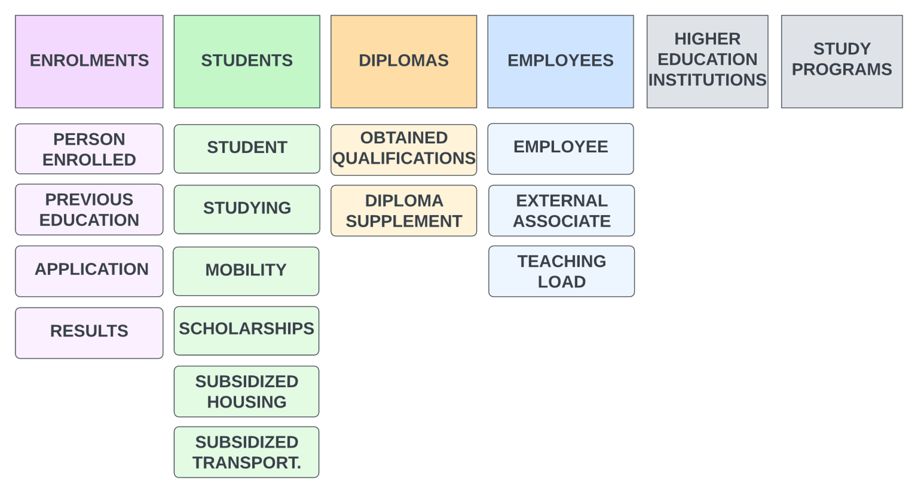
Data Model and Subject Areas

Slide 11
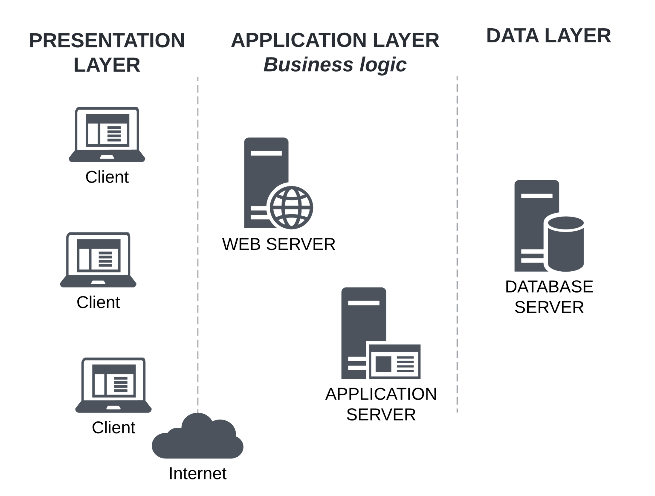
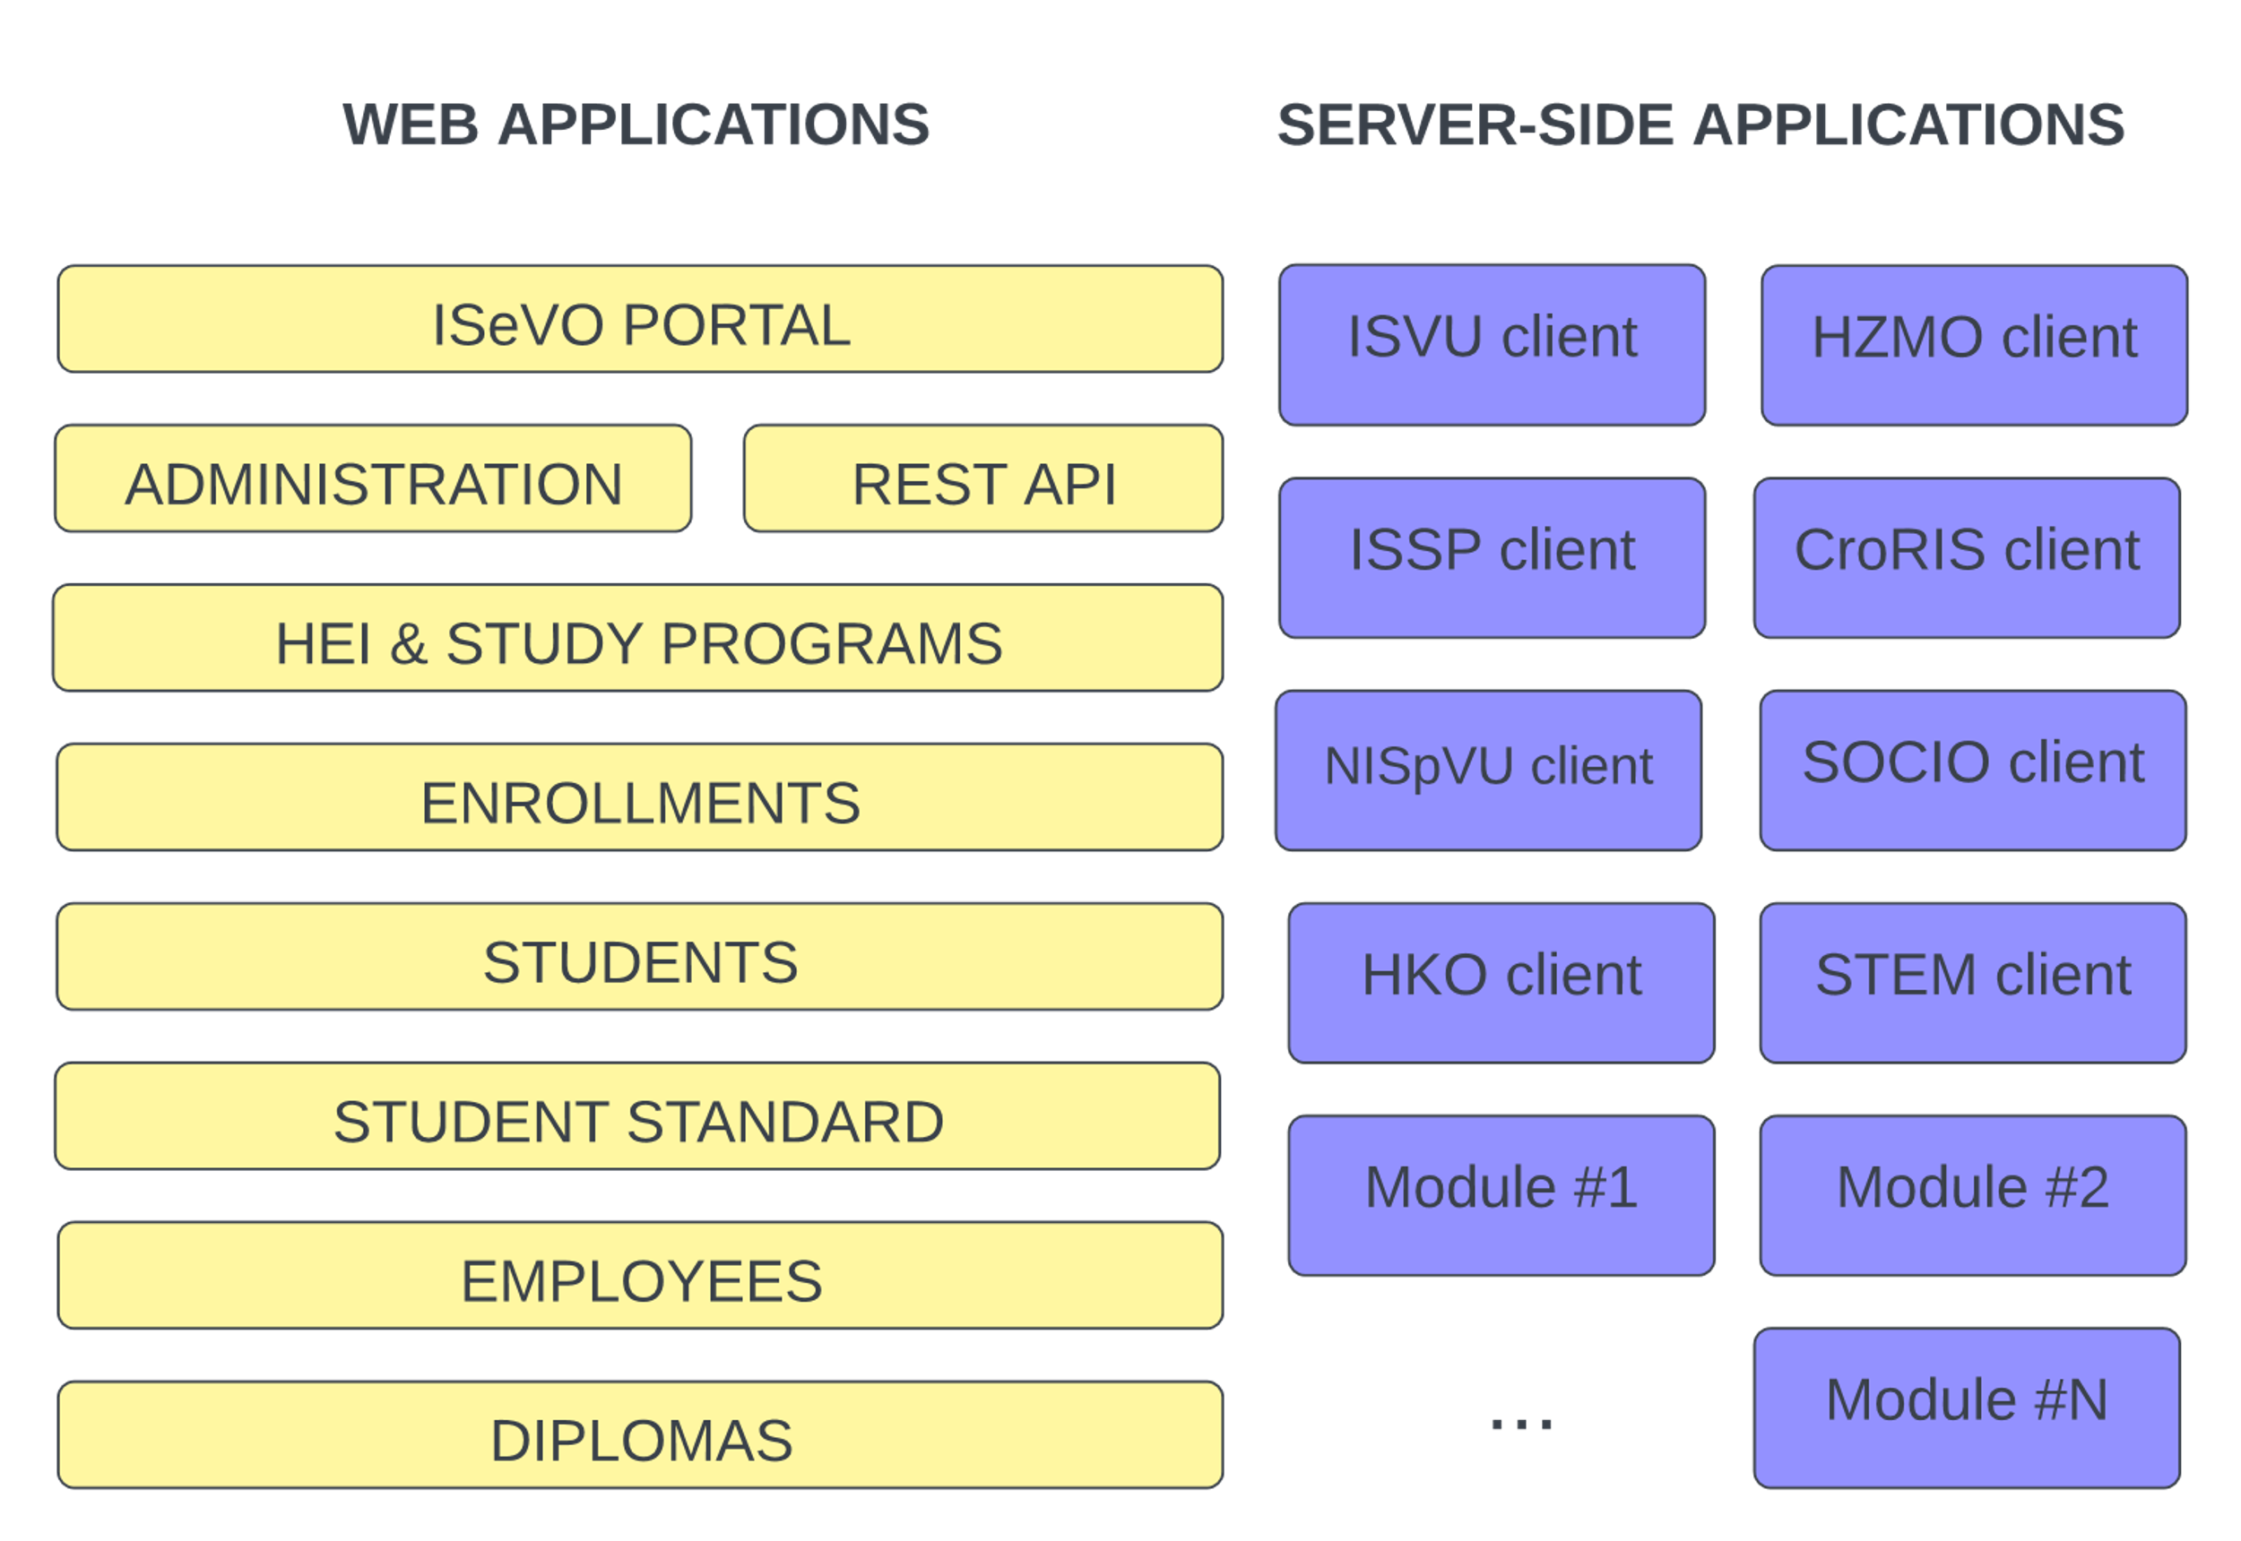
Architecture and Software Modules
System Architecture
Software Modules
Notes:
Priča:
ISeVO će biti izgrađen kao skup programskih modula na troslojnoj arhitekturi. To znači da će korisnici sustavu pristupati putem web aplikacija (što znači da nema instalacija na računalo.)
Odvojeni moduli, ovisno o funkcionalnostima, cjelinama sustava olakšava razvoj i isporuke cjelina sustava u fazama. Isporuka ili izmjena jednog modula minimalno utječe na rad i razvoj drugih modula sustava.
Za korisnike, različiti moduli u stvari nisu važni jer će sve biti integrirano i neprimjetno će se prelaziti s jednog na drugi modul. Kao što je to napravljeno u našim drugim sustavima, npr. u CroRIS-u.

Slide 12

Development
Approach

Slide 13
Agile Development Approach
Basic idea
Enable quick delivery of valuable parts of the system
Constantly develop and upgrade software modules with additional features
Have end-users and stakeholders involved in the project all the time
Next Release
INCEPTION
CONSTRUCTION
TRANSITION
Notes:
done in phases following the agile approach to the software development
provide valuable deliverables to the users in regular time intervals and before the end of the project
basic idea: to enable the quick delivery of valuable parts of the system
delivery of modules with limited functionality.
Software modules will be upgraded and extended constantly with additional features.
Have end-users and stakeholders involved in the project all the time

Slide 14
Project Milestones
2022.
2023.
2024.
2025.
2026.
System design document for ISeVO
ISeVO
core library
Digital diploma register
Employees register
Connecting the Register of Higher Education Institutions and the Register of Study Programs
ISpPU
Public procurement of external programming services
Enrollments register
Students register

Slide 15

Anticipated Challenges
Heterogeniety of data sources
Engagement of stakeholders and end-users
Resistance to change
Lack of resources and short deadlines

Slide 16
Current Status of the Project
Public procurement process for external programming services
Preparation of the development environment
Development of web application for connecting the Register of Higher Education Institutions and the Register of Study Programs
Notes:
At the time of writing this paper, the public procurement process for external programming services is in progress. Usually, this process lasts for a couple of months, and hopefully, without any complications, it will be finalised during the summer of 2023. Because of that, the majority of software developers and external resources will be able to join the project in the late summer or beginning of autumn.
In the meantime, we are doing the business analysis and gathering user requirements for the system that will be built. Also, functional specifications are written and stored on the collaboration tool (Confluence), which will be used during the project. We anticipate that these preparations will enable a rapid programming start, better utilisation of external resources, and faster delivery of specific project results.
Additionally, we are involved in preparing the related by-laws that should regulate the operation of the HE Register.

Slide 17

Conclusion
DIPLOMAS
New Registers to be build:
  Enrollments, Students, Employees, Diplomas
A lot of work ahead of us, big impact on existing systems
Have in mind final goal, objective and vision
EMPLOYEES
STUDENTS
ENROLLMENTS
Data collection from various sources
THE source of truth
Strong emphasis on analysis and reporting
STUDY PROGRAMMES
HEIS
Notes:
New Registers to be build:
Enrollments, Students, Diplomas, Employees
A lot of work ahead of us, bigimpact on existing systems
Have in mind final goal, objective and vision

Slide 18
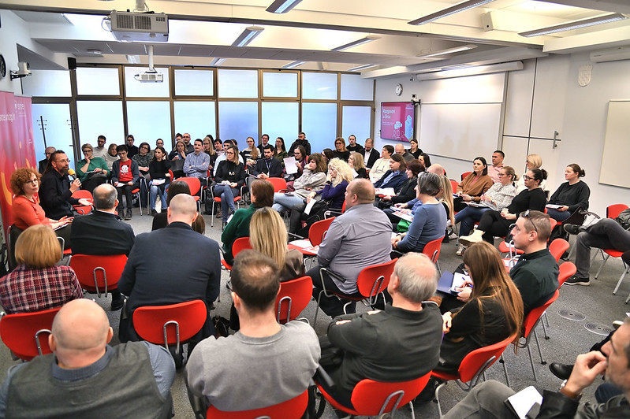
Questions and Comments?

Slide 19
Thank you!
Nadza.Milanovic@srce.hr
Matija.Kranjcina@srce.hr

Slide 20

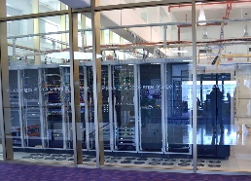
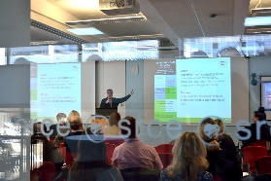
University Computing
Centre - Srce
founded in 1971, part of the University of Zagreb
is heart of Croatian academic and research e-infrastructure
is one of the key subjects in planning, designing, construction and maintenance of the advanced computing, communication and information systems and services for A&R community in HR
ensures connection of Croatian A&R e-infrastructure with related European and global e-infrastructures
provides consulting, expert and educational support in the field of ICT to all subjects of the academic and research community
promotes, fosters and supports innovative usage of ICT in education and research
~160 employees
2 data centers

Slide 21


e-Sveučilišta Project
Investment: Digital transformation of higher education
Investment holder: Ministry of Science and Education
Project coordinator: Croatian Academic and Research Network - CARNET
Project value: 84 million euros
Implementation period: 1.3.2022. - 31.12.2025.
Partners:
  University Computing Center (Srce)
  Agency for Science and Higher Education (AZVO)
  National University Library (NSK)
e-Sveučilišta project is funded from the National recovery and resilience plan
2021. – 2026.
Content of this presentation is sole responsibility of the University of Zagreb, University Computing Centre

