Slide 1
Making Scientific Publications More Machine-Readable
A Workshop on Automated Conversion to JATS XML
Ljiljana Jertec Musap
Draženko Celjak
www.srce.unizg.hr/en
SRCE - University of Zagreb University Computing Centre

Slide 2
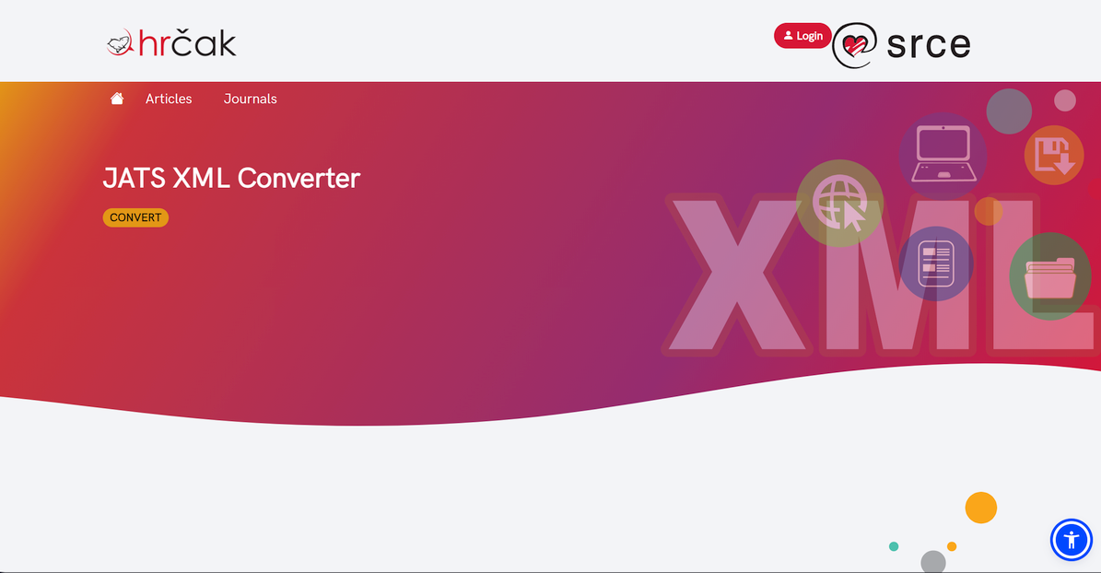
Content
SRCE & HRČAK
JATS XML
  Advantages
  Structure of JATS XML document
Service for conversion to JATS-XML
  Timeline
  Architecture
  Demo & hands on
  Sustainability
Q&A / Discussion

Slide 3
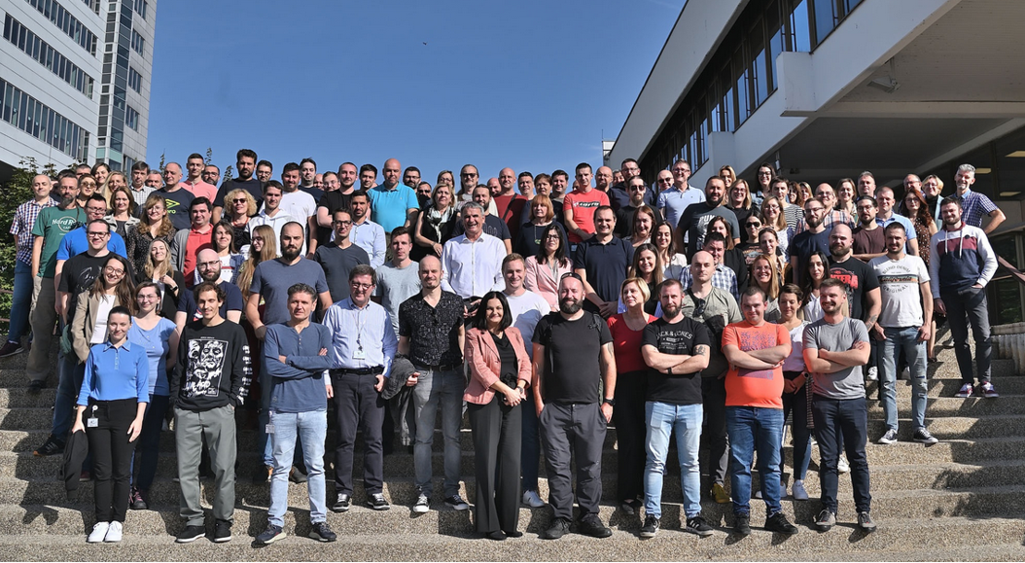

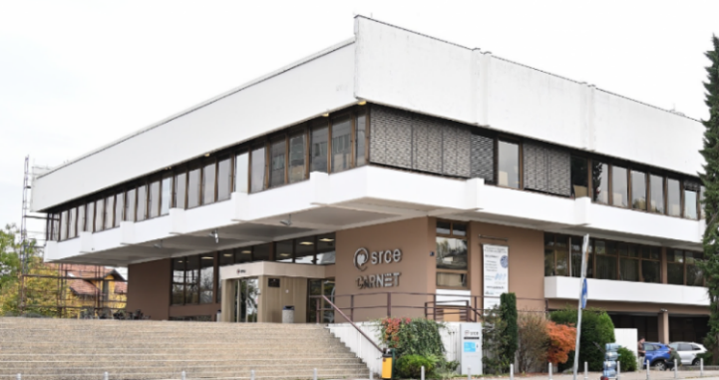
University Computing Centre - SRCE
Organisation
~ 170 employees
11 organizational units
3 locations
Builds and operates national
e-infrastructure and digital services
30 public services for the needs of the academic and scientific community in Croatia
Supports digital transformation of education, research and business
Promotes Open Science and Open Education
OPERAS Conference 2024
24th April 2024

Slide 4
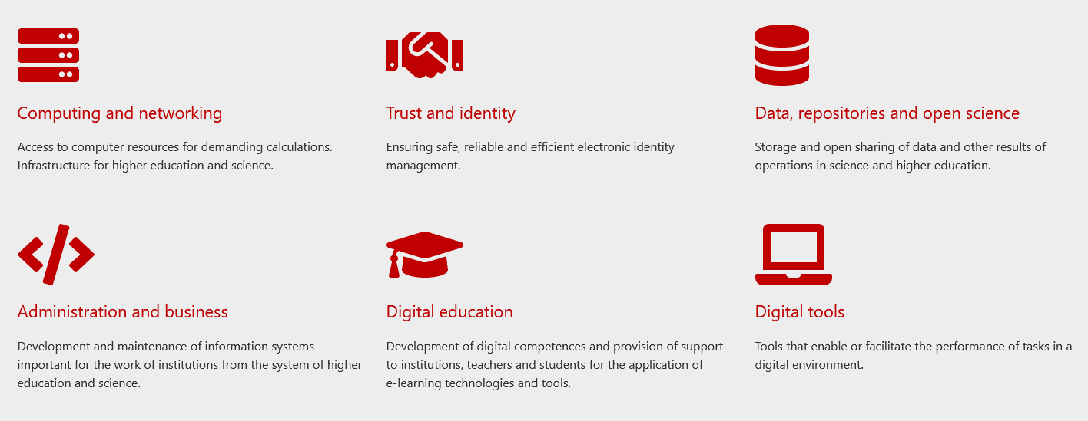
Service Catalogue

Slide 5
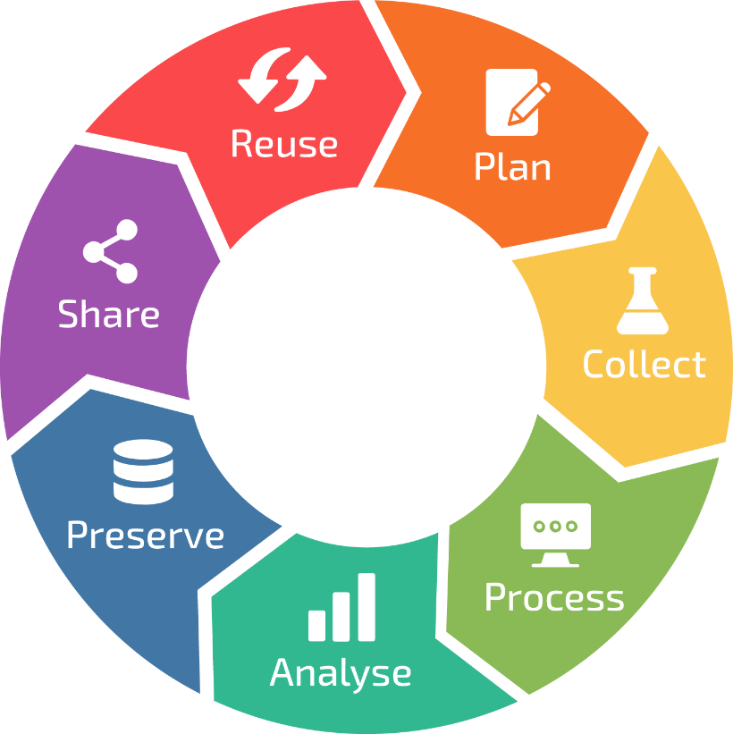





Support for Open Science
INFORMATION SUPPORT
Croatian Research
Information System
Research
Data
Lifecycle
DATA, REPOSITORY AND OPEN SCIENCE
Dabar I Hrčak I Puh
Support to Open Science
Supek
ADVACED COMPUTING
Supercomputer Supek I resource Vrančić
ACQUIRING HPC COMPETENCE AND CONSULTING
Croatian Competence Center for HPC
Education and provision of specialized support in the use of digital resources and services

Slide 6


Portal of Croatian scientific and professional journals – HRČAK
In production since 2006
2 main goals: promotion of OA & technical support for OA
Open Journal Systems (OJS) for ~ 50 journals
Open Monograph Press (OMP) since November 2022.
Visibility (70k+ daily visits), promotion of good practices, trainings
  machine readable, interoperable, rich metadata, CC licences….
  inclusion criteria

Slide 7


Slide 8

Advantages of JATS XML
Journal Article Tag Suite (Publishing, version 1.1)
Set of elements and attributes for tagging journal articles
Semantic description of the structure, metadata and body of the article
Open standard
Machine-readability
Content & reference mining
Increases findability and visibility of the article
Facilitates distribution of the article
Independent of text processor

Slide 9
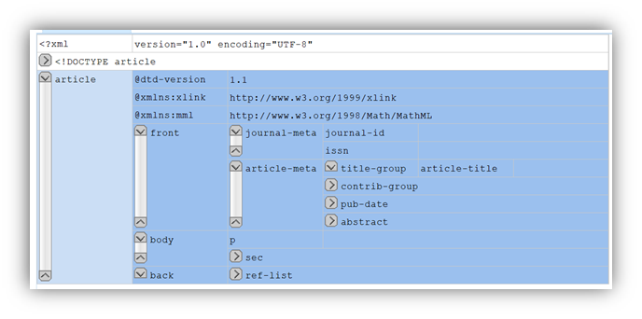
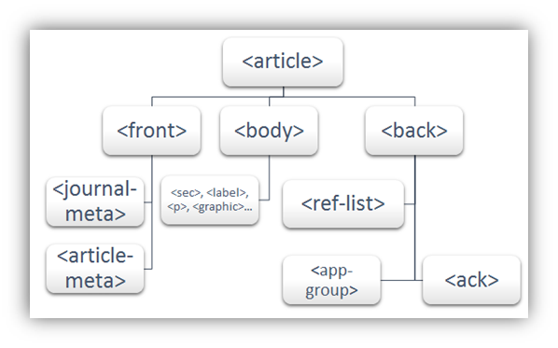
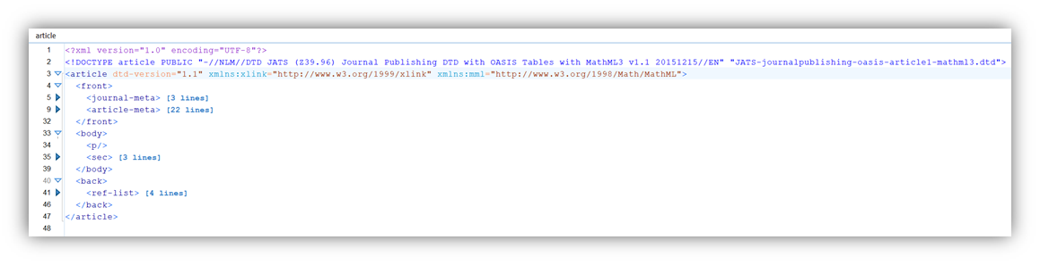
Structure of JATS XML document

Slide 10

Service for conversion to JATS XML on HRČAK timeline
2017
JATS XML support released
Journals create and publish XML to HRČAK
2023
Automatic DOCX to JATS XML conversion on HRČAK
2024
Support for European journals
EOSC
Guidelines for editors (in Croatian)
15+ educations, workshops, consultations
40+ journals are publishing JATS on HRČAK
570+ automatically created JATS XML files within HRČAK
4190+ JATS XML files externally created by editors and published on HRČAK

Slide 11




JATS XML Converter
Authentication​
List of members

Slide 12
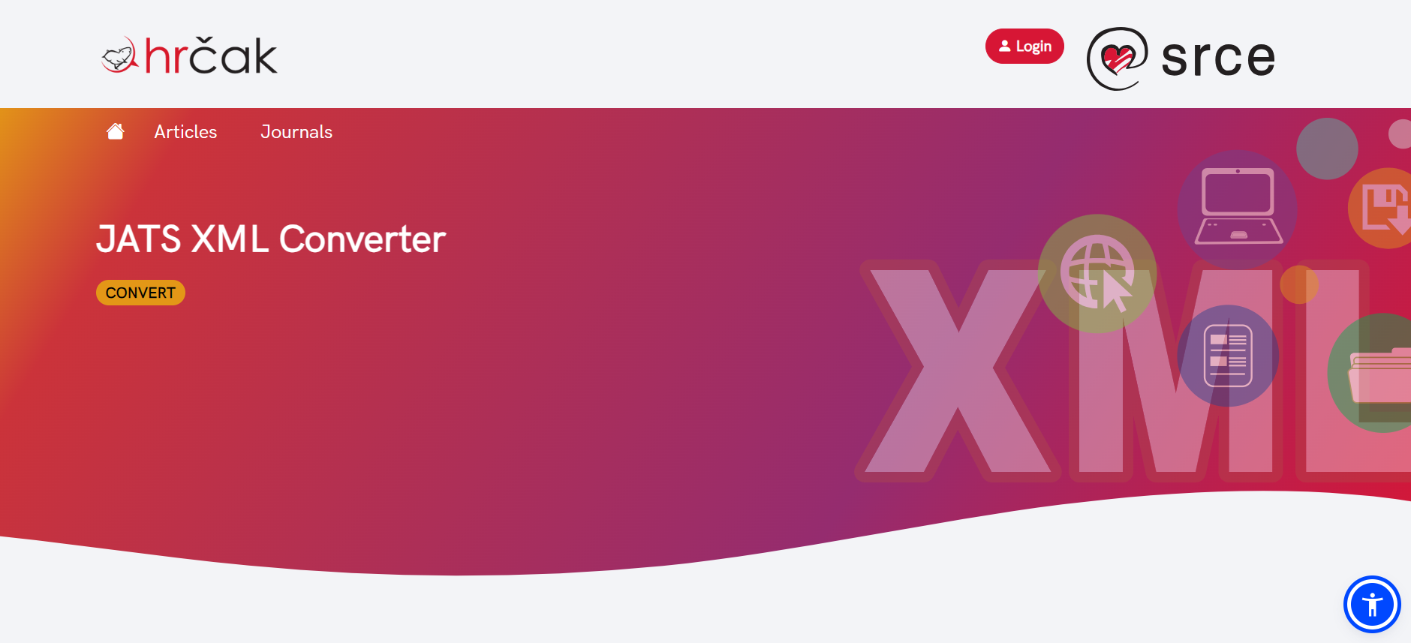
Demo
https://jats.srce.hr/

Slide 13

Future plans, sustainability, Q&A
Near future:
  Testing
  Terms of use
  EOSC marketplace
Future development ideas
  Improvements
  Exposing API
  Plugin for OJS
Sustainability
  Support
  Resources
  Development

Slide 14
Thank you hrcak@srce.hr
https://jats.srce.hr/
Guidelines for preparing a DOCX documents
https://hrcak.srce.hr/en
OPERAS Conference 2024
24th April 2024

